Slide 1
ITU-T Activities on ICTs,
the Environment and Climate Change
Ahmed ZEDDAM
Chairman of ITU-T Study Group 5
(France Telecom Orange)

Slide 2
Agenda
ICTs, the Environment and Climate Change
ITU-T Study Group 5 “Environment and Climate Change”
Overview of upcoming and recent symposiums, events and workshops
Overview of projects and publications
Additional information

Slide 3
ICTs, the Environment and Climate Change

Slide 4
ITU-T Resolution 73 on ICTs, the Environment and Climate Change Revised and agreed at World Telecommunication Standardization Assembly (Dubai, 2012)
Recognizes that ICTs play a vital role in tackling environmental challenges;
Resolves to promote the use of ICTs as cross-cutting tool to assess and reduce GHG emissions, optimize energy and water consumption, minimize e-waste and improve its management;
Supports studies on, inter alia, green data centers, smart buildings, green ICT procurement, cloud computing, energy efficiency, smart transportation, smart logistics, smart grids, water management, adaptation to climate change and disaster preparedness, and reduction of GHG emissions;
Encourages internal and external collaboration to move forward the environmental global agenda.
instructs all ITU‑T study groups to cooperate with ITU-T SG5 to develop appropriate Recommendations on ICTs, the environment and climate change issues within the mandate and competency of ITU‑T.

Slide 5
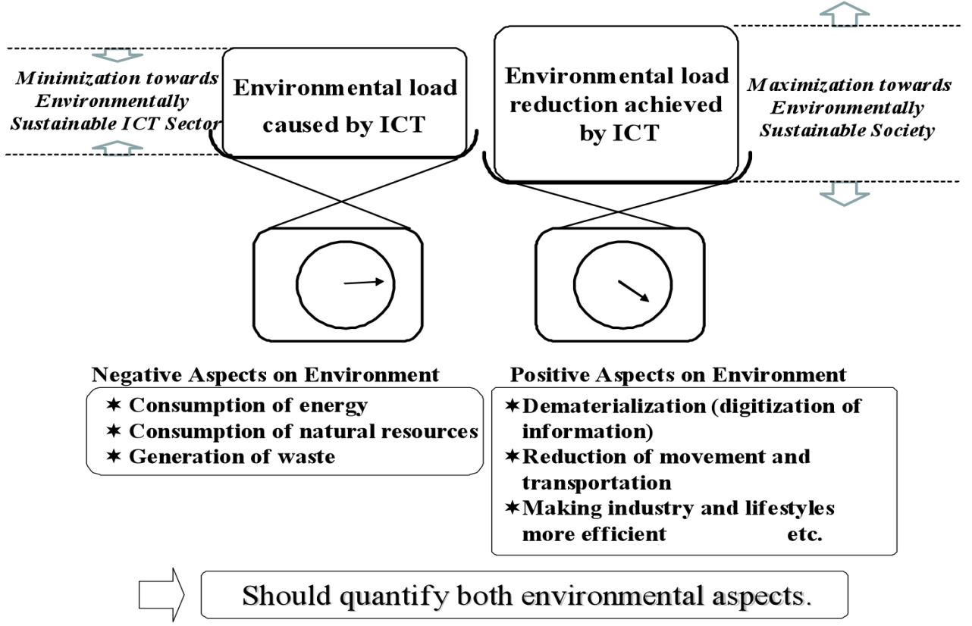
Environmental Aspects of ICT
Positive and Negative aspect on Environment

Slide 6
ICTs Play a Double Role in Climate Change
ICTs are part of the problem…
The Bad News: ICT Accounts for Approximately
2%
of Global CO2 Emissions
But ICTs are also part of the solution…
The Good news: ICT has the potential to reduce emissions in other sectors by
15%
Smart buildings, Smart metering, Smart Motor systems, Smart Logistics plus Dematerialisation of Transport
VS
Projected to become 3,5% in 2020

Slide 7
ITU-T Study Group 5 “Environment and Climate Change”

Slide 8
ITU-T SG5
“Environment and climate change”
Q 12 Terminology
WP1/5
Damage prevention and safety
WP2/5
Electromagnetic fields: emission, immunity and human exposure
WP3/5
ICT and climate change
5 Questions
6 Questions
7 Questions
Notes:
Kindly note that WP3 has 8 question if we count the new Question of Gilbert.
Paolo comments but actually in the web are 6…. 17,18,19,21,22 and 23

Slide 9
ITU-T Study Group 5 “Environment & Climate Change”
Next meeting:
Geneva, Switzerland, on
29 Jan-7 Feb 2013
ITU-T SG5/WP3’s work areas:
Q 13/5 - Environmental impact reduction including e-waste
Q 14/5 - Setting up a low cost sustainable telecommunication infrastructure for rural communications in developing countries
Q 15/5 - ICTs and adaption to the effects of climate change
Q 16/5 - Leveraging and enhancing the ICT environmental sustainability
Q 17/5 - Energy efficiency for the ICT sector and harmonization of environmental standards
Q 18/5 - Methodologies for the assessment of environmental impacts of ICT
Q 19/5 - Power feeding systems

Slide 10
Question 14/5
Scope: identify, assess and consolidate the challenges faced by developing countries in setting up a low cost sustainable telecommunication infrastructure in rural areas of developing nations.
Tasks:
energy efficiency and powering of mobile network systems for deployment of telecommunication infrastructure in areas without access to electricity grid;
improve the resilience of mobile networks in all countries in disaster situations (e.g. hurricane, tropical storm, etc).

Slide 11
Highlights on Deliverables of WP3/5
Important green ICT standards developed by SG5 WP3 during the study period (2009-2012). These are namely:
Recommendation ITU-T L.1000: Universal power adapter and charger solution for mobile terminals and other hand-held ICT devices
Recommendation ITU-T L.1001: External universal power adapter solutions for stationary ICT devices
Recommendation ITU-T L.1100: A method to provide recycling information of rare metals in ICT products
Recommendation ITU-T L.1200 : Direct current power feeding interface up to 400V at the input to telecommunications and ICT equipment
Recommendation ITU-T L.1300: Best practices for green data centres
Recommendation ITU-T L.1310: Energy efficiency metrics and measurement for telecommunication equipment
Recommendation ITU-T L.1400 : Overview and general principles of methodologies for assessing the environmental impact of information and communication technologies
Recommendation ITU-T L.1410 : Methodology for environmental impacts of Information and Communication Technologies (ICT) goods, networks and services
Recommendation ITU-T L.1420 : Methodology for environmental impacts of Information and Communication Technologies (ICT) in organizations
Notes:
Rec. L.1000 provides high level requirements for a universal power adapter and charger solution that will reduce the number of power adapters and chargers produced and recycled by widening their application to more devices and increasing their lifetime. The solution also aims to reduce energy consumption. The longer life cycle and possibility of avoiding device duplication reduces the demand on raw materials and waste. The universal power adapter and charger solution is designed to serve the vast majority of mobile terminals and other ICT devices.
Rec. L.1100 provides information on the recycling procedures of rare metals in information and communication technology (ICT) goods. It also defines a communication format for providing recycling information of rare metals contained in ICT goods.
Rec. L.1200 specifies the direct current (DC) interface between the power feeding system and ICT equipment connected to it. It also describes normal and abnormal voltage ranges, and immunity test levels for ICT equipment to maintain the stability of telecommunication and data communication services. The specified interface is operated from a DC power source of up to 400 V to allow increased power consumption and equipment power density, in order to obtain higher energy efficiency and reliability with less material usage than using a lower voltage such as -48 VDC or AC UPS power feeding solutions.
Rec. L.1300 describes best practices aimed at reducing the negative impact of data centres on the climate. It is commonly recognized that data centres will have an ever-increasing impact on the environment in the future. The application of the best practices defined in this Recommendation can help owners and managers to build future data centres, or improve existing ones, to operate in an environmentally responsible manner. Such considerations will strongly contribute to a reduction in the impact of the information and communication technology (ICT) sector on climate change.
Rec. L.1310 contains the definition of energy efficiency metrics test procedures, methodologies and measurement profiles required to assess the energy efficiency of telecommunication equipment.
Metrics and measurement methods are defined for telecommunication network equipment and small networking equipment.
These metrics allow for comparisons of equipments within the same class e.g. equipments using the same technologies.
Comparisons of equipments in different classes are out of the scope of this Recommendation.
Rec. L.1400 presents the general principles on assessing the environmental impact of information and communication technologies (ICT) and outlines the different methodologies that are being developed:
• Assessment of the environmental impact of ICT goods, networks, and services
• Assessment of the environmental impact of ICT projects
• Assessment of the environmental impact of ICT in organizations
• Assessment of the environmental impact of ICT in cities
• Assessment of the environmental impact of ICT in countries or group of countries.
This Recommendation also provides some examples of opportunities to reduce the environmental load due to ICT.
Rec. L.1410 deals with the assessment of the environmental impact of information and communication technology (ICT) goods, networks and services. It is organized in two parts:
Part I (clause 5) – ICT life cycle assessment: framework and guidance.
Part II (clause 6) – Comparative analysis between ICT and a reference product system (baseline scenario); framework and guidance.
Part I deals with the life cycle assessment (LCA) methodology applied to ICT goods, networks and services (ICT GNS). Part II deals with comparative analysis based on LCA results of an ICT GNS product system and a referenced product system.
This Recommendation provides specific guidance on energy and greenhouse gas (GHG) impacts.
Rec. L.1420 presents the methodology to be followed if an organization intends to claim compliance with this Recommendation when assessing its information and communication technology (ICT) related energy consumption and/or greenhouse gas (GHG) emissions.
This Recommendation can be used to assess energy consumption and GHG emissions generated over a defined period of time for the following purposes: for assessment of related impact from ICT organizations or for assessment of impact from ICT related activities within non-ICT organizations.

Slide 12
ITU-T Methodologies
Common set of methodologies for the assessment of ICT carbon footprint
Without, it will be impossible to provide meaningful comparisons
Helps to establish the business case to go green
3 Recommendations published - available on the ITU-T website:
ITU-T L.1400 Overview and general principles
ITU-T L.1410 Environmental impact of ICT goods, networks and services
ITU-T L.1420 Environmental impact of ICT in organizations
3 Recommendations under preparation :
ITU-T L.1430 Environmental impact of ICT projects (consent expected in 2013)
ITU-T L.1440 Environmental impact of ICT in cities (consent expected in 2013)
ITU-T L.1450 Environmental impact of ICT in countries (consent expected in 2014)
Developed in cooperation with UNFCCC Secretariat, EC and over 40 other organizations etc..
L.1410 and L.1420 have been successfully tested by ICT industry in the framework of the European Commission Pilot Project with the goal to establish a common methodological framework to be adopted by the ICT industry.
Notes:
These methodologies aim at providing accurate and reliable tools for assessing the environmental impact, which will generate statistics that governments and regulators can rely on to gauge the benefits that green ICTs can achieve for social and economic welfare.
Rec. L.1400 presents the general principles on assessing the environmental impact of information and communication technologies (ICT) and outlines the different methodologies that are being developed:
• Assessment of the environmental impact of ICT goods, networks, and services
• Assessment of the environmental impact of ICT projects
• Assessment of the environmental impact of ICT in organizations
• Assessment of the environmental impact of ICT in cities
• Assessment of the environmental impact of ICT in countries or group of countries.
This Recommendation also provides some examples of opportunities to reduce the environmental load due to ICT.
Rec. L.1410 deals with the assessment of the environmental impact of information and communication technology (ICT) goods, networks and services. It is organized in two parts:
Part I (clause 5) – ICT life cycle assessment: framework and guidance.
Part II (clause 6) – Comparative analysis between ICT and a reference product system (baseline scenario); framework and guidance.
Part I deals with the life cycle assessment (LCA) methodology applied to ICT goods, networks and services (ICT GNS). Part II deals with comparative analysis based on LCA results of an ICT GNS product system and a referenced product system.
This Recommendation provides specific guidance on energy and greenhouse gas (GHG) impacts.
Rec. L.1420 presents the methodology to be followed if an organization intends to claim compliance with this Recommendation when assessing its information and communication technology (ICT) related energy consumption and/or greenhouse gas (GHG) emissions.
This Recommendation can be used to assess energy consumption and GHG emissions generated over a defined period of time for the following purposes: for assessment of related impact from ICT organizations or for assessment of impact from ICT related activities within non-ICT organizations.

Slide 13
Direct current power feeding interface up to 400V at the input to telecommunications and ICT equipment
Recommendation ITU-T L.1200 specifies direct current power feeding with interface direct current 260V to 400V at the power input to ICT equipment which can offer many potential benefits:
simple power chain
low maintenance
modularity and power scalability
high reliability
high energy efficiency (gain of 5 to 20% energy consumption compared to different existing best in class powering solutions)
low cost at same performance level.
Notes:
This Rec. specifies a LVDC current interface at the power input of ICT equipment obtained from a power source of up to 400 Volts (260-400VDC voltage range) , which allows higher energy efficiency and reliability than can be achieved using low voltage power feeding solutions. The recommendation defines a power feeding system applicable to ICT equipment compliant with L.1200 in locations equipped with these power sources such as: telecommunication centres; radio base stations; data centres; and customer premises.
Additionally, the LVDC interface will simplify the use of renewable energy sources producing LVDC output such as photovoltaic generators or some fuel cell systems.
A gain of 5 up to 20% of energy consumption has been assessed and measured in existing sites by several certified experiments compared to existing powering solutions.

Slide 14
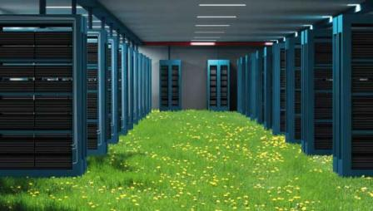
Best Practices for Green Data Centres
Recommendation ITU-T L.1300 describes a certain number of best practices aimed at reducing the negative impact of data centres on climate change. It is commonly recognized that data centres will have an ever-increasing impact on the environment in the future, considering the huge development of cloud services.
Such best practices are related to optimum design and construction as well as to most efficient use and management of data centres, taking into account both power and cooling equipment.
For example, applying best practices to cooling could reduce the energy consumption of a typical data centre by more than 50 per cent.
The application of the best practices defined in this Recommendation can therefore help owners and managers to build future data centres, or improve existing ones, to operate in an environmentally responsible manner.
Notes:
Rec. L.1300 describes best practices aimed at reducing the negative impact of data centres on the climate. It is commonly recognized that data centres will have an ever-increasing impact on the environment in the future. The application of the best practices defined in this Recommendation can help owners and managers to build future data centres, or improve existing ones, to operate in an environmentally responsible manner. Such considerations will strongly contribute to a reduction in the impact of the information and communication technology (ICT) sector on climate change.

Slide 15
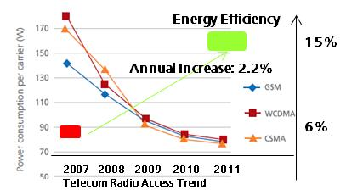
Energy efficiency metrics and measurement for telecommunication equipment
Recommendation ITU-T L.1310 contains the definition of energy efficiency metrics, the related test procedures, methodologies and measurement profiles required to assess the energy efficiency of telecommunication equipment (Phase 1).
including: wired as well as wireless broadband access; optical transport technologies; routers; switches; mobile core network equipment; and small networking equipment used in homes and small enterprises.
These metrics evaluate ICT equipment’s energy efficiency through a comparison between its technical performance (useful work) and its energy consumption.
Contributions are needed to develop the network level metrics (Phase 2)

Slide 16
ITU-T New Resolution on E-Waste Agreed at World Telecommunication Standardization Assembly (Dubai, 2012)
The New Resolution urges ITU to:
Contribute to alleviate the negative impact of e-waste on the environment and health;
Pursue and strengthen the development of ITU activities in regard to handling and controlling e-waste from ICT equipment and methods of treating it:
Best practices,
Recommendations, methodologies and other publications,
Guidance for policy makers;
Assist developing countries, which are the countries that suffer most from the hazards of e-waste without being the most responsible;
Collaborate with all relevant stakeholders.

Slide 17
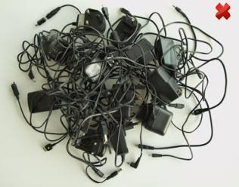
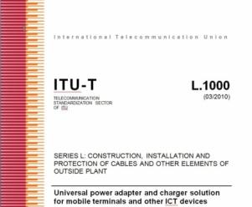
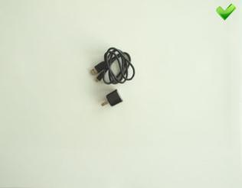
Tackling E-waste with Global ICT Standards
“Universal power adapter and charger solution for mobile terminals and other ICT hand held devices” (Recommendation ITU-T L.1000)
Saves 82,000 tons of e-waste per year
Saves at least 13.6 million tonnes of CO2 emissions annually
Notes:
Rec. L.1000 provides high level requirements for a universal power adapter and charger solution that will reduce the number of power adapters and chargers produced and recycled by widening their application to more devices and increasing their lifetime. The solution also aims to reduce energy consumption. The longer life cycle and possibility of avoiding device duplication reduces the demand on raw materials and waste. The universal power adapter and charger solution is designed to serve the vast majority of mobile terminals and other ICT devices.

Slide 18
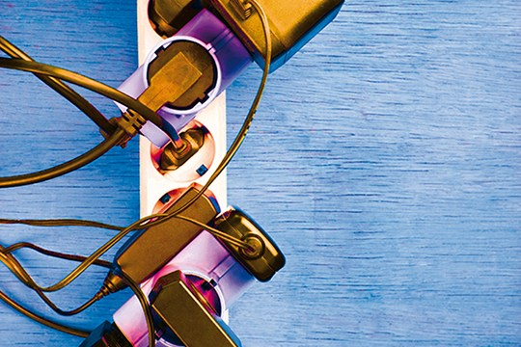
Waste Management with Smart ICT Standard
The step after L.1000…
NEW - “External universal power adapter solutions for ICT equipment for stationary use” (Recommendation ITU-T L.1001)
Saves 300,000 tonnes of e-waste annually
Reduces the energy consumption and greenhouse gas (GHG) emissions of external power supplies by between 25% and 50%
Approved in December 2012
Contributions are needed to develop Universal Power Adapter for portable devices (Phase 2)
Notes:
Recommendation ITU-T L.1001 provides requirements for a universal power adapter solution (UPA) for stationary ICT devices that will reduce the number of produced power adapters by widening their application to more devices, enabling their reuse and increasing their lifetime. The solution also aims to reduce energy consumption. The longer life cycle and possibility of avoiding device duplication reduces the demand on raw materials and production of huge e-waste amount. The universal power adapter solution for ICT equipment for stationary use is designed to serve the vast majority of ICT devices.

Slide 19
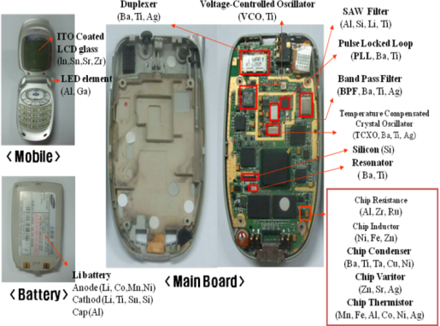
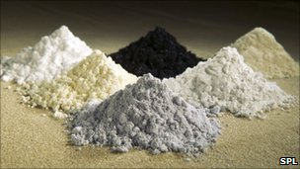
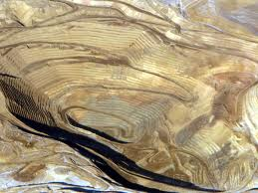
Recycling Rare Metals in ICT Products
ITU-T L.1100 Recommendation on Rare Metals outlines key considerations in all phases of the recycling process, and provides guidelines as to how organisations may fairly and transparently report on rare metal recycling.
Notes:
Rec. L.1100 provides information on the recycling procedures of rare metals in information and communication technology (ICT) goods. It also defines a communication format for providing recycling information of rare metals contained in ICT goods.

Slide 20
Overview of upcoming and recent symposiums, events and workshops

Slide 21
Joint Coordination Activity on ICTs & Climate Change (JCA-ICT&CC)
The purpose of the JCA-ICT&CC is to provide a visible contact point for ICT and Climate Change activities in ITU-T, to seek co-operation from external bodies working in the field of ICT & CC:
Next meeting to be dedicated to
“Smart Sustainable Cities” will be held on 5 February 2013
during the next ITU-T Study Group 5 meeting to be held from 29 January to 7 February 2013 in Geneva, Switzerland

Slide 22
8th ITU Symposium on ICTs, the Environment and Climate Change
10-13 April 2013 - Turin, Italy
To move the agenda forward on using ICTs to monitor climate change, mitigate and adapt to its effects and to promote environmental sustainability
To identify future requirements for ITU’s related work – including standardization of ICT equipment and networks as well as development activities
Preceded by a Workshop on EMF to be held in Turin on 9 April 2012

Slide 23
3rd ITU Green Standards Week
To bring together leading specialists in the field, from top policy-makers to engineers, designers, planners, government officials, regulators, standards experts and others.
To raise awareness of the importance and opportunities of using ICT standards to build a green economy.
Topics:
Green ICT Standards
E-waste
Smart Sustainable Cities
Submarine Communication Networks for Climate/Ocean Monitoring and Disaster Warning
SEE YOU IN MADRID, 3-7 June 2013

Slide 24
Overview of projects and publications

Slide 25
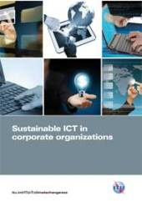
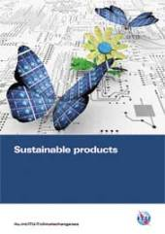
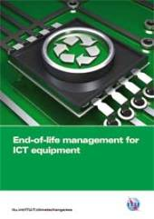
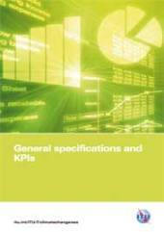
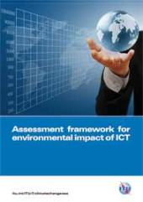
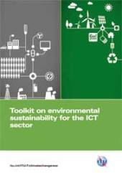
ITU Toolkit on Environmental Sustainability for the ICT Sector
Notes:
The Toolkit on Environmental Sustainability for the ICT sector is an ITU-T initiative which provides plenty of detailed support on how ICT companies can build sustainability into the operations and management of their organizations, through the practical application of international standards and guidelines.
This toolkit provides a set of agreed upon sustainability requirements for ICT companies that allows for a more objective reporting of how sustainability is practiced in the ICT sector in these key areas: sustainable buildings, sustainable ICT in corporate organizations, sustainable products, end of life management, general specifications and KPIs, and an assessment framework for environmental impacts of the ICT sector.

Slide 26
Purpose of the toolkit
Detailed practical support on how ICT companies can build sustainability into their operations and management
Practical
support
Ongoing contribution to ITU-T Study Group 5 which has the goal of developing global standards in this arena
Checklist
Standards
Support
Standardized checklist of sustainability requirements specific to the ICT sector

Slide 27
Collaboration with over 50 partners
3p Institute for Sustainable Management
Alcatel Lucent
BBC
BIO Intelligence Service
BT
CEDARE
Climate Associates
ClimateCHECK
Cogeco Cable
DATEC Technologies
Dell
Ernst & Young
ETRI
ETNO
ETSI
European Broadcasting Union
France Telecom/Orange
Fronesys
Fujitsu
GHG Management Institute (GHGMI)
Hewlett-Packard
Hitachi
Huawei
IBI Group
Imperial College
Infosys
International Telecommunication Union (ITU)
Mandat International
MicroPro Computers
Microsoft
MJRD Assessment Inc.
National Inter-University Consortium for Telecommunications
Nokia Siemens Networks
NEC Empowered by Innovation
NTT
Panasonic
PE INTERNATIONAL AG
Research In Motion
Scuola Superiore Sant’Anna of Pisa
Step Initiative
Telecom Italia
Telecommunications Networks and Telematics Laboratory
Telecommunication Technology Committee
Telefónica
Thomson Reuters
Toshiba
United Nations Environmental Programme
United Nations Environmental Programme Basel convention
United Nations University
University of Genova
University of Zagreb
Verizon
Vodafone Ghana

Slide 28
Toolkit content
Document | Summary
Introduction to toolkit | A business-led perspective on the use of sustainability in ICT organizations
Sustainable ICT in corporate organizations | Sustainability issues with the use of ICT products and services
Sustainable products | Sustainability-led design principles and practice for ICT products
Sustainable buildings | Sustainability management of the construction, use and decommissioning of ICT buildings
End-of-life management | Support in dealing with the various end-of-life stages of ICT equipment
General specifications and KPIs | Environmental KPIs that can be used to manage and evaluate sustainability performance
Assessment framework | Mapping the standards and guidelines applying to the ICT industry

Slide 29
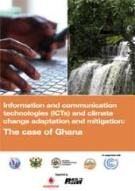
Climate Change Adaptation, Mitigation and Information & Communications Technologies (ICTs): The Case of Ghana
“How can developing countries effectively integrate ICT tools within climate change adaptation and mitigation strategies?”
In cooperation with
Supported by
Notes:
As this report suggests, Information and Communication Technologies (ICTs) can help developing countries to unlock those opportunities, and overcome the challenges posed by climate change through e-enabled adaptation and mitigation responses.
This report focuses on exploring an increasingly important question: “How can developing countries effectively integrate ICT tools within climate change adaptation and mitigation strategies?”
The contribution of this report is two-fold. It presents the potential of ICTs towards adaptation and mitigation through the concrete case of Ghana, illustrating the challenges and opportunities faced by developing countries in this field. The report complements this analysis by offering concrete lessons learned and practical suggestions aimed at developing country decision makers and practitioners, thus fostering the adoption of novel, ICT-supported approaches to climate change adaptation and mitigation.
This report was prepared by Angelica Valeria Ospina (University of Manchester), Cristina Bueti (ITU), Keith Dickerson and David Faulkner (Climate Associates).

Slide 30
Links
ITU and climate change
http://www.itu.int/climate
ITU-T/SG5 “Environment & Climate Change”
http://www.itu.int/ITU-T/studygroups/com05/index.asp
ITU Symposia & Events on ICTs and Climate Change http://www.itu.int/ITU-T/worksem/climatechange
ITU-T and climate change http://www.itu.int/ITU-T/climatechange

Slide 31
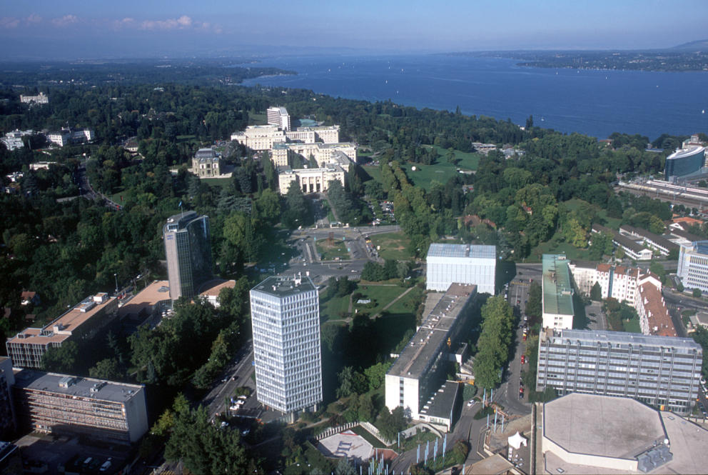
Thank YOU
greenstandard@itu.int

