Slide 1
Sustainable Rural telecom Infrastructure
i²TB
Enabling Innovations …..
Krishna Sirohi
President – Impact Innovations in Technology & Business (i²TB)
Chairman, GISFI Standards Coordination Committee

Slide 2
Sustainability ?
i²TB
Sustainable Growth with harmony
Growth
Business
Society
Individual
Setting up the sequence of importance
Affects sustainability in some sense

Slide 3
Examples of Non-Sustainability
i²TB
End of Colonization
Stage1: Limited Interaction with Representatives
Returns >> Efforts
Viable Operations
Stage2: Increased Interaction reaching masses
Poor governance
Loss of harmony
Loss of Trust
Rise of mass unrest
Governance Efforts increased
Returns ~ Efforts
Questioning Viability
Stage3: Inadequate Correction
Returns << Efforts
Un-viable Operations
UNSUSTAINABLE !!
Consolidation of Mobile Telecom OEMs
Stage1: Limited usage for Business class, in developed world
Revenue Scale: $20 /month
Viable Operations
Stage2: Growth in China
Revenue Scale: $10 /month
Transfer of low Revenue to Infrastructure provider
Competition with emerging local OEM
Reduced Business margins
Questioning Viability started
Stage3: Growth in India
Revenue Scale: $6 /month
Solution started reaching masses
Operators demands increased
Competition compelled to serve at low or negative margins
Un-viable Operations for many- led to consolidation
UNSUSTAINABLE !!

Slide 4
Commonality in Un-Sustainability Examples
i²TB
Inappropriateness in Solution for masses
Holistic assessment of emerging requirement were almost missing
Non-participating Business Model
Sub-optimally addressed requirements puts stress on business viability
Change in Solutions takes time,
But time may not be available due to :
with increased political awareness and
demand of Service Obligation
Unaddressed gaps leads to INNOVATIONS, by new players in the game

Slide 5
Current Status of Telecom Services in India
i²TB
Broad Classification | Population (In Million)
Entire Nation | 1200
Cities/Towns | 350
Villages near City/Towns | 200
Remote Villages | 450
Extreme Remote Villages | 200
# of Cities/ Villages
6000
125K
400K
100K
Pop. Density (Person/ SqKm)
325
5000
400
300
100
Tele-phony | Broad- Band
Yes | Part
Yes | No
Part | No
No | No

Slide 6
Main Challenges for Rural Deployment
i²TB
Sub-Optimal Backhaul Networks
Non Availability of Electric Grid Power
Un-Sustainable Telecom Infrastructure
PREVAILINGPOINT OF ECONOMIC VIABILITY
R
E
V
E
N
U
E
C
O
S
T
REQUIRED
POINT OF ECONOMIC VIABILITY
DISTANCE FROM CITY

Slide 7
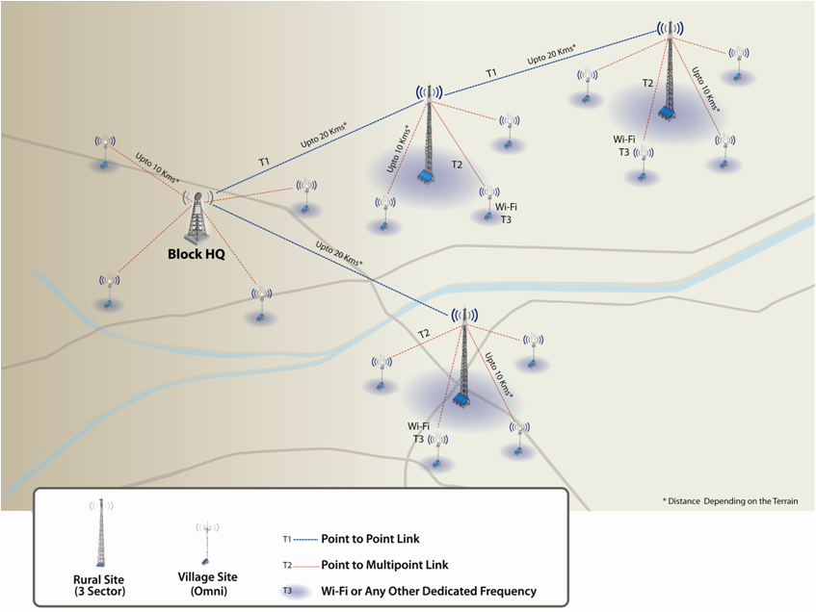
Engineering & Business Approach for Sustainable Infrastructure
i²TB
Cost Effective CAPEX & Zero OPEX
Energy Efficient
Works without Electric Grid Power
Economically Viable with Green Energy Sources
Suitably Engineered / Packaged
Does not Require Air-Conditioning
Extreme Dust & Rain Proof
Easy to INSTALL & OPERATE BY Semi-Skilled Staff
Suitable Deployment Architecture
Leveraging with existing networks and add newer network capability in collaborative mode
Innovative Business Models lead by user groups
Solution Architected and designed for Low economy mass users with limited user capability
Suitable wireless Technology for Large Cells, Small Cells, Personal cells and backhaul
Extremely low Electromagnetic radiation
Telecom as Generic Vehicle for information transfer, not necessarily a service provider
Enabling platform for Services for Inclusive Growth

Slide 8
Services Requirement for Inclusive Growth
i²TB
Basic Telephony To All
SERVICES / APPLICATION over Broad-Band
1. Governance | 7. Financial Services
2. Health | 8. Identity Management
3. Education | 9. HRD / Monitoring
4. Agriculture | 10. Socio Economic Growth
5. Food Supply Chain Management | 11. More Informed Democracy
6. Resource Monitoring | 12. Framework for Civil Rights
& more …

Slide 9
Key Direction of Indian NTP 2012
i²TB
Inclusive Growth - Address Digital Divide between Urban & Rural
Voice Tele-density : 169% (Urban) & 41%(Rural)
Service Obligation for Inclusive Growth
Broadband as Infrastructural vehicle for all Services
70% Rural BB Penetration by 2017 and 100% by 2020
250K Villages (Panchayats) Optical Fiber connectivity through NFON as key enabler for achieving target
Sustainable telecom Infrastructure in all 615K villages
India as Hub for Electronic/Telecom Manufacturing
Leader in Innovative Service Delivery for emerging needs

Slide 10
GISFI Objectives
i²TB
To enable India to be dynamic knowledge based economy able to compete globally
To create solutions for societal trust & security by having nationally standardised ICT environment
To ensure that national ICT policy implementation is aligned to the global state-of-the-art, in particular with major trading partners (USA, Europe, China, Japan, ... )
GISFI is already implementing both Indian and global standardisation policies:
By basing its work on the Indian Governmental policy
By cooperating with international standardization organizations

Slide 11
GISFI Focus Areas & Leadership
i²TB
S.No. | Working Groups | Industry Leadership
 | Overall Leadership of Technical Working Groups | Krishna Sirohi i2TB-SPPL
1 | Internet of Things | Balamurlidhar P, TCS
2 | Cloud & Service Oriented Network | Parag Pruthi, NIKSUN
3 | Green ICT | Arvind Mathur, CISCO
4 | Future Radio Network | Rakesh Agrawal, VNL
5 | Spectrum | Pawan Garg, Former Wireless Advisor, GoI
6 | Security & Privacy | Anand R Prasad,NEC
7 | Special Interest Group | Debu Nayak, HUAWEI

Slide 12
Sustainable Standardization
i²TB
Traditionally, Business has driven the Standardization so far.
Composite Innovations including :
Technology
Business
Participation
for Sustainable Service Delivery will lead the Standardization organizations
Standards Organization need to be partner in Innovation and should take responsibility to make them Global Standards to remain relevant.
GISFI plans the same way.
We expects ITU to lead and establish this as the theme for future Standards, meant to be for masses !

Slide 13
Enabling Innovations.. Mission for i²TB
i²TB
Creating and validating Business ideas for ICT based business.
Evolving Product/Solution/Service Design, Market Positioning and Business case by providing matured and hands-on guidance.
Prepare Technology Startups for Angel/VC Funding
Prepare funded Startup for Scaling the Operations
Represent Technology Entrepreneurs in Global Standardization & Policy Formulation Forums

Slide 14
Conclusions
i²TB
Task for enabling Inclusive Growth worldwide is huge.
There is no time to do things conventionally.
High Speed and Collaborative Approach for development of :
Technology & Solutions
Standards and
Business Model
…. are essential for Sustainability!

Slide 15
Thanks You for Attention !
i²TB
Enabling Innovations …..
Krishna Sirohi
Contacts:
M: +91 9899488800
E: president@i2tb.in
Krishna.sirohi@gmail.com

