Slide 1
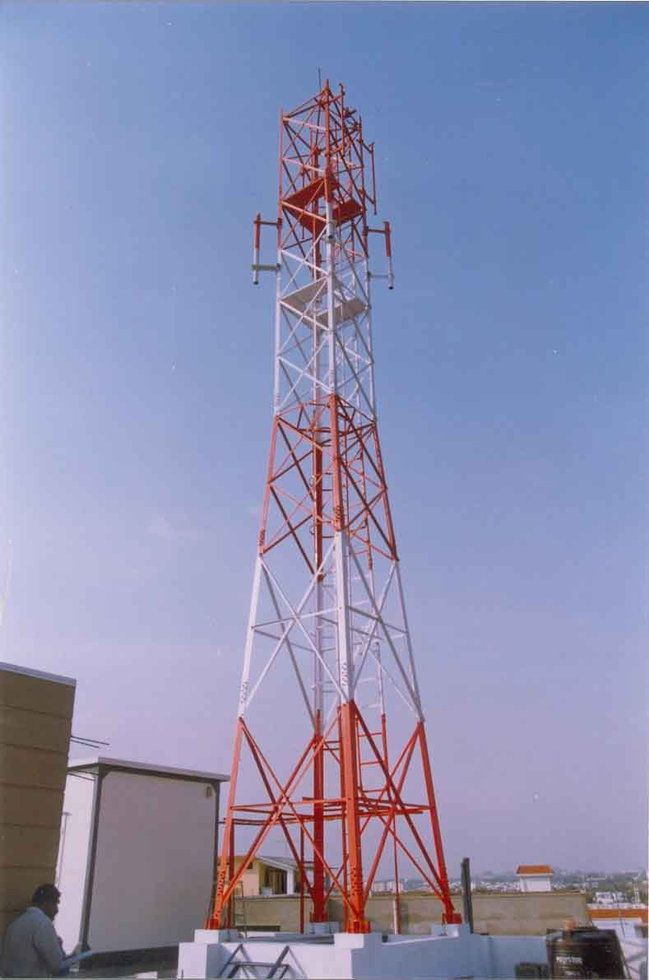

Global ICT Standardisation Forum
For India (GISFI)
Sustainable Rural Communication - New Approach to Green Telecom
17 December 2012
Presentation by: T.R.Dua
Vice Chairman
GISFI

Slide 2
India is the fastest growing telecom market…
Mobile tele-density of ~77%
World’s second largest wireless market
3G and BWA Auction conducted in 2010
3G & LTE services launched in 2010/2011

Slide 3
Overview of the Indian Power Sector & the Grid problem
One of the biggest challenge of the twenty-first century - …going green
Over 300 million people, i.e. roughly 20% of our population don’t have access to grid electricity.

Slide 4
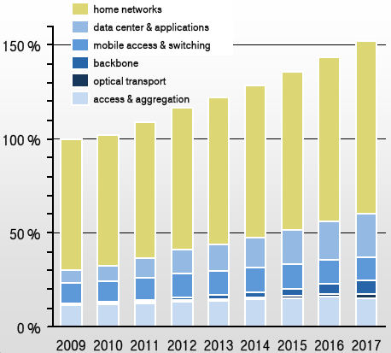
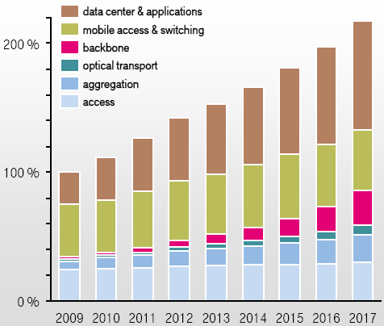
Telecom energy consumption is 1% of global energy consumption
Overall annual network energy consumption
Operator’s energy consumption share
Global telecom industry energy consumption is estimated at 164 TWh/year
Source: Emerson Network Power – Energy Logic for Telecom

Slide 5
ICT sector emissions are expected to be 2-3% of total emissions by 2020
ICT sector emissions are expected to increase from 0.53 billion tones carbon dioxide equivalent (CO₂e) in 2002 to 1.43 billion tones CO₂e in 2020
The contribution from global telecommunication systems is 230 million tons CO2
If no action is taken, the overall costs and risks of climate change will be equivalent to losing at least 5% of global gross domestic product (GDP) each year.
Telecom sector is responsible for 0.6% of global carbon emissions
Source: SMART 2020: Enabling the low carbon economy in the information age

Slide 6
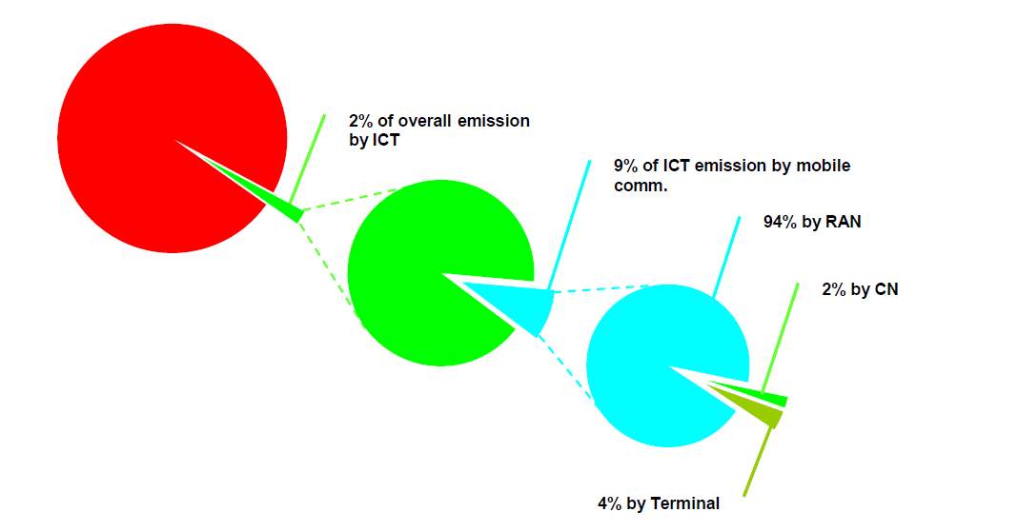
9% of ICT emission is due to mobile communication

Slide 7
Telecom emissions from infrastructure and devices are expected to more than double by 2020
Global telecoms footprint (infrastructure and devices)
(Global telecom emissions %)
The global telecom emissions are expected to grow at a compounded annual growth rate (CAGR) of 4.8% to reach 349 million tonnes (Mt) CO₂ in 2020 from 151 MtCO₂e in 2002.
Increased mobile phone and internet usage is driving the increase in telecom infrastructure. Fixed–line narrowband is expected to remain fairly constant, however, the number of mobile and broadband accounts are expected to more than double by 2020.
By 2020, the relative share of telecoms devices is expected to remain fairly constant, but the mobile network is expected to dominate the overall telecom carbon footprint.
Source: SMART 2020: Enabling the low carbon economy in the information age

Slide 8
India’s share in the global ICT footprint is low
India is included in RoW with other countries, with the share being only 27% of 1.43%. This amounts to only 0.38%.
The US and China collectively contribute around four times more emission than India does.
RoW = Rest of World ( includes, India Brazil, South Africa, Indonesia and Egypt
EiT = Economies in transition. (includes Russia and non-OECD Eastern Europe countries
Source: SMART 2020; Report by The Climate Group

Slide 9
Telecom sector in India contributes to negligible amount of GHG emission
ICT in India accounts for 1.5% of the country’s total energy bill. This is expected to increase to 2.7% by 2020.
Energy expenses range from 15% to 30% of all operational expenses.
Sector-Wise CO2 (e) emissions in India are almost similar to Global pattern
Agriculture, Electricity, Transport and Cement account for 70% of CO2 emissions in India.
Telecom included in “Other Industry” with a share of just 9%.
Share of Telecom sector in the overall CO2 emissions is negligible.
Sector-wise CO2e emissions in India
Source: INCCA – India GHG Emission, 2007 - MOEF

Slide 10
The path to a Diesel-Free Telecommunication
There is no subsidy for telecom
The close correlation between energy saving and money could motivate the corporations and business entities to pay more attention to their energy consumption, and work towards its reduction.

Slide 11
Solar Experience
Basis 8000+ Solar installations @ telecom tower, experience / learning as below:
    Sharp drop in Solar tariffs, still not DG parity
    Only capable to support low load outdoor sites
    Type of application of telecom (99.95% uptime) contrary to only day time operation. Resulting huge battery back-ups.
  Space required is high, with a concern towards clear sky in South
  Rapid surrounding development shadowing solar installations is a greater challenge

Slide 12

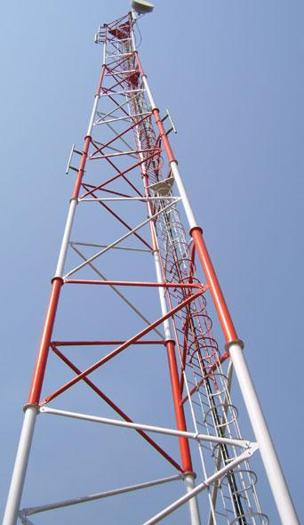

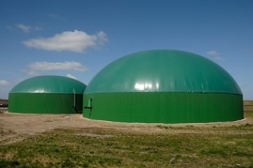
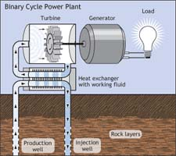
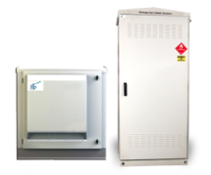
Which is the Right Renewable Energy Option for Telecom?
Solar?
Wind ?
Biomass ?
Geothermal ?
Fuel Cell ?
Telecom Tower
Hybrid of Above ?

Slide 13
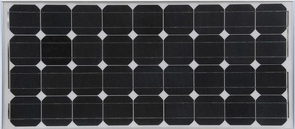
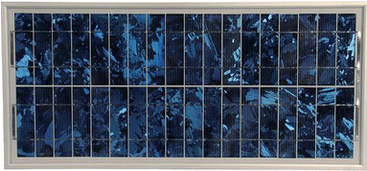

Which is the Right Solar technology?
Monocrystalline?
Cells are made from a single silicon crystal.
This crystal is cut into wafers roughly 0.2mm thick
The modules in production convert up to 15% of the energy from the sun into electricity, and test models over 20%
Polycrystalline?
It is made from cells containing lots of small silicon crystals.
This makes them cheaper to produce but also slightly less efficient than monocrystalline modules.
Thin-film?
The layers making it are about 40 times thinner than a strand of human hair, at just 2 microns.
Although the efficiency of thin-film panels is only about 10%, they use less material and are cheaper than crystalline modules

Slide 14
The Road Ahead
Telecommunication in India needs to sustain high growth rates, address energy scarcity issues for rural penetration and adapt a road map for low carbon growth.
An approach to integrate the demand for rural electrification to diesel replacement needs of the telecom tower segment shall create an opportunity to decentralized renewable energy providers. It shall also open up vistas for private enterprise development and private capital participations.

Slide 15
Requirements of Green Telecom
Unity in Diversity
  Distributed micro-generation (0-20KW), cumulative in Million KW
  Cumulative 2000 MW of RET installation at app. 2 Lakh sites to meet DoT directive on Green Telecom
Reliability
  24x7x365 power/fuel availability,
Scalability
  Horizontal : To meet countrywide spread of Telecom, even up to un-electrified villages
  Vertical : Modular capacity addition to support strong business model of increased sharing and data growth
Operations & Maintenance
  Robust Ecosystem for widely distributed O&M : On site on time support
Commercial Viability
  Sustainable & commercially viable solution
Multiple factors influencing the right and sustainable approach towards
Greener Telecom

Slide 16
Synopsis of Green Journey in Telecom
Consumption
Transmission
Generation
BTS
  Reduced from 2.5 to 1 KW
  Improved temperature
Air Con
  Improved EER / CoP
Sharing
  Energy demand reduced by more than 25%
Rectifier efficiency
  Improved from 90 to 95%
Power conversion losses
  Reduced, like DC DG sets etc.
Losses incurred for isolation and stabilization
  Saving of 2% at 50 to 75% load and 3 to 5 % at load lesser than that by introduction of SVR size optimization
Telecom adversely impacted due to Discom failure to support the growth
Produced Power at 2.5 times of Grid tariff
Power Generation expertise required

Slide 17
A new approach
Uniquely focused on bottleneck infrastructure,
Would cover several areas/people who would otherwise wait indefinitely for Broadband and basic telecom connectivity – faster roll-out
Making the largest investments to provide the best-in-class infrastructure,
Determined to tackle environmental issues with Green Energy & thereby reduce Diesel and Kerosene consumption.
Ease out the pressure on environment and improve the sky-lines,
National reduction of Carbon foot-print in line with International standards,
Uniquely positioned to partner with Government Agencies to :
  Provide surveillance services for security checks and traffic control
  Phone charging stations in rural areas
  Community Emergency Lighting in rural areas in case of power-cuts
  Provide Green and Clean Energy.

Slide 18




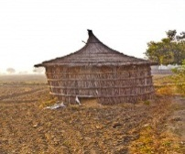




Energy Sharing – RESCO concept
RESCO
IP1
RESCO
Community
A Collaborative Approach

Slide 19
RESCO Evolution
Telecom has become a part of our life. 24x7. Telecom penetration in our country is much deeper than power. Telecom industry countered the power deficit with huge financial impact and delivered one of the fastest growing telecom in world.
Few years back, the concept of infrastructure sharing was introduced to maximized the asset utilization. While it helped new players for rural penetration, this has also far reaching impact upon energy consumption of all the sharing operators.
“Sanjha Chulha” is our tradition.
“Energy Sharing” is our future.
In the next phase the concept of energy sharing was introduced. Telecom towers industry jointly decided to pool in expert organizations to power up their towers through Renewable Energy Technology. Thus got incubated the RESCO: Renewable Energy Services Co., an enabler to “Sanjha Chulha”
Towers falling into cluster owned by multiple tower companies were offered to RESCOs for Green Power supplies with committed long term PPA. RESCOs are encouraged to supply surplus power to community.
Starting journey from diesel abatement to achieve target of grid parity.
RESCO: An Indian Telecom Revolution - Guiding The World

Slide 20
RESCO Model
Plants are set up and managed by solution providers, who are experts in the solar solution unlike telecom companies, who do not view this as a core competence.
Defining the standard solar solution based on the type of tower site will result in more efficient solutions being adopted by players across the industry and can also drive down capital cost for solar solution.
Identification of telecom sites by the infrastructure providers would help broad base of the solar energy as an option across the country.
Number of towers selected for the solar solution, makes it more viable for the solution providers as well.

Slide 21
Drivers for RESCO model
Non expertise in power generation & maintenance.
Focus on improved Network footprint.
Isolated & distributed network with limited scale.
Can act as a Anchor load for a RESCO who can support other customers in vicinity.
Coordination with regulatory bodies to utilize available support like subsidy etc.
RESCO can bring better technology expertise & innovation in alternate energy sources.

Slide 22
RESCO : Industry Innovation to Grow together
Implementation
Engagement
TowerCos offering towers for Collaborative Approach
Concept
Industry joined hands to jointly Engage the RESCOs to offer their towers to supply RE power
Interacting with the possible RESCOs
Long term -10 years PPA
Conceptualized RESCO model to meet power deficit while making the network Green
Telecom anchor customer while surplus power to community
Grow along with experts

Slide 23
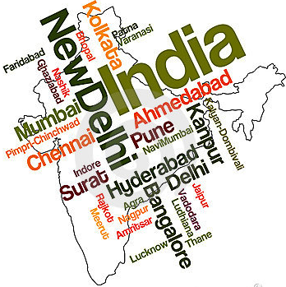
RESCO Model
Solar
Biomass
Bio CNG
RESCO
Fuel Cell
Rural Economic Growth
Community – Surplus Power Feeding
Anchor Load – Telecom IP1’s jointly offering their towers to select RESCOs
Low Carbon
Socio-economic Growth
RESCOs using the right RET mix
Telecom Tower RESCO Community

Slide 24
RESCO : Journey so far
Long term PPA model Rs/KWH
All IPs offering sites together
Long term -10 years PPA
RET soln. from RESCOs
Surplus power to community
Technical and commercial evaluation of RESCOs engaged
Infrastructure providers identifying the needs to provide renewable energy to towers
IMPLEMENTATION
ENGAGEMENT
CONCEPT
Its just a beginning; miles to go
Many RESCOs in Wait and Watch mode

Slide 25
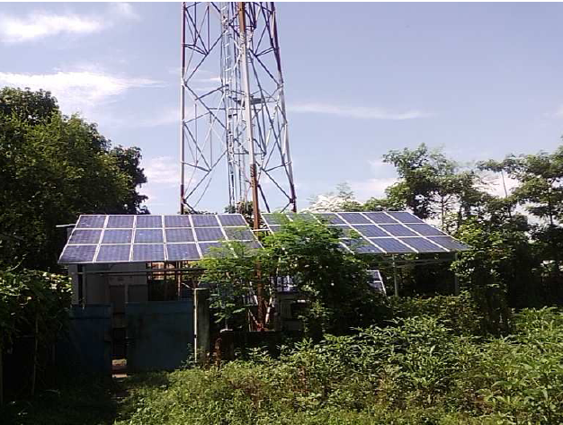
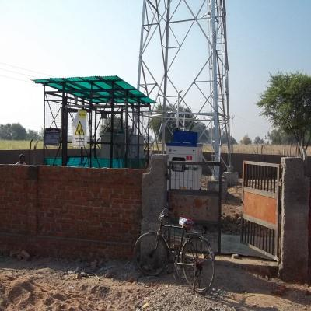
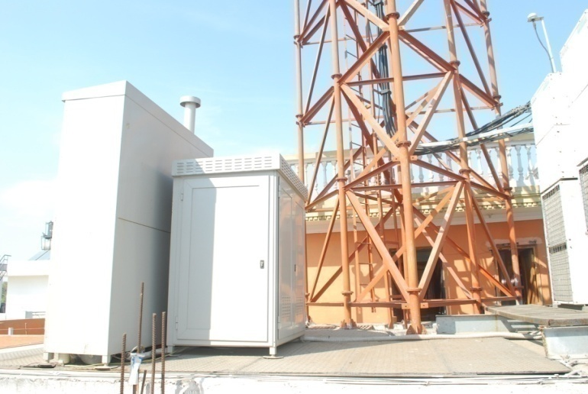
Its Possible, Boss !
Finding an alternative for traditional energy sources to run telecom towers is no more a CSR activity for Indian telecom industry, it’s a must now.

Slide 26

Thanks
For your attention:
E-mail: tilakrajdua@gmail.com
Mobile: +91 9810150000
Website: www.gisfi.org

Slide 27
RESCO: Update
RESCOs engaged : ~75 nos.
Technical bids received : 25 nos.
Commercial Bids received : 16 nos.
Mahindra & Mahindra (Bio-CNG) and CMES (Bio-mass) shortlisted for first 1100 sites pilot project
Other technologies like Solar, Wind, etc under discussion for early implementation

