Slide 1
Sustainable Rural Communication through broadband
Anil Kaushal
Senior DDG TEC
DOT
18th December,2012

Slide 2
Policy Aspiration of BB
National Telecom Policy-2012
• TODAY: No. of BB connections (≥ 256 Kbps) = 15 million (October’ 2012)
• Vision : BB on Demand
• Increase rural tele-density from 35 to 60 (year 2017) 100 (year 2020)
• Affordable and reliable broadband on demand(year 2015)
• BB connections targets
• 175 million ‐ ( year 2017 )
• 600 million ‐ ( year 2020 ) at minimum 2 Mbps DL speed
• higher speeds of at least 100 Mbps on demand.
• Recognise telecom and BB connectivity as a basic necessity like
education and health & work towards ‘Right to Broadband’.
• Synergise between existing, on‐going and future Government programs
viz e‐ gov, e‐panchayat, NREGA, NKN AADHAR, AAKASH tablet etc. & BB
roll‐out, Sharing;
• GAP? : Miles to go ! How to we leap frog?

Slide 3
Role of Broadband in Nation Building
Potential and power of BB to touch and empower our lives both in urban /rural
More so in RURAL where bulk of 72% people live bringing fulfillment, Electronically/online beginning with key sectors:
Health, Education, Governance and Democratization of information and so on
Let us touch Bottom of pyramid: through resonance of Convergence, Policy, Regulation, Action(Realization)

Slide 4
FACTORS RESPONSIBLE
Urban‐Rural FOR DIGITAL DIVIDE
Difficult terrain & Scattered Population
Lack of Infrastructure (Roads, Power etc.)
Low income
Higher CAPEX & OPEX, Low ARPUs

Slide 5
BB a complex Ecosystem
BB ≠ Voice
Voice evolution: 4khz 64 kbps 32 kbps
16kbps 9600bps 1200bps
BB evolution: Smoke signals‐Morse‐50bps telex‐
Kbps‐Mbps‐Gbps – Tbps …… ∞ ?……
Foundation of BB infrastructure= OFC
Power of fiber to cope growing needs of BB well understood

Slide 6
2‐BB complex Equations
BB ≠ Voice
AVL Good BB= BHN + AN + User D +Con.+ Lit + Awareness + AFFORD +Trust+ Felt need
Felt need = natural for voice = Cultivated by society for BB
Eco‐system = simple for voice = complex for BB (3C‐ triangle)
Rural BB = Filling Gaps in BH+AN‐‐‐unbalanced eqn. at Bottom of Pyramid

Slide 7
How do we meet aspiration?
Urgent need for inclusive growth through BB
Deployment of a National Broadband infrastructure is a prerequisite
Indeed A gigantic and challenging task for vast country with diverse terrain and diversity of people.
Need for STIMULUS‐ to trigger BB Ecosystem
Questions:
Where required? From whom? How?

Slide 8
Prerequisite to BB Proliferation‐
Study
Deployment of a National Broadband infrastructure is a prerequisite,
Way forward:
Understand the Reach of the existing infrastructure (core, middle and access) and
to identify and address the infrastructure gaps.
A study “Deployment Models and Required Investments for Developing Rural Broadband Infrastructure in India ” was commissioned by the CII & conducted by Analysys Mason.
One of the key findings is the role of the Government.
Like in other countries, here too, government’s intervention and support is necessary for the broadband ecosystem to reach a critical mass.

Slide 9
Global study: 3‐ Investment models possible:
1. Ownership
2. Public Private Partnership (PPP) and
3. Financial Incentives

Slide 10
Depending on Extent of Govt. involvement
The Ownership model has
the highest level involvement with the govt. deploying and owning the broadband core/middle mile infrastructure
The PPP model has
relatively lower level of govt. role, with govt. partnering with one or more private operators in developing the BB infrastructure
The Financial incentives model defines
govt’s role as a facilitator for providing incentives & grants to public and private sector companies for deploying BB infrastructure, but without having any ownership

Slide 11
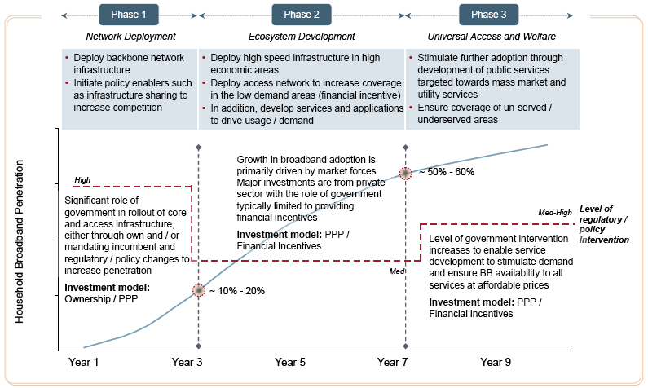
Broadband Evolution and Growth Framework

Slide 12
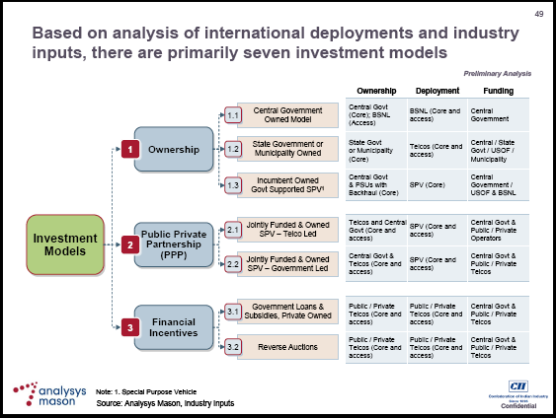
Investment perspective

Slide 13
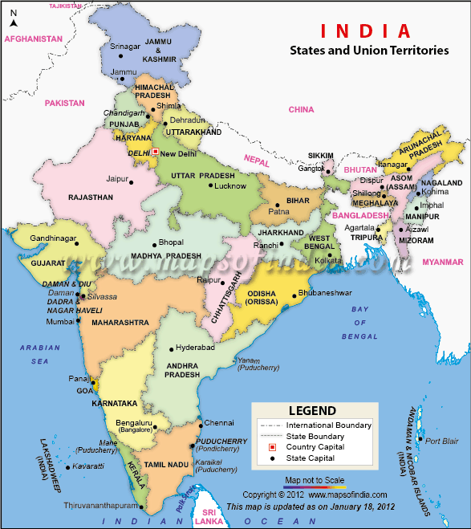
INDIAN ADMINISTRATIVE SETUP
Population 1.17Billion
72% Rural
Area 3,287,263
Sq. Kms
States 28
UT 7
Districts 640
Blocks 6,382
Villages 6,38,619

Slide 14
Organisation of villages into GPs
Gram Panchayat= VILLAGE COUNCIL Basic
administrative unit in villages
No. of Villages | 6,38,619
No. of Gram Panchayats | 250000
No. of Blocks | 6382
No. of Districts | 640
Average no. of Gram Panchayats per District | 390
Average no. of Gram Panchayats per Block | 40
Average no. of Villages per Gram Panchayats | 3

Slide 15
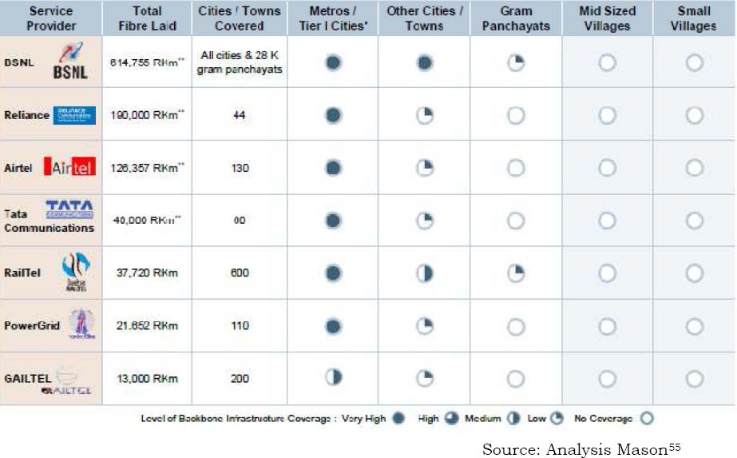
Existing Fibre=+8,00,000 Km
Reach/Coverage ?

Slide 16
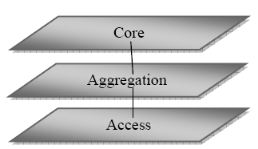
Telecom Network Layers‐Gaps in OFC
Reach
Gap from Block to GP
A new Rural market
at BoP waiting
to be tapped

Slide 17
GIS mapping of fibre
GIS mapping of 3 CPSUs –BSNL,RAILTEL,PGCIL completed by NIC
GIS Data of few private telecom operators received.
Data is inadequate.
Data from others has requested without further delay.

Slide 18
Gaps estimation
Existing fibers from Block to be leveraged by leasing existing operators (BSNL/RAILTEL/PGCIL)
On average 2km incremental OFC per GP required from nearest existing OFC to GP
No. of GPs to be covered 2,50,000
Incremental cable needed to be laid 5,00,000 Km
Associated electronics to be mounted on the cable from Block to GPs
Estimated cost INR 20,000 Crore ($4 billion)

Slide 19
What is National Optical Fibre Network
(NOFN)?
NOFN ‐ A Project to connect 2,50,000 Gram Panchayats(GPs) through OFC Approved by GoI on 25.10.2011
NOFN Project will bridge connectivity gap between GPs and Blocks.
Project to be implemented by NOFN‐SPV namely Bharat Broadband Network Ltd (BBNL).
Envisaged as a Centre‐State joint effort .
Govt. of India to fund the project through the Universal Service Obligation Fund (USOF). Rs. 20,000 Cr.($4B)
State Govts. are expected to contribute by way of not levying any RoW charges (including reinstatement charges)
Reinstatement to be done by BBNL
Suitable Tri‐partite MoU to be signed by GOI, State Govt. & BBNL

Slide 20
BBNL‐Infrastructure Provider
Bandwidth Provider
Gap filler in aggregate layer
Users of NOFN are access operators(TSPs/ISPs/Cable TV operators)
Enables them to launch various access services
Operator of operators (carrier of carriers)
B2B,No retailing
Non‐discriminatory access to all licensed operators
Seeks to trigger Ecosystem opening up new Rural markets
Incremental in nature

Slide 21
NOFN Details
NOFN Details
• NOFN will ensure that Broadband of at least 100Mbps is
available at each GP
• NOFN will provide non‐discriminatory access to all
categories of service providers.
• On NOFN, e‐health, e‐education, e‐governance &
ecommerce applications & Video conferencing facilities
can be provided.
• NOFN Project implementation time (by 31.10.2013).

Slide 22
What does NOFN offer to Service
Providers ?
Guaranteed Bandwidth at GP and Block
Beneficiary operators to interconnect NOFN at its PoP at Block and further built up connectivity using existing networks upwards
Access Providers to interconnect at GPs to launch their retail services.
Standard interfaces for interconnection at GPs as well as Blocks
• Centralised Management – NMS, OSS/BSS

Slide 23
Highlights NOFN
Evolution: HLC‐Advisory body‐SPV(Incorporated as BBNL)
NOFN to be built using dark fibres leased from three CPSUs (or any other desirous telecom operator) and laying incremental fibre.
NOFN to offer interconnection at Block level and Gram Panchayat (GP) level
Guaranteed Bandwidth of 100 Mbps at GP

Slide 24
Highlights of NOFN(Contd.)
Both Active & Passive technologies to be deployed depending on ground situation
Ring & tree architecture to be used depending on ground realities and requirements
NOFN will use technologies that are scalable, maintainable, observable & controllable meeting ground realities of diverse rural environment.
NOFN to be operated and controlled centrally (NMS) by BBNL

Slide 25
RoW (Right of Way)
Telecom Cables are laid along roads/railway tracks/ on electric transmission/ distribution towers.
This requires permission (termed RoW) from the concerned authorities viz. PWD, Municipality, Forest, Panchayat Authorities, Rural Engineering Service, Electricity Boards, Irrigation, Private Electricity Distribution Agency, etc.
Project execution by BBNL will commence after
tri‐partite MoU is signed .

Slide 26
Other Issues‐Ecosystem
Availability of relevant applications & content particularly in priority areas viz.e‐Education, e‐ Health, e‐Gov applications to suit local requirements
Timely availability and affordable customer end devices relevant to rural applications
Pilot Trials – Participation by access providers at GPs, content providers & Govt. Departments

Slide 27
Conclusions & Recommendations
Ensure concerted approach distinctly for rural needs.
Strategy to be cohesive, yet diverse as per regional needs.
Start deployment with simple devices and applications, gradually progressing towards complex ones.
Scalable services, bandwidth, and upgradable devices.
Energy efficient systems and devices.
Utilize mix of technologies and networks

Slide 28
Thank You

