Slide 1
Digital Financial Services PARAGUAY

Slide 2
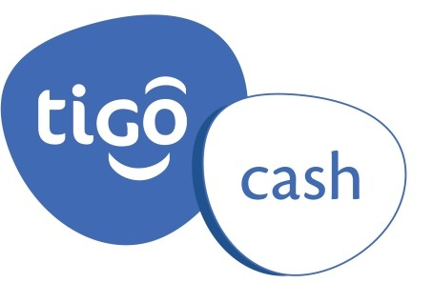
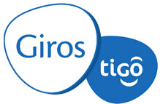
How it began
Who?
Launched on
31 May 2008
In 2010, services were re-engineered, with focus on small, national transfers, under the brand name Giros Tigo.
20 December 2008
In 2012, pursuing the evolutionary approach, the brand name Tigo Money was launched: payment of bills and other payments, purchases in places of commerce…

Slide 3
How it began
Who?
How it began> Articles> Presentation lunch for Tigo Cash service
31 May 2008 00:00 / Attended by managers and agents of the company
Presentation lunch for the Tigo Cash service
At midday yesterday, Tigo presented the new Tigo Cash service, which will allow its customers to carry out transactions in different places of commerce. The launch took place in the main meeting room at the Sheraton.
The lunch was attended by managers from the mobile telephone company, as well as agents, representatives, and special guests. Participants took part in a prize draw, and were able to try out the service.
How it began> Printed copy >Economy >Presentation of Billetera Personal (Personal Wallet)
20 December 2008 / Núcleo SA
Presentation of Billetera Personal (Personal Wallet)
Núcleo SA, on behalf of its company Personal, launched its new Billetera Personal (Personal Wallet) service, which will allow all telephone users to transfer money wherever and whenever they may wish, without having to carry cash around.

Slide 4
What’s on offer?
Who?
Billetera Tigo Money (Tigo Money Wallet): make mini-downloads of cash to your phone, send money, pay your bills and make other payments, pay in places of commerce that are part of the Tigo Money network.
This is prepay, you download money to your wallet (commission-free) at Tigo Money points.
Your wallet also loads cash each time you receive a transfer.
Billetera Personal (Personal Wallet): pay and transfer money using your mobile phone. This allows you to store money on your phone for use whenever and however you may wish, with the backing of Banks and Financial Companies.
The Billetera Personal service provides you with a pocket full of money regardless of your mobile telephone service balance.

Slide 5
What’s on offer?
BILLETERA TIGO MONEY (Tigo Money Wallet): Allows you to pay and transfer money using your mobile phone. Store money on your phone for subsequent use. Backed by major banks and local places of commerce.
GIROS TIGO (Tigo Transfers): This service allows you to send money via Tigo to someone else anywhere in the country, and allows that person to cash the money at any of the places competent to do so.
Mobile payments: This service allows customers to use their Tigo to make purchases in commercial establishments affiliated to an entity that processes credit cards. All Tigo users possessing a credit card will be able to use their mobile device to make purchases in the commercial establishments without having to have their credit card on them.
Mobile banking: This service allows customers to use their Tigo to make purchases in commercial establishments affiliated to an entity that processes credit cards.
ATMs: ATMs belonging to the Dinelco network can be used to make withdrawals using Billetera (Wallet) and Envíos (Tranfers).
Micro credits: The customer requests the credit, entering the word “familiar” and his/her identity card number. Once it has been approved, he/she recieves an SMS for the approved credit and then withdraws the money from one of the Tigo agencies.

Slide 6
What’s on offer?
BILLETERA PERSONAL (Personal Money Wallet): Allows you to pay and transfer money using your mobile phone. Store money on your phone, backed by banks and financial companies.
ENVIOS PERSONAL (Personal Tranfers): This service allows you to send money via Personal to someone else anywhere in the country, and allows that person to cash the money at any of the Personal outlets competent to do so.
Mobile payments: This service allows customers to use their Personal to make purchases in commercial establishments affiliated to an entity that processes credit cards. All Personal users possessing a credit card will be able to use their mobile device to make purchases in the commercial establishments without having to have their credit card on them.
Mobile banking: This service allows customers to use their Personal to make purchases in commercial establishments affiliated to an entity that processes credit cards.
ATMs: ATMs belonging to the Dinelco network can be used to make withdrawals using Billetera Personal (Personal Money Wallet) and Envíos Personal (Personal Tranfers).

Slide 7
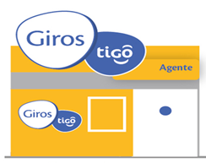
How is the electronic cash balance distributed?
Bank
Clearing
Level 1
Operator
Level 2
Agent
Agent 1
Agent 2
Agent 3
Level 3
Point of sale
End user
Agents and Points of Sale have to pre-purchase the cash balance in order to carry out transactions.
The electronic cash balance on the platform is the same as the real balance of money (clearing account + trust).
In the transactions between levels 1, 2 and 3, commissions are not generated.
The commissions are generated from the end user’s transactions.

Slide 8
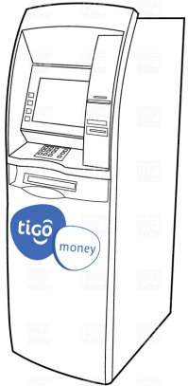
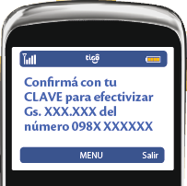
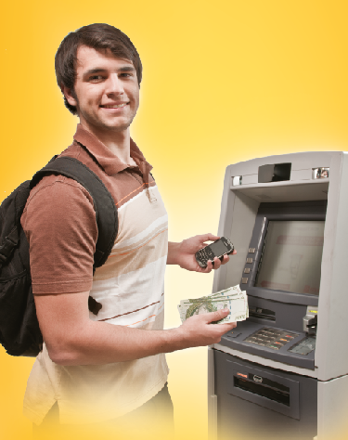
Withdrawal of money at ATMs
Customer recieves a transfer and goes to ATM. Chooses option: Withdrawal of transferred money.
Enters mobile number, PIN and amount to be withdrawn.
Customer receives message on mobile phone and enters PIN on phone to approve the transaction.
Customer withdraws the money from the ATM.
1
2
3

Slide 9
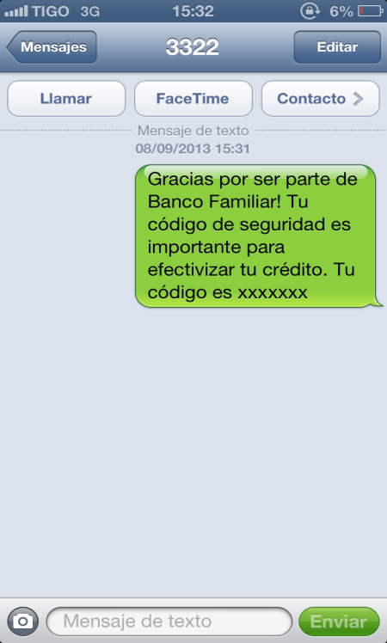
In 2010, Giros Tigo was chosen as part of the Technologies for Financial Inclusion Programme (BID – Fomin – CAF) with the “Last Mile” project in alliance with financial institutions, for mass disbursements and payments.
1
Customer requests credit, entering the word “familiar” and identity card number.
2
3
Approved
Thank you for choosing Banco Familiar, your code is xcvvzxc, you may proceed to a Tigo Money POS to receive payment.

Slide 10
2014 Digital Finances Prize
The 2014 Digital Finances Prize recognizes outstanding initiatives on the part of financial intermediates, networks of agents, communication companies and technology, including mobile phone operators, that use information and communication technologies to increase financial inclusion in the region.
Tigo Paraguay was awarded the Digital Finances Prize for its performance and financial transparency and for the quality and use of its financial services. Its product TIGO Money (Mobile Cash Paraguay, S.A) has stood out in the field of digital finances by making financial services more readily available (including person-to-person (P2P) cash transfers, payment operations and microcredits), taking advantage of the coverage of its points-of-sale network and an agreement with the Banco Familiar.
It currently has over 500 000 customers and 3 000 points of sale throughout Paraguay.
SOURCE: Multilateral Investment Fund (FOMIN), member of the IDB Group

Slide 11
Mobile money for financial inclusioN
Around 28% of the population of Paraguay use the electronic wallet and transfers. Paraguayans are the most active users of the mobile platform in Latin America, and the country is seen as a regional and global leader in the use of mobile money.
Only 22% of the adult population in Paraguay have a bank account, which is very similar to the banking situation in Haiti and Guatemala.
The mobile platform is the financial vehicle used by the Social Action Secretariat (SAS) to transfer the Tekoporã subsidies. The first time they did so, they enabled some 4 198 families to receive the subsidy using the e-wallet system, with the telephone companies Personal and Tigo.
The “Last Mile” project made it possible for over 500 000 people living in low-inclusion areas to make transfers and subscribe to public and private services using their mobile phones.
Queen Maxima of the Netherlands, adviser to the United Nations Secretary-General on matters of financial inclusion, emphasized that “…Paraguay is today’s leader in the use of the mobile service in the region, and this type of innovative technology is extremely promising in terms of reaching sectors that are excluded and marginalized by formal financial services”.
SOURCE: Survey on Financial Inclusion. BCP Report.

Slide 12
REGULATIONS ON ELECTRONIC MEANS OF PAYMENT Resolution No. 6 (13 March 2014) of the Central Bank of Paraguay
Wherefore, in the exercise of the powers vested in it,
THE DIRECTORATE OF THE CENTRAL BANK OF URUGUAY
RESOLVES:
To approve the REGULATIONS ON ELECTRONIC MEANS OF PAYMENT, the text of which is annexed hereto and forms part of this Resolution;-------------------------
To suppress Resolution No. 7, Act 69 of 9 August 2004, of the Directorate of the Institution;----------------------------------------------------------------------------------------------
To communicate to whom it may concern, publish and archive.------------------------------
REGULATIONS ON ELECTRONIC MEANS OF PAYMENT:
Art. 9, Required documentation
b2) The documentary evidence issued by CONATEL attesting that the technical and economic conditions for the provision of telecommunication services comply with the norms and provisions in force within the framework of the regulation of telecommunications.
In all cases, any agreements established for the provision of services must be in conformity with the principles of neutrality, non-discrimination and equal access.

Slide 13
REGULATIONS ON THE USE OF TELECOMMUNICATION SERVICES AS ELECTRONIC MEANS OF PAYMENT
The purpose of the Regulations is to establish the technical, economic and legal conditions applicable to the provision of the telecommunication services used as the support for making electronic payments, over the networks of those services, in conformity with the provisions set forth in the “Regulations on Electronic Means of Payment of the Central Bank of Paraguay”
Principle of network neutrality
Principle of equal treatment in the service
Principle of equal access to use and provision of the service
Interoperability between entities providing electronic means of payment

Slide 14
Many thanks!

