Slide 1
ITU Regional Standardization Forum for Americas (Washington D.C., United States, 21 September 2015)
Combating counterfeit, substandard and unauthorized equipment
João Alexandre Zanon
Regulatory Specialist – PRRE/SPR/ANATEL
Associate Rapporteur of ITU-T Question Q8/11
Rapporteur of CITEL Correspondence group on the Combat of Counterfeit substandard and unauthorized ICT devices
zanon@anatel.gov.br

Slide 2
Outline
SIGA Project
Challenges when addressing the problem.
Multi Layer Initiative.
CITEL PCCI Initiatives.
Recent ITU Initiatives.
What we should aim for.

Slide 3
SIGA Project

Slide 4
General Statistics

Slide 5
SIGA - Sistema Integrado de Gestão de Aparelhos
O “Sistema Integrado de Gestão de Aparelhos – SIGA” aims to control counterfeit, cloned and unauthorized mobile devices.
The project is based on Anatel Regulatory framework that dictates that operators can only allow on the network authorized devices.
The Project is lead by Anatel with the participation of all relevant actors (Anatel, Operators, ABR-Telecom, Manufactures, GSMA, among others).
The system is operated by ABR-Telecom and is active since march 2014 collecting the relevant information from all mobile networks on Brazil.
The system is generating the reports and alarms necessary to map the Brazilian scenario so that Anatel can define the next actions.

Slide 6
SIGA Premises
• Centralized solution: built jointly and integrated to all Brazilian mobile operators;
• Automated solution: allowing the input of information with low human intervention;
• Scalable, Dynamic and Flexible: expandable system, rules adjusted over time;
• Multiple sources of info: CDRs, operators systems, international databases;
• Reliable and secure: Minimize impacts on regular end users;

Slide 7
Challenges when addressing the problem.

Slide 8
Challenges when addressing Counterfeit/Substandard/unauthorized
Construct a reliable reference database.
Need of reliable Unique identifiers (as indicated on Res. 188).
Preferable use of international reference databases + national bases.
Identification and definition of actions for for each scenario.
Attack every device of focus first on voice terminals?
How to address the cloned problem?
Reduce end-user impact.
Define Legacy Terminal actions (regulatory wave?)
Strong Educative campaign to pass information to the user.
Actions effective only on terminal already on the network.
How to control the entrance of new Counterfeit, substandard and unauthorized?

Slide 9
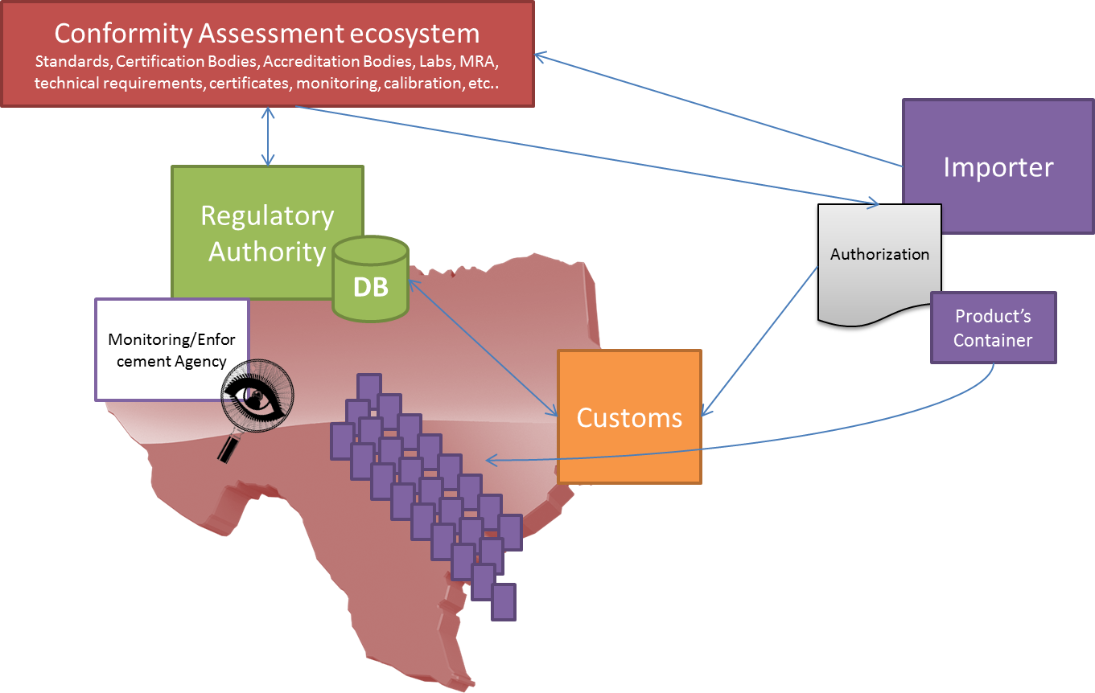
Blocking the entrance of these new Devices
Source: ITU-T TR – Combating Counterfeit

Slide 10
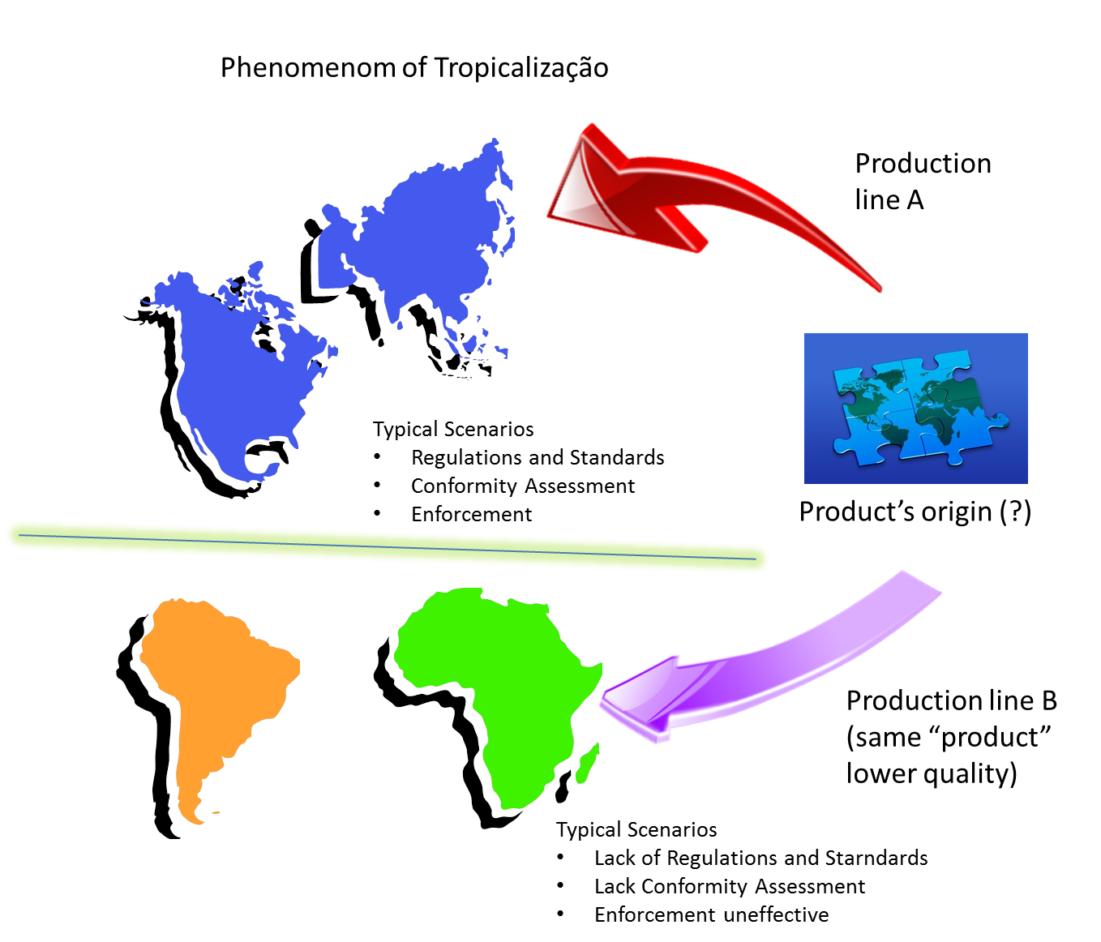
CA Policy Importance
Source: ITU-T TR – Combating Counterfeit

Slide 11
ICT Equipment Control Workflow

Slide 12
Multi Layer Initiatives

Slide 13
Multi Layer Initiatives
National: Example - Brazil‘s SIGA and Custom Integration.
Regional:
CITEL CCPI:
GTPR Correspondence Group on the Combat of Counterfeit, substandard and unauthorized mobile terminals.
GTPR Rapporteurship on Fraud Control, Regulatory Non-compliance Practices in Telecommunications and Regional Measures against the Theft of Mobile Terminal Devices
COMTELCA: Workshop – Combating Counterfeit (15/16 April 2015).
Global Wide – ITU Actions:
PP14 Resolution 188 on Counterfeit.
ITU-T SG11 (Q8/11) Technical Report.
ITU Event on the combat of Counterfeit.
Creation of three new work items on April’s Meeting.
Cooperation with other organizations.

Slide 14
CITEL PCCI Initiatives

Slide 15
CITEL PCCI Activities
XXIV Meeting of PCC.I (Lima, May 2014):
Resolution 222 (XXIV-14) - established the "Correspondence Group to Discuss Regional Measures to Combat the Spread of Counterfeit, Substandard and Unapproved Mobile Devices”
Mandate: develop definitions ,evaluate the scope; share information, experiences and best practices among Member States and associate members of CITEL, developing recommendations and guidelines
XXV Meeting of PCC.I (Asunción, August 2014):
Work plan of Correspondence Group included in the scope of the Rapporteurship on Fraud Control (Brazil as Co-Rapporteur):
Definitions of Counterfeit, substandard and unapproved.
Definition the scope of the problem.
Collect members experiences, solutions and best practices.
Consolidate all the information above on a Technical Report.
Recommend Solutions and resolutions to Members.
Further cooperation with ITU-T on the topic.
Approval of a questionnaire to the members states.

Slide 16
CITEL PCCI Activities
XXIVI Meeting of PCC.I (Cusco, May 2015):
Incoming Liaison from ITU-T Q8/11 informing the progress of the work.
Contribution with members experience on the combat of counterfeit devices.
XXVII Meeting of PCC.I (Washington, September 2015):
Proposal of the base text for the Technical Report on Counterfeit, Substandard and Unauthorized based on ITU-T TR Counterfeit and responses to the questionnaire.
Discussion on how CITEL can coordinate its works with ITU-T Q8/11 work items.
Discussion of possible IAP/Multi-country contribution to ITU-T Draft Recommendation on Counterfeit.
Revision of the Rapporteurship Work plan.

Slide 17
CITEL CCPI Activities - XXVII Meeting of PCC.I – USA/2015
Proposal of the base text for the Technical Report on Counterfeit, Substandard and Unauthorized Mobile Devices (P1!T-3715_i):
Based on ITU-T TR Counterfeit and responses to the questionnaire.
Presents the proposed definition to Counterfeit, Substandard and Unauthorized devices.
Consolidates some Citel’s Member experiences on the combat of these devices.
List some challenges that need to be faces by members.
Revision of the Rapporteurship Workplan.
Focus work on CITELS TR, ITU-T cooperation (Draft Recommendation).

Slide 18
CITEL CCPI Activities - XXVII Meeting of PCC.I – USA/2015
How can CITEL can coordinate its works with ITU-T Q8/11 (P1!T-3716_i):
Draft ITU-T TR-CF_BP “Technical Report – Guidelines on Best Practice and Solutions for Combating Counterfeit ICT Devices”: Collection of CITEL members’ experiences on CITEL Technical Notebook - These experiences should then be submitted to ITU-T Q8/11 as a contribution of the region.
Draft ITU-T Recommendation Q.FW_CCF “Framework for solution to combat counterfeit ICT Devices”: Possible IAP/Multi-country contribution to ITU-T, with the base text, to the next Q8/11 meeting to be held in Geneva, 2-11 December, 2015.
Proposed Definition (Based on ITU-T TR-Counterfeit and CITEL TR):
Counterfeit ICT Device: Is a device that is sold and distributed in contravention of applicable national and/or international technical standards, conformity processes, as well as national regulatory requirements or other applicable legal requirements. In design characteristics, it is a product that explicitly infringes the trademark or design of an original or authentic product, copies the trademark (brand) of an original well-recognized brand, copies the form factor of the original product, and/or copies the packaging of the original product.

Slide 19
Recent ITU Initiatives

Slide 20
Recent ITU Initiatives
In November 2014, the ITU Plenipotentiary Conference 2014 (PP-14) adopted a new Resolution 188 on “Combating counterfeit telecommunication/ICT devices”
Recognize that counterfeit telecommunication/ICT devices have become a growing problem;
Recognize that ITU and relevant stakeholders have a key role to play in fostering coordination between the parties concerned to study the impact of counterfeit devices and the mechanism for limiting them and to identify ways of dealing with them internationally and regionally;
Instruct the Directors of the ITU Bureaus to assist Member States in addressing their concerns with respect to counterfeit telecommunication/ICT devices through information sharing at regional or global level, including conformity assessment systems; and
Invite ITU Member States to take all necessary measures to combat counterfeit telecommunication/ICT devices, to cooperate and exchange expertise among themselves in this area, and to encourage participation in industry programs combating counterfeit telecommunication/ICT devices.
http://www.itu.int/en/ITU-T/C-I/Documents/WSHP_counterfeit/PP-14%20Resolution%20on%20Counterfeit%20Devices.docx

Slide 21
Recent ITU Initiatives
ITU-T SG11: Protocols and test specifications
Question 8 of study Group 11 Activities - Guidelines for Implementations of Signaling and Protocols and for Addressing Counterfeit ICT devices
Rapporteur: Isaac BOATENG – Ghana - isaac.boateng@nca.org.gh
Associate Rapporteur: João ZANON – Brazil - zanon@anatel.gov.br
Motivation: Several forums and conferences have also called for ITU assistance in addressing the growing problem of counterfeit telecommunication/ICT products and devices, which is adversely affecting all stakeholders in the ICT field (vendors, governments, operators and consumers).
Study Items: What activity is needed in the ITU‑T Sector to prepare common guidelines by the ITU‑T and ITU‑D Sectors, containing different aspects related to technical matters, in particular to address Counterfeit ICT devices?
Task: Develop guidelines to address the problem of counterfeiting of ICT devices;

Slide 22
Recent ITU Initiatives
Technical Report on Counterfeit ICT Equipment was approved on November 2014 and the document has been published and translated in the six languages of the Union: Covers key elements regarding the legal and regulatory nuances of the subject and also provide some use cases and experiences of countries that are already engaged in the combat of Counterfeit devices. (http://www.itu.int/pub/T-TUT-CCICT-2014)
ITU Event on combating counterfeiting ICT devices (November 2014): Recognized by the participants that the whole ICT industry is affected by counterfeiting, the importance of ICTs as a tool to combat counterfeiting of not only ICT devices, but also counterfeiting of products in other industries. Also the following ITU’s roles in combatting counterfeit:
Multi-stakeholder cooperation — ITU could leverage its public-private membership and relations with other organizations to foster cooperation in the area of counterfeiting;
Gathering and sharing of information — ITU could facilitate the collection, analysis and exchange of information about counterfeiting and substandard practices in the ICT sector, and about how ICTs could be used in the ICT/other industries as a fighting tool;
Building capacity and raising awareness — ITU could raise awareness among stakeholders about the negative effects of counterfeit and substandard ICT devices;
Use of technical solutions — ITU could continue the discussion on the role of IGOs in using technical standards and conformance & interoperability programs to combat counterfeit and substandard ICT devices; and
Development and enforcement of adequate legal, regulatory and policy measures — ITU could assist Member States in doing this; such measures should be comprehensive, effective and custom-tailored, yet consistent with best practices at the regional and international levels.
http://www.itu.int/en/ITU-T/C-I/Pages/WSHP_counterfeit.aspx
http://www.itu.int/en/ITU-T/C-I/Documents/WSHP_counterfeit/Final%20Report/Summary-of-Discussions-18Dec2014.docx

Slide 23
Recent ITU Initiatives
LAST MEETING: 21-29th April 2015 – Geneva, Switzerland: Creation of three new workitems:
Draft ITU-T Recommendation Q.FW_CCF “Framework for solution to combat counterfeit ICT Devices: This recommendation should contain a reference framework with the requirements that should be considered when deploying solutions to combat counterfeit ICT devices.
Draft ITU-T TR-CF_BP “Technical Report – Guidelines on Best Practice and Solutions for Combating Counterfeit ICT Devices”: This Technical Report aims to collect information regarding difficulties, challenges and barriers faced by ITU Members, and some Best Practices and Solutions for Combating counterfeit ICT Devices.
Draft ITU-T TR-Sub_Una “Technical Report on Methodologies and use cases for combating the substandard and unauthorized telecommunication/ICT devices": This Technical Report should provide background information on the nature of the issues related to substandard and unauthorized ICT equipment, corresponding activities within the ITU and in other relevant forums.
NEXT MEETING: December 2015 – Geneva, Switzerland: Discuss the contributions to the new worki tems.

Slide 24
Current participating Countries/Entities
ORGANIZATION | COUNTRY
Telekom Austria | Austria
Anatel, Brazil | Brazil
BIS | UK
CCK, Kenya | Kenya
Cisco Systems | USA
ETRI | Korea (People’s Republic of)
GSMA | N/A
Huawei | China
Microsoft Mobile OY | USA
Ministry of Telecom and Mass Communications of the Russian Federation | Russia
MMF (invited experts) | Belgium
MSID | Korea (People’s Republic of)
NCA | Ghana
NCC | Nigeria
NEC | Japan
NTT | Japan
TTA | Korea (People’s Republic of)
TCRA | Tanzania
Ukrainian State Centre Of Radio Frequencies | Ukraine
UNIS | Ukraine
WIPO, WTO | N/A

Slide 25
What we should aim for

Slide 26
What we should aim for
Multi Level Actions and Cooperation.
Bilateral and Regional cooperation.
International best-practices and recommendations.
Reduce End-user impact (Good Faith user)
Good user communication is crucial.
Weave for legacy terminal (turnover).
National multiple actions to combat Counterfeit/Substandard/Unauthorized
Structured C&I Policy and Custom Integration.
Solutions to Remove Counterfeit from the market.
Reliable reference databases to our solutions
Secure unique identifier - PP14 Res. 188 Counterfeit
Global references databases + Country Specific databases.

Slide 27
Thank You!
Any Questions?
João Alexandre Zanon
zanon@anatel.gov.br

