Slide 1
Industry IoT Standardization Initiatives
Mike Chartier
Intel

Slide 2
Nascent Environments
Company
Strengths
Company
Strengths
Company
Strengths
Market Need
Company
Strengths
Company
Strengths
Company
Strengths
Company
Strengths

Slide 3
Typical bottom up organic approach
Small group of like minded “fellow travelers” collaborate on what they believe the industry needs.
Create a special interest group (SIG).
Common to have multiple groups addressing the same need.
Period of experimentation, competition and feedback from the market.
Usually not zero-sum.
Standardization moves to official SDOs (IEEE), Certification stays in industry org (WFA).

Slide 4
Classic Examples
USB
  A group of seven companies began the development of USB in 1994: Compaq, DEC, IBM, Intel, Microsoft, NEC, and Nortel.
Bluetooth
  The Bluetooth Special Interest Group (SIG) is formed with five companies in 1998.

Slide 5
Current Example
Alliance for
Wireless
Power
Power
Matters
Alliance
Wireless
Power
Consortium
* Third party brands and trademarks may be claimed as the property of others.

Slide 6
Current Example
Alliance for Wireless Power
Power Matters Alliance
June 1, 2015 – The Alliance for Wireless Power (A4WP) and Power Matters Alliance (PMA), industry leaders in wireless charging technology, have announced the signing of the merger agreement between the two organizations.
* Third party brands and trademarks may be claimed as the property of others.

Slide 7
Current IoT Industry Standards Landscape

Slide 8
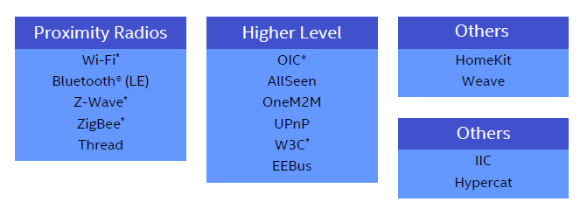
Current IoT Industry Standards Landscape

Slide 9
Current IoT Industry Standards Landscape
Almost all activity
Occurring here

Slide 10






Current IoT Industry Standards Landscape
Brillo,
Weaveillo
HomeKit
* Third party brands and trademarks may be claimed as the property of others.

Slide 11
Closing Thoughts
No “One Standard to Rule Them All”
Common themes-
  Consistency
  Low power
  Security
Cooperation between standards
  Interoperability
  Collaboration
  Consolidation

