Slide 1
ITU Regional Standardization Forum for Americas (Washington D.C., United States, 21 September 2015)
Digital Financial Services in Brazil
João Alexandre ZANON,
Regulatory Specialist, PRRE/SPR/ANATEL
zanon@anatel.gov.br

Slide 2
The Brazilian Scenario.
Why regulate Mobile Payments.
Law Nº 12.865, from October 9, 2013.
Regulatory Challenges.
The Focus Group – DFS.

Slide 3
The Brazilian Scenario

Slide 4
Mobile subscriptions in Brazil
Source: Anatel
The total amount of mobile subscriptions reached 278 millions in September, 2014.
77% of these subscriptions were under a prepaid plan.

Slide 5
Mobile subscriptions in Brazil
(in million)
Source: Anatel

Slide 6
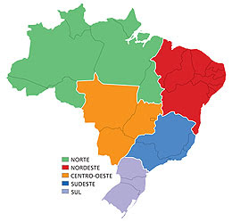
Mobile Density in Brazil
North
117%
Northeast
125%
Midwest
159%
Southeast
145%
Brazil
137%
South
140%
Source: Anatel (September, 2014)

Slide 7
Brazilian population with bank account
Source: Central Bank of Brazil

Slide 8
Payment Methods in Brazil
Source: Central Bank of Brazil

Slide 9
Why Regulate Mobile Payments

Slide 10
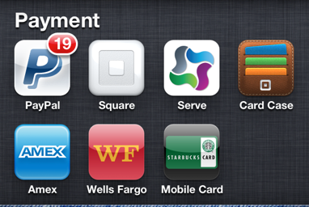
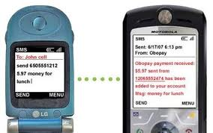
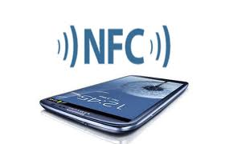
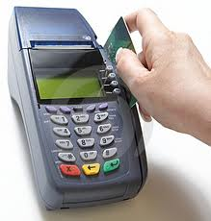
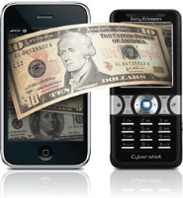
Today – Different setups and payment Technologies
Smartphone – Huge Innovation on solutions:
Mobile Money e Digital Wallet.
Internet banking at Mobile Terminal.
E-Payment service providers.
In-app Payments.
Mobile Point of Sale (mPOS).
Access Technologies:
Mobile Network based (SMS, USSD).
Close Contact (NFC).
Based on Cloud/Internet.
Payment Models:
Credit card Based.
Pre-Paid Account.
With or without pre-approved credit.

Slide 11
Main Payment Technologies
Technologies
Device Acceptance
Usability
User Interaction
Security
Market Share (2009)
Volume and Valor
SMS
77% 93%
WAP/Web/HTTPS
2% 5%
USSD
4% 1%
NFC
16% 1%
Source: Gartner “Market Insight: The Outlook on Mobile Payment ” (2010) - Telefônica
3 in 4 devices sold on Brazil are smartphones.
19,5 millions of smartphones sold between January e may de 2014.
Growth of 71% when comparting to the five first months of 2013.
Smartphones sells should reach 47 millions of devices in 2014.
Source: data from Jul/2014 - Associação Brasileira da Indústria Elétrica e Eletrônica – Abinee.

Slide 12
Why Regulate
Need of a Legal Landmark for the current setups to guarantee Juridical Stability.
Address some current setups that today don’t have any government regulation but are very important to consumers;
Reduce Popular economy Risk and Systemic Economy Risk;
Promote Financial Inclusion;
Guarantee Crucial user rights;
Promote Low cost solutions for end-users;
Promote Competition, through an open and interoperable platform.
Creation of a National Task Force, with participation of Brazil Central Bank, Ministry of Communications and Anatel toe the Needed Legal Landmark (MP 615/13, May 17, 2013).
Law Nº 12.865, October 9, 2013: Mandate about payment setups and Payment Institutions integrated to the SPB (Brazilian Payment System) – Arts 6º to 15º.

Slide 13
Law Nº 12.865, October 9, 2013.

Slide 14
Principles and Objectives
Interoperability
Innovation
Eficiency
Non-discriminatory treatment
Reliability, quality and safety

Slide 15
Principles and Objectives
Interoperability at the payment setup and between different setups;
Innovation at payment setups and incentive to new payments models;
Reliability and Efficiency at payments setups and institutions, promote competition and possibility to transfer digital money funds to other payment setups or institutions;
Non-discriminatory treatment to necessary services and infrastructure for deployment of new payments setups;
End-User needs: freedom of choice, security, economic protection, non-discriminatory treatment, privacy and personal data protection, transparent and complete terms of services;
Reliability, Quality and Security of payments services;
Financial Inclusion, taking into account quality, security standards and transparency.

Slide 16
Some Brazilian examples

Slide 17
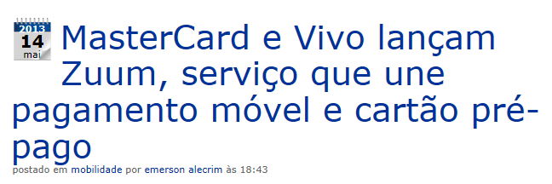
Established Payment Setups

Slide 18
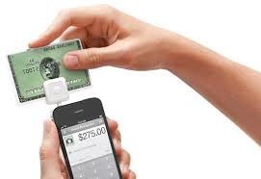
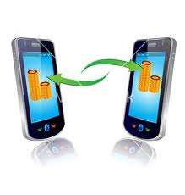
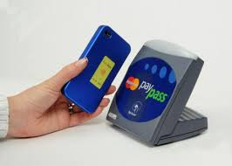
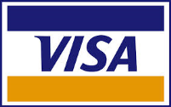
Established Payment Setups

Slide 19
Regulatory Challenges

Slide 20
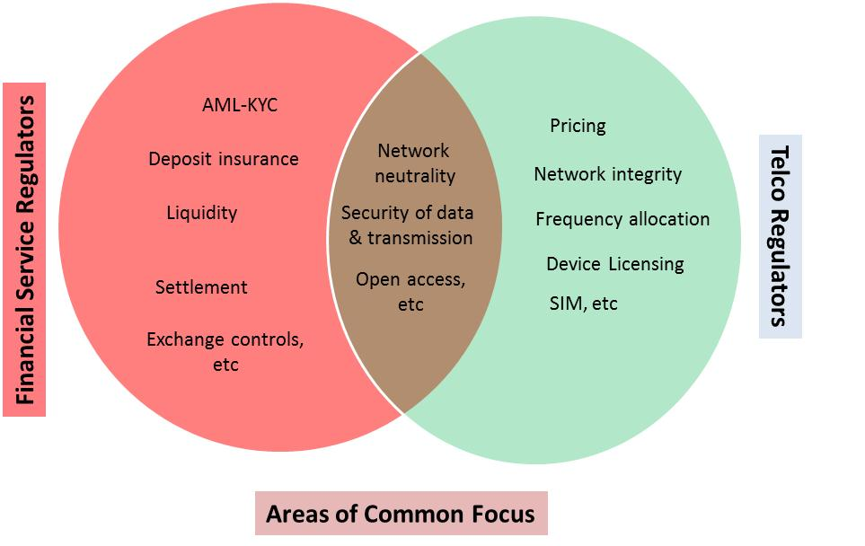
Mandates Division
Clear scope of regulatory focus will help both the regulators and the industry

Slide 21
Today, does Anatel need to create new Regulations?
Law n.º 9.472/97 – General Telecommunication Law:
Art. 61. Value added service is the activity that adds value to the telecommunications service that supports same, and with which new features related to the access, storage, presentation, handling or recovery of information are not mistaken.
§ 1º Value added service is not a telecommunications service, however, the provider thereof is classified as user of the telecommunication service providing support thereto, with the rights and obligations inherent to this condition.
§ 2º Access to the utilization of telecommunications service networks for rendering value added services is assured to interested parties, for which the Agency shall regulate the conditions as well as organize the relationship between same and the telecommunications service providers.
Art. 3 (consumers rights), III of RGC – Consumer General Regulation
III – to a non-discriminatory treatment when using the service, if the technical conditions are fulfilled, taking into account the todays regulation;

Slide 22
Other Regulatory Challenges
Conflict Prevention and Resolution, in partnership between BACEN, Anatel e SNDC
Consumers Rights defense:
Transparent and complete Users Term of Service;
Security, Privacy/Data Protection;
Reliability – transaction confirmation/error notification;
Reliable and fast Unrecognized debit resolution;
A Trustable environment generate growth:
Ex: Secure Terminal, combat to fraud and disloyal commercial practices.
Avoid strong regulation at new players, to stimulate innovation and competition.
Stablished a transaction process to implement to current setups the principles mandated on Law 12.865/2013.
Example: Interoperability, non-discriminatory access to infrastructure.
Promote Financial Inclusion

Slide 23
The Focus Group – DFS
Digital Financial Services

Slide 24
ITU-T – FG DFS
Created in the middle of 2014 with a 2 year mandate;
Participants: ITU Members, other UN organizations, other standard organizations, NGOs e private sector;
4 Working Parties:
Ecosystem
Interoperability
Technology, Innovation and Competition
Consumer Experience (Quality, Security, Data/Privacy Protection)
Strong Relation with ITU-T SG3:
Study Companies Market Power/Relevance and the need of regulatory remedies:
Mandatory Interoperability?
Necessary to regulate prices?
price-cap or cost-based?

Slide 25
Thank You!
João Alexandre Zanon
zanon@anatel.gov.br

