Slide 1
ITU Focus Group Digital Financial Services
ITU Regional Standardization Forum for Americas
(Washington D.C., United States,
21 September 2015)
Vijay Mauree,
Programme Coordinator, ITU
Vijay.Mauree@itu.int

Slide 2
I. Mobile Banking v/s Mobile Money
MOBILE BANKING
Banking services delivered through a mobile phone. Need a bank account.
Digital Financial Services
The use of ICTs and non-bank retail channels to extend the delivery of financial services to unbanked.
    Bank account not needed.
    Use of agents for cash in and cash out.
    Use mobile handsets and other digital means for transactions

Slide 3
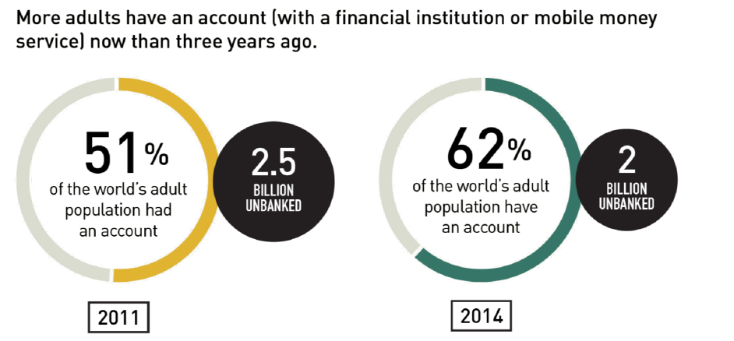
III. Digital Financial Services and Financial Inclusion
1.6 billion have a
mobile phone
Source: FINDEX 2014

Slide 4
VI. Stakeholder Alignment
Regulators
Mobile Money Service Providers
Consumers ?
SERVICE PROVIDERS (commercial viability):
High volume of low margin transactions
For MNOs: increasing average revenue per customer, reducing customer churn
For banks: expanding the customer base to low and middle income segments
REGULATORS :
Mitigating systemic risk
Protecting the consumer
Promoting financial inclusion
Successful Deployment

Slide 5
VII. Critical Success Factors
Interoperability
Technology impact on ecosystem
Regulatory Dialogue
Consumer Risks
Security Issues
User Friendliness

Slide 6
ITU Focus Group Digital Financial Services (FG DFS)
VIII. ITU FG DFS
Duration: 2 years
Open to all stakeholders
1st Meeting: Geneva, 5th December 2014.
    97 participants, 25 countries
2nd Meeting: Washington DC, 21st April 2015.
    78 participants, 23 countries
3rd Meeting: 30 Sept – 2 October 2015, Malaysia
4th Meeting:
  15-17 December, ITU, Geneva
  14 December: Workshop on Digital Financial Services and Financial Inclusion
www.itu.int/en/ITU-T/focusgroups/dfs/

Slide 7
Stakeholders
VIII. ITU FG DFS
International Organizations
Central Banks
Telecom Regulators
Mobile Money Operators
Payment Service Providers
DFS Platform Providers
Standards Development Bodies

Slide 8
























Stakeholders
VIII. ITU FG DFS
Better Than Cash
Alliance

Slide 9
VIII. ITU FG DFS
  GOAL: Recommend a standardization roadmap for interoperable digital financial services for financial inclusion.
  Objectives
  Identify the technology trends in digital financial services
  Describe the ecosystem for digital financial services.
  Identify successful use cases for implementation of secure digital financial services.
  Study the best practices related to policies, regulatory frameworks, consumer and fraud protection, business models and ecosystems for digital financial services.
  Suggest new work items for ITU-T Study Groups

Slide 10
Four Working Groups Have Been Established to Lead the Focus Group’s Efforts
VIII. ITU FG DFS
Main areas of work
Interoperability
Consumer Experience & Protection
Technology, Innovation & Competition
DFS Ecosystem

Slide 11
Working Group Tasks
DFS Ecosystem
  Obtain, review and leverage existing documents on global digital financial service specifications, standards, guidelines (including SG2 in TSAG-TD 158), etc. Some 65 documents related to DFS have been reviewed
  Describe definitions of terminology and taxonomy for digital financial services
  Describe the ecosystem for digital financial services in developed and developing countries and the respective roles and responsibilities of the stakeholders in the ecosystem
  Identify key elements of the ecosystem necessary for financial inclusion
  Establish liaisons and relationships with other working groups; determine need for future ITU-T actions
Interoperability
  develop a working definition of interoperability for digital financial services,
  undertake stocktaking of successful / unsuccessful initiatives for interoperability,
  develop a descriptive paper (which will include amongst others; a definition of interoperability, use cases, and discuss the layers and dimensions of interoperability identified by the working group) and
  develop a toolkit for interoperability.

Slide 12
Working Group Tasks
Technology, Innovation and Competition
  Six workstreams have been established
    Review of DFS Platforms
    Collect handset specifications in use in developing markets
    Collect handset types in use in developing markets
    Security for DFS
    Big data
    Competition Issues
Consumer Experience and Protection
  Develop guidelines for consumer protection for DFS
  Develop guidelines for quality of service in DFS.

Slide 13

THANK YOU
www.itu.int/en/ITU-T/focusgroups/dfs/.

