Slide 1

Bridging the Standardization Gap
ITU Regional Standardization Forum For Asia Pacific Region
Bangkok, Thailand, 25 August 2014
Ashish Narayan
ITU Regional Office for Asia and the Pacific

Slide 2
Presentation Overview
ICT – the integrating thread and current trends
Bridging the standardization gap – A development perspective

Slide 3
ICT – the integration thread and regulatory trend
ITU ASP RO
Notes:
3

Slide 4
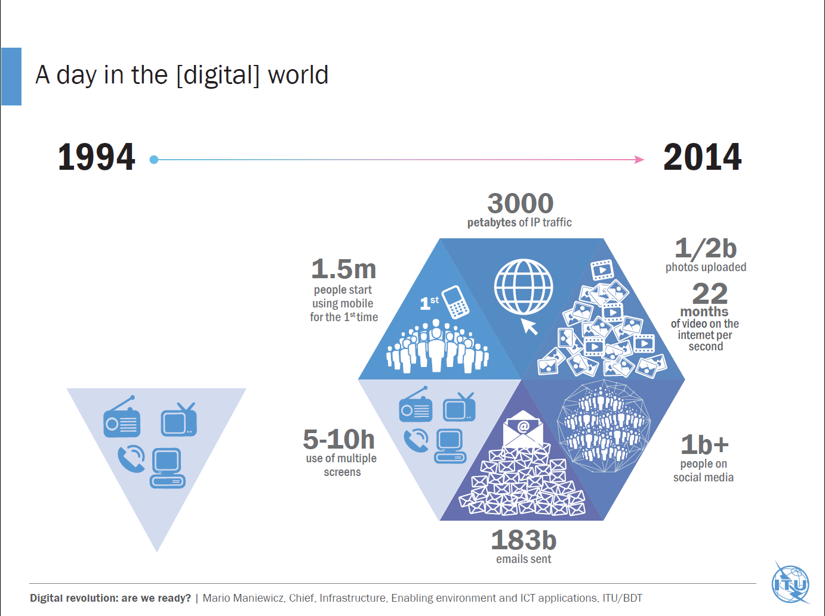
ITU ASP RO
Notes:
4

Slide 5
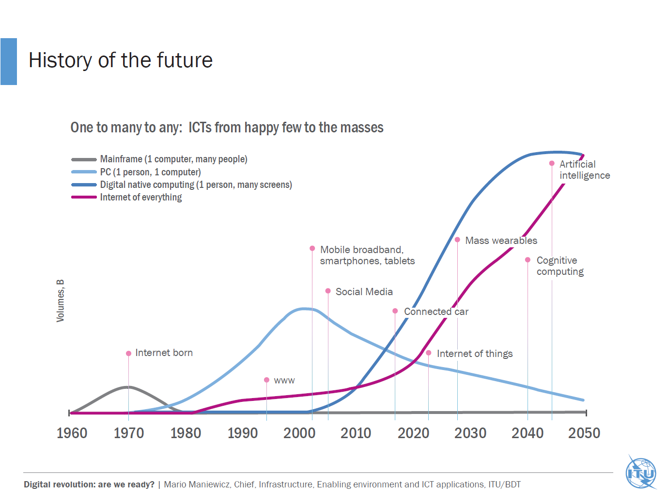
ITU ASP RO
Notes:
5

Slide 6
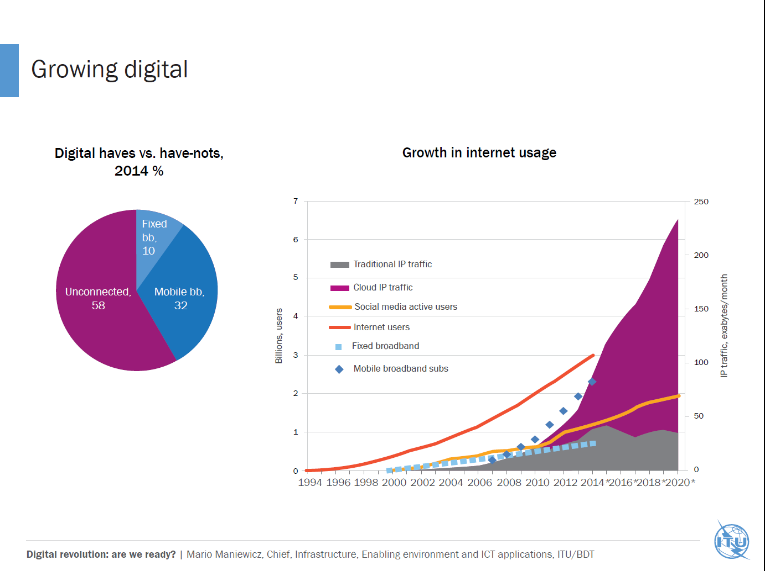
ITU ASP RO
Notes:
6

Slide 7
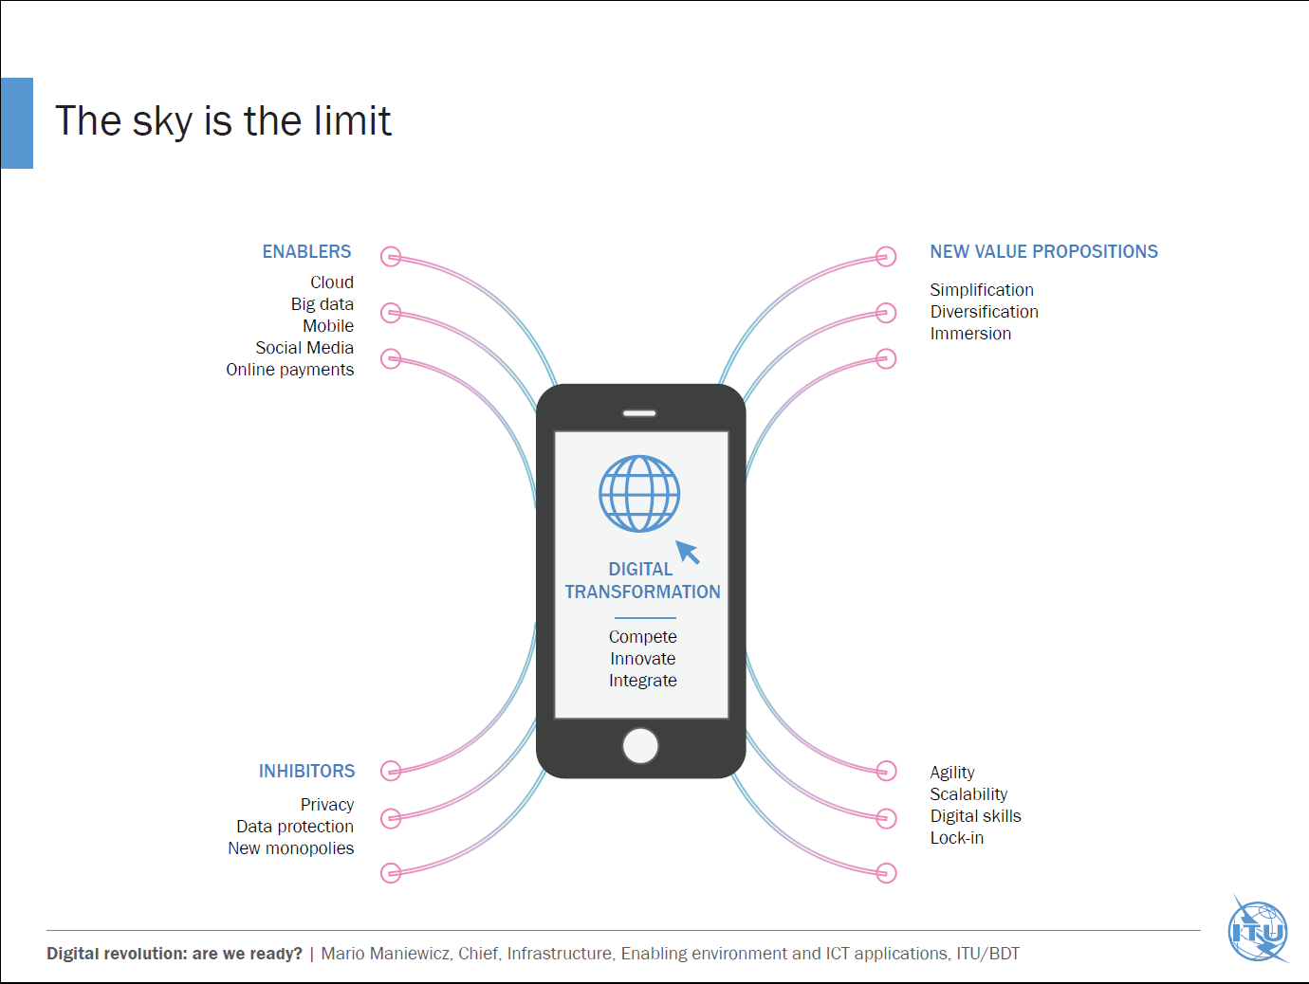
ITU ASP RO
Notes:
7

Slide 8
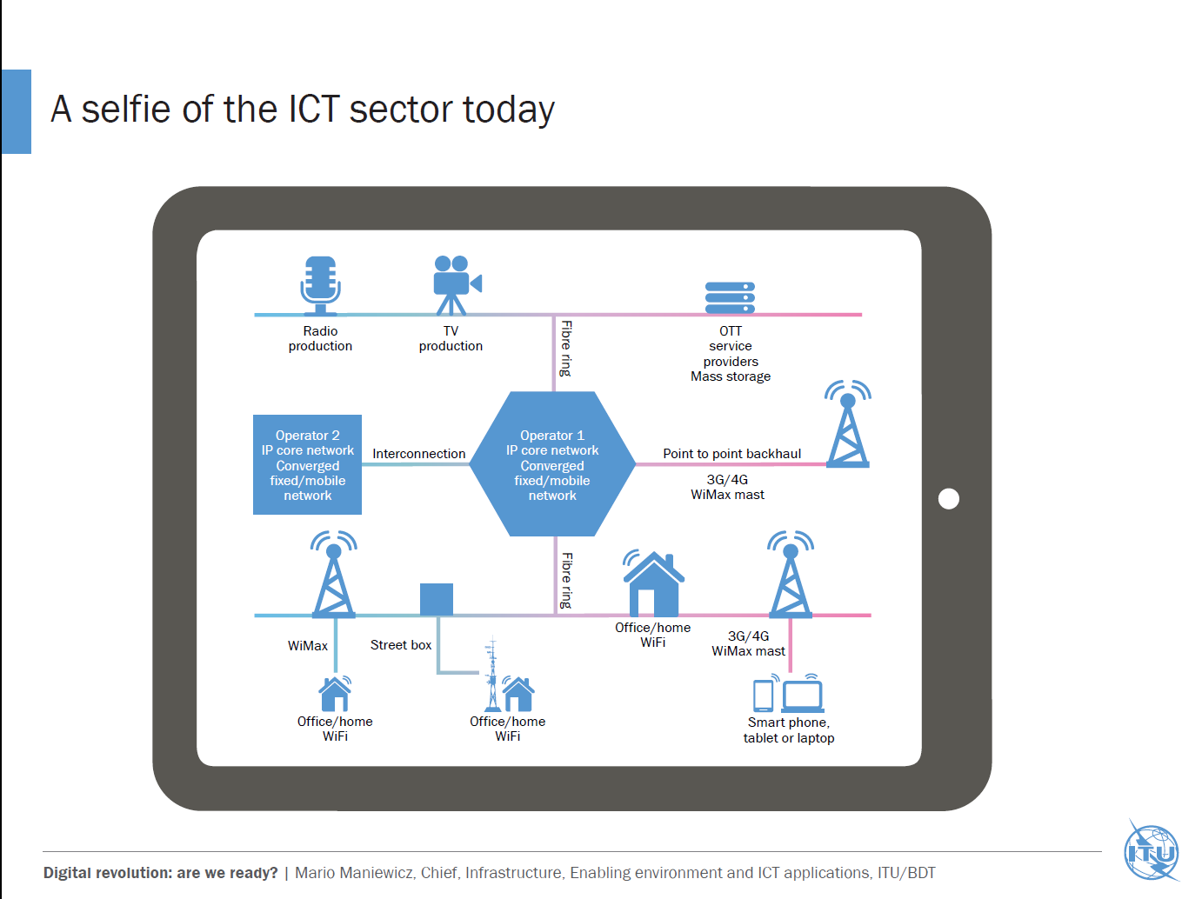
ITU ASP RO
Notes:
8

Slide 9
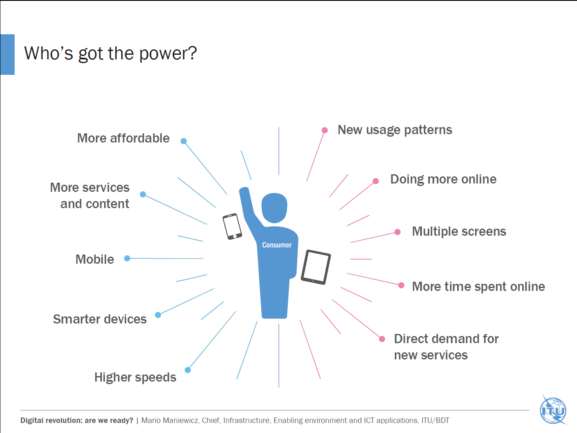
ITU ASP RO
Notes:
9

Slide 10
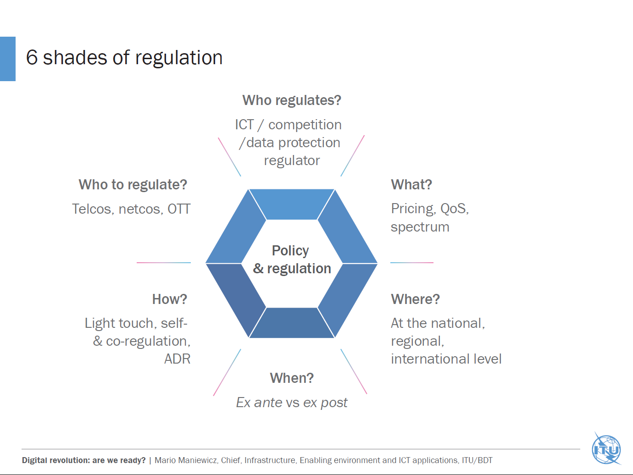
ITU ASP RO
Notes:
10

Slide 11






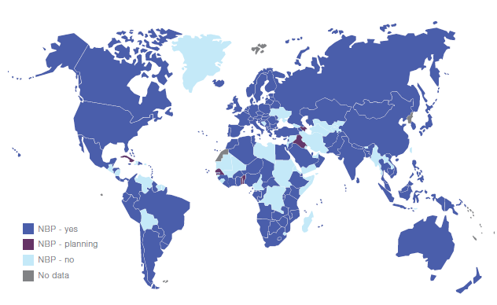


















IMPROVING
QUALITY OF LIFE..
Emergency
Education
Health
Agriculture
Investment
Governance
Applications
Policy & Regulation
Capacity Building
Transport
Sensor Networks
Universal Broadband
Green ICT & E-Waste
Measurements
Electricity
Privacy & Security
Infrastructure Security
SMART
SUSTAINABLE
CITIES
Water
Digital Inclusion
Spectrum Management
Standards, Conformity & Interoperability
Teleworking
C&I

Slide 12
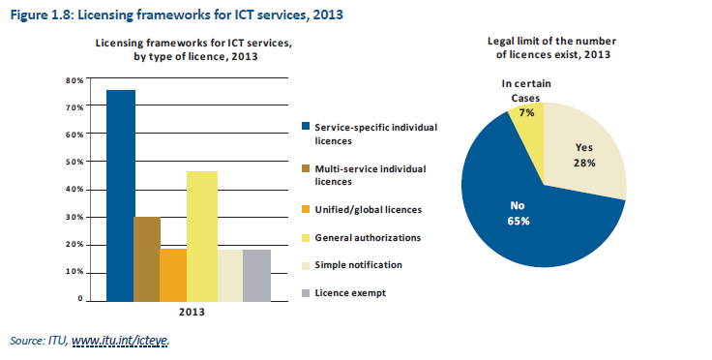
Licensing framework
Notes:
12

Slide 13
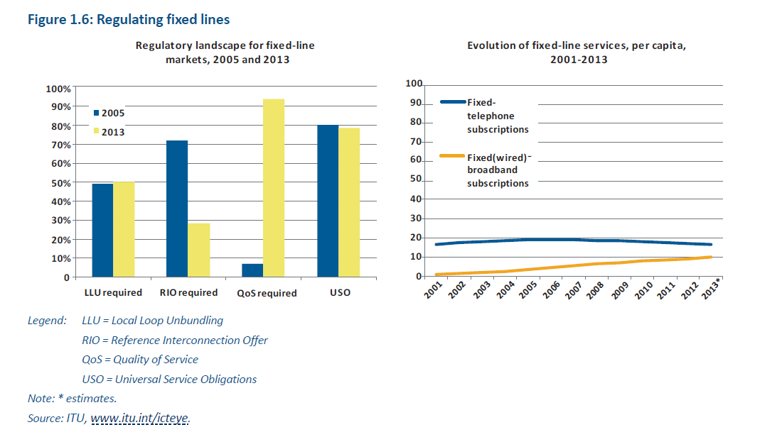
Regulating fixed line services

Slide 14
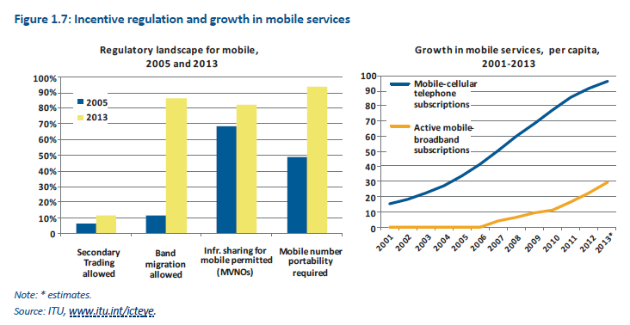
Regulating mobile services

Slide 15
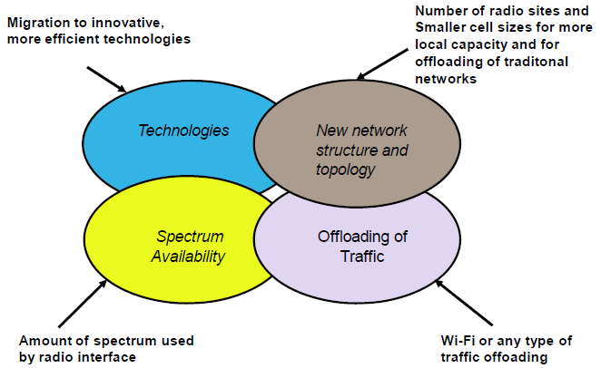
Options to manage mobile demand
Source: Report ITU-R M.2243 (00/2011)
Notes:
15

Slide 16

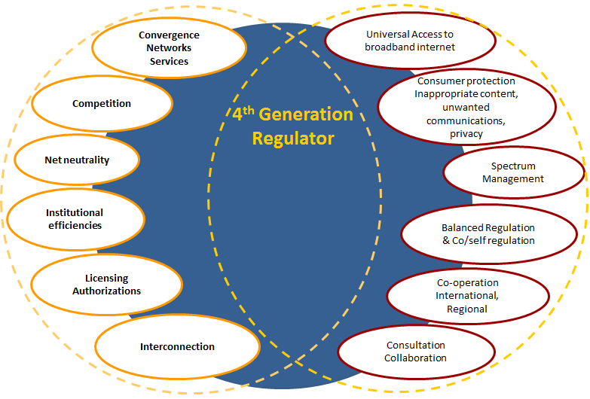

Regulation 4.0
Notes:
To address those challenges, a different approach to regulation is needed which is what we call the 4th generation of regulation. The range of new services offered over broadband networks are raising basic questions about who should be regulated and how.
4th-generation regulators differ from previous generations of regulators in the emphasis they place on the pursuit of government social and economic policy goals, as well as on the need for improved consumer protection and access to broadband networks. A unique feature of the Regulator 4.0 is his role of partner and leader, in addition to being a neutral referee in the market.
The fourth-generation regulation has to maximize the benefits of new technologies, applications and services, while minimizing the threats to consumers and economies.
The evolution of the fourth-generation regulator’s role can be viewed as a necessary response to the changing environment.
In a nutshell, 4th generation regulation can be characterized by two words: diversity and adaptability. It is about evolution, not radical change.
Note:
First generation of regulation
highly regulated monopolies
(state-owned or privately-owned ncumbents)
Second generation of regulation
Limited (managed) competition
Partial privatization (depending on the country)
Creation of separate regulator
Third generation regulation
Focus on protection of competition and consumers
Creation of converged ICT regulators, expanding mandate)

Slide 17
Regulation 4.0 - GSR 13 Best Practices
Gen 1
(Monopoly)
Gen 2
(Liberalization and Privatization)
Gen 3
(Managing competition)
Gen 4
(Socio-economic policy goals)
1 Innovative and smart regulatory approaches fostering equal treatment of market players without putting
extra burden on operators and service providers
2 The evolving role of the regulator:
the regulator as a partner for
development and social inclusion
3 The need to adapt the structure and institutional design of the regulator to develop future regulation
Notes:
To address those challenges, a different approach to regulation is needed which is what we call the 4th generation of regulation. The range of new services offered over broadband networks are raising basic questions about who should be regulated and how.
4th-generation regulators differ from previous generations of regulators in the emphasis they place on the pursuit of government social and economic policy goals, as well as on the need for improved consumer protection and access to broadband networks. A unique feature of the Regulator 4.0 is his role of partner and leader, in addition to being a neutral referee in the market.
The fourth-generation regulation has to maximize the benefits of new technologies, applications and services, while minimizing the threats to consumers and economies.
The evolution of the fourth-generation regulator’s role can be viewed as a necessary response to the changing environment.
In a nutshell, 4th generation regulation can be characterized by two words: diversity and adaptability. It is about evolution, not radical change.
Note:
First generation of regulation
highly regulated monopolies
(state-owned or privately-owned ncumbents)
Second generation of regulation
Limited (managed) competition
Partial privatization (depending on the country)
Creation of separate regulator
Third generation regulation
Focus on protection of competition and consumers
Creation of converged ICT regulators, expanding mandate)

Slide 18










Broadband, Millennium Development Goals, WSIS

Slide 19

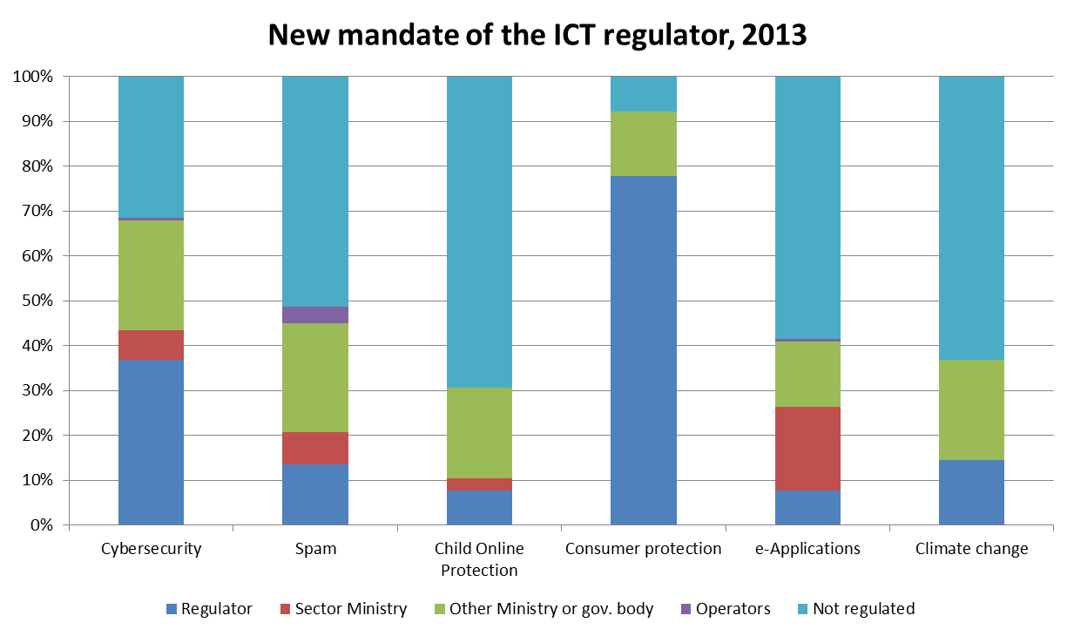
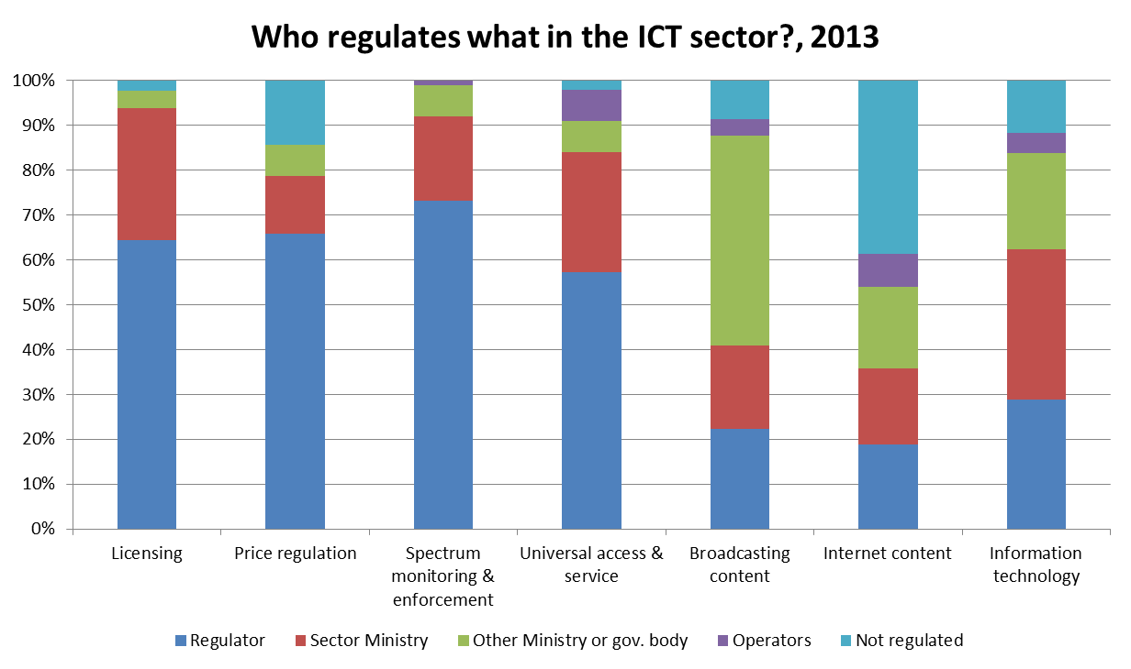






Policy & Regulation
Need for cross-sector collaboration
Sensor Networks
Universal Broadband
Green ICT & E-Waste
Infrastructure Security
Source: ITU Telecommunication/ICT Regulatory Database, www.itu.int/icteye
Spectrum Management
ICT SECTOR REGULATORY RESPONSIBILITY -
Who regulates what?
Standards, Conformity & Interoperability
C&I

Slide 20



NATIONAL REGULATORY ENTITY (Lead Agencies Examples)..
Emergency
Education
Health
National Disaster Management Authority, Military, Internal Affairs
Ministry of Education, Education Boards, Local Government
Electricity
Ministry of Health, Local Government
Ministry of Power, Regulator
Local Government
Governance
City, Municipal , provincial , Central Government Agencies
Transport
Universal Broadband
Sensor Networks
Local Government, Department of Transport
Competition
Authority
Ministry of ICT
Sector Regulators
Security Agencies
Standardization Bodies
Green ICT & E-Waste
Water
Infrastructure Security
Ministry of Finance, Banking Regulator
Teleworking
Spectrum Management
SMART
SUSTAINABLE
CITIES
Standards, Conformity & Interoperability
Finance & Payment
C&I

Slide 21



COLLABORATION MECHANISMS
Emergency
Education
Health
Electricity
Integrated Policy
Legislation
Governance
Co-Regulation
Standardization (International / National)
Transport, Trade, Logistics
MoU or Cooperation Agreement
Coordination Committee
Water
Projects, Coordination on Case to Case basis
Teleworking
SMART
SUSTAINABLE
CITIES
C&I
Infrastructure Security

Slide 22










SMART
SUSTAINABLE
CITIES
REGULATORY COLLABORATION
Security
Health
Telecom
Governance
Environment
Education
Transport and Logistics
Finance
Others
Water
Telecom
Others
Transport
Electricity
COLLABORATIVE
NETWORK OF
Regulators
Multi Utility
Regulator
C&I

Slide 23



Tanzania | MoU signed between Bank of Tanzania (BoT) and Tanzania Communication Regulatory Authority (TCRA).
India | Statutory guidelines for operationalizing M-Banking issued by the Reserve bank of India (RBI) for banks and Regulations by the Telecom Regulatory Authority of India (TRAI) on QoS, Tariffs for service providers.
Pakistan | MoU between Pakistan Telecommunication Authority (PTA) and State Bank of Pakistan (SBP)
Mobile Banking
Australia | Legislation separates powers between Australian Consumers and Competition Commission (ACCC) and Australian Communications and Media Authority (ACMA). Chairman of ACCC and ACMA are Associate Members in ACMA and ACCC respectively.
Mauritius | MoU Signed between Competition Commission (CCM) and ICT Authority (ICTA)
United Kingdom | Agreement on procedures between Office of Fair Trade (OFT) and Office of Communications (OFCOM).
Competition
Egypt | Green ICT Strategy implemented through a MoU between Ministry of Communications & IT (MCIT) and Ministry of Environmental Affairs (MEA)
Singapore | E2PO is a multi-agency committee led by the National Environment Agency (NEA) and the Energy Market Authority (EMA) and comprises the Economic Development Board (EDB), Land Transport Authority (LTA), Building and Construction Authority (BCA), Housing and Development Board (HDB), Infocomm Authority of Singapore (IDA), Agency for Science, technology and Research (A*STAR), Urban Redevelopment Authority (URA), Jurong Town Corporation (JTC) and National Research Foundation (NRF). The Ministry of the Environment and Water Resources (MEWR) and Ministry of Trade and Industry (MTI) are also represented in the committee.
Green ICT & E-Waste
ITU ASP RO
Notes:
23

Slide 24



Singapore | Joint project on Tele-health by Ministry of Health and Infocomm Development Authority (IDA)
United States | Joint Statement and MoU between Federal Communications Commission (FCC) and Food and Drug Administration (FDA) on broadband and wireless enabled medical devices
Health
UAE | Environment Agency - Abu Dhabi (EAD) and the Telecommunications Regulatory Authority (TRA) have signed a Memorandum of Understanding (MoU) to promote cooperation and partnership in the field of technology and information security,
Electricity
Egypt | Green ICT Strategy implemented through a MoU between Ministry of Communications & IT (MCIT) and Ministry of Environmental Affairs (MEA)
Singapore | Infocomm@SeaPort programme is a collaboration between the Infocomm Development Authority of Singapore (IDA) and the Maritime and Port Authority of Singapore (MPA). e-freight is a joint programme between IDA and Civil Aviation Authority of Singapore seeking to enhance competitiveness and increase productivity in the air cargo logistics sector through infocomm.
Transport, Trade, Logistics
UK Regulators’ Network (UKRN) is an initiative of the UK economic regulators: CAA, FCA, Ofcom Ofgem, ORR, Ofwat, UR. Monitor and the Water Industry Commission for Scotland (WICS) are also participating as observers
ITU ASP RO
Notes:
24

Slide 25
Bridging the standardization gap – A development perspective
ITU ASP RO
Notes:
25

Slide 26

Bridging Standardization Gap

Slide 27

Bridging the Standardization Gap: An Introduction
Participation in the ICT standard process gives to contributors the chance to provide inputs and better understand of the technologies and applications that will become the next market reality.
Good and liable standards help to improve the establishment of regional and national set of technical requirements and ultimately contributes to access safe and interoperable ICT equipment.
Standardization capabilities contributes to reduce the digital divide between the developed and developing worlds.
Increasing the knowledge and capacity of developing countries for the effective application/implementation of standards (Recommendations) developed in ITU-T and ITU-R is fundamental for bridging the standardization gap.
  The activities from ITU Regional Offices and Areas Offices is key. Tailored capacity building events and assistance to developing countries will increase inputs from developing countries into ICT standards.
Workshops
Publications
Trainings
Direct Assistances
Study Groups

Slide 28
PP-2010
PP 2010 – Resolutions on BSG
Resolutions 25 and 123 (Rev. Guadalajara, 2010) of the Plenipotentiary Conference, on strengthening the ITU regional presence and bridging the standardization gap between developing and developed countries;
Resolution 44 (Rev. Dubai, 2012): resolved to implement action plan aimed at bridging the standardization gap between developing and developed countries. Four programmes are considered:
  Strengthening standard-making capabilities;
  Assisting developing countries with respect to the application of standards;
  Human resources capacity building; and
  Fundraising for bridging the standardization gap.

Slide 29

WTDC-14
WTDC-14, Dubai, highlighted the relevance of regional activities and engagement on bridging the standardization gap between developing and developed countries.
The Dubai Declaration specifically asserts that “increased participation of developing countries in ITU activities to bridge the standardization gap is needed to ensure that they experience the economic benefits associated with technological development, and to better reflect the requirements and interests of developing countries in this area;”
Fostering “the development of telecommunication/ICT networks as well as relevant applications and services, including bridging the standardization gap” is the new ITU-D Objective 2;
Approval of the Recommendation ITU-D 22 , “Bridging the standardization gap in association with regional groups of the study groups.”
Programme: Telecommunication/ICT networks, including conformance and interoperability and bridging the standardization gap: The objective of BDT's work in this area is to assist Member States in the implementation of evolution to these future network architectures and technologies, in accordance with the applicable standards (Recommendations) developed in ITU-T and ITU-R, for bridging the standardization gap, making better use of and managing infrastructure and resources as well as addressing interconnection issues of emerging networks.
Resolution 47 on the enhancement of knowledge and effective application of ITU Recommendations in developing countries, was revised to stress of the usefulness of ITU guidelines on the application of ITU Recommendations;

Slide 30
WTDC-14: Regional Offices and BSG
Resolution 44
  i) be engaged in the activities of TSB in order to promote and coordinate standardization activities in their regions to support the implementation of the relevant parts of that resolution and to carry out the objectives of the action plan, and launch campaigns to attract new Sector Members, Associates and Academia from developing countries to join ITU-T;
  ii) assist the vice-chairmen, within the offices' budgets, in mobilizing members within their respective regions for increased standardization participation;
  iii) organize and coordinate the activities of the regional groups of ITU-T study groups;
  iv) provide the necessary assistance to the regional groups of ITU-T study groups;
  v) provide assistance to the regional telecommunication organizations for the setting-up and management of regional standardization bodies,
Rec. 22: Bridging the standardization gap in association with regional groups of the study groups
Recommends:
  that a functional structure for regional offices be implemented to support the activities of the regional groups;
  that there be a budget allocation to regional offices to support the activities of the regional groups and their leaderships;
  that the result of the activities of regional groups be sent for use, as appropriate, in the ITU-D.
Requests BDT Director:
to implement a functional structure for the regional offices to support the activities of the regional groups;
to facilitate and support chairmen and vice-chairmen of ITU-T study groups from developing countries in promoting standardization activities and mobilizing members in subregional groups through workshops, seminars and forums.

Slide 31
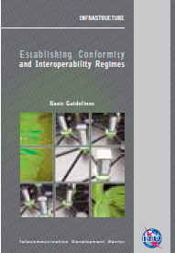
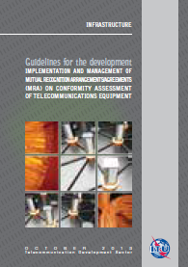
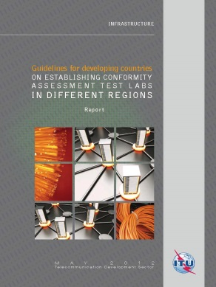
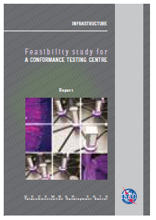
C&I Guidelines
Guidelines for the development, implementation and management of mutual recognition arrangements/agreements (MRAs) on conformity assessment
Establishing Conformity
and Interoperability Regimes – Basic Guidelines
Guidelines for developing countries on Establishing Conformity assessment Test Labs in Different Regions
Feasibility Study for the establishment of a Conformity Testing Centre
Need for lab based training in Asia-Pacific region

Slide 32
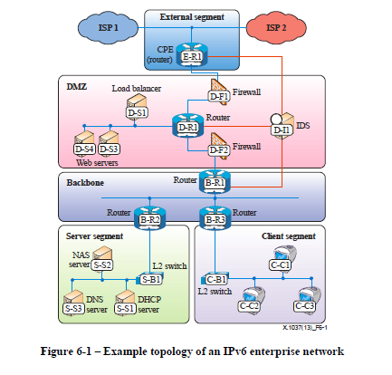
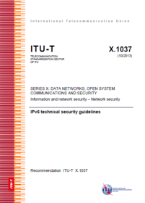
IPv6 Infrastructure Security (ITU-T X.1037)
Network Devices
(Router, Switch, NAT device)
Security devices such as firewalls and IDS Devices
(Intrusion Detection System, Firewall)
Clients, servers, and other end devices
(End Nodes, DHCP, DNS)
Workshops, Direct Country Assistances

Slide 33
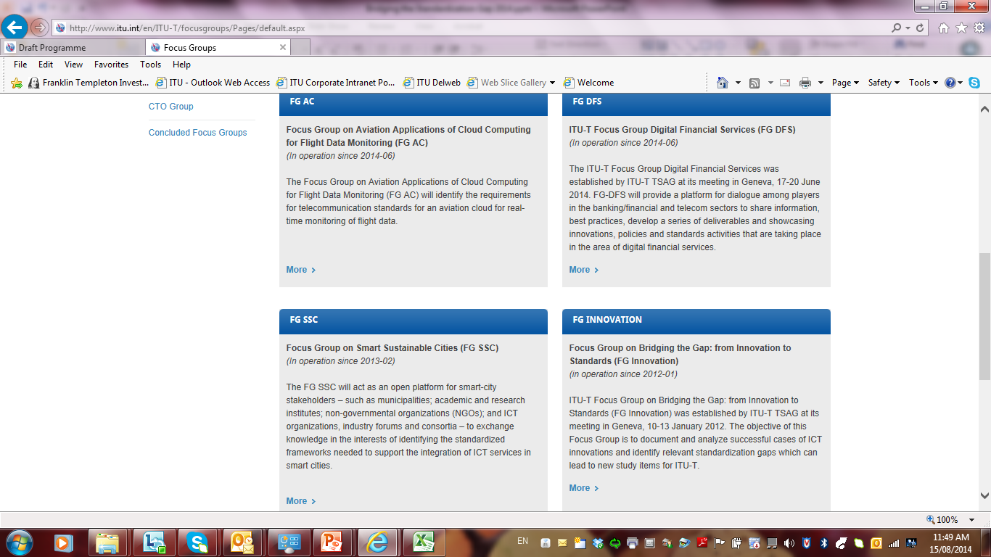
Focus group outcomes and regional activities

Slide 34
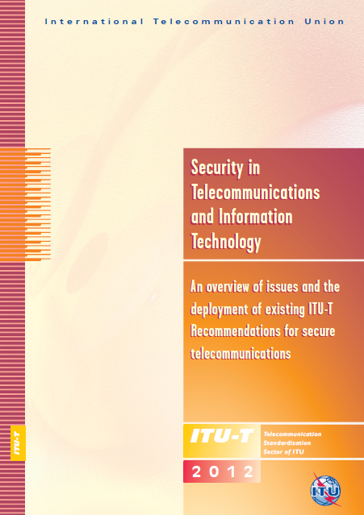
General security objectives for ICT networks
a) Access to, and use of networks and services should be restricted to authorized users;
b) Authorized users should be able to access and operate on assets they are authorized to access;
c) Networks should support confidentiality to the level prescribed in the network security policies;
d) All network entities should be held accountable for their own, but only their own, actions;
e) Networks should be protected against unsolicited access or operations;
f) Security-related information should be available via the network, but only to authorized users;
g) Plans should be in place to address how security incidents are to be handled;
h) Procedures should be in place to restore normal operation following detection of a security breach;
and
i) The network architecture should be able to support different security policies and security mechanisms of different strengths.

Slide 35
Some examples of activities in Asia-Pacific
Continued assistance on Type Approval in Mongolia (2013 & 2014)
ITU Regional Workshop on Bridging the Standardization Gap
28-29 November 2013, Myanmar
ITU Workshop on "Greening the Future: Bridging the Standardization Gap on Environmental Sustainability"
Colombo, Sri Lanka, 3-4 October 2013
Training on Broadband Quality of Service (Busan, 2012), IPv6 Infrastructure Security (2013)
ITU-T SG 3 RO / AO (2013)
Workshops, Direct Country Assistances

Slide 36

ITU Asia-Pacific activities 2014 and Standards (1)
Country assistances | Country(ies)
Type approval procedure for Radio and Telecommunication Terminal Equipment (R&TTE) | Sri Lanka
Enabling Efficiency in Energy Management through ICTs | Pakistan
E-Health Opportunities: Leveraging ICTs in Asia-Pacific | Bangladesh
Development of training material on new technologies | R.O. Korea
Forums, Workshops | Dates | Venues
Bridging the Standardization Gap | 25 Aug | Bangkok
Regional Economic and Financial Forum for Asia and Pacific Region and meeting of the Study Group 3 AO Group | Sep | Myanmar
4th ITU Green Standards Week | 22-26 Sep | China
Regional Training on Smart Sustainable Cities | 29 Sep – 2 Oct | Bangkok, Thailand

Slide 37
ITU Asia-Pacific activities 2014 (Planned and Implemented) and Standards II
Trainings | Dates | Venues | Centre(s)
Smart Technologies and Services in the LTE-Advanced Era | 13-16 May | R.O. Korea | PNU
IPv6 Infrastructure Security | 30 Jun – 4 Jul | Thailand | MICT Thailand
ITU ACMA International Training Program | 23-25 Jul | Sydney | Australia
ICT trends in providing interactive and pay television services | 9-10 Sep | Viet Nam | MIC/Viettel
Mobile cloud computing applications on developing value added services | 11-12 Sep | Viet Nam | MIC/Viettel
Cloud Forensics and Service Oriented Security (Data Center and Wireless Security) | 25-27 Nov | Thailand | IMPACT
Wireless security practices for policy makers and regulators | 31 Mar-25 April | ITU Academy Online | IMPACT
Quality of Service of Telecom Services from a regulators perspective | tbc | ITU Academy Online | PTA

Slide 38

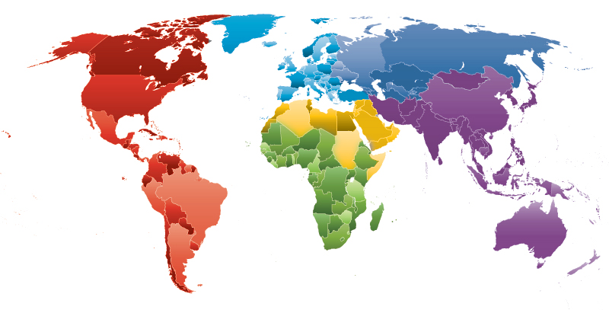
ITU Asia-Pacific Centres of Excellence
highly specialized training opportunities at low or no fees……..
Spectrum Management
(Ministry of ICT, Iran)
Policy & Regulation
Pakistan Telecommunication
Authority
Technology Awareness
Pusan National University
Rep. of Korea
Business Management
Ministry of ICT, Thailand
Broadcasting
Asia Pacific Institute
for Broadcasting
Development
Rural ICT Development
Universiti Utara Malaysia
ICT APPLICATIONS
Vietnam
CYBERSECURITY
IMPACT
New CoE Strategy from 2015
Visit http://academy.itu.int
Multi-stakeholder & Smart Partnerships !
Notes:
38
38

Slide 39
Summary
Enhanced application of standards in the expected outcome of policy makers, regulators and industry;
Enhanced inputs from the stakeholders in the standardization activities
Need for increased activities enabling countries to quickly and effectively deploy standards and raise their future needs

Slide 40
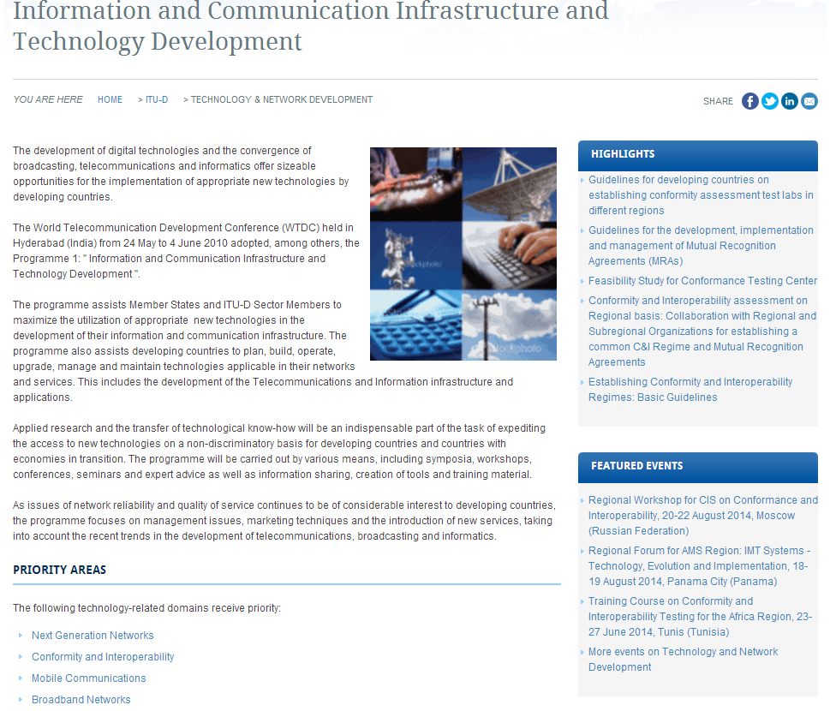
More information on BSG
additional information can be found at the ITU-D’s ICT and Technology Development website.

Slide 41

ITU : http://www.itu.int
ITU Asia Pacific : http://www.itu.int/ITU-D/asp/CMS/index.asp
Notes:
41

