Slide 1
Standardization Activities in Brunei Darussalam
ITU Regional Standardization Forum For Asia Pacific Region
(Bangkok, Thailand, 25 August 2014)
Nizam Othman
Senior Manager, AITI
nizam.othman@aiti.gov.bn

Slide 2
Contents
Brunei Darussalam in brief
Telecommunications trends
Standardization activities
Interest from Stakeholders

Slide 3

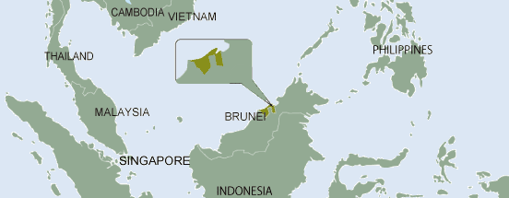
Brunei Darussalam
Brunei Darussalam is a small country with population of 414,400
Brunei has a total land area of 5,765 km²
High quality of life with estimated US$31,000 per capita income
Hydrocarbon resources account for over 90% of its export and more than 50% of Gross Domestic Product.
Source: BEDB
Notes:
2nd highest per capita income in ASEAN (Global Competitiveness Report 2009-2010)
2nd highest quality of life in ASEAN (Human Development Report 2009)
One of the highest literacy rates in the world – 94.9% (Human Development Report 2009)

Slide 4
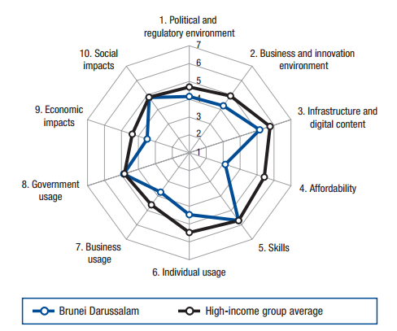
Telecoms & ICT trend
Strong telecoms growth especially in mobile and broadband sector
3 major telcos which serve FTTH broadband and LTE mobile service
Telecoms consumer devices importation per population is approx. 80%
Ranked 45 out of 148 in the Networked Readiness Index 2014
121%
Source: AITI & WEF
Notes:
63% percent is mobile phone

Slide 5
Standardization Activities
Technical requirement for equipment such as line terminal and radio-communication devices
Prepare /adopt
National Standard Centre
Technical Regulation
Regulatory Authority
Certification & Permit
Enforce
Conformity of standard done through type approval

Slide 6
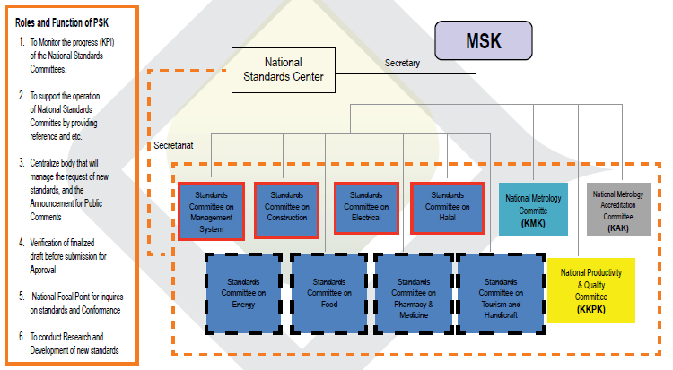
National Standard Centre

Slide 7
Standardization Activities –
Type of Standard
Mandatory
  Technical Regulation/Specification develop by AITI
  Covers critical elements such as frequencies, power and safety requirement.
Voluntary
  No domestic standard
  Industry can refer to international standards

Slide 8
Standardization Activities
Development of Technical Regulation
AITI
Neighboring countries
SDOs such as ITU, ETSI
No involvement from stakeholders
No testing and certification facility
No telecoms standardization body
Notes:
No involvement from industries and academia

Slide 9
Standardization Activities
Standard
Conformance
Level 1
Low risk equipment
Level 2
Medium risk
Amateur radio, marine radio etc
Level 3
High risk
Basestation, high power radio etc
SRDs, PTSN etc
Equipment Registration
- Self declaration
Mandatory
Type Approval
- Check for frequency and power specification. No test report required
Type Approval
- Required test report
Voluntary
No regulatory requirement for conformance

Slide 10
Need for Standard to address current and future issues
Current issues
Environment and climate change
Quality of Service
Broadband
Future
Smart City

Slide 11

Stakeholders Interest in
Standardization
Industry x
Low no. of industry
Not in the innovation business
How to stimulate interest on Standard?
Regulator √
Safeguard public
Interoperability
Academia x
Minimal capacity
How to encourage stakeholders participation?
Telcos √ and x
Ensure QoS
However lack of involvement and knowledge in Standard

Slide 12
Stakeholders Interest in
Standardization (2)
Observation
  Standard considered as “good to have” – not a priority
  Very minimal standard experts
  No demand from the industry
    Local industries import system/solution rather than to develop
  Not actively involve with international SDOs

Slide 13
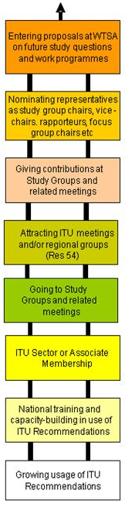
Regulator
Consumer
Industry

Slide 14
Thank You.

