Slide 1
Smart Water Management
Regional Challenges and Future Prospects
Dr. Ramy A. Fathy, PhD
Chairman, ITU-T Focus Group on Smart Water Management (FG SWM) rahmed@tra.gov.eg ramy.ahmed@ieee.org
June 2014, Kampala, Uganda
ITU-T Focus Group on Smart Water Management

Slide 2
Outline
Water and Economic Development
Key Global Water Challenges
Water Utilities Stakeholders Challenges
Integrated Smart Water Resource Management
Roadmap of Smart Water Management Implementation

Slide 3
Outline
Water and Economic Development
Key Global Water Challenges
Water Utilities Stakeholders Challenges
Integrated Smart Water Resource Management
Roadmap of Smart Water Management Implementation

Slide 4
Water is vital for life, development, and the sustainability of the environment!
Water is a precious natural resource, vital for life, development and the environment. It can be a matter of life and death, depending on how it occurs and how it is managed.
Abundance is a problem. Scarcity is a problem. A perfect balance that meets the society water demands, without exceeding the unmanageable threshold of water supplies is crucial for the effective management of the resources.
Water can be an instrument for economic survival and growth. The vice versa is also true !
“Inadequate water quantities or bad quality water can be a limiting factor in poverty alleviation and economic recovery, resulting in poor health and low productivity, food insecurity and constrained economic development.” (Niyi Gbadegesin and Felix Olorunfemi, 2007)

Slide 5
Water Availability and Economic Development: A Self Reinforcing Loop !
Low access to adequate water and sanitation
High rate of communicable diseases
Reduction in vitality & economic productivity
Poverty
Notes:
The higher the poverty rates in a certain society, the lower the access to adequate water and sanitation services..

Slide 6
Outline
Water and Economic Development
Key Global Water Challenges
Water Utilities Stakeholders Challenges
Integrated Smart Water Resource Management
Roadmap of Smart Water Management Implementation

Slide 7
Outline
Water and Economic Development
Key Global Water Challenges
Water Utilities Stakeholders Challenges
Integrated Smart Water Resource Management
Roadmap of Smart Water Management Implementation

Slide 8
The global water consumption exceeds the global population growth and distribution network inefficiencies are aggravating the problem.
Predictions indicate increase in the world population, concentrating especially in urban areas and cities in the next twenty years → Significant increases in the demand for potable water and waste water generation.
Currently, water consumption doubles every twenty years, more than double the rate of human population growth.
Increased demand versus obsolete distribution networks.
The influence of climate change which aggravates weather phenomena, affecting especially big cities. Flexible systems will be needed to adapt to these circumstances and provide resource management at critical times.

Slide 9
One-fifth of the world's population lives under conditions of water scarcity

Slide 10
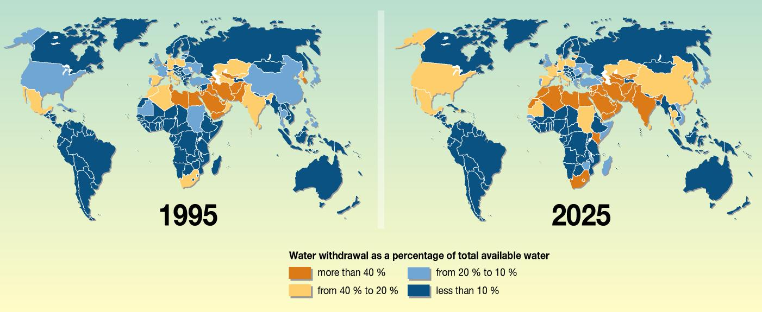
More than 2.8 billion people from 48 countries will face water scarcity problems by 2025

Slide 11
Physical versus economic scarcity
Physical Water Scarcity
A condition where there is not enough water to meet demand.
Mainly induced due to the lack of investment in water resource construction and management to meet the required water demand.
Economic Water Scarcity
No enough monetary means to obtain adequate and clean water.
Most arid regions often suffer from the lack of physical access to water resources.

Slide 12
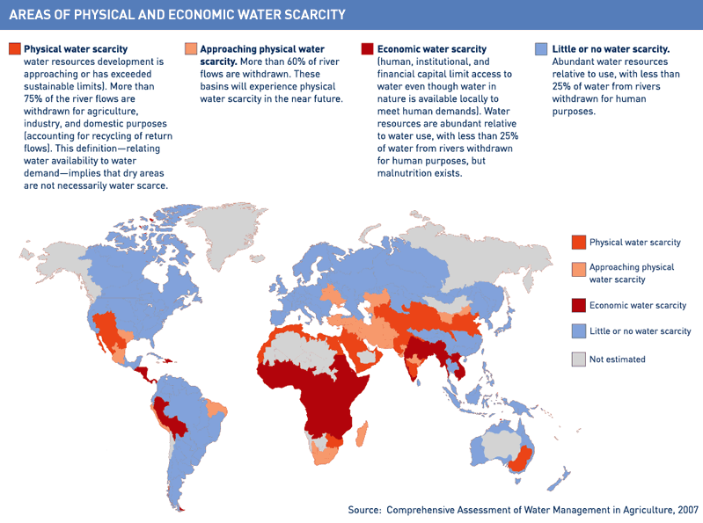
Nearly every region in the world suffers from areas with physical and/or economic water scarcity, with varying degrees.

Slide 13
Nearly every region in the world suffers from areas with physical and/or economic water scarcity, with varying degrees.
Approximately 700 million people in 43 countries suffer from water scarcity today.
In 2025, 1.8 billion people will be living in countries with absolute water scarcity, and 67% of the global population could be living under water stressed situations.
Under the existing climate change condition, almost 50% the global population will be living in areas of high water stress by 2030, with 75 to 250 million people in Africa.
In some arid and semi-arid places between 24 and 700 million people will be displaced from their places.
Sub Saharan Africa has the largest number of water stressed countries of any region (UNDESA, 2013).

Slide 14
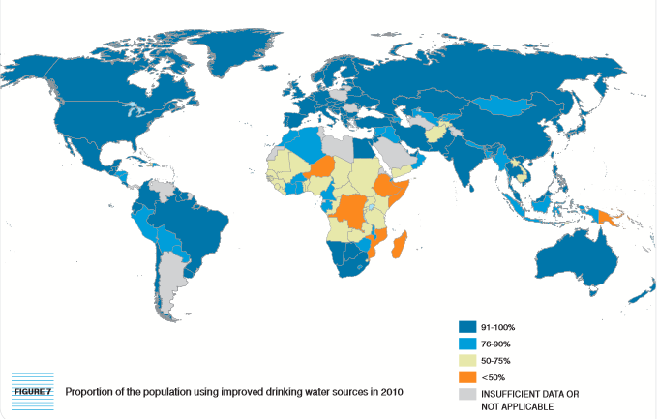
Water scarcity and access to basic water services is a global problem.
Almost 89% (6.1 billion people) of the total global population have access to an improved water source in 2010. However, more than 780 million people, or one-tenth of the global population still relied on unimproved drinking water sources.

Slide 15
Impact of climate change on water availability is crucial.
The hydrological cycle is a continuous movement of water through precipitation and evaporation and all of the processes in between above and below the surface of the Earth. The increase in temperatures impact water cycle dramatically.
The increase in temperature causes people, animals, and plants to consume more water in order to safeguard their lives. Moreover, many social and economic development activities, such as producing energy at power plants, raising livestock, and growing food crops also require more water.
Amount of fresh water available for all of these activities may reduce as the Earth warms and as competition for water resources increases (USGCRP, 2009).

Slide 16
The real future concern of the change in the rainfall pattern is the decrease of run-off water, which may affect large agricultural areas.
People, animals, & plants consume more water
Increase in Temp
Rate of Evapotrans
Atmosphere capacity of holding water
Excess precipitation
Rain (rather than snow)
Snow melting earlier in a year
Scarcity and less availability of water
Changes in water flow of rivers

Slide 17
climate change is expected to seriously affect the available water resource for arable regions in the next 40 years (e.g., Europe, United States, parts of Brazil, South Africa).

Slide 18
Outline
Water and Economic Development
Key Global Water Challenges
Water Utilities Stakeholders Challenges
Integrated Smart Water Resource Management
Roadmap of Smart Water Management Implementation

Slide 19
Outline
Water and Economic Development
Key Global Water Challenges
Water Utilities Stakeholders Challenges
Integrated Smart Water Resource Management
Roadmap of Smart Water Management Implementation

Slide 20
The challenges of the water utilities stakeholders are multifaceted and complex and requires innovative cost effective solutions to address them.
Institutional Constraints
Aging Infrastructure
ICT Gap
Lack of Investment (15-20 Yrs. Return)
Public Service
Data Unavailability
Lack of QoS

Slide 21
Outline
Water and Economic Development
Key Global Water Challenges
Water Utilities Stakeholders Challenges
Integrated Smart Water Resource Management
Roadmap of Smart Water Management Implementation

Slide 22
Outline
Water and Economic Development
Key Global Water Challenges
Water Utilities Stakeholders Challenges
Integrated Smart Water Resource Management
Roadmap of Smart Water Management Implementation

Slide 23
Integrated Water Resource Management + Smart ICT Technologies → Integrated Smart Water Resource Management (ISWM)
IWRM is a process that promotes the coordinated development and management of water, land and related resources in order to maximize economic and social welfare in an equitable manner without compromising the sustainability of vital ecosystems. (Technical Committee of the Global Water Partnership)
Focus on the knowledge and participation of all stakeholders and sectors involved
We propose a slightly alternative definition that is foreseen to impact the targeted ISWM architecture.
ISWM is a process that uses information and communication technologies and/or other means to realize the coordinated effective and efficient; management, development, and conservation of the water ecosystem in order to improve ecological and economic welfare in an equitable manner without compromising the sustainability of dependent ecosystems and stakeholders.

Slide 24
ISWM Main Architectural Components
Stakeholder Integrated Information System
Stakeholder Dimension
Modeling and Prediction
Decision Support Systems
ICT Infrastructure and Control
Infrastructure Dimension

Slide 25
ISWM Services and Sub-Systems
Stakeholder Integrated Information Systems: The water ecosystem including utilities, municipalities, users have different uses and levels of water related information. Information systems centered on collaboration, and integration with well designed information security policies aids in minimizing costs, and maximizing efficiency in water use and environmental friendliness, both for industrial and domestic users.
Automatic Meter Infrastructures (AMI), which allow automated and secured readings and improved communications between users and the central management, is one key enabling technology.
Decision Support Systems (DSS): Are a fundamental aspect of modern ISWM which provides informed key decisions to water managers in critical situations. The DSS compiles data from Pollution and Water Quality Control, AMI, Weather Forecasting Systems, Modeling and Water Channel Behaviors, and much more to provide an intelligent cost effective decisions. Usually the geographical aspect is implemented by means of a Geographical Information System (GIS).
Infrastructure Elements: Including the necessary module specific ICT for SWM, communications and information infrastructure.

Slide 26
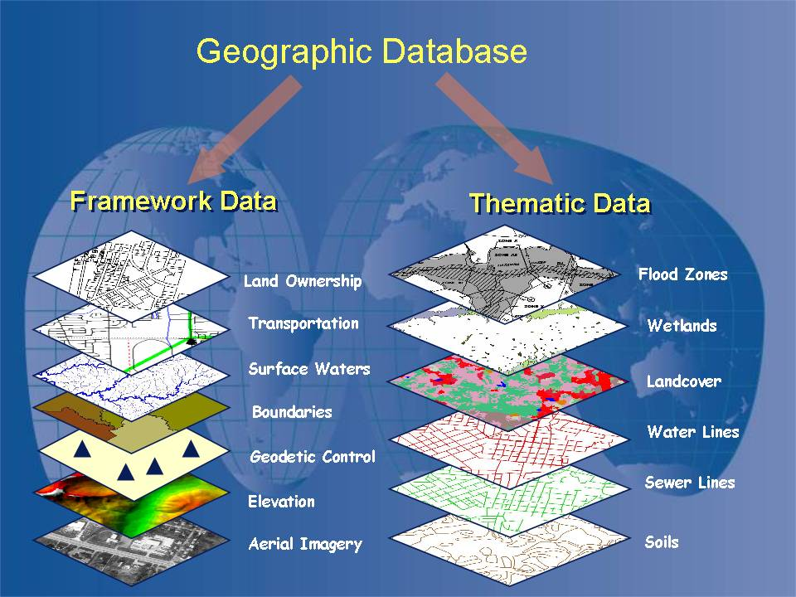
Information Infrastructure
In the water sector, information system and knowledge management are recognized as important attributes for efficient and effective water works.
GIS: technology that integrates hardware, software, and data required to capture, manage, analyse, and display all forms of geographically referenced information. GIS allows the user to view, visualize, question, interpret, and understand data in different circumstances that clarify patterns, trends, and relationships in the form of reports, maps, and charts.
Source: http://www.onslowcountync.gov/assets/18981.jpg?langType=1033

Slide 27
Communication Infrastructure
Traditional water management systems mainly depends on protocols, industrial control systems, and adopted registered structures.
Difficult to follow emerging communication trends very quickly.
Opportunity to adopt an existing infrastructure into a more flexible IP-based monitoring system: alarm gathering, leakage detection and prevention, demand prediction, energy reduction, water quality monitoring, and billing activities.
SCADA systems, advantageous for being highly distributed, are applied to control geographically distributed resources where centralized data acquisition and control are important to the system operation.
It is the most common method currently applied in distribution systems, like water distribution and wastewater collection systems.
The system control unit performs centralized monitoring, and control long distance communication network; including monitoring the status of data processing and alarms.
The method can work using the combination of radio and direct-wired connection systems.
The General Packet Radio Services (GPRS) and Global System for Mobile communication (GSM) are the common wireless technologies applied to cellular networks to be used as water metering infrastructure. → Widely available, widely supported by many telecom operators and vendors, and low bandwidth requirement.

Slide 28
Modeling, Prediction and DSS
Hydrological models and DSS help water resource professionals, companies, and universities, local, regional, and governmental authorities, meteorological agencies, and other water sectors to effectively:
  manage,
  predict, and
  make proper decisions on the available water resource.
Hydraulic model based simulation and optimization of water distribution network (WDN) was a trend of research during the last decades.
Real-time processing of data from environmental instrumentation (whether they are in situ and from remote sensing)
DSS helps solving decision-making problems in the management of water distribution network.
Computer simulation based or indigenous knowledge based
Heuristics and AI

Slide 29
Smart Metering
Meters and sensors are currently being intensively applied to regulate different activities of water distribution systems such as hydraulic pressure and flow, water quality, head losses, and water and energy consumptions.
Convey prompt, reliable, and information-secured water metered information to avoid any potential damages, foresee expected disasters, detect leakages and provide accountability.
Real-time decision making at the measurement and monitoring location.
Improved data quality and overall consistency.
Remote configuration capability.
Meters & Sensors
Flow
Pressure
Quality
SCADA
Consumption
Leak Detction

Slide 30
Water Supply and Irrigation Design and Management
Adopted since the early fifties.
Modern and advanced water supply plants in the developed countries are currently fully automatized.
Different ICT tools are used to
  synchronize water supply with demand,
  regulate pump operations to save energy,
  manage the withdrawal of water from different sources and reservoirs, and
  control the purification processes in sewage recovery structures.
ICT tools in agricultural development activities helps to improve the network and hydraulic design of irrigation systems.
Possible elementary software applications include water head losses calculation during flowing water in pipes.
Advanced software applications simulate the water flow in a complicated loop of water networks and facilitate optimization of pressure flow in irrigation systems.
ICT tools help to facilitate computerized irrigation water budgeting system based on soil type and its water retention capacity, climatic condition, crop water requirements, soil moisture, and the plant water potential measurements.

Slide 31
Pollution Control
Increasing worldwide contamination of water sources with thousands of industrial and natural chemical compounds is one of the key environmental problems facing humanity.
Approximately 3 billion people do not have access to safe drinking water, which is linked to over 35% of all deaths in developing countries.
Water quality assessments are based on the analysis of the physical, chemical and bacteriological parameters and require customized apparatus and trained staff.
Environmental water monitoring includes measurements of physical characteristics (e.g. pH, temperature, conductivity), chemical parameters (e.g. oxygen, alkalinity, nitrogen and phosphorus compounds), and abundance of certain biological taxa.
Assays of biological activity could be included such as alkaline phosphatase, tests for toxins and direct measurements of pollutants such as heavy metals or hydrocarbons.
Up to 70,000 known and emerging chemicals that might be present in various water resources, including for drinking water production.
860 active compounds are currently formulated in pesticide products.

Slide 32
Pollution Control
Traditional Methods
Real Time Monitoring Methods
Lab based methods that require an effective management process
Mass Spectrometry
Amperometric Sensors
Bio-sensors
EM Sensors
Standard UV-Vis Measurements
Lab-on-chip
Using automated and situ methods
…
…

Slide 33
Monitoring and Early Disaster Warning Systems
Continuous rains, and short bursts of heavy rain, cause breaches of water courses and flooding of crossings
Early warning systems involve four elements, which need to be supported by governance, coordination mechanisms from national to local levels, and by appropriate infrastructure. These four elements are:
(1) Behavior Prediction and Modeling: Modeling the expected behavior of the water system with multiple degrees of freedom can provide case scenarios for possible disasters and expected impact.
(2) Risk Assessment: Risk assessment provides an estimate of the probability of occurrence of an incident along with its expected impact. Priorities can be set to addressed highest probable events with maximum potential negative impact.
(3) Warning Service: Constant monitoring of possible disaster precursors is necessary to generate prompt and reliable warnings on time. Integration of multiple data sources for consistency and fast data fusion is key to undertake a decision.
(4) Communication and Dissemination: Clear warnings must reach relevant stakeholders in a fast and reliable way suitable to the incident at hand. Coordinated cross agencies communication and dissemination systems are key.

Slide 34
Outline
Water and Economic Development
Key Global Water Challenges
Water Utilities Stakeholders Challenges
Integrated Smart Water Resource Management
Roadmap of Smart Water Management Implementation

Slide 35
Outline
Water and Economic Development
Key Global Water Challenges
Water Utilities Stakeholders Challenges
Integrated Smart Water Resource Management
Roadmap of Smart Water Management Implementation

Slide 36
Roadmap to ISWM
How can governments and water authorities implement an ISWM?
Develop and understanding to answer the following questions:
How is decision taken in water management issues? By what procedures?
How can the following aspects be insured?
  Fairness
  Transparency
  Effectiveness
  Mutual Value
  Public Engagement
  Environmental Sustainability
What are the current available infrastructure and what are the currents limitations?
The high-level Roadmap is as a four stage procedure:
(1) The first is the developing a collaboration governance and decision-making framework. At this stage, the objectives of the ISWM and the KPI of performance are developed and agreed by the water management stakeholders.
(2) The second stage in the development of the Information Infrastructure. (e.g. Databases, Maps, Knowledgebase…) At this stage the question of how much resources are available and who needs it is answered.

Slide 37
Roadmap to SWM
(3) The third stage is the development of the necessary communication and sector specific infrastructure after conducting the necessary cost-benefit analysis and value proposition. Case studies and means to satisfy the agreed KPI should be envisioned in the process. This stage takes into consideration all aspects priorities, and budgetary and other constraints.
(4) The next stage is the implementation and monitoring stage, where institutional and capacity building, environmental sustainability are embedded in this stage. Assessment of the socio-economic and ecological impacts of the implemented system should be applied and evaluated for further process feedback.

Slide 38
References
Focus Group on Smart Water Management (FG SWM): http://www.itu.int/en/ITU-T/focusgroups/swm/Pages/default.aspx
Draft deliverable on “The Role of ICT in Water Resource Management”, Ramy A Fathy, and Solomon Hailu, SWM-o-0007.
Niyi Gbadegesin and Felix Olorunfemi, “Assessment of Rural Water Supply Management in Selected Rural Areas of Oyo State, Nigeria, ATPS Working Paper Series No. 49, 2007.

Slide 39
Thank You

