Slide 1

ITU Activities on Bridging the Standardization Gap (BSG)
ITU Regional Standardization Forum for Africa
(Kampala, Uganda, 23-25 June 2014)
Vijay Mauree,
Programme Coordinator
ITU
Vijay.mauree@itu.int

Slide 2
Focus Group Smart Water Management
Established during TSAG meeting in June 2013
Parent Group : ITU-T SG 5
Web site: http://www.itu.int/en/ITU-T/focusgroups/swm/
Chairman : Dr Ramy Ahmed, NTRA, Egypt
2 meetings to date, 3rd meeting on 27 June, Uganda

Slide 3

Main Issues
Source : Partnering for Solutions: ICTs in Smart Water Management

Slide 4
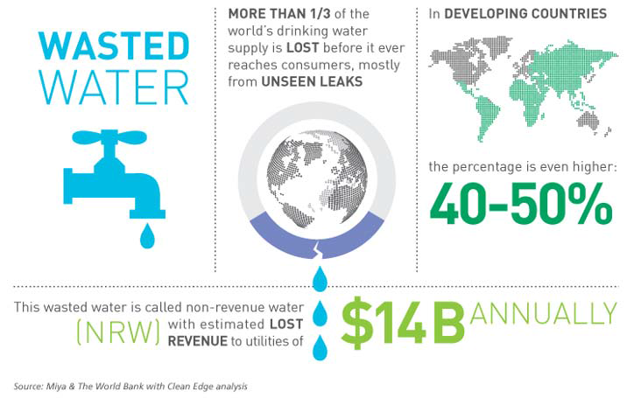
Main Issues
Source : Partnering for Solutions: ICTs in Smart Water Management

Slide 5
Main Issues
Lack of information about methodologies on measuring water demand and supply for domestic and economic sectors;
Inconsistency on the amount of water that could be saved from use of ICTs. Therefore, a common methodology for assessing the impact of ICTs on water consumption in agriculture and production of goods is necessary.
Improve the overall water use efficiency to minimize the losses in the system and distribute the available water for agriculture in an equitable way;
Need for common data format for data collected from various sources (e.g. rivers, utility networks, weather, etc.)

Slide 6
Tasks
Collect and document information on national, regional and international smart water management initiatives; reporting on current activities and technical specifications.
Specify the roles to be played by ICTs in smart water management.
Develop a list mapping key stakeholders involved in the area of ICTs and smart water management.
Develop Key Performance Indicators (KPIs) to assess the impact achieved through the use of ICTs in water-management systems.

Slide 7
Tasks
Develop a set of methodologies for estimating the impact of ICTs on water conservation.
Identify water-management ICT applications and services with the potential to ensure interoperability and the benefits of economies of scale.
Draft technical reports that address standardization gaps and identify new standardization work items to be taken up by its parent group, ITU-T Study Group 5 (Environment and climate change).

Slide 8
Structure
FG SWM
WG 2
WG 3
WG 1
Role of ICTs in Smart Water Management
Standardization gaps, KPIs, metrics and efficient ICT and Smart Water Management
Communications, liaisons and members' engagement

Slide 9
WG 1: 3 Deliverables
Status report on SWM initiatives
Technical Report on the Use Cases and the Role of ICTs in Smart Water Management
Technical Report on Building Smart Water Eco-Systems

Slide 10
WG 2: 8 Deliverables
Technical report on Standardization Activities and Gaps for SWM
Technical report on architectural framework and solutions for efficient SWM.
Technical Report on the KPI to assess the impact of the use of ICT in SWM.
Technical report on the methodologies to assess the impact of ICTs on improving water management
Technical Report on the requirements for water sensing and early warning systems

Slide 11
WG 2: 8 Deliverables
Technical report on the prediction and mitigation of water related hazards
Technical Report on smart water networks (smart piping, pressure management etc).
Methodologies to evaluate the social and economic impacts of ICTs from smart drinking water supply systems

Slide 12
WG 3: 8 Deliverables
Development of an international stakeholders map (e.g ISO, IEC, WMO, etc) in the area of SWM
Stakeholder requirements and challenges for sustainable SWM
ICT And Water for All – Kit for policy makers on the potential uses and impact of ICT for SWM
Position paper based on the Luxor Call to Action
Establishment of online media presence
Participation in events to promote FG activities
Smart Water Application Challenge

Slide 13
Conclusion
Availability of water resources is a critical issue
Technology has an important role to play
Participation of all stakeholders is important
Bring your contribution

