Slide 1
Overview of
ITU-T Study Group 5 “Environment and Climate Change”
Ahmed ZEDDAM Orange
Chairman, ITU-T Study Group 5

Slide 2
Agenda
ITU
ITU-T Study Group 5
Working Party 1
Working Party 2
Working Party 3
Regional Groups
Related Groups
Joint Coordination Activity on ICT and Climate Change
Focus Group on Smart Sustainable Cities
Focus Group on Smart Water Management
Work with us

Slide 3
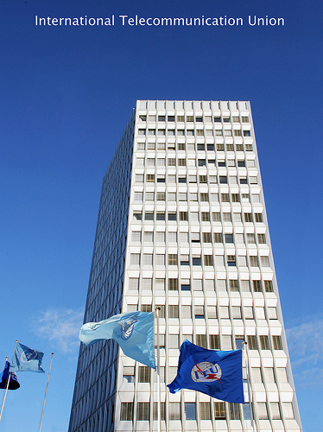
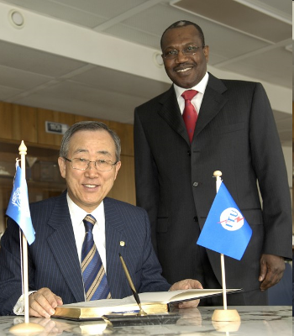
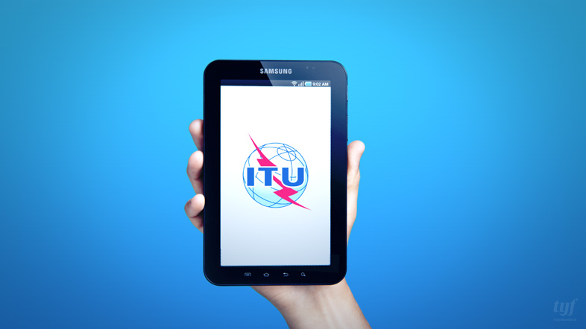
ITU
UN specialized agency for ICTs
unique public/private partnership
Members:
193 Member States (Governments and regulatory bodies)
Over 700 Private Sector (Sector Members and Associates)
Over 63 Academia
Notes:
UN agency for ICTs
Members:
193 Member States (Governments and regulatory bodies)
Over 700 Private Sector (Sector Members and Associates)
Over 63 Academia

Slide 4
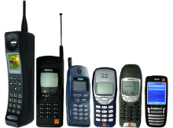
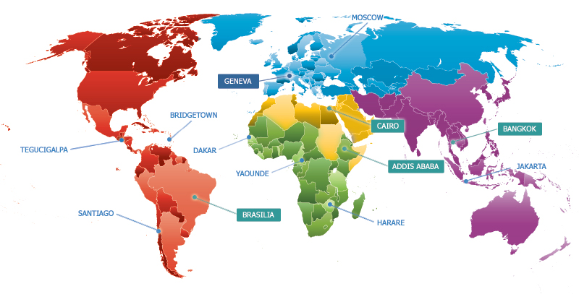
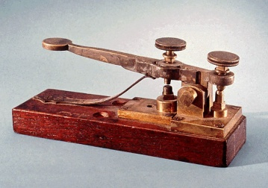
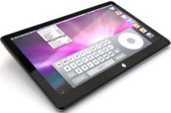
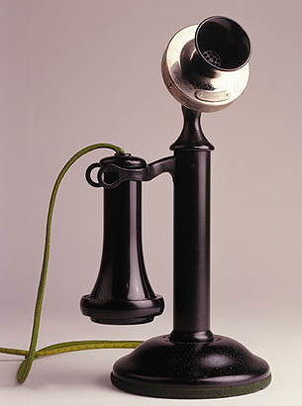
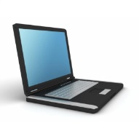
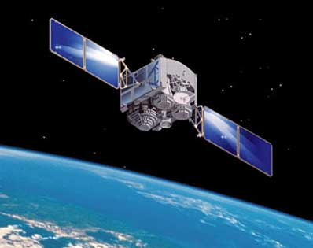
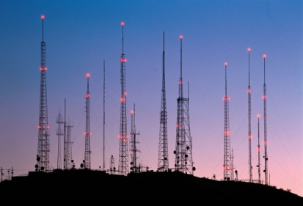
ITU’s structure
Standardization (ITU-T) produces interoperable technical ICT standards
Radiocommunication (ITU-R) coordinates global wireless communication
General Secretariat provides coordination
for the whole organization
Development (ITU-D) provides assistance to the un-connected

Slide 5
ITU-T Study Group 5
Mandate
Lead study group for:
environment and climate change;
electromagnetic compatibility and electromagnetic effects.
Structure
7 Questions
WP1/5
Damage prevention and safety
WP3/5
ICT and climate change
5 Questions
WP2/5
Electromagnetic fields: emission, immunity and human exposure
Question 12 Terminology
6 Questions

Slide 6
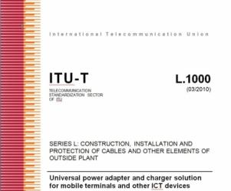
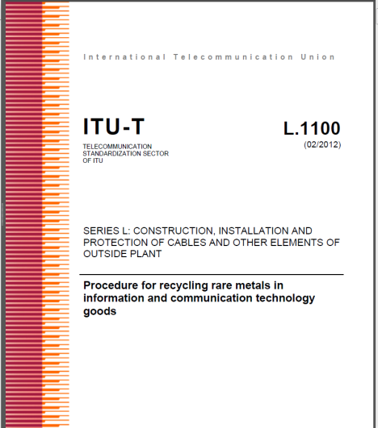
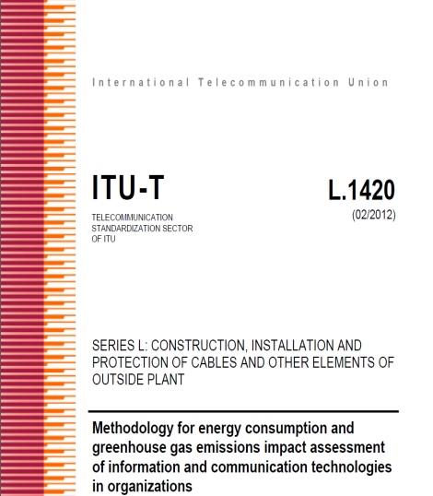
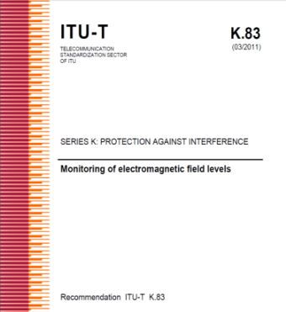
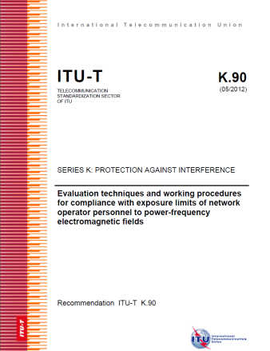
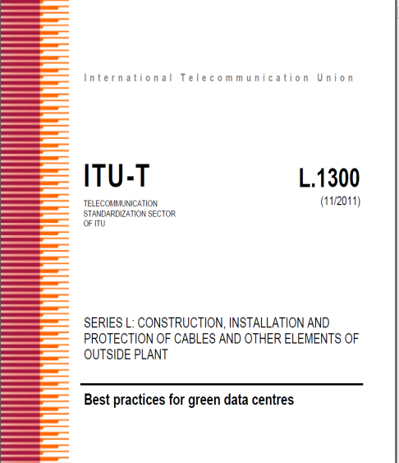
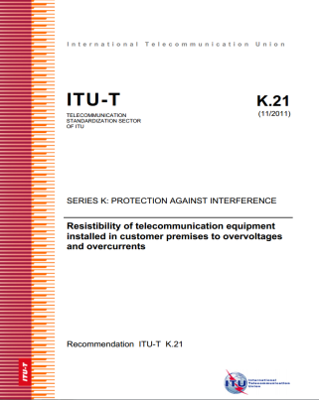
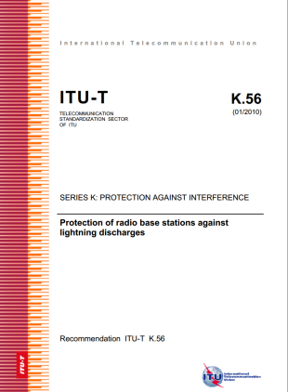
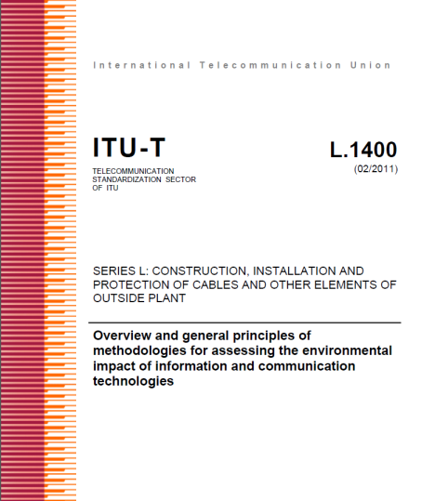
Tasks and Objectives
Study and identify standards needs;
Develop non-discriminatory international standards (ITU-T Recommendations), technical reports, best practices and implementation guides;
Ensure interoperability and reduce technical barriers;
Facilitate international cooperation between international and regional standardization bodies;
Reduce the gap in standards between the developed and developing countries.

Slide 7
Working Party 1 (WP1/5)
Work areas:
Q1/5 - Copper cables, networks and fibre-optic connection hardware for broadband access
Q2/5 - Protective components and assemblies
Q3/5 - Interference to telecommunication networks due to power systems and electrified railway systems
Q4/5 - Resistibility and safety in telecommunications
Q5/5 - Lightning protection and earthing of telecommunication systems
WP1/5
Damage prevention and safety
5 Questions
Notes:
WP1/5 is responsible for studies relating to protection of telecommunication installations in order to reduce damages and achieve safety of telecom personnel and users of telecom services.

Slide 8
WP1/5: damage prevention and safety
Highlights on deliverables:
ITU-T K.12 - Characteristics of gas discharge tubes for the protection of telecommunications installations
ITU-T K.21 - Resistibility of telecommunication equipment installed in customer premises to overvoltages and overcurrents
ITU-T K.27 - Bonding configurations and earthing inside a telecommunication building
ITU-T K.56 - Protection of radio base stations against lightning discharges
Guide on the Use of the Overvoltage Resistibility Recommendations
Notes:
ITU-T K.12 - Characteristics of gas discharge tubes for the protection of telecommunications installations: Requirements and test procedures for gas discharge tubes (GDT) used for the protection of telecommunication installations. The requirements and test procedures assure the protection function of the component and that it presents a safe operation during its expected service life.
ITU-T K.21 - Resistibility of telecommunication equipment installed in customer premises to overvoltages and overcurrents: Resistibility requirements and test procedures for equipment installed in or on the premises, covering overvoltages or overcurrents including: surges due to lightning on or near the line plant; short-term induction from adjacent a.c. power lines or railway systems; earth potential rise due to power faults; direct contacts between telecommunication lines and power lines; and electrostatic discharges.
ITU-T K.27 - Bonding configurations and earthing inside a telecommunication building: Earthing and bonding procedures to be implemented inside a telecommunication building to ensure the safety of personnel, the protection of equipment against damage, and the mitigation of electromagnetic interference within the building.
ITU-T K.56 - Protection of radio base stations against lightning discharges: Set of procedures to protect a radio base-station from direct lightning flashes in its tower, as well as from lightning surges conducted by power and telecom
lines connected to the base-station. The procedures contain requirements for earthing, bonding, cable routing, and installation of surge protective devices.
Guide on the Use of the Overvoltage Resistibility Recommendations: Guide to the testing of equipment, particularly equipment with multiple external and internal ports. The guide assists in laying out a test plan in the interests of ensuring compliance with ITU-T Recommendations on overvoltage resistibility.

Slide 9
Working Party 2 (WP2/5)
Work areas:
Q6/5 - EMC issues arising from the convergence of IT and communication equipment
Q7/5 - Human exposure to electromagnetic fields (EMFs) due to radio systems and mobile equipment
Q8/5 - EMC issues in home networks
Q9/5 - Generic and product family EMC recommendations for telecommunication equipment
Q10/5 - Security of telecommunication and information systems concerning the electromagnetic environment
Q11/5 - EMC requirements for the Information Society
WP2/5
Electromagnetic fields: emission, immunity and human exposure
6 Questions
Notes:
WP2/5 is responsible for studies relating to achieve EMC of telecommunication installations and safety of telecom personnel and population against electromagnetic fields.

Slide 10
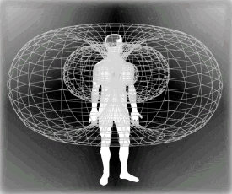
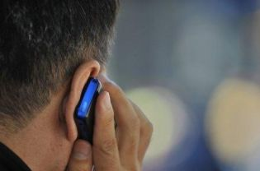
WP2/5: electromagnetic fields: emission, immunity and human exposure
Highlights on deliverables:
ITU-T K.48 - EMC requirements for telecommunication equipment - Product family Recommendation
ITU-T K.83 – Monitoring of electromagnetic field levels
ITU-T K.87 - Guide for the application of electromagnetic security requirements – Overview
ITU-T K.91 - Guidance for assessment, evaluation and monitoring of human exposure to radio frequency electromagnetic fields
ITU-T K.92 - Conducted and radiated electromagnetic environment in home networking
Notes:
ITU-T K.48 - EMC requirements for telecommunication equipment - Product family Recommendation: Emission and immunity requirements for switching, transmission, power, digital mobile base-station, wireless LAN, digital radio relay system, xDSL, and supervisory equipment. The requirements also describe operational conditions for emission and immunity testing, as well as performance criteria for immunity tests.
ITU-T K.83 – Monitoring of electromagnetic field levels: Guidance on making long-term measurements in the monitoring of electromagnetic fields (EMF), with the end-purpose of providing the general public with the accessible data on EMF levels.
ITU-T K.87 - Guide for the application of electromagnetic security requirements - Overview: Electromagnetic security risks of telecommunication equipment and how to assess and prevent those risks, in order to comply with the information security management guidelines outlined in Recommendation ITU-T X.1051. Major electromagnetic security risks addressed include:
• natural electromagnetic threats (e.g., lightning)
• unintentional interference (i.e., electromagnetic interference)
• intentional interference (i.e., intentional electromagnetic interference)
• deliberate EM attacks via high-altitude electromagnetic pulse
• deliberate high-power electromagnetic attacks
• information leakage from electromagnetic emanation
(i.e., electromagnetic security)
ITU-T K.91 - Guidance for assessment, evaluation and monitoring of human exposure to radio frequency electromagnetic fields: Comprehensive guide to the assessment and monitoring of human exposure to radio
frequency electromagnetic fields (RF EMF) in areas with surrounding radiocommunication installations, based on existing exposure and compliance standards in the frequency range of 9 kHz to 300 GHz. The guide is oriented
to the examination of areas accessible to people in the real environment of currently operated services with many different sources of RF EMF, but also gives references to standards on EMF compliance of products.
ITU-T K.92 - Conducted and radiated electromagnetic environment in home networking: Describes the home networking electromagnetic environment and offers guidance on its evaluation. It covers the typical conducted and radiated phenomena, the attributes of the home networking environment, and the specification of disturbance characteristics and levels.

Slide 11
Working Party 3 (WP3/5)
Work areas:
Q13/5 - Environmental impact reduction including e-waste
Q14/5 - Setting up a low cost sustainable telecommunication infrastructure for rural communications in developing countries
Q15/5 - ICTs and adaptation to the effects of climate change
Q16/5 - Leveraging and enhancing the ICT Environmental sustainability
Q17/5 - Energy efficiency for the ICT sector and harmonization of environmental standards
7 Questions
WP3/5
ICT and climate change
Q18/5 - Methodologies for the assessment of environmental impact of ICT
Q19/5 - Power feeding systems
Notes:
WP3/5 is responsible for studies relating to ICT, environment and climate change, development of methodologies for evaluating the ICT effects on climate change and publishing guidelines for using ICTs in an eco-friendly way.

Slide 12
WP3/5: ICT and climate change
Highlights on deliverables:
ITU-T L.1000 - Universal power adapter and charger solution for mobile terminals and other ICT hand held devices
ITU-T L.1001 - External universal power adapter solutions for ICT equipment for stationary use
ITU-T L.1002 - External universal power adapter solutions for portable information and communication technology devices
ITU-T L.1300 - Best practices for green data centres
ITU-T L.1310 - Energy efficiency metrics and measurement methods for telecommunication equipment
ITU-T L.1400 - Overview and general principles of methodologies for assessing the environmental impact of information and communication technologies
ITU-T L.1410 - Methodology for the assessment of the environmental impact of information and communication technology goods, networks and services
ITU-T L.1420 - Methodology for energy consumption and greenhouse gas emissions impact assessment of information and communication technologies in organizations
ITU-T L.1430 - Methodology for assessment of the environmental impact of information and communication technology greenhouse gas and energy projects
Notes:
ITU-T L.1000 - Universal power adapter and charger solution for mobile terminals and other ICT hand held devices: Universal power adapter and charger solution targeting reduced device duplication, demand on raw materials and waste. Designed to serve the vast majority of mobile ICT devices and also offering improved energy efficiency, the solution widens adapters and chargers’ application to more devices, thereby enabling their reuse and increasing their lifetime.
ITU-T L.1001 - External universal power adapter solutions for ICT equipment for stationary use: Universal power adapter solution (UPA) for stationary ICT devices targeting reduced device duplication, demand on raw materials and waste. Designed to serve the vast majority of ICT devices and also offering improved energy efficiency, the UPA solution for stationary ICT equipment widens UPAs’ application to more devices, thereby enabling their reuse and increasing their lifetime.
ITU-T L.1002 - External universal power adapter solutions for portable information and communication technology devices: Universal power adapter solution (UPA) designed for portable ICT devices. It is complementary to [ITU-T L.1000] and [ITU-T L.1001] and aims to cover the widest possible range of ICT devices for portable use within the defined voltage and power ranges.
ITU-T L.1300 - Best practices for green data centres: Best practices aimed at reducing the negative impact of data centres on the climate. The application of the best practices defined in this Recommendation can help owners and managers to build future data centres, or improve existing ones, to operate in an environmentally responsible manner.
ITU-T L.1310 - Energy efficiency metrics and measurement methods for telecommunication equipment: Energy efficiency metrics test procedures, methodologies and measurement profiles required to assess the energy efficiency of telecommunication network equipment.
ITU-T L.1400 - Overview and general principles of methodologies for assessing the environmental impact of information and communication technologies: The first Recommendation of the L.1400-series gives an overview of the series’ general principles and contains a guide to the other standards comprising the L.1400-series.
ITU-T L.1410 - Methodology for the assessment of the environmental impact of information and communication technology goods, networks and services: Methodology to assess the environmental impact (positive and negative effects) of ICT goods, networks and services, and specific guidance on energy and greenhouse gas (GHG) impacts.
ITU-T L.1420 - Methodology for energy consumption and greenhouse gas emissions impact assessment of information and communication technologies in organizations: methodology to assess ICT-related energy consumption and/or greenhouse gas (GHG) emissions in ICT organizations as well as ICT-related activities within non-ICT organizations.
ITU-T L.1430 - Methodology for assessment of the environmental impact of information and communication technology greenhouse gas and energy projects: methodology to assess the environmental impact of information and communication technology (ICT) greenhouse gas (GHG) and energy projects. This assessment methodology is specifically directed at quantifying and reporting GHG emission reductions, GHG removal enhancements, energy consumption reductions, and enhancement of energy generation and storage in ICT GHG and energy projects.

Slide 13
Regional Groups
Study Group 5 Regional Group for the Americas
Study Group 5 Regional Group for Asia and the Pacific
Study Group 5 Regional Group for the Arab Region
Study Group 5 Regional Group for Africa
Notes:
Study Group 5 Regional Group for Africa
encourage national authorities, operators and consumers from developing countries to work together and better contribute to ITU-T activities on the achievement of EMC in telecommunication installations as well as on EMF and human health
enhance the collaboration on all activities related to climate change
Study Group 5 Regional Group for the Arab Region
maximize the involvement of Arab States in relevant activities of ITU-T SG5
disseminate the relevant information and activities of SG5 on environment and climate change, the implementation of Resolution 72 regarding to the measurement related to human exposure to electromagnetic fields, and other activities of SG5
Study Group 5 Regional Group for the Americas
disseminate studies on electromagnetic environment and ICT & climate change, especially on human exposure to EMF
encourage the participation of its countries in SG5 events
establish a link to attend Americas countries needs regarding the issues covered by SG5 mandate
Study Group 5 Regional Group for Asia and the Pacific
disseminate studies on electromagnetic environment, human exposure to EMF, as well as ICT and climate change
encourage the participation of its countries in the SG5 events
establish a link to attend Asia Pacific countries needs regarding the issues covered by SG5 mandate.

Slide 14
Related Groups
United in diversity to shape a better future through global ICT standards
Activities open to all

Slide 15
Joint Coordination Activity on ICTs & Climate Change
Discussions that matter
Seek cooperation from external bodies working in the field of ICT and climate change
Provide a contact point for ICT and Climate Change activities in ITU-T
Enable effective communication with external bodies
Notes:
The Joint Coordination Activity on ICTs and climate change (JCA-ICT&CC) has been established by TSAG during its first meeting of the study period 2009-2012 (Geneva, 28-30 April 2009) on the basis of the successful completion of the work of the Focus Group on ICT and Climate Change. The purpose of the JCA-ICT&CC is to coordinate the ITU-T ICTs and climate change work amongst the ITU T Study Groups, and to liaise with the ITU-R and ITU-D Sectors. The membership shall comprise all ITU-T SG Chairmen, all ITU-T SG Counsellors/Engineers, the TSAG Chairman and Counsellor, a number of SG Chairmen’s appointees, ICT & CC contact persons in ITU-T Study Groups and invited representatives from relevant SDOs such as IEC, ISO or relevant academia, consortia or fora.
External bodies include representatives from relevant SDOs such as IEC, ISO or relevant academia, consortia or fora.

Slide 16
Focus Group on Smart Sustainable Cities
Shaping the City We Want
Established at the Study Group 5 meeting in Geneva (February 2013)
Mandate extended until May 2015
As an open platform for smart-city stakeholders to exchange knowledge in the interests of identifying the standardized frameworks needed to support the integration of ICT services in smart cities.
Next meeting: 18 September 2014, Reading, United Kingdom
Notes:
The FG-SSC will act as an open platform for smart-city stakeholders – such as municipalities; academic and research institutes; non-governmental organizations (NGOs); and ICT organizations, industry forums and consortia – to exchange knowledge in the interests of identifying the standardized frameworks needed to support the integration of ICT services in smart cities.
Main tasks and deliverables:
Defining the role of ICTs in environmentally sustainable smart cities, and identifying the ICT systems necessary to the development of a Smart Sustainable City;
Collecting and documenting information on existing smart city initiatives and technical specifications, focusing in particular on the identification of standardization gaps;
Identifying or developing a set of Key Performance Indicators (KPIs) to gauge the success of smart-city ICT deployments;
Establishing relationships and liaison mechanisms with other bodies engaged in smart-city studies and development;
Identifying future smart-city standardization projects to be undertaken by its parent group, ITU-T Study Group 5;
Developing a roadmap for the ICT sector’s contribution to Smart Sustainable Cities, providing cohesion to the development and application of technologies and standards.

Slide 17
Focus Group on Smart Water Management
Addressing the World Water Crisis
Established by the ITU-T TSAG meeting in Geneva (June 2013)
A multi-stakeholder approach to the development of smart water-management systems.
Next meeting: 15-16 September 2014, London, United Kingdom
Notes:
The Focus Group on Smart Water Management (FG-SWM) was established by the ITU-T TSAG meeting in Geneva, 4-7 June 2013.
The FG-SWM is expected to carry out the following specific tasks:
Collect and document information on national, regional and international smart water management initiatives; reporting on current activities and technical specifications.
Specify the roles to be played by ICTs in smart water management.
Develop a list mapping key stakeholders involved in the area of ICTs and smart water management.
Develop Key Performance Indicators (KPIs) to assess the impact achieved through the use of ICTs in water-management systems.
Develop a set of methodologies for estimating the impact of ICTs on water conservation.
Identify water-management ICT applications and services with the potential to ensure interoperability and the benefits of economies of scale.
Draft technical reports that address standardization gaps and identify new standardization work items to be taken up by its parent group, ITU-T Study Group 5 (Environment and climate change).

Slide 18
Importance of Global Standards
Promote environmental sustainability, combat climate change and tackle e-waste;
Avoid health risks from electromagnetic fields (EMF) produced by telecommunication devices and installations;
Protect telecommunication equipment and installations against damage and malfunction due to electromagnetic disturbances, such as those from lightning;
Ensure safety of personnel and users of networks against current and voltages used in telecommunication networks.
Work with us!

Slide 19
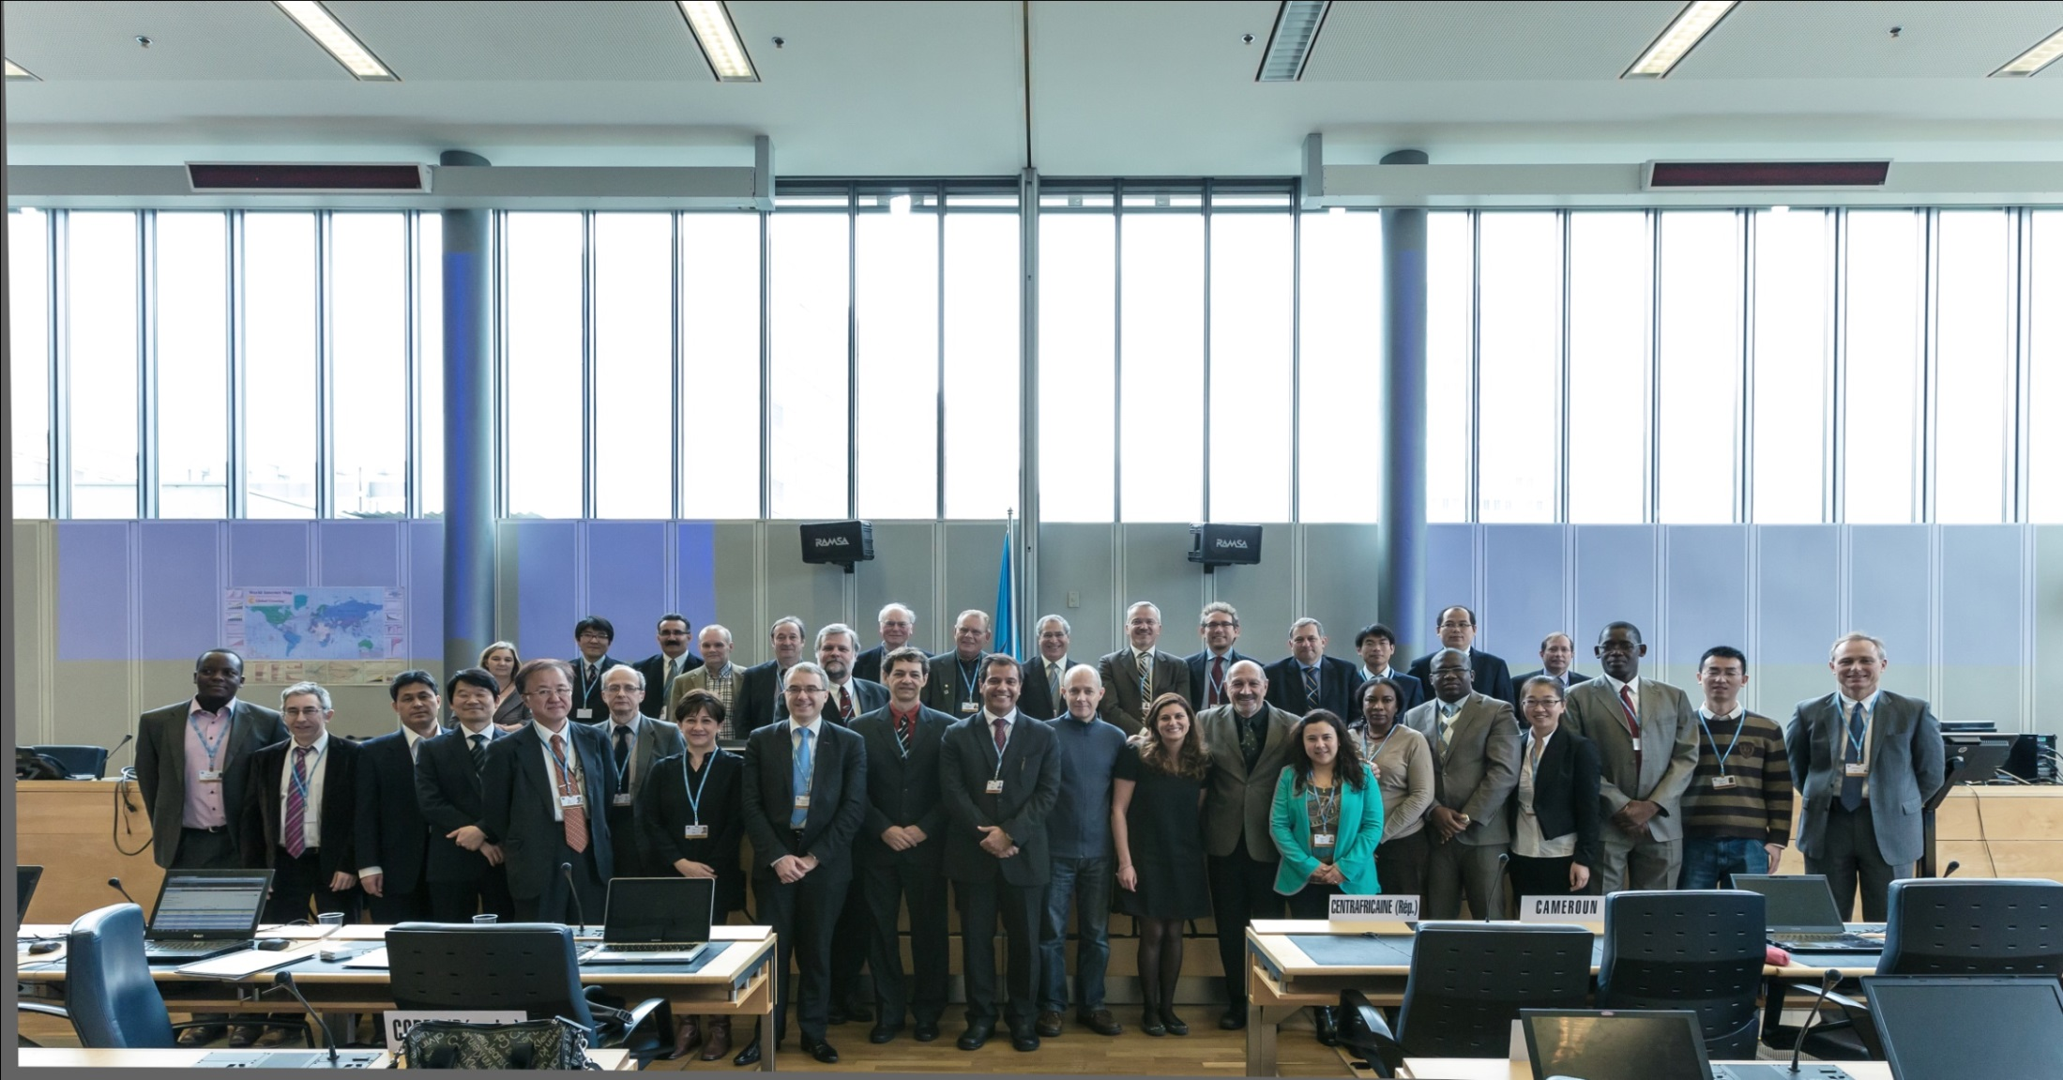
THANK YOU
ITU-T/SG5 “Environment & Climate Change” itu.int/go/tsg5
ITU-T and Climate Change itu.int/go/ITU-T/climate
tsbsg5@itu.int

