Slide 1

Overview of ITU-T SG12
ITU Regional Standardization Forum for Africa
(Kampala, Uganda, 23-25 June 2014)
KWAME Baah-Acheamfuor
Chairman, ITU-T SG12
kwame.baah-acheamfuor@nca.org.gh

Slide 2
Structure of ITU
General Secretariat
ITU-R
(radiocommunication)
ITU Council
ITU-D
(development)
WRC & RA
WTDC
Plenipotentiary Conference
ITU-T
(standardization)
WTSA

Slide 3
Structure of ITU-T
Study Group y
Study Groups …
Working Party 2/x
Working Party 1/x
Working Party 3/x
Working Parties …
Working Party 1/y
Question 1/1
Question 1/2
Question 1/3
Question 1/1
WTSA
Study Group x
TSAG & Review Committee

Slide 4
The Evolution of ITU-T SG 12
Established in 1957
Separate SG 16 for Transmission Planning
  Old SG 12 just did subjective testing & telephone standards
  At CCITT Plenary Assembly in 1984, these SGs were merged to form the present-day SG 12
During same time SG 12 had a Laboratory WP
  Subjective & objective testing for loudness of telephones
  In the CCITT Laboratory in Geneva - closed in 1988
Since 1986 Speech Quality Experts Group (SQEG)
  To better provide the quality requirements and subjective testing for speech coding algorithms standardized by SG 18 (later SG 15, now SG 16)
  Key role in the standardization of all of the G.711-G.729 speech and audio codecs, and still exists as Q7/12.

Slide 5
Evolved to……..
Since 1997 Video Quality Experts Group (VQEG)
  With a nucleus of subjective and objective video quality expertise from SG12
  SG12 still maintains close contact with VQEG
Since the early 1990s work in SG 12 has expanded
  Into many new technology areas
    ATM
    VoIP
    Multimedia
    Digital wireless
    IP QoS classes
    Ethernet
    IPTV, etc.
    Network Performance
    Resource Management.
Since 2008 SG12 was given responsibility for
  Operational aspects of telecommunication network service quality
  Responsibility for the QoS Development Group (QSDG)
Mandate of SG12 currently as Lead Study Group on
  Quality of service and quality of experience
  Driver distraction and voice aspects of car communications

Slide 6
SG 12 Mandate
Performance, QoS and QoE
Responsible for Recommendations on performance, quality of service (QoS) and quality of experience (QoE) for
  full spectrum of terminals, networks and services
    ranging from speech over fixed circuit-based networks
    to multimedia applications over networks that are mobile and packet based
Included are
  operational aspects of performance, QoS and QoE
  end-to-end quality aspects of interoperability
  development of multimedia quality assessment methodologies, both subjective and objective.
SG 12 is the Lead SG on
  quality of service and quality of experience
  driver distraction and voice aspects of car communications
http://www.itu.int/en/ITU-T/studygroups/2013-2016/12/Pages/default.aspx

Slide 7
SG 12 Leading Team
Chairman
  Kwame Baah-Acheamfuor (Ghana)
Vice Chairmen
  Paul Barrett (United States)
  Vincent Barriac (France)
  Gamal Amin Elsayed (Sudan)
  Hyung-Soo Kim (Republic of Korea)
  Al Morton (United States)
  Qi Feng (China)
  José Guadalupe Rojas Ramírez (Mexico)
  Akira Takahashi (Japan)
  Hassan Talib (Morocco)
TSB Support
  Hiroshi Ota, Engineer
  Emmanuelle Labare, Assistant

Slide 8
Working Parties
WP 1 Terminals and multimedia subjective assessment
CHAIR: Lars Birger Nielsen (Denmark)
VICE CHAIR: Gunilla Berndtsson (Sweden)
Q3/12 | Speech transmission characteristics of communication terminals for fixed circuit-switched, mobile and packet-switched (IP) networks
Q4/12 | Hands-free communication and user interfaces in vehicles
Q5/12 | Telephonometric methodologies for handset and headset terminals
Q6/12 | Analysis methods using complex measurement signals including their application for speech enhancement techniques and hands-free telephony
Q7/12 | Methods, tools and test plans for the subjective assessment of speech, audio and audiovisual quality interactions
Q10/12 | Conferencing and telemeeting assessment

Slide 9
Working Parties
WP 2 Objective models and tools for multimedia quality
CHAIR: Paul Barrett (United States)
VICE CHAIR: Vincent Barriac (France)
Q8/12 | E-Model extension in wideband transmission and future telecommunication and application scenarios
Q9/12 | Perceptual-based objective methods for voice, audio and visual quality measurements in telecommunication services
Q14/12 | Development of parametric models and tools for multimedia quality assessment
Q15/12 | Objective assessment of speech and sound transmission performance quality in networks
Q16/12 | Framework for diagnostic functions and their interaction with external objective models predicting media quality

Slide 10
Working Parties
WP 3 Multimedia QoS and QoE
CHAIR: Paul Coverdale (China)
VICE CHAIR: Akira Takahashi (Japan)
Q11/12 | Performance interworking and traffic management for Next Generation Networks
Q12/12 | Operational aspects of telecommunication network service quality
Q13/12 | QoE, QoS and performance requirements and assessment methods for multimedia
Q17/12 | Performance of packet-based networks and other networking technologies

Slide 11
Overseen by SG12
Q1/12 | SG 12 work programme and QoS/QoE coordination in the ITU‑T
Q2/12 | Definitions, guides and frameworks related to QoS/QoE
QoS Development Group
  Yvonne Umutoni, Chair
Regional Group for Africa
  Gamal Amin Elsayed, Chair
CarCom Focus Group (closed in 2013)
  Hans Gierlich, Chair
Driver Distraction Focus Group (closed in 2013)
  Scott Pennock, Chair

Slide 12
SG 12 Recommendations
E-Series: Overall Network Operation, telephone service, telephone operation and human factors
  E.420-E.479, E.800-E.859
G-Series: Transmission Systems and media, digital systems and networks
  G.100-series, except G.160-, G.180- and G.190-series, G-1000 series
I-Series: Integrated Services Digital Network
  I.350-series (including Y.1501/G.820/I.351), I.371, I.378, I.381
P-Series, except P.900-series:Terminals, subjective and objective test methods
Y-series: Global Information infrastructure, Internet Protocol aspects and Next Generation Networks
  Y.1220-, Y.1530-, Y.1540-, Y.1560-series

Slide 13
Recently approved Recommendations
E. 803: “Quality of service parameters for supporting service aspects”
E.804:”QoS Aspects for Popular Services in Mobile Networks”
E.807: “Definitions and associated measurement methods of user-centric parameters for call handling in cellular mobile voice service”.

Slide 14
Recently approved Recommendations
ITU-T Supplement.9 (E. Series): “Guidelines on Regulatory Aspects of QoS” and some best practices worldwide
Y.1545: Roadmap for the quality of service of interconnected networks that use the Internet Protocol

Slide 15
Next Meeting
ITU-T SG12 meeting
2nd to 11th September, 2014
Geneva, Switzerland

Slide 16
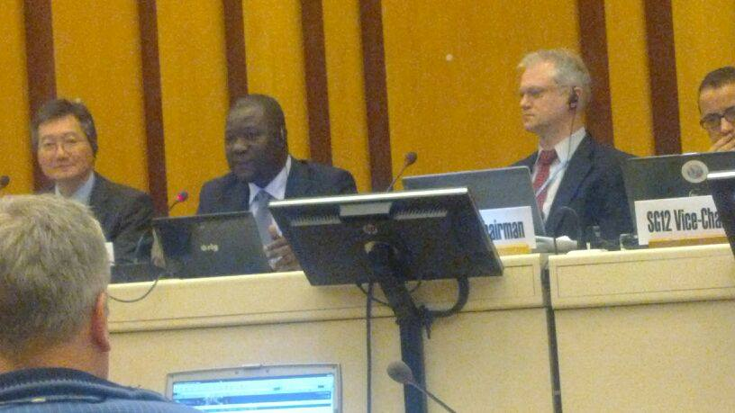
Welcome to SG12

