Slide 1
Overview of
ITU-T activities on ICTs, the environment and climate change
Ahmed ZEDDAM Orange
Chairman, ITU-T Study Group 5

Slide 2
ITU-T’s environmental mandate
Resolution 73 - Information and communication technologies, environment and climate change
Resolution 79 - The role of telecommunications/ information and communication technology in handling and controlling e-waste from telecommunication and information technology equipment and methods of treating it
World Telecommunication Standardization Assembly (WTSA-12), Dubai, United Arab Emirates
Notes:
WTSA-12
ITU-T Resolution 73 - Information and communication technologies, environment and climate change
Revised and consented at World Telecommunication Standardization Assembly (Dubai, 2012)
Recognizes that ICTs play a vital role in tackling environmental challenges;
ITU-T Resolution 79 - The role of telecommunications / information and communication technology in handling and controlling e-waste from telecommunication and information technology equipment and methods of treating it
Consented at World Telecommunication Standardization Assembly (Dubai, 2012)
Contribute to alleviate the negative impact of e-waste on the environment and health

Slide 3
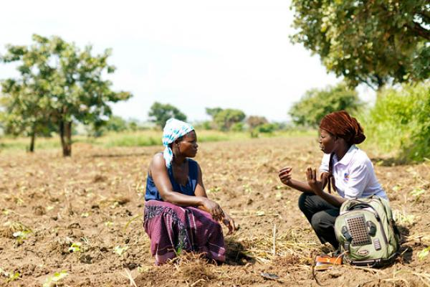
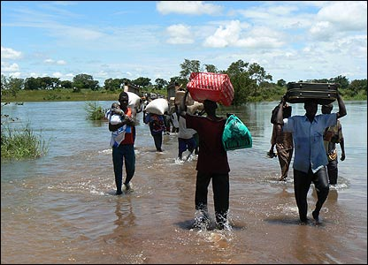
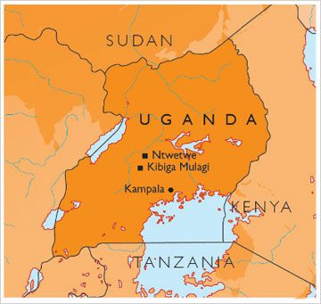
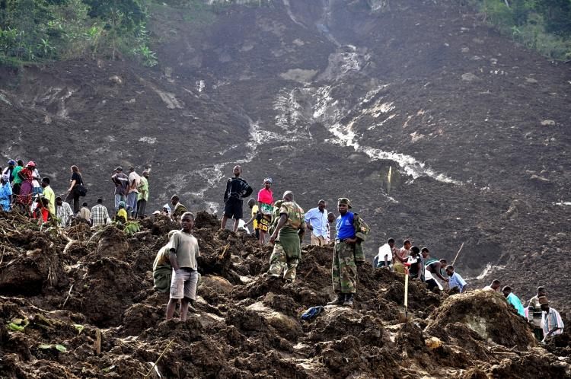
Uganda
chimpreports.com
Environmental issues: climate susceptible to flood and drought events
Natural resources: copper, cobalt, hydropower, limestone, salt, arable land
Agriculture is the most important sector of the economy
theepochtimes.com
Threats, priorities and opportunities

Slide 4
Uganda
Persistent environmental degradation and climate change threats will affect every sector of development
Uganda is making concerted efforts to identify climate change-opportunities and to develop climate change mitigation and adaptation programmes
National Climate Change Policy 2013
ICTs can play a key role in fostering, inter alia, green services, environmental monitoring and e-waste management
go2africa.com
Threats, priorities and opportunities

Slide 5
ITU-T’s environmental programme
Develop international standards to protect the environment
Assist countries to develop policies and implement standards on climate change adaptation and mitigation
Help companies becoming more sustainable and socially responsible
Research and development on areas which include e-waste, energy efficiency and smart sustainable cities
Raise awareness on role of ICT in tackling environmental challenges
Using ICTs to protect the environment
Notes:
WTSA-12
ITU-T Resolution 73 - Information and communication technologies, environment and climate change
Revised and consented at World Telecommunication Standardization Assembly (Dubai, 2012)
Recognizes that ICTs play a vital role in tackling environmental challenges;
ITU-T Resolution 79 - The role of telecommunications / information and communication technology in handling and controlling e-waste from telecommunication and information technology equipment and methods of treating it
Consented at World Telecommunication Standardization Assembly (Dubai, 2012)
Contribute to alleviate the negative impact of e-waste on the environment and health

Slide 6
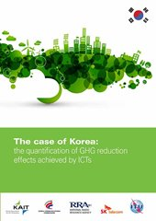
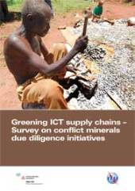
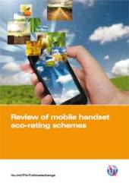
Research and development
Case study on Ghana:
Replicable framework for climate change adaptation and mitigation
Identifying policy and standards needs
Notes:
Climate Change Adaptation, Mitigation and Information & Communications Technologies (ICTs): the Case of Ghana
This report focuses on exploring an increasingly important question: “How can developing countries effectively integrate ICT tools within climate change adaptation and mitigation strategies?” The contribution of this report is two-fold. It presents the potential of ICTs towards adaptation and mitigation through the concrete case of Ghana, illustrating the challenges and opportunities faced by developing countries in this field.

Slide 7
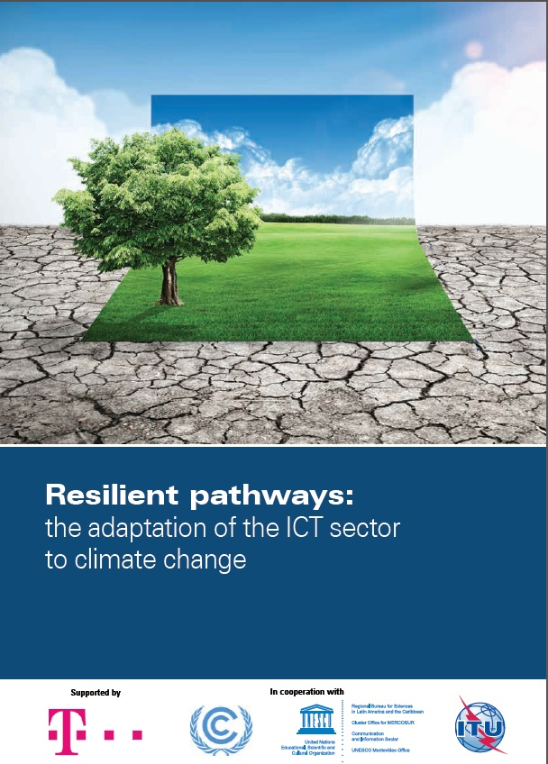
Latest publications
Reports released in March and April 2014
Notes:
​Resilient pathways: the adaptation of the ICT sector to climate change
The main objective of this report is to explore the impacts of climate change on the ICT sector and the potential for adaptation, while emphasizing the need for resilient pathways of action, enabling environments and new standards to foster the sector’s approach to adaptation.
Partnering for solutions: ICTs in Smart Water Management
Though economic growth, climate change and rising populations highly influence the availability of global water resources, strategic incorporation of ICTs in SWM can mitigate some of these challenges. Such achievements, however, are unattainable without proper stakeholder involvement and buy-in. The principal intention of this report is to go further and emphasize how ICTs can overcome some of the challenges faced in the water sector when there is proper stakeholder involvement.

Slide 8
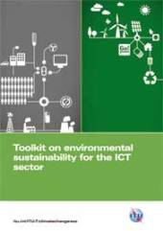
Toolkit on environmental sustainability
Detailed practical support on how ICT companies can build sustainability into their operations and management
Practical
support
Checklist
Standards
Support
Standardized checklist of sustainability requirements specific to the ICT sector
Ongoing contribution to ITU-T Study Group 5 which has the goal of developing global standards in this arena
Notes:
The Toolkit on Environmental Sustainability for the ICT sector is an ITU-T initiative which provides plenty of detailed support on how ICT companies can build sustainability into the operations and management of their organizations, through the practical application of international standards and guidelines.
This toolkit provides a set of agreed upon sustainability requirements for ICT companies that allows for a more objective reporting of how sustainability is practiced in the ICT sector in these key areas: sustainable buildings, sustainable ICT in corporate organizations, sustainable products, end of life management, general specifications and KPIs, and an assessment framework for environmental impacts of the ICT sector.

Slide 9
Toolkit content
Document | Summary
Introduction to toolkit | A business-led perspective on the use of sustainability in ICT organizations
Sustainable ICT in corporate organizations | Sustainability issues with the use of ICT products and services
Sustainable products | Sustainability-led design principles and practice for ICT products
Sustainable buildings | Sustainability management of the construction, use and decommissioning of ICT buildings
End-of-life management | Support in dealing with the various end-of-life stages of ICT equipment
General specifications and KPIs | Environmental KPIs that can be used to manage and evaluate sustainability performance
Assessment framework | Mapping the standards and guidelines applying to the ICT industry

Slide 10
Global portal on ICTs, environment and climate change
Launched in February 2014
Notes:
The ITU Global Portal on ICTs, the environment and climate change features ITU-T Green ICT Standards, and provides current external resources related to ICTs and climate change.
Topics:
CLIMATE CHANGE
SMART Water Management
SMART SUSTAINABLE CITIES
E-WASTE
GREEN ICT PROCUREMENT
CLOUD COMPUTING AND DATA CENTERS
GREENING ICT SUPPLY CHAINS

Slide 11
Raising awareness
Meeting of the ITU-T SG5 Working Party 1 and Working Party 2 23-29 July 2014, Geneva, Switzerland
Forum on "EMF - What does it really mean?“ 4 September 2014, Santo Domingo, Dominican Republic
Forum on Smart sustainable Cities (SSC) 17 September 2014, Reading, United Kingdom
4th ITU Green Standards Week 22-26 September 2014, Beijing, China
Meeting of the ITU-T SG5 Regional Group for Asia and the Pacific (SG5 RG-AP) 26 September 2014, Beijing, China

Slide 12
ITU Green Standards Week
Annual event
Global platform for discussion and knowledge-sharing to raise awareness of the importance and opportunities of using ICT standards to build a green economy and ensure a sustainable future
To bring together leading specialists in the field, from top policy-makers to engineers, designers, planners, government officials, regulators, standards experts and others.
Notes:
After the successful events held in Rome (2011) and Paris (2012), ITU-T has continued to lead the organization of Green Standards Weeks.
The 3rd Green Standards Week took place in Madrid, Spain, about two weeks ago and featured, inter alia, discussions on e-waste management, eco-rating scheme and Smart Sustainable Cities.
The Green Standards Week is the global platform for discussion and knowledge-sharing that brings together leading specialists in the field and aims to raise awareness of the importance and opportunities of using ICT standards to build a green economy and ensure a sustainable future.

Slide 13
ITU Green Standards Week – 4th edition
Overview
Forum on “Green ICT for a sustainable resource efficient economy” 22 September 2014
Forum on "E-waste: the inconvenient truth“ 23 September 2014
High-Level Forum on "Setting the vision for smart sustainable cities“ 24 September 2014
Forum on “Using EMF to achieve the smartest sustainable city” 25 September 2014
Regional meeting of SG5 Regional Group for Asia and the Pacific 26 September 2014
SEE YOU on 22-26 September 2014 in Beijing!
Notes:
ITU is organizing the fourth Green Standards Week, from 22 to 26 September 2014 in Beijing, China. The Green Standards Week will be kindly hosted by Huawei in close cooperation with the China Academy of Telecommunication Research (CATR) of the Ministry of Industry and Information Technology (MIIT) of the Government of the People's Republic of China. The Green Standards Week acts as global platform for discussion and knowledge-sharing in order to raise awareness of the importance and opportunities of using ICT to build a green economy and ensure a sustainable future.
The Green Standards Week will bring together leading specialists in the field, from top policy-makers to engineers, designers, smart city planners, government officials, regulators, standards experts and others.
Organizers: ITU and CATR
Host: Huawei

Slide 14
Envisioning a sustainable future for Africa
Raise awareness on the role of global standards in spreading access to green ICTs and in enabling sustainability
Work in partnership with major stakeholders to develop green ICT standards to build a green economy and combat climate change
Standardized achievement can be multiplied worldwide across the whole industry
Improve environmental regulations for ICT to keep pace with consumer expectations

Slide 15
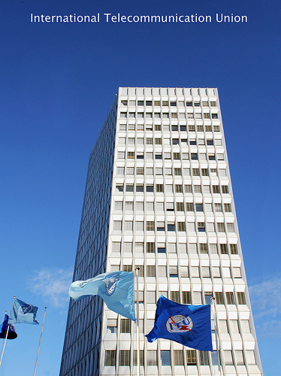
THANK YOU
ITU-T and Climate Change itu.int/go/ITU-T/climate
ITU Symposia & Events on ICTs and Climate Change itu.int/ITU-T/worksem/climatechange
ITU-T/SG5 “Environment & Climate Change” itu.int/go/tsg5
greenstandard@itu.int

