Slide 1
ITU-T Recommendation E.807: “Definitions and associated measurement methods of user-centric parameters for call handling in cellular mobile voice service”.
ITU Regional Standardization Forum for Africa
(Kampala, Uganda, 23-25 June 2014)
Samuel K. Agyekum, QoS Officer, NCA
samuel.agyekum@nca.org.gh

Slide 2
Presentation Outline
Introducing E.807 “Definitions, associated measurement methods and guidance targets of user-centric parameters for call handling in cellular mobile voice service”
Scope of E.807
QoE Parameter Definitions
Test Methodology
Measurement Profile
Explanation on Parameter Definitions, Equations, Targets
Network-QoE parameter Relationship Matrix
Conclusion

Slide 3
Introducing E.807
Call handling is an important aspect of Cellular mobile voice service user experience which is executed end-to-end by the Access and Non Access Stratum of the network (i.e GSM, CDMA or UMTS)
To enable Regulators and Operators measure Call Handling of Cellular Mobile Voice Service for benchmarking and compliance, the document defines five parameters, describes the methodology in accessing them as well as provides some guidance targets

Slide 4
Scope of E.807
The recommendation provides an expose into call handling in Cellular mobile Voice service systems but most importantly relates signaling procedures to major key performance indicators used in the assessment of voice service handling. Some causative factors that incapacitate mobile networks not to perform at their desired levels in consonance with meeting minimum communication standards in respect of guidance targets are discussed herein.

Slide 5
QoE Parameter definitions
Parameter 1: Call Setup Time or Voice Service Access Time
Parameter 1 is the period of time elapsing from the sending of a complete destination address (target telephone number) to the setting up of a call to the receiving terminal.
Parameter 2: Stand-alone Dedicated Control Channel (SDCCH) or Radio Resource Control Congestion Rate
Parameter 2 is defined as the probability of failure of accessing a stand-alone dedicated control or radio resource control channel during call set up.

Slide 6
QoE Parameter definitions
Parameter 3: Traffic Channel Congestion Rate or Voice Service Non-Accessibility Ratio
Parameter 3 is defined as the probability of failure of accessing traffic channel(s) or radio access bearers during call connections.
Parameter 4: Call Drop Rate or Voice Service Cut-Off Ratio
Parameter 4 is the probability of a call terminating without any of the users’ will.

Slide 7
QoE Parameter definitions
Parameter 5: Call Completion Rate or Voice Service Retainability Ratio
Parameter 5 is defined as the probability that a call has, after being successfully set up, to be maintained during a period of time, ending normally, i.e., according to the user’s will.

Slide 8
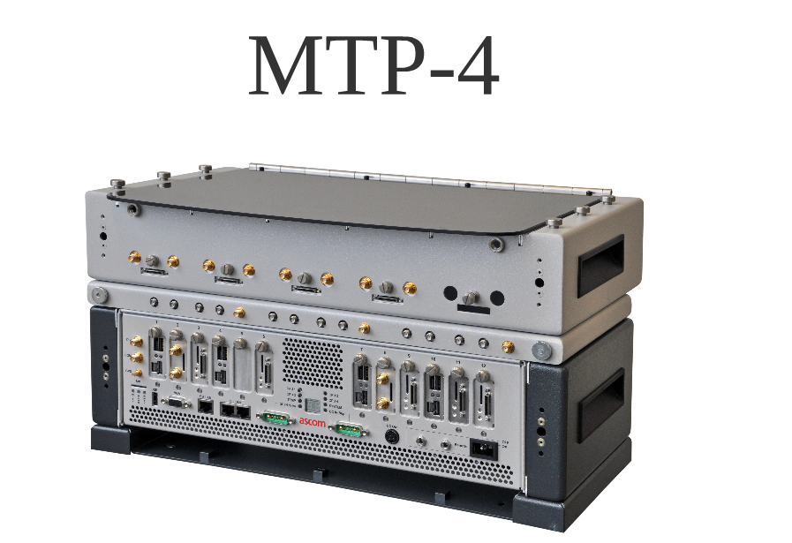
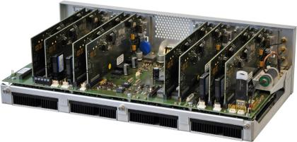
Test Methodology
The test methodology is based on three basic characteristics:
End-to-End Measurements
Impartiality
Objectivity

Slide 9
Measurement Profile
Voice calls are performed in series of 2 attempts within 10 seconds for a delay of 10 seconds between series.
A successful call is to last a maximum of 60 seconds and has to be completed in a window of 90 seconds. The minimum time required for a call set up before the end of a call window is 30 seconds. The maximum call set up time is 30 seconds

Slide 10
Measurement Profile
Guard interval of 10 seconds are calibrated to ensure effective call clearing.
The relationship between Mobile Originating Calls (MOC) and Mobile Terminating Calls (MTC) is 1:1

Slide 11
Explanations on Parameter Definitions, Equations & Targets
 | Layer 3 Markers | Equations | Guidance Targets
Call Setup Time | “A1” is the time when the MS sends a Channel Request message. “A2” is the time when the MS receives the Alerting message from the MSC | = talert signal -taddress-sending | 95 percent of calls connected < 10.00 sec
SDCCH Congestion | No Layer 3 <<CC: Setup>> within 30s a Layer 3<<CC: Channel Release>> | =No. of Connect fails due to Imm. Ass Failures/ MOC Attempts * 100 [GSM] =No. of Connect fails due to RRC Setup Failures/ MOC Attempts *100 [UMTS] | Setup Failed Calls < 1%

Slide 12
Explanations on Parameter Definitions, Equations & Targets
 | Layer 3 Markers | Equations | Guidance Targets
TCH Congestion | No Layer 3 <<CC: Connect Acknowledge>> within 30s after sending a Layer 3 <<CC: Setup>> OR a Layer 3 <<CC: Release>> [GSM] [CDMA] OR a Layer 3 <<CC: RRC Connection Release>> OR a Layer 3<<CC: Channel Release>> [UMTS] | =No. of Connect fails due to Assignment Failures/ MOC Attempts * 100 [GSM] [CDMA] =No. of Connect fails due to RAB Setup Failures/ MOC Attempts *100 [UMTS] | Connect Failed Calls < 1%
Call Drop Rate | Phone goes into Idle Mode (Layer 3<<RR: System Information 3>> OR Layer 3 <<Idle Report>> OR Layer 3<<CC:DL Disconnect>> | =Number of Calls terminated unwillingly/ MOC Attempts or Successful MOC Attempts * 100 [Regulatory Analysis] = Number of Calls terminated unwillingly/ Successful MOC Attempts * 100 [Network Operator Analysis] | Dropped Calls < 3%

Slide 13
Explanations on Parameter Definitions, Equations & Targets
 | Layer 3 Markers | Equations | Guidance Targets
Call Completion Rate | Only call attempts that had Layer 3 message <<CC: UL Disconnect>> or << RRC Connection Release Complete >> are considered | = Number of Normally ended calls/ MOC Attempts * 100 | Not less than 70%

Slide 14
Network-QoE Parameter Relationship Matrix
Network Factors | Call Setup Time | SDCCH Congestion | TCH Congestion | Call Drop Rate
Poor Coverage
Network Interference
Hardware & Transmission Faults
Insufficient Signaling Resources
Improper Parameter Configuration
Routing
TRX Imbalance of UL & DL Paths
Software Incompatibility

Slide 15
Conclusion
This recommendation seeks to provide step-by-step signaling procedures required in originating and terminating a voice call; more so indicating important Layer 3 reference points used in analyzing the five user-centric parameters afore-discussed. Also, a relationship has been established between network performance and voice service quality.

