Slide 1
Activités de SG5 pour un développement durable des TIC:
Overview of
Question 17/5 «L'efficacité énergétique pour le secteur des TIC et de l'harmonisation des normes environnementales" Groupe de travail 3 (WP3 / 5)
“Environmental impact reduction including e-waste”
Gianluca Griffa
Telecom Italia Rapporteur of Question 17 and Associate Rapporteur of Question 13, ITU-T Study Group 5

Slide 2
Groupe de travail 3 /5
TIC et changements climatiques
Domaines d’activités
Q13/5 «La réduction de l'impact environnemental, y compris les déchets électroniques »
Q14/5 « établissement d’une infrastructure de télécommunications durable et à moindre cout pour les communautés rurales des pays en développement
Q15/5 « TIC et adaptation aux effets du changement climatique »
Q16/5 « effet de levier et amélioration de la durabilité environnementale des TIC »
Q17/5 « efficience énergétique pour le secteur des tic et harmonisation des normes environnementales »
Q18/5 « méthodologies pour l’évaluation de l’impact environnemental des TIC »
Q19/5 « systèmes d’alimentation électriques »
Notes:
WP3/5 is responsible for studies relating to ICT, environment and climate change, development of methodologies for evaluating the ICT effects on climate change and publishing guidelines for using ICTs in an eco-friendly way.

Slide 3
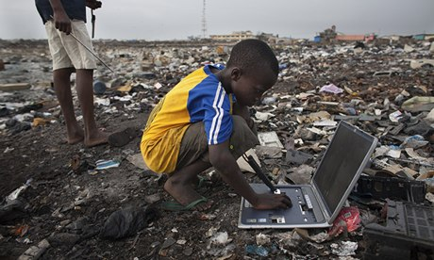
Faits sur les déchets électroniques à travers le monde
Il y avait 2,37 millions de tonnes de déchets électroniques en 2013 - environ 7 kg pour chaque personne sur la planète Seulement 8% des vieux téléphones cellulaires sont recyclés correctement Seulement 12,5% des déchets sont recyclés Le recyclage d'un million d'ordinateurs portables économise suffisamment d'énergie pour alimenter 3600 foyers
Notes:
3

Slide 4
Question 13/5
Réduction de l'impact environnemental, y compris les déchets électroniques
Domaine d'études prinipal Assurer la sécurité et la performance environnementale associées aux produits des TIC, des équipements et des installations, y compris la prévention des matières dangereuses et l'élimination finale grâce à des normes veiller à ce que les produits des TIC, des équipements et des installations aient un impact minimal sur l'environnement et la santé minimiser l'effet sur l'environnement des produits existants et nouveaux en cours de développement et en particulier les déchets résultants atténuer les déchets électroniques et réduire l'impact négatif environnemental et sanitaire comme les émissions de GES potentiels résultant d’une manipulation incontrôlée par un recyclage adéquat et respectueux de l'environnement

Slide 5
Question 13/5
Réduction de l'impact environnemental, y compris les déchets électroniques
Principales tâches: Élaborer des recommandations dans le domaine de l’atténuation et de la minimisation des dechets Motiver les membres de l'UIT à partager leurs expériences nationales et à diffuser les connaissances recueillies sur les aspects environnementaux et de durabilité des lois ou des directives Déterminer les processus afin de minimiser l'impact sur l'environnement (y compris la santé) de produits (matériaux, l’isolement des matières dangereuses ), les procédés de fabrication, les procédures opérationnelles et l'élimination ;
Notes:
5

Slide 6
Services attendus sous étude Déchets électroniques
Déchets électroniques
Métaux rares
A printing label format to provide rare metals information of ICT goods
Implementation guidelines for ICT supply chains due diligence on conflict minerals
Due Diligence Guidelines for Conflict Metals (Supply Title: Technical guidelines towards exercising due diligence when handling conflict minerals)
Technical report on life-cycle management of ICT equipment
Implementation guide on e-waste management
Supplement on Best practices on e-waste management in developing countries including information on country success stories
Test suites for assessment of the External universal power adapter solutions for stationary/portable information and communication technology device
Diligence appropriée
Les contributions sont les bienvenues! Prenez part à notre discussion
Notes:
6

Slide 7
Faits saillants sur les services attendus
Série des systèmes d’alimentation
Recommandation UIT-T L.1000: Adaptateur au secteur universel et une solution de chargeur pour les terminaux mobiles et autres appareils de TIC à main: Recommandation UIT-T L.1001: solutions d'adaptateur d'alimentation externe universelle pour l'information fixe et appareils de technologie de communication: Recommandation UIT-T L.1002: solutions d'adaptateur d'alimentation externe universelle pour les appareils de technologies de la communication et d’information mobile: Recommandation UIT-T L.1005: suites de test pour l'évaluation de la solution de chargeur universel:
Notes:
MTBF: Mean Time Between Failure
ITU-T L.1000 provides high level requirements for a universal power adapter and charger solution that will reduce the number of power adapters and chargers produced and recycled by widening their application to more devices and increasing their lifetime. The solution also aims to reduce energy consumption. The longer life cycle and possibility of avoiding device duplication reduces the demand on raw materials and waste. The universal power adapter and charger solution is designed to serve the vast majority of mobile terminals and other ICT devices.
- “Universal power adapter and charger solution for mobile terminals and other ICT hand held devices” (Recommendation ITU-T L.1000)
- Saves 82,000 tons of e-waste per year
- Saves at least 13.6 million tonnes of CO2 emissions annually
ITU-T L.1001 provides requirements for a universal power adapter solution (UPA) for stationary ICT devices that will reduce the number of produced power adapters by widening their application to more devices, enabling their reuse and increasing their lifetime. The solution also aims to reduce energy consumption. The longer life cycle and possibility of avoiding device duplication reduces the demand on raw materials and production of huge e-waste amount. The universal power adapter solution for ICT equipment for stationary use is designed to serve the vast majority of ICT devices.
- Consented on 12 October 2012 - NEW - “External universal power adapter solutions for ICT equipment for stationary use” (Recommendation ITU-T L.1001)
- Saves 300,000 tonnes of e-waste annually
- Reduces the energy consumption and greenhouse gas (GHG) emissions of external power supplies by between 25% and 50%
7

Slide 8
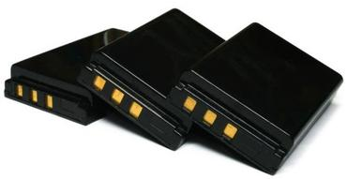
Highlights on deliverables
Batteries
Recommandation UIT-T L.1010: solution de batteries vertes pour téléphones portables et autres dispositifs d'information manuels et de technologie de la communication. Prolonge la durée de vie des appareils Réduit la consommation globale des ressources Élimine les matières toxiques
Notes:
8

Slide 9
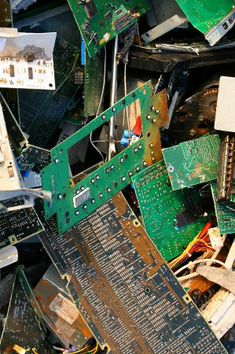
Highlights on deliverables
Gestion des déchets électroniques
Nécessité de recyclage de métaux rares: Recommandation UIT-T L.1100: Une méthode pour fournir des informations sur le recyclage de métaux rares dans les produits des TIC L.1101: Méthodes de mesure pour caractériser les métaux rares dans les produits TIC
L'énergie n'est pas inépuisable, de même que les ressources naturelles ne sont pas infinies Nous devons transformer notre comportement quotidien, envisager des objectifs ambitieux pour un avenir durable
Notes:
ITU-T L.1100 outlines key considerations in all phases of the recycling process, and provides guidelines as to how organizations may fairly and transparently report on rare-metal recycling.
ITU-T L.1101 presents measurement methods to characterize rare metals in ICT goods. To achieve successful recycling systems, the rare metals information provided by manufacturers should be accurate.
For successful recycling, producers are required to provide detailed information on rare metals to recyclers. The provided information should be accurate for effective recycling. However, many measurement and characterization methods may be used to obtain this information on elements (rare metals). Moreover, each method has its intrinsic advantages and disadvantages for the analysis of these elements. Element separation abilities and quantitative resolutions are divergent in different measurement methods. A common measurement method can facilitate recycling information exchanges between producers and recyclers.
Based on the guidelines of IEC 62321, this Recommendation provides reference characterization procedures for efficient recycling of rare metals by using XRF (X-ray fluorescence) and ICP-MS (inductively coupled plasma mass spectrometry) measurement methods.
9

Slide 10
L'énergie n'est pas inépuisable, de même que les ressources naturelles ne sont pas infinies Nous devons transformer notre comportement quotidien, envisager des objectifs ambitieux pour un avenir durable
Le changement est possible et ne peut attendre. Nous devons agir maintenant.
Photo credit: leadchangegroup.com

Slide 11
Question 17/5
L'efficacité énergétique pour le secteur des TIC et harmonisation des normes environnementales
Domaine d'étude principal
Définition des méthodes de mesure, les mesures / KPI et les valeurs de référence pour les différentes technologies Partage des meilleures pratiques pour l’ amélioration de l'efficacité énergétique de TIC Analyse des architectures énergétiques efficientes et solutions en faveur des réseaux intelligents Compléter et harmoniser les normes en matière de TIC et de l'environnement élaborées par d'autres commissions d’ études de l'UIT et organismes de normalisation
Notes:
11

Slide 12
Question 17/5
Définition des méthodes de mesure, les mesures / KPI et les valeurs de référence pour les différentes technologies
Principales tâches: Élaborer des recommandations dans le dans le domaine de l'efficacité énergétique Développer les meilleures pratiques et les meilleurs cas de référence Fournir et maintenir une vue d'ensemble des technologies clé d'atténuation Coordonner avec d'autres commissions d’études de l'UIT et d'autres organismes sur une base régulière pour assurer un alignement plus étroit

Slide 13
Services à fournir sous Etude
Work in progress
L.assDC - Assessment of energy efficiency on infrastructure in data center and telecom center
L.DC minimum set - Minimum data set and communication interface requirements for Data Center energy management
L.M&M_Networks - Energy efficiency measurement and metrics for telecommunication network
L.NET_Infra_assessment - Total network infrastructure Energy efficiency metrics
L.RBS_assesment - Energy efficiency metrics of mobile station cell site and best practice for energy saving
New work items
Assessment of energy consumption of telecommunication services
Reference operational model and interface for improving energy efficiency of ICT network devices
Analysis of the energy efficiency of telecommunication services used for the needs of smart grid applications
Standardization terms and trends in energy efficiency
Contributions are welcomed!
Take part of our discussion
Notes:
Work in Progress
L.assDC “Assessment of energy efficiency on infrastructure in data center and telecom center”. This Recommendation will define an assessment methodology of data center and telecommunication room infrastructure energy efficiency considering running conditions. The infrastructure will include an assessment methodology of whole Data center/ Telecom center infrastructure (or facility) efficiency, cooling system efficiency, power system efficiency, etc. It is expected to be consented in 2014
L.DC minimum set “Minimum data set and communication interface requirements for Data Center energy management”. This Recommendation will establish a minimum data set necessary to manage in environmentally conscious data centers and telecom centers. Moreover, it will define high-level interface requirements of ICT and facility equipment communication that contribute to energy saving and energy management. It is expected to be consented in 2014
L.M&M_Networks “Energy efficiency measurement and metrics for telecommunication network”. This Recommendation is jointly developed with ETSI EE and is aimed to define the topology and level of analysis to assess the mobile network energy efficiency (expressed as bit/Wh or m²/Wh), including radio base stations, backhauling systems, radio controllers and other infrastructure radio site equipment. The covered technology are GSM, UMTS, LTE (including LTE-A). Networks could be defined by geographic boundaries, such as city-wide, national or continental networks and could be defined by demographic boundaries, such as urban or rural networks. It is expected to be consented in 2014
L.NET_Infra_assessment “Total network infrastructure Energy efficiency metrics”. This Recommendation will specify principles and concepts of energy efficiency metrics and measurement methods to evaluate the energy efficiency of a total network consisting of telecommunication equipment and infrastructure equipment. The Recommendation will develop also methodology to consider the influence on total energy consumption of the maintenance activity establishing methodologies to consider the energy necessary for the transport activities embedded in the maintenance phase. It is expected to be consented in 2015
L.RBS_assesment “Energy efficiency metrics of mobile station cell site and best practice for energy saving”. This Recommendation report will energy efficiency metrics, test procedures, methodologies and measurement methods required to evaluate the energy efficiency of a mobile station cell site including the energy consumption for: equipment, infrastructure (including cooling and monitoring systems, lighting etc) and energy losses due to AC/DC rectifiers and cable losses. It will also contains the best practices for energy saving of the mobile station cell site. It is expected to be consented in 2015
Approved new Work Items
Assessment of Energy Consumption of Telecommunication Services. This new Recommendation will describe a methodology to assess the energy consumption of Telecommunication services. In particular the document is intending to define metrics and measurement methods for assessing (and measuring) the energy consumed by services. The output data obtained using this Recommendation can be used as input data for the methodologies developed in ITU-T Recommendation L.1410.
Reference operational model and interface for improving energy efficiency of ICT network devices. This new Recommendation will specify reference operational models for improving energy efficiency of networks including both wireline and wireless devices, both network and user side. Such reference model would help to reduce the network energy consumption, e.g. through entering energy saving sleep mode, implementing energy aware/proportional operation or traffic routing in order to reduce the number of active nodes
Analysis of the Energy Efficiency of Telecommunication Services used for the needs of Smart Grid applications. This new Supplement will be focused on the analysis of the energy consumption of different network technologies and architectures in support of the Smart grid (SG) and the identification of opportunities to improve the energy efficiency of SG, while matching the Service Levels required by the SG applications
Standardization terms and trends in energy efficiency. This new framework Recommendation will provide general requirements such as definitions of common understanding of terms, clarification of energy efficiency definition for different types of technologies (e.g. equipment/site/network/service level). It will refer to existing ITU-T Recommendations as well as other SDO’s deliverables

Slide 14
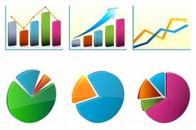
Faits saillants sur les services à fournir
Recommandation UIT-T L.1300rev - Meilleures pratiques pour les centres de données verts Recommandation UIT-T L.1310rev - mesures d'efficacité énergétique et de mesure pour l'équipement CCM Recommandation UIT-T L.1320 - mesures d'efficacité énergétique et de la mesure de la puissance et des équipements de refroidissement pour les télécommunications et les centres de données Recommandation UIT-T L.1340 - valeurs informatives sur l'efficacité énergétique des équipements de télécommunication
Notes:
Recommendation ITU-T L.1300rev “Best practices for green data centres”. This Recommendation provides a set of updated rules/best practices to be referred to when undertaking improvement of existing data centres, or when planning, designing or constructing new ones. More precisely, the following main areas are taken into account: ICT equipment and services; cooling and power equipment; data centre building and monitoring.
Recommendation ITU-T L.1310rev “Energy efficiency metrics and measurement for telecommunication equipment”. This Recommendation contains the definition of energy efficiency metrics test procedures, methodologies and measurement profiles required to assess the energy efficiency of different telecommunication equipment (DSLAM, MSAN, wireless, routers, Ethernet switches…), including now also Converged Packet Optical Equipment with packet signal, TDM signal and WDM signal functions.
Recommendation ITU-T L.1320 “Energy efficiency metrics and measurement for power and cooling equipment for telecommunications and data centres”. Recommendation ITU-T L.1320 contains the general definition of metrics, test procedures, methodologies and measurement profiles required to assess the energy efficiency of power and cooling equipment for telecommunications and data centres. Metrics and measurement methods are defined for power equipment, alternating current (AC) power feeding equipment (such as AC uninterruptible power supply (UPS), direct current (DC/AC) inverters), DC power feeding equipment (such as AC/DC rectifiers, DC/DC converters), solar equipment, wind turbine equipment and fuel cell equipment. In addition, metrics and measurement methods are defined for cooling equipment such as air conditioning equipment, outdoor air cooling equipment and heat exchanging cooling equipment.
Recommendation ITU-T L.1340 “Informative values on the energy efficiency of telecommunication equipment”. This Recommendation provides informative values on the energy efficiency of different types of telecommunication network equipment and small networking equipment in use in both the fixed and mobile networks. These values are related to energy efficiency metrics, test procedures, methodologies and measurement profiles that have been defined in Recommendation ITU-T L.1310. These informative values are intended to be a valued reference resource for those in the process of choosing the most energy-efficient technologies for network upgrade and deployment and, in so doing, reducing the carbon footprint of the Information and Communication Technology (ICT) sector.

Slide 15
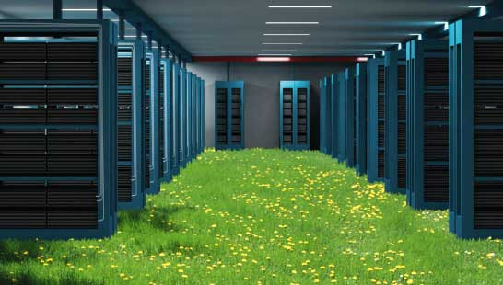
Faits saillants sur les services à fournir
ITU-T L.1300rev Best practices for green data centres
Par exemple, l’application des meilleures pratiques pour les centres de refroidissement peut réduire la consommation d’énergie d’un centre de données typique de 50 %.
%.
Les meilleures pratiques liées a la conception optimale et a la construction
Utilisation efficace et gestion des centres de données, en tenant compte a la fois des équipements d’alimentation et de refroidissement
Notes:
Recommendation ITU-T L.1300 describes best practices aimed at reducing the negative impact of data centres on the climate. It is commonly recognized that data centres will have an ever-increasing impact on the environment in the future. The application of the best practices defined in this Recommendation can help owners and managers to build future data centres, or improve existing ones, to operate in an environmentally responsible manner. Such considerations will strongly contribute to a reduction in the impact of the information and communication technology (ICT) sector on climate change.
The application of the best practices defined in this Recommendation can therefore help owners and managers to build future data centres, or improve existing ones, to operate in an environmentally responsible manner.
For example, applying best practices to cooling could reduce the energy consumption of a typical data centre by more than 50 per cent.

Slide 16
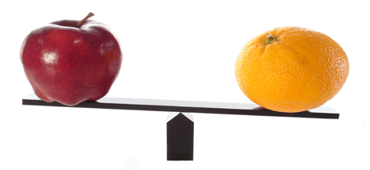
Faits saillants sur les services à fournir
UIT-T L.1310rev
mesures d'efficacité énergétique et les méthodes de mesure pour les équipements de télécommunications
Métriques et méthodes de mesure définies pour le haut débit filaire équipement / sans fil et de petits appareils de réseautage Ces mesures permettent des comparaisons d'équipements au sein de la même classe (par exemple l'équipement en utilisant les mêmes technologies)
Notes:
Recommendation ITU-T L.1310 contains the definition of energy efficiency metrics test procedures, methodologies and measurement profiles required to assess the energy efficiency of telecommunication equipment.
Metrics and measurement methods are defined for telecommunication network equipment and small networking equipment.
These metrics allow for comparisons of equipment within the same class e.g. equipment using the same technologies.
Comparisons of equipment in different classes are out of the scope of this Recommendation.
Benefits:
Understand the evolution of network in term of efficiency
Compare different solution of the same technologies

Slide 17
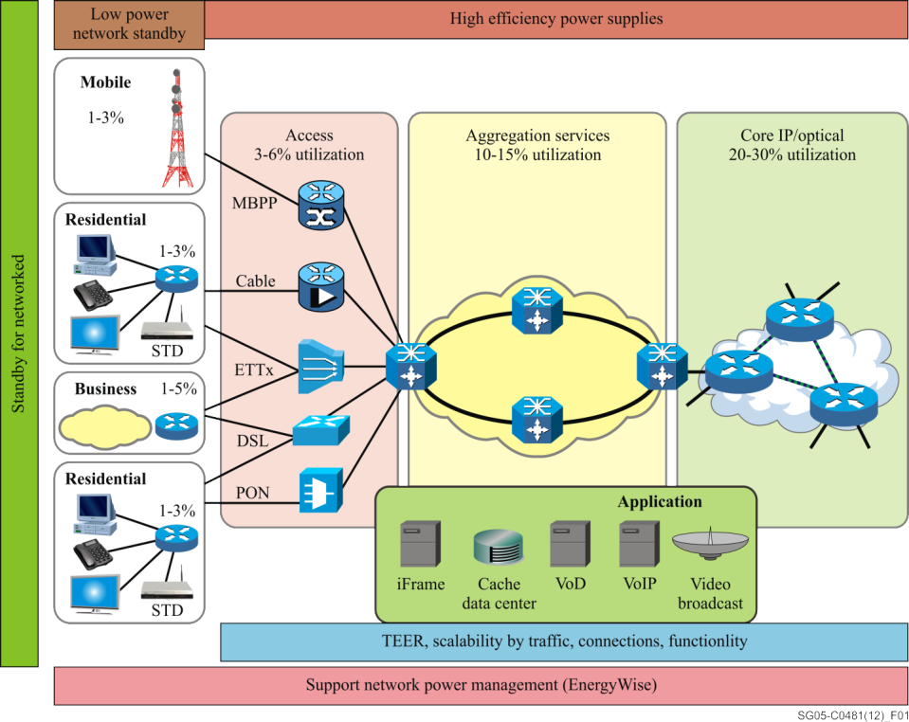
Faits saillants sur les services à fournir
Supplément sur ​​l'efficacité énergétique pour équipements de télécommunication
Recommandation UIT-T L.1300rev - Meilleures pratiques pour les centres de données verts Recommandation UIT-T L.1310rev - mesures d'efficacité énergétique et de mesure pour l'équipement CCM Recommandation UIT-T L.1320 - mesures d'efficacité énergétique et de la mesure de la puissance et des équipements de refroidissement pour les télécommunications et les centres de données Recommandation UIT-T L.1340 - valeurs informatives sur l'efficacité énergétique des équipements de télécommunication
Notes:
Supplement on energy efficiency for telecommunication equipment reviews the concepts for energy efficiency in application to networking devices; it presents a concept of place in a network as a base for classification, describes a process for creating a single metric for energy efficiency which reflects the qualities of equipment scalability with traffic levels and provides testing topologies and traffic pattern descriptions.
Network functionality, measure energy usage, network architecture and components are analyzed
Power measurement conditions, positions in the network and energy efficiency are discussed in the supplement

Slide 18
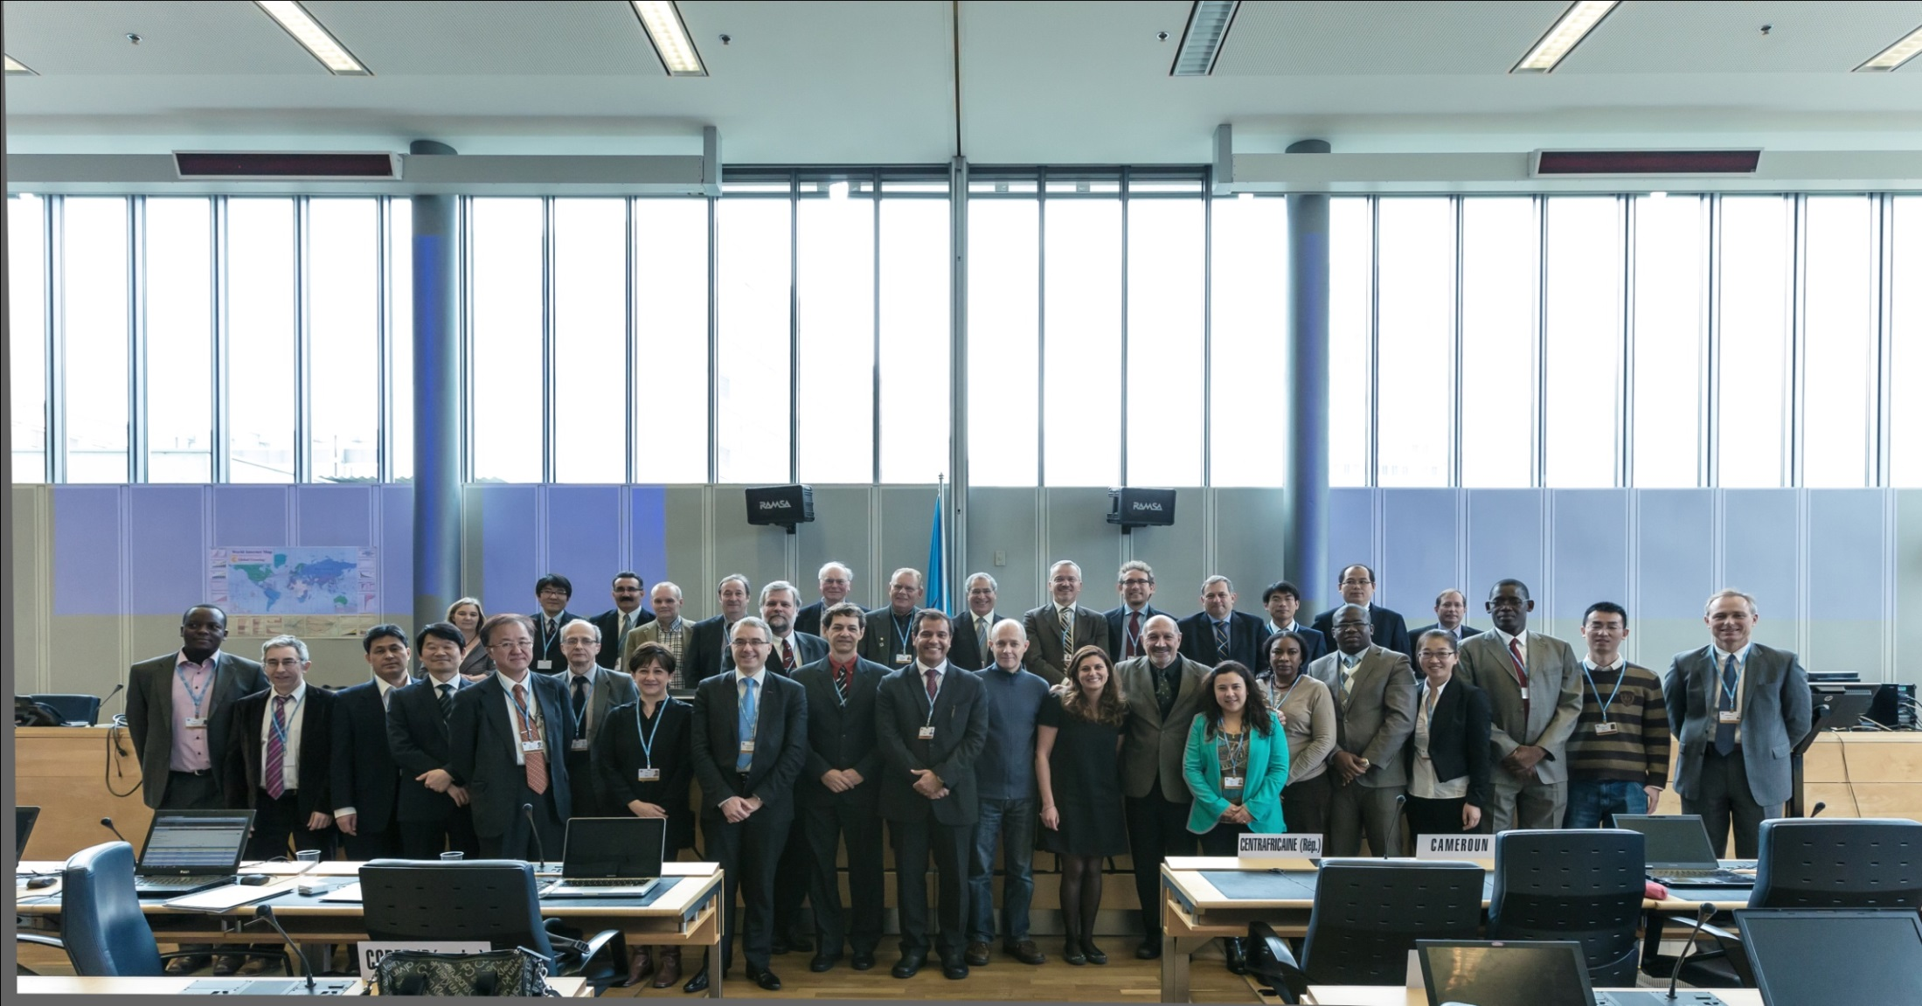
informations complémentaires
ITU-T/SG5 “Environment & Climate Change” itu.int/go/tsg5
ITU-T and Climate Change itu.int/go/ITU-T/climate
MERCI!! tsbsg5@itu.int

