Slide 1
ITU Regional Standardization Forum for Africa Dakar, Senegal, 24-25 March 2015
Energy and Environment
Protection of Equipment
Bocar KELLY,
Head of Architecture and Planning Networks Department , SONATEL bocar.kelly@orange-sonatel.com

Slide 2
Context
The availability of energy remains indispensable for the success of our projects.
Its sustainability remains a key factor for a QoS.
60% of networks failures (especially radio side) are due to the NRJ and the environment.
One of the special properties of the energy is that some of its characteristics depend on both the producer/distributor of electricity, equipment manufacturers and the client (Sonatel) .
Therefore we shoud deal with adopting a consistent methodology to ensure a qualitative power supply that is secured and adapted to our equipment.

Slide 3
Context
1 single figure to remind ...
... 57% of networks incidents stem from an power interruption
Origin | 2003 | 2011
Energy | 28% | 57%
Hardware Failure | 46% | 24%
Software Bug | 13% | 6%
mistake | 9% | 11%
Other | 4% | 2
Source: Study IALA 11/2011 Market U. S
Off cuts of fiber

Slide 4
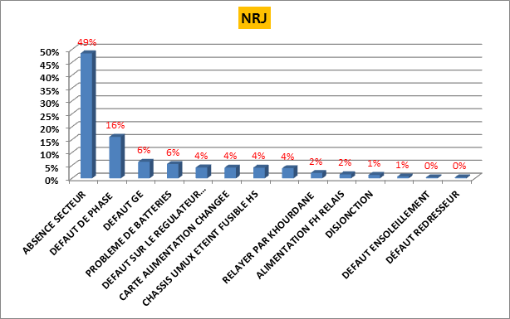
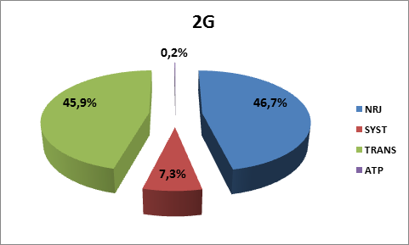
Case Analysis Sonatel
The analysis of incidents Shows that the NJR unavailability accounts for the main cause with 59% in 2013, 46.7% in 2014.
Zoom on the distribution incident NRJ
2013
2014

Slide 5
Sonatel Approach
Classification of sites
Classification of our sites in accordance with of the level of risk and setting up of adapted engineering rules enabling us to warrant the quality and the availability of energy.
Priority | Type of site | Sub priority
P0 | Strategic sites (2S)
P1 | Nodal sites (NS)
P2 | Medium sites (MS) | P2a
 |  | P2b
 | Delicate Sites (DS)
P3 | Traditional Access Site (TS)
 | Universal access site (US)

Slide 6
Sonatel Approach : Engineering Rules for P0 Sites
Site P0 | AES component | Rectifiers | Primary Power Supply of Rectifiers | Cabinet 48 V | Supply of equipment
 | Standard | 2 in redundancy with sharing of battery | Each rectifier supplied with a specific low voltage switch gear specific | 02 Cabinets in each room supplied with different rectifiers | Double supply of equipment eligible by two 48 V different sources
 | Primary component | Transf. MT/BT | GE | LOW VOLTAGE SWITCH GEAR
 | Standard | 2 | 2 | 2
 | technical environment component | box | Air Conditioning
 | Standard | 02 Air conditioning boxes supplied with two different LOW VOLTAGE SWITCH GEAR | Equitable distribution of the air conditioning in the 02 boxes

Slide 7
Approach Sonatel : Engineering Rules P1 Sites
Site P1 | AES Component | Rectifiers | Primary Power Supply for rectifiers | Cabinet 48 V | Supply of equipment
 | Standard | 2 in redundancy with sharing of battery if the site hosts a multiservice router | Each rectifier supplied with the same LOW VOLTAGE SWITCH GEAR | 02 Cabinets in each room supplied with different rectifiers if the site hosts a multiservice router | Double supply of equipment eligible by two 48 V different sources if the site hosts a multiservice router
 | Primary component | Transf. MT/BT | GE | LOW VOLTAGE SWITCH GEAR
 | Standard | 1 | 1 | 1
 | technical environment component | boxes | Air Conditioning
 | Standard | 01 Air conditioning box | Equitable distribution of the air conditioning in the box

Slide 8
The Optimization solutions for the Energy Consumption
"energy consumption" criterion is determining one for the choice of telecoms equipment during the tender calls process
Modernization of the RAN to reduce energy consumption:
Decrease of energy consumption TRX
Decrease of energy consumption for the charging of batteries
Prioritize the deployment of Outdoor BTS sites :
Improvement of the environment
Cancellation of the air conditioning consumption c(Outdoor)
The deployment of solar base stations (project Oryx 302 sites) is part of the "green strategy" aiming to achieve a reduction of:
Reduction of CO2 emissions
Decline in our overall consumption of energy
Migration of 100% Generator (GE) sites to hybrid Solar/GE with Saving Opex

Slide 9
Protection of Equipment against Factors External
Protect equipment against lightning strikes, and power surges during the construction phase of site:
Erection of a lightning conductor suitable and effective to capture the shock of lightning (more frequent in the rural area).
Grounding to lead this energy safely by using the down conductor.
Dispel this energy in the earth through a circuit of earth circuit of low-impedance
Eliminate possible loops and potential differences in ensuring the equi-potentiality of metal weights and circuits of earth.
Protect the equipment against power surges and transients on the power lines .
Protect the equipment against surges.

Slide 10
THANK YOU
Q&A

