Slide 1


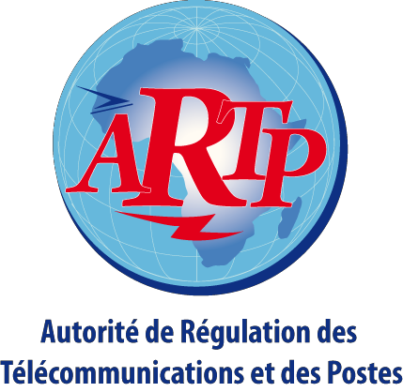




UN PEUPThe - UN BUT - AE Faith
PRIMHASTURE
Regional Forum for standardization Dakar 24 - March 25, 2015
SUPPORT FOR THE PROBLEMATIC OF NIR: case of Senegal

Slide 2




SUMMARY
1.
CONTEXT AND GENERAL INFORMATION
2.
RECALL OF THE INTERNATIONAL REGULATORY REQUIREMENTS
3.
THE REGULATION IN SENEGAL
4.
A FEW RESULTS OF MEASUREMENTS
5.
PROSPECTS
2
20.03.15

Slide 3
1- CONTEXT AND GENERAL INFORMATION
• Proliferation of base antennas of cellular networks;
• Implantation of radio stations in public places;
• Concern for the surrounding population
• Non-ionizing Radiation (frequencies below 300 GHz)
• Ionizing Radiations (X-rays, gamma, alpha, beta, etc.) that produce ionisations in the materials they pass through?
3
20.03.15

Slide 4
2- RECALL OF INTERNATIONAL
REGULATORY REQUIREMENTS
•
In 1996 the WHO has established an international project for the study of electromagnetic fields whose goal is to evaluate the effects on health and the environment from exposure to electrical and magnetic fields included in the range of frequencies from 0 to 300 GHz band.
The International Radiation Protection Association (IRPA) has put in place the scientific commission ICNIRP for promoting the protection against non-ionizing radiation (NIR) in the interest of the population and the environment.
The ICNIRP is a non-governmental organization officially recognized by the WHO and the ILO in the field of NIR
•
•
4
20.03.15

Slide 5
2-RECALL OF INTERNATIONAL REGULATORY REQUIREMENTS
The ICNIRP has established in 1998 the recommendations in two phases:
PHASE 1: Basic Restrictions (TAS / DAS) expressed in
A limit of 0.4 W/Kg for the workers
A limit of 0.08 W/kg for the general public
PHASE 2: reference levels expressed in
Electric field strength (E in V/m),
Magnetic field strength (H) in A/m),
Magnetic induction (B in mT),
Power density (S in W/m2).
5
20.03.15

Slide 6
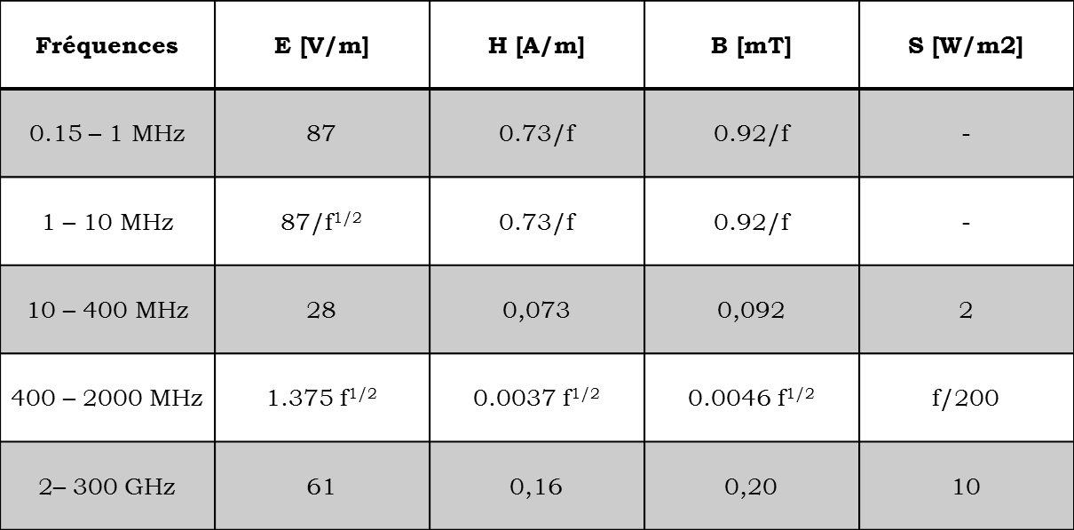
2- RECALL OF INTERNATIONAL REGULATORY REQUIREMENTS
The reference values for the general public:
6
20.03.15

Slide 7
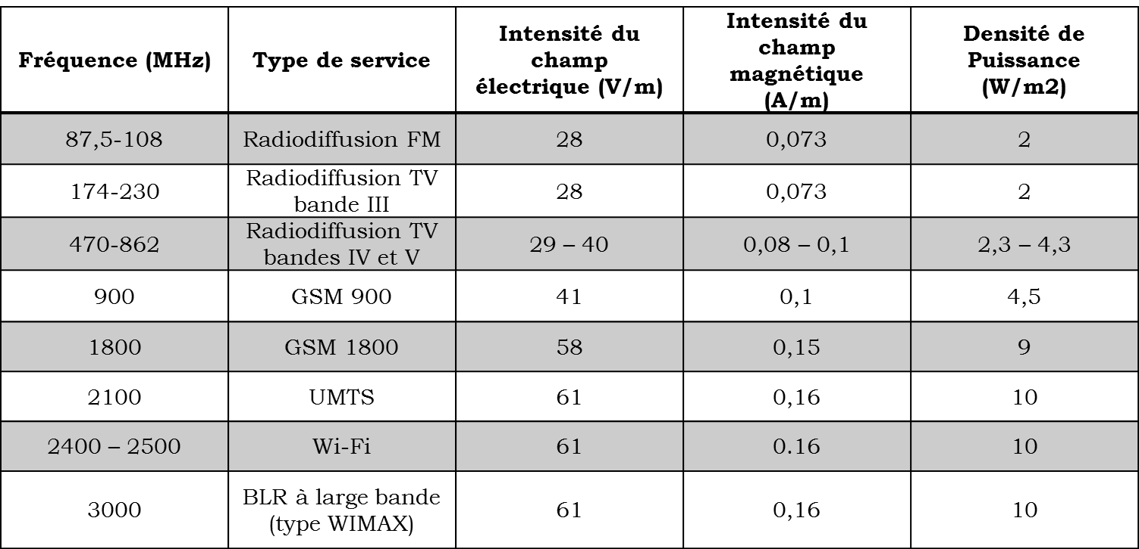
2- RECALL OF INTERNATIONAL REGULATORY REQUIREMENTS
The reference levels for the different radio services:
7
20.03.15

Slide 8
3- THE REGULATIONS IN SENEGAL
In Senegal, article 78 of the code of Telecommunications stipulates that:
"The installation and operation of radio equipment must be done while taking into account the imperatives related to the protection of the public in relation to electromagnetic fields"
The exposure limit values are laid down in the draft decree on the application of the Code of telecommunications.
8
20.03.15

Slide 9
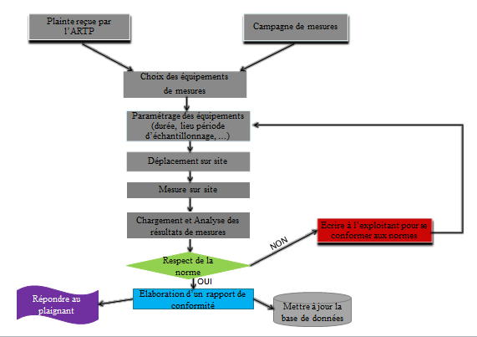
4- SOME RESULTS OF MEASUREMENTS
Algorithm of Measures
9
20.03.15

Slide 10
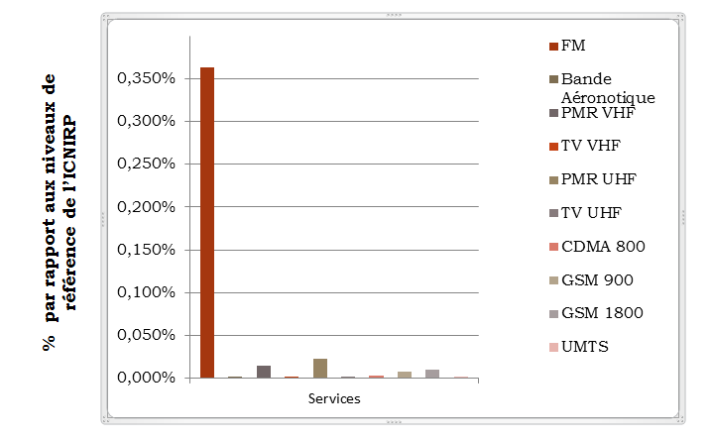
4- SOME RESULTS OF MEASUREMENTS
The graph below provides a comparison between the values of fields measured and those enacted by the ICNIRP
10
20.03.15

Slide 11
5- Prospects
Acquisition of equipment destined to NIR measures.
Deployment of a fixed network of probes in the areas with a high concentration of radio electricity.
Establishment of a commission in charge of sites and easements that bring together all the actors involved in the environment (Urban Planning, local communities, government departments, land development, etc.).
Establishment of a national observatory for NIR with the creation of a web site where the public can visualize in real time the exposure levels.
11
20.03.15

Slide 12
THANK YOU FOR YOUR ATTENTION

