Slide 1
Comprehensive Approach to assessment
of the Quality of multimedia services
ITU Regional Forum on standardisation
Dakar, March 24-25, 2015

Slide 2


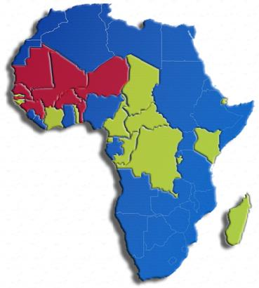


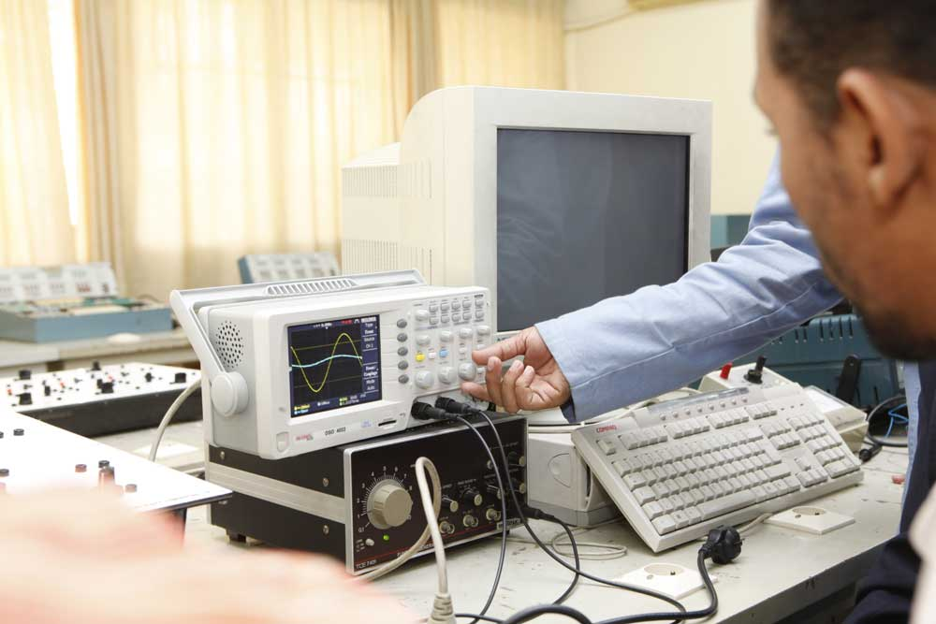

Presentation of the ESMT
7 founding member countries
more than 15 countries partners
CENTER OF EXCELLENCE

Slide 3
EXPERTISE on Multimedia QoS of the ESMT
Why should we audit the QoS Multimedia?
Context African
ICT development on the African continent and the regulation of competition
1
Universal Access
2
Protection of the interests of consumers
LIberalisation
Determination of the level of satisfaction of users
3
Protection of the right of users
4
Compliance with the contract specifications load of operators
3
Notes:
SURUDAHDENN@GMAIL.COM

Slide 4
EXPERTISE on Multimedia QoS of the ESMT
Average throughput of the transfer
Latency/deadline of transit of services
Respect of KPI
Warranted throghput
Objectives
Rate of services cut
Reliability of the transfer ( errors ?)
4
Notes:
SURUDAHDENN@GMAIL.COM

Slide 5
Approach 1
QoS EXPERTISE of the ESMT
It is done in reduced mobility by teams of qualified investigators equipped with testing software of QoS parameters available freely on the internet. After appraising the quality of multimedia services, they proceed with:
the intelligence of the collection sheets
the assessment of links, positions, hours, the average throughput , the minimum throughput, the maximum throughput, latency, other KPIS, ...

Slide 6
Approach 2
QoS EXPERTISE of ESMT
It is done in full mobility by teams of qualified investigators equipped with advanced platforms of tests purchased from recognized suppliers. They move in vehicles and record the trace of multimedia tests that are carried out.
The indicators used are similar to the first approach but they are supplemented with the error rate per measure., ...

Slide 7
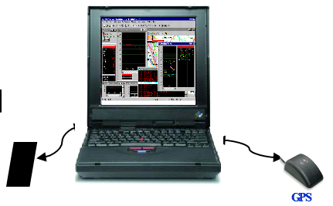


Presentation of devices of measurement (2)
QoS Multimedia Expertise of the ESMT
SAMSUNG
Sony Ericsson
GPS
Nokia
Hsi Bluewin
Of Swisscom For PC
4G mobile mark
Performance test
ACCUVER
7

Slide 8

Presentation of devices of measurement (1)
QoS Multimedia EXPERTISE of the ESMT
SAMSUNG
Sony Ericsson
GPS
Nokia
Collection Tools
ACCUVER
NEMO
ZK
TEMS
Investigation
8

Slide 9
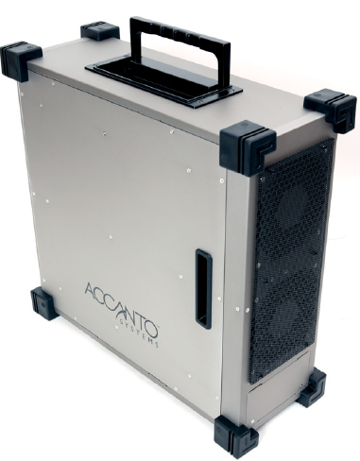
Presentation of devices of measurement (3)
EX QoS Multimedia EXPERTISE of the ESMT
VoIP, NGN, IMS and PS Domain
Field CS
Interco
TDM,
ATM
TDM
GPS
IP
Tools for monitoring
Tools for monitoring operator
Protocols Analyzer
9

Slide 10

Terrain Foyer, Rocade Fann Bel Air Dakar
BP 10 000 Dakar Liberté - Senegal
Tel: (221) 33,869 03 00
Fax: (221) 33,824 68 90
Email: Esmt@esmt.sn
Www.esmt.sn
10

