Slide 1
ITU Regional Standardization Forum For Africa
Dakar, Senegal, 24-25 March 2015
Session 4:
Tools and Methods of QoS Measures of the Mobile Internet of Broadband Networks
Case of Morocco
Hassan TALIB,
Vice-Chair ITU-T SG 12, Head DCT ANRT
Talib@anrt.ma // Htalib@ties.itu.int

Slide 2
Plan of the Presentation
The mobile Internet service 3G in Morocco
Introduction: QoS background ...
Types of measures:
  Mobile Internet 3G on PC,
  Mobile Internet 3G Smartphones
  Measures FTP or HTTP
Mesured Indicators (Definitions)
Platform of servers of Measures
Measurement Tools
  Conclusions and recommendations
Senegal, Dakar, March 24-25, 2015

Slide 3
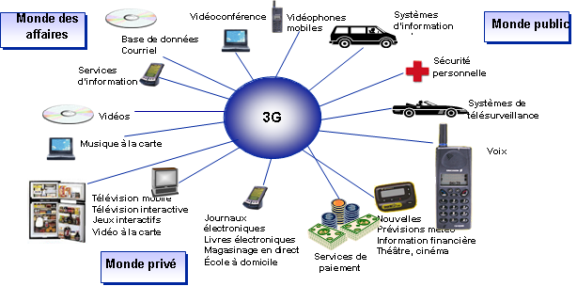
The mobile Internet service 3G at Morocco
Three Operators 3G ( Universal Operators ) :
  Itissalat Al-Maghrib (Morocco Telecom) and Medi Telecom: Technology UMTS
  Morocco connect (Wana Corporate) : UMTS technologies and CDMA-2000.
The 3G services, launched in Morocco in March 2007, will drive the development of the Internet in Morocco
Senegal, Dakar, March 24-25, 2015

Slide 4
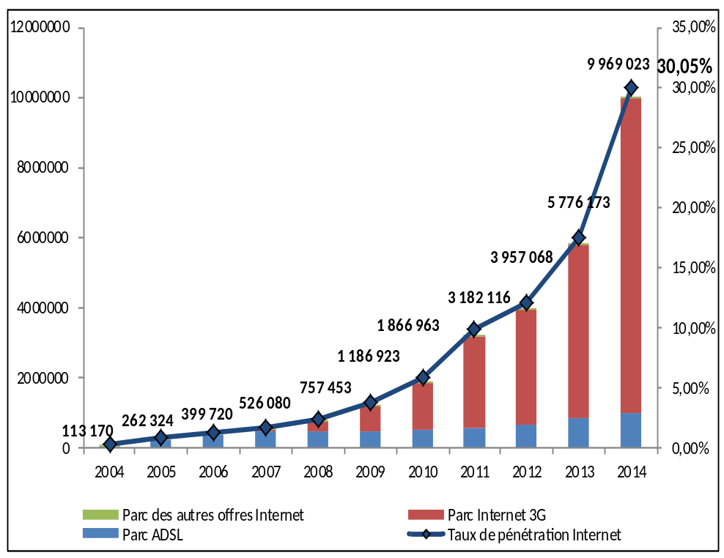
The mobile Internet service 3G at Morocco
The Internet park has experienced sustained growth during the past five years, and in particular from 2011 onwards.
This growth is mainly due to the development of offers for mobile internet 3G.
On nearly 10 million Internet subscribers, more than 90% use the connections 3G mobile against 9.8 per cent for the fixed ADSL access.
Senegal, Dakar, March 24-25, 2015

Slide 5
The mobile Internet service 3G at Morocco
On the period 2008-2014 : the average monthly bill by Internet subscriber has recorded a decline of 85 %.
At end 2014, the average monthly bill by internet subscriber has reached 23 DHHT/month/customer. For the Internet 3G, this invoice is within the range of 18 DHHT/month/customer whereas it is 93 DHHT/month/customer for ADSL.
Senegal, Dakar, March 24-25, 2015

Slide 6
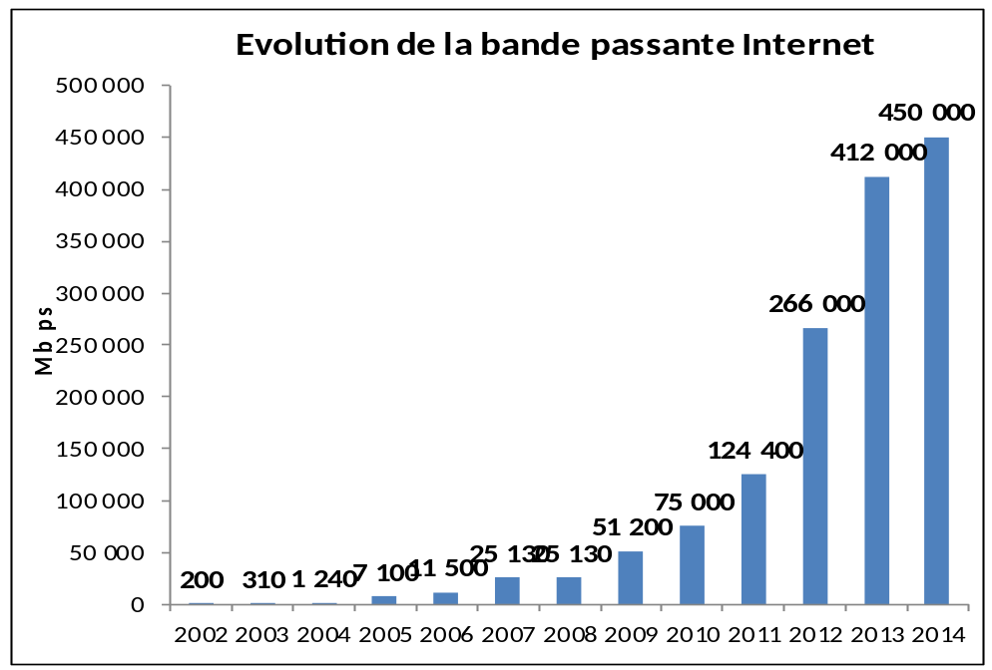
The mobile Internet service 3G at Morocco
International bandwidth and Domain Names
Evolution of the number of domain names " .my "
The park of the domain names " .ma " continues to grow by reaching 54,450 accounts at end 2014 or a growth of nearly 7% compared to end of 2013.
The names of domains created directly under the extension ‘ma’ is dominant ( 88.7 % ).
The bandwidth of international internet has experienced a growth of more than 9% in 2014 with a capacity of 450 000 Mbps.
Senegal, Dakar, March 24-25, 2015

Slide 7
Plan of the presentation
Introduction: QoS background
Senegal, Dakar, March 24-25, 2015

Slide 8
Background for the Follow up of QoS/QoE ANRT
Device for QoE :
QoE Portal and downloaded applications
Adoption of a communication strategy (publication)
An international regulatory framework (standards) :
ITU-T: series E, G, P, Y, QoS Handbook, ...
Regional: ETSI (EG-series), IEEE,...
A national regulatory framework:
Responsibilities
-QoS obligations for operators
A benchmark of best practices and a technological watch
The ANRT exercised a steady monitoring of the QoS
Use feedbak:
Complaints,
Press,
Associations of consumers,
...
Analysis of the data received from the operators in terms of performance, KPIS and QoE measures.
Measures on the field (campaigns) carried out by the ANRT

Slide 9
Background for the Follow up of the QoS
Establishment of a comprehensive system of reception of KPI of operators: all networks and all services
Full operational Model of KPI data according to the fixed frequencies
Elaboration of reference documents agreed by all the actors regulating the field measures of the QoS
Mastered Externalisation of measures and use of the results by the operators

Slide 10


Background for the follow up of the QoS
Methodology for the Evaluation of the Quality of service QoS Data for the 3G networks (UMTS or CDMA2000 on PC or SP) is perfectly valid and adapted for broadband mobile Networks :
4G ( ),
Wifi Outdoor (offloading ) ,...
Senegal, Dakar, March 24-25, 2015

Slide 11
Plan of the Presentation
Types and conditions of Measures QoS :
  Mobile Internet 3G on PC,
  Mobile Internet 3G Smartphones on
  Measures FTP or HTTP
Senegal, Dakar, March 24-25, 2015

Slide 12
QoS of the Mobile Internet 3G
Types and conditions of QoS Measures :
  Mobile Internet 3G on PC: USB dongles (Prepaid Or Post-Paid) on computers for the UMTS or the CDMA-2000.
  Mobile Internet 3G on Smartphones: SIM/ 3G for subscribers on SP/tablets only for the UMTS.
  Measures in FTP mode or HTTP : to be carried out with sized Files for measures (Up/Dw): 1Mb, 5Mb, ...
Senegal, Dakar, March 24-25, 2015

Slide 13
QoS Of The Mobile Internet 3G
Types and conditions of QoS Measures :
  Evaluation of the QoS ≠ Evaluation of the Coverage.
  Any Measure must be carried out only in the areas declared fully covered by all the operators at the same time : exercise of geographical sample and the map of coverage.
  The exercise of mapping of coverage must be done with full detail of the quarter and not with that of the City.
Senegal, Dakar, March 24-25, 2015

Slide 14
Plan of the presentation
Measured Indicators

Slide 15
QoS of the mobile Internet 3G
For each type of measure, what indicators are relevant?
  Jitter, delay, debit, loss of data, etc. ?
  Pragmatic objectives (by satisfaction survey) relevant for user experience : measure the accessibility (Rate and connection time), the reliability and the speed (debit of transmission and reception).
  Transformation of these elements in ten (10) indicators:
Senegal, Dakar, March 24-25, 2015

Slide 16
QoS Of The Internet Mobile 3G
List of the ten (10) measured Indicators :
  The rate of successful connections: A connection is successful if it is established in a period of less than 1 minute. The rate of successful connections is calculated on the basis of all of the measures carried out.
  The rate of successful connections in a period of less than 10 seconds: The rate of successful connections in a period of less than 10 seconds is calculated on the basis of all of the measures carried out.
  The rate of files of 1 Mb sent within a period of less than 2 minutes: A file is considered to be sent if the file is sent fully within a period Dmax And if its content is correct. The rate is calculated on the basis of the total number of files sent.
  The rate of files of 5 Mb received within a period of less than 5 minutes: A file is considered received if the file is received in full and if its content is correct. The rate is calculated on the basis of the total number of downloaded files.
Senegal, Dakar, March 24-25, 2015

Slide 17
QoS Of The Internet Mobile 3G
List of the ten (10) measured Indicators :
  The data debit achieved for 90% of the files of 1 Mb sent: This indicator corresponds to the percentile at 90 per cent of the files sent.
  The data debit achieved for 50% of the files of 1 Mb sent: This indicator corresponds to the percentile at 50 per cent of the files sent.
  The data debit achieved for 10% of the files of 1 Mb sent: This indicator corresponds to the percentile at 10 per cent of the files sent.
Senegal, Dakar, March 24-25, 2015

Slide 18
QoS of the Mobile Internet 3G
List of the ten (10) measured Indicators :
  The debit of data achieved for 90% of the files of 5 Mb received : This indicator corresponds to the percentile at 90 per cent of the files sent.
  The debit of data achieved for 50% of the files of 5 Mb received: This indicator corresponds to the percentile at 50 per cent of the files sent.
  The debit of data achieved for 10% of the files of 5 Mb received: This indicator corresponds to the percentile at 10 per cent of the files sent.
Senegal, Dakar, March 24-25, 2015

Slide 19
QoS of the mobile Internet 3G
Measured Indicators :
  Important Details:
  The debit for the 3G networks is a debit shared between all users. The actual debit (operated) is always Lower than the theoretical one (marketed). It is a technological consideration.
  But this debit is measurable for all the operators with the same device.
Senegal, Dakar, March 24-25, 2015

Slide 20
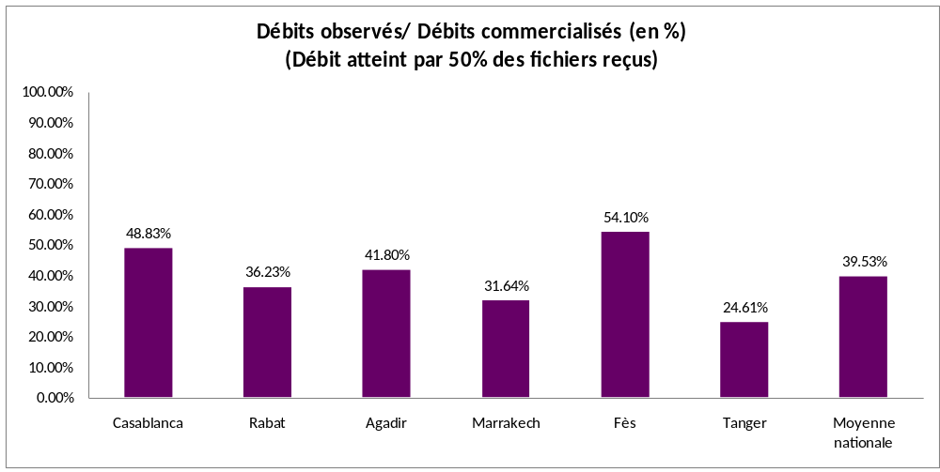
QoS of the Mobile Internet 3G
Additional Indicator: TUDC
  The Rate of use of the contractual debit (TUDC) corresponds to the relation between the used debit (observed) and the contractual one (marketed) in the relevant operator’s. This relation is expressed in percentage.
An actual
Example for a
3G network.
Senegal, Dakar, March 24-25, 2015

Slide 21
Plan of the presentation
Platform of servers of Measures

Slide 22
QoS Of the mobile Internet 3G
Platform of servers of measures:
  Measuring the performance of a 3G mobile Internet network is performing measurement of the QoS of a connection through this network between a terminal and a data server.
  Several external factors may impact on one of the segments of the test path. Hence the challenging of the results of measures by the relevant operator.
  The option of measures with an international server must be set aside.
Senegal, Dakar, March 24-25, 2015

Slide 23
QoS of the 3G mobile Internet
Platform of servers of measures:
  Problem: Lack of server (among the hosts), at the national level, connected to all the networks with a capacity greater than the highest debit offer!!!
  Solution: design of a platform of servers of measures at the level of the regulator’s premisses.The capacities of the links are greater than the measured debits (example 10Mb/s to measure 7.2 Mb/s and 20Mb/s to measure 14.4 Mb/s).
Senegal, Dakar, March 24-25, 2015

Slide 24
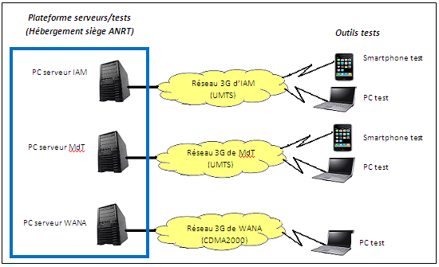
QoS of the 3Gmobile Internet
Platform of servers:
All the test files are installed in each server of the platform connected by FO to the 3G network of the operator.
Senegal, Dakar, March 24-25, 2015

Slide 25
Plan of the presentation
Measurement Tools

Slide 26
QoS of the 3G Internet Mobile
Tools of Measures (Precautions)
  Terminal Equipment (PC, SP, and dongles/USB) , Criteria Of Choice :
    Choose among the industrial models the most used in the national market.
    With performing characteristics that do not curb the the highest measured debits. For the PC (OS, firewalls, antivirus, etc. ) and for the Terminals (Twindowsize, MTU, CPU, RAM, etc. ).
Senegal, Dakar, March 24-25, 2015

Slide 27
QoS Of The Internet Mobile 3G
Tools of measures (Precautions)
  Profiles of subscriptions used:
    Post-paid or prepaid.
    Beware to downgrade of debit if the download volume reached the thresholds.
    The tests on the SP must be done in 3G strained mode and not in dual (avoid confusion GPRS or EDGE).
    For each operator (a server and a link) only one measurement is to be done at once.
Senegal, Dakar, March 24-25, 2015

Slide 28
QoS of The 3G Internet Mobile
Tools of Measures
  Application Software (agents installed in the terminals : PC and SP) :
    To each data connection, the application records information upwardly for automatic calculation of all the QoS indicators of the connection (level of fields, SC, failures, success, etc. ) as well as the GPS position
    The application allows you to store directly and automatically all the results (indicators) in a server that centralizes the preparation of the required reports in the framework of the dedicated portal.
Senegal, Dakar, March 24-25, 2015

Slide 29
Plan of the presentation
  Conclusions and recommendations

Slide 30
Conclusions and Recommendations
Recommendation 1
  Permanent consultation with the upstream operators on the methodology. Adoption of a concerted approach of reference for the follow up.
Recommendation 2
  None of the operators is informed on the sites of the measures or about the period.
Senegal, Dakar, March 24-25, 2015

Slide 31
Conclusions and Recommendations
Recommendation 3
  Achieve a significant number of blank QoS measures with the same tools as those used in the campaigns of actual measures and preferably in the presence of the representatives of the operators concerned by the measures (mitigate or do away with any challenge of potential operators).
Senegal, Dakar, March 24-25, 2015

Slide 32
Conclusions and Recommendations
  Recommendation 4
  Measures for operators: positive use of results by the operators (use of the platform test servers//objective potential financing of campaigns by the operators).
  Recommendation 5
  Publish the results (comparative), adopt a communication strategy and consider The sanctions For the anomalies as Last resorts.
Senegal, Dakar, March 24-25, 2015

Slide 33
Conclusions and Recommendations
  Recommendation N°5 ( further part)
  Publication of the results of measures:
1st voice campaign on a large sample (about thirty cities and concentration points airports, tourist centers etc. ).
1ER Quarter of the year
2nd campaign similar to the first based on practically the same sample.
4Th Quarter of The year
Communication of results
to operators
Deadline within 5 to 6 months for
Correction of abnormalies
identified by the ANRT
(Publication of Results and communication)
Senegal, Dakar, March 24-25, 2015

Slide 34
Thank you for your attention
Questions/Answers
Talib@anrt.ma // Htalib@ties.itu.int

