Slide 1
AUDIT OF THE QOS OF MOBILE TELEPHONY NETWORKS 2G/ 3G: THE CASE OF COTE D'IVOIRE
FORUM ON THE STANDARDIZATION IN AFRICA
(Dakar, Senegal, March 24-25 2015)
Fabrice KOUHON Derou,
Chef de service de la Quality de Service,
Autorité de Regulation des Télécommunications/TIC de Côte D’Ivoire
Kouhon.derou@artci.ci

Slide 2
Summary
Telecommunications Environment
Mobile telephony in Cote d'Ivoire
Audit of the QOS of mobile telephony networks 2G/ 3G

Slide 3
Telecommunications Environment
DECRET
LOIS
ORDONNANCE
Ordinance N°2012-293 of 21 march 2012 on telecommunications and Information and communications Technologies
Decree n°2013-302 of 02 may 2013 setting the specifications contents of individual licences ; the authorization for the establishment and operation of telecommunications networks /ITC and the delivery of telecommunications services.
Act relating to electronic transactions, protection of private data and fight against cybercriminality.
LEGAL
INSTITUTIONAL FRAMEWORK
ORANGE
FIXED TELEPHONY
COTE D’IVOIRE TELECOM
IAP
AFNET
IZINET
MOBILE TELEPHONY
MTN
MOOV
COMIUM
GREENN
NIAMOUTIE TELECOM
AROBASE TELECOM/MTN
VIPNET
CI2M (AVISO)
SAV PROVIDERS
MEDIASOFT
PREMIUM
INTERACTIVE
ALINK
YOOMEE
ACTORS

Slide 4
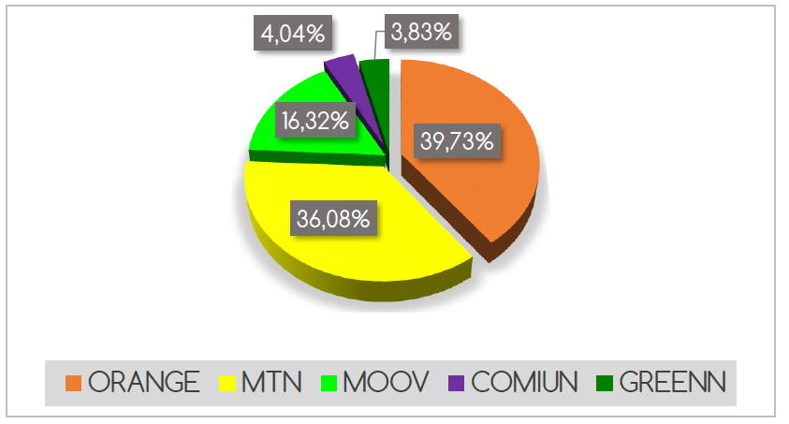
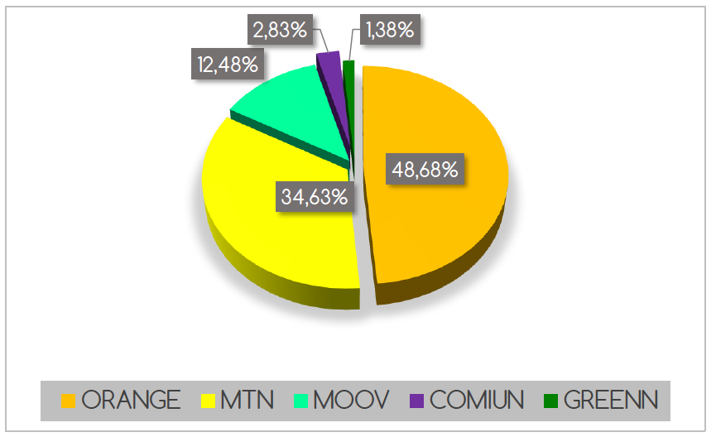
MOBILE TELEPHONY IN CI
2G networks: 6 Operators | 3G networks: 3 Operators
ATLANTIC TELECOM CI COMIUM CI MTN CI NIAMOUTIE TELECOM ORANGE ORICEL CI | ATLANTIC TELECOM CI MTN CI ORANGE CI
PARK OF SUBSCRIBERS: 22,104,575
TURNOVER 2014:783,888,154,000 FCFA
Source: http://www.artci.ci/images/stories/pdf/rapport_activite/stat_4eme_trim_2014.pdf

Slide 5
OBLIGATIONS OF OPERATORS
Specifications (1/2)

Slide 6
OBLIGATIONS OF OPERATORS
Specifications(2/2)
Obligations relating to the data throughput rate
30 Kbits/s in 2G
512 Kbit/s in 3G
Obligations relating to the quality of the signal
RxQual: 96% measured must be less than or equal to 4.
Error Rate in interference: -16db<EC/I0
Error Rate in transport: redoubled<10
Coverage Obligations of the population
Obligations per stratum
Obligations on network availability
In an area deemed covered, the probability that mobile services are available for a user.
Penalties defined in the CDC in case of breaches

Slide 7
AUDIT OF THE QOS
Objectives:
Check the conformity of the indicators of quality of services
Reflect the image of the quality of service such as the one that is felt by the customer
Make a comparative study of the QoS/QoE offered by the operators
Periodicity: Half-yearly
Development of a protocole of mesurement
Selection of a firm
Development of an operating mode
Field campagn
Post-TReatment
Results
Cease and desist order/Penalties

Slide 8
AUDIT OF THE QOS
The measurement protocol
THE ARTCI sets with all the operators the measurement protocol that will be applied during the campaign. It contains:
The types of networks and the operators to be audited
The audited services
The modes of measurement
The geographical areas for Measurement
The prerequisite to the campaign
The mesured indicators and their reference thresholds
The penalized indicators
The mode of classification
The mode of publication
Background: Texts and regulations in force (CDC, ITU, ETSI etc. . ), Good practices observed

Slide 9
AUDIT OF THE QOS
The measurement protocol (Audit 2014)
Types of networks and operators to be audited: 2G/ 3G, all operators
The audited services
The mode of measurement : , INDOOR/IN CAR/OUTDOOR 2G/ 3G/ DUAL MODE

Slide 10
AUDIT OF THE QOS
The measurement protocol (Audit 2014)
The modes of action: INDOOR/IN CAR/OUTDOOR
The MultiMedia services/Internet
Videophony:
The principle of videophony measurement is to assess the ability of a subscriber to access the network, to maintain its communication for a duration of 2 minutes and talk properly to his/her interlocutor in covered areas where the network of the 3G operator is available
Successive calls to 120s with an idle length of 30s
MMS:
The principle of MMS measurement is to assess the possibility for sending an MMS and a good receiving in a reasonable time, without error.
Issuing of MMS text+image of 20kb successive
DATA:
The principle of the DATA measurement is to assess the possibility for downloading a data file and its good receiving in a reasonable time, without error or for navigating easily on a web site or even for watching a streaming video easily and without interruption
FTP UL/DL to an FTP server via Dongle and Smartphone
HTTP Browsing toward the most famous of reference sites
Streaming from a server

Slide 11
AUDIT OF THE QOS
The measurement protocol (Audit 2014)
The measured indicators and their reference thresholds

Slide 12
AUDIT OF THE QOS
The measurement protocol (Audit 2014)
The measured indicators and their reference thresholds
Rate of communications incorrectly billed zero
Call Rates forwarded to voice mail of least 3s billed zero
Rate of calls to the call center successful within 20 s greater than 90%
Rate of communications attended by an operator within one minute is greater than 90%

Slide 13
AUDIT OF THE QOS
The measurement protocol (Audit 2014)
The penalized indicators

Slide 14
AUDIT OF THE QOS
The measurement protocol (Audit 2014)
The penalized indicators
The mode of classification
By indicator
By coverage & network availability
By type of service
By type of network
Overall
The mode of publication
Notification of results to each operator
Availability of this RAW DATA for each operator
Release of the results in the press, publication on web site of ARTCI

Slide 15
AUDIT OF THE QOS
Development of a protocole of mesurement
Selection of a firm
Development of an operating mode
Field Campaign
Post-treament
Results
Cease and desist order/Penalties
Operating Mode:
Prepared by the selected firm and ARTCI
Set the technical descriptions and rules of measures on field
Measurement Chains
Types of terminals
Validation of scripts of Measures
Validation of the size of the samples and the points of measurements
Planning of the audit

Slide 16
AUDIT OF THE QOS
Operating Mode: measurement chain (Audit 2014)
Operator Has
2G
Operator B
2G
Operator C
2G
Operator D
2G
Operator E
2G
Operator F
2G
Operator Has
Dual
Operator Has
2G
Operator B
2G
Operator Has
3G
Operator B
3G
Operator C
3G
Operator D
2G
Operator E
2G
Operator F
2G
Operator B
Dual
Operator C
2G
Operator D
2G
Operator Has
3G
Operator B
3G
Operator C
Dual
Operator E
2G
Operator F
2G
Operator C
3G
Local
ARTCI
03/10/2014
Mobile Team
17

Slide 17
AUDIT OF THE QOS
Development of a protocole of mesurement
Selection of a firm
Development of an operating mode
Field Campaign
Post-treatment
Results
Cease and desist order/Penalties
From field campaign to the results of the audit:
Unfold the protocol on the ground
Schedule: the rushing hour on the network of the operator
Measures carried out simultaneously for all operators
Presentation of results to operators
Availability of these RAW DATA for each operator and results for analyzes, comments and suggestions
Presentation of the final report of the audit to the press and publication on the website of ARTCI

Slide 18
AUDITDE QOS
Development of a protocol of mesurement
Selection of a firm
Development of an operating mode
Field campaign
Post-treatment
Results
Cease and desist orderPenalties
Cease and desist order or penalties:
Decision of the regulation council issuing a cease and desist order to correct the stated breaches
Decision of the Regulation Council imposing penalties for breaches of QOS

Slide 19
AUDIT OF THE QOS
Recommendations
Define a collaborative framework between the regulator and the operators
Define a measurement protocol and a detailed operating mode , adopted by all operators
Ensure the implementation of the measurement protocol on the field
Have a quite representative sample
Publish the comparative results
Prospects 2015
2 Audits of the QoS of mobile networks
Supplement the audits with analyzes of the data of WTO-R
Setr up a continuous control system with probes
Improvement of the protocol by detailing the operating mode as far as possible

Slide 20
THANK YOU FOR YOUR ATTENTION
QUESTIONS ?
Kouhon.derou@artci.ci

