Slide 1
Control and Monitoring Platform of the QoS/ QoE of Mobile telephony Networks in Senegal

Slide 2
SUMMARY
Context
Objectives targeted through the Plan of Actions
Elements that have guided the choice of the Plan of Actions
The Components of the Plan of Actions
Description of the different components of the Plan of Actions
Recall of the QoS indicators Followed up monthly by the ARTP

Slide 3
Context

Slide 4
Context
Very strong growth of the market for mobile telephony observed these recent years (7.5 % of penetration in 2003, 38.9 % in 2007 and more 106% in December 2014);
More stringent requirements of consumers with the generation of Multimedia services and the uses of the mobile;
Downgrading Quality of Services during the promotional sales;
Less satisfactory expectations of consumers and resurgence of complaints in matters such as availability of service, coverage, throughput, .. ;
Instructions from the Managing Director to raise the QoS to one of the Priorities of ARTP notably the QoS perceived by the Consumer;
Orientation toward the QoE;
Ambition to align on the International Standards;

Slide 5
Objectives targeted through the Plan of Actions
Ensure compliance with the provisions of specifications for operators and decisions of ARTP in the field of QoS;
Enable consumers to access to emergency services at any area in the territory ;
More stringent requirements of consumers with the generalization of multimedia services and the uses of the Mobile;
Bring the operators to continuously improving the QoS of their networks and create a dynamic of competition through the QoE ;
Improve the coverage of the territory in population and area;
Equip ARTP with equipment and adequate platforms, for control of vocal services QoS/QoE, SMS and data;

Slide 6
Elements that have guided the choice of the Plan of Actions

Slide 7
Elements that have guided the choice of The Plan of Actions
The improvement of the QoS/QoE retained as the top Priority in 2015 by the Executive Department of ARTP ;
The follow up of the QoS such as what is perceived by the user on a daily basis ;
The taking into account of the Consumer’s concerns ;
The taking account of the strategic plan of ARTP 2015-2017
Obligation for ARTP to give visibility to operators , consumers and other actors, on its system of caring for the mobile QoS/QoE in 2015.

Slide 8
Components of the Plan of Actions

Slide 9
The Components of the Plan of Actions 1/2
The strengthening of the control and monitoring platform of the QoS of the networks of mobile telephony operators;
The Establishment of a system for handling consumer complaints and Information for the general public on the QoS/QoE of operators’Networks ;
Supervision of the QoS of the operators’networks of mobile telephony during religious events (Touba, Tivavouane, Kaolack, Popenguine, Call Limamoulaye, ETC. ) and the venues of mass meetings;
Acquisition of Equipment for the measurement of the QoS/QoE ;
Operation of an attending and monitoring device of calls towards emergency numbers ;

Slide 10
The Components of the Plan of Action 2/2
Acquisition of a Platform for the assessment of the quality of service (QoS) and the quality of experience (QoE) of Networks of mobile telephony;
Technology Watch on the monitoring of the QoS/QoE of mobile telephony networks;
Dynamic Monitoring of the Development of infrastructure of mobile telephony operators (coverage maps);

Slide 11
Description of the different components of the plan of actions

Slide 12
Strengthening of the control and monitoring platform of the QoS of Mobile telephony operators 1/2
Revision of the threshold of QoS indicators (KPI) in accordance with the best international practices and in consultation with the operators ;
Bilateral meetings each quarter with the QoS operators to draw up statements of the previous quarter and set the prospects for the next quarter. At the end of these meetings, a communiqué will be released for all the sector actors;
Realization of quarterly measurement campaigns by area in accordance with the administrative divisions of Senegal to raise defaults and have them addressed by operators ;

Slide 13
Strengthening of the device control and monitoring of the QoS Mobile telephone operators 1/2
Realization of a campaign of measures for the coverage of the operators networks on the national territory (field measures) with restitution meetings for all the actors of the sector and publication of results during the first semester of 2015 ;
Establishment of a new watch device on the QoE in the 45 departments of Senegal from the first semester of 2015, by selecting the bêtatestors that are able to trace back malfunctioning in real time observed on the networks of operators.

Slide 14
2. Establishment of a system for handling consumer complaints and information of the general public on the QoS/QoE :
Ad hoc operation of QoS measures further to complaints of consumers;
Publication of a decision pertaining to the upgrading of the procedures of consumers’complaints handling on the QoS (Consumer associations will be strongly consulted) ;
Establishment of a tool to allow consumers to report their claims up to ARTP in real time;
Communication on the management of the QoS and the use of phone devices on missions.

Slide 15
3. Supervision of the Mobile QoS during religious events and in venues of mass meetings:
The relevant religious events are: Magal, Gamou of Tivavouane, of Kaolack and Medina Gounass, Popenguine, Daaka, ETC
For each event, the following device is provided for:
    Establishment of a toll free number;
    Presence of a team of ARTP on site throughout the length of the event (the realization of measures, coordination with the operators, the organizers, etc. ) ;
    Communication around the event (Press, radio, Web,etc. ).

Slide 16
4. Acquisition of equipment for the measurement of the QoS Services:
Acquisition of tracing Mobile for the realization of ad hoc measures of the QoS , in case of complaints from consumers;
Acquisition of two (2) spectrum analyzers, allowing to carry out measurements of the quality and the speed of ADSL lines for customers ;
Acquisition of a QoS measurement chain allowing to:
  Perform measurements of the Quality of vocal services and data of mobile communications (QoS) ;
  Appraise the level of actual coverage of each of the operators of mobile telephony on the basis of the coverage maps provided by those operators ;

Slide 17
5. Establishment of an attending and monitoring Device for emergency numbers
The realization of steady verification campaigns for the proper routing of emergency numbers ;
Development of a Plan of actions;
Support from authorities for the establishment of a unique platform geared to calls to emergency numbers ;

Slide 18
7. Acquisition of a platform for the evaluation of
the Quality of Service (QoS) and the Quality of Experience
(QoE) of uses of Mobile telephony networks
Establishment of a platform capable of collecting, treating and analyzing the performance indicators of Mobile telephony networks, regardless of the technology and services offered;
A Solution Capable to oversee the Quality of Service and the Quality of Experience provided to users.

Slide 19
8. Technology Watch on the QoS/QoE for mobile telephony services:
Regular Participation in the work of studies groups of ITU in order to keep track with evolvement permanently. ;
Regular benchmarking on the best practices of regulators in the field of monitoring the QoS and the QoE ;
Acquisition and testing of all new products and services of telecommunications, to be launched by the operators.

Slide 20
8. Monitoring of the dynamics of the development of the mobile telephony Infrastructure:
To ensure that the operators update regularly their coverage maps by technology and release them on their web sites to give more visibility to consumers ;
Regular monitoring of the declared coverage by the operators through the realization of Measurement campaigns.

Slide 21
Recall of QoS indicators follow up monthly by ARTP

Slide 22
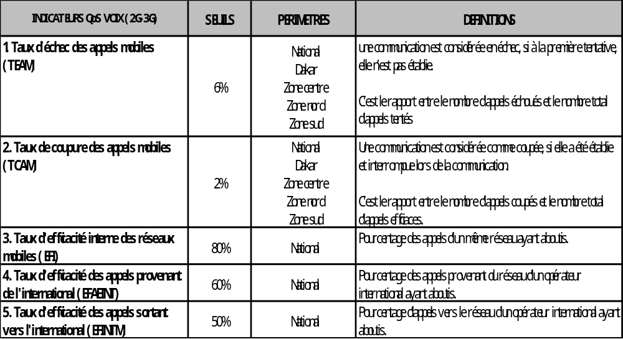
1. INDICATORS QoS VOICE (2G-3G)

Slide 23
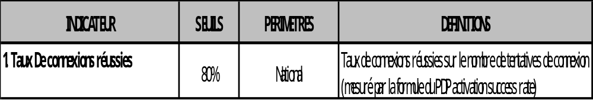
2. INDICATORS DATA(2G-3G)

Slide 24
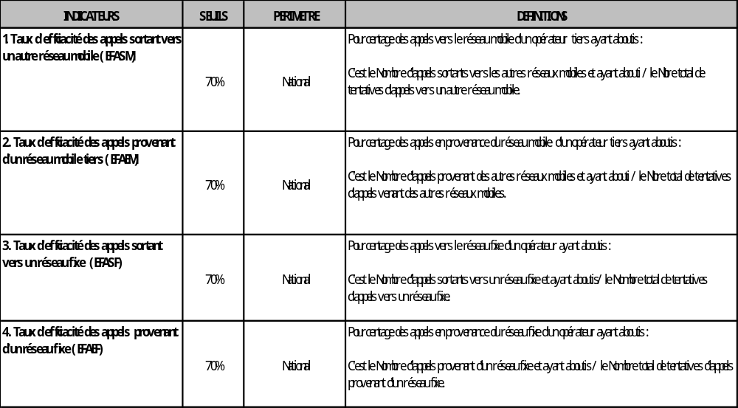
3. INDICATORS INTERCONNEXION(2G-3G)

Slide 25
THANK YOU FOR YOUR ATTENTION

