Slide 1
ITU Regional Standardization Forum For Africa
Dakar, Senegal, 24-25 March 2015
Session 3 :
Operational and Regulatory Aspects to Predict for a good QoS of the Internet Mobile in broadband networks
Hassan TALIB,
Vice-Chair ITU-T SG 12, Head DCT ANRT
Talib@anrt.ma // Htalib@ties.itu.int

Slide 2
Plan of the Presentation
General Overview On QoS of the mobile Internet
Operational Aspects
Regulatory Aspects (ITU-T standards and recommendations)
  Regulatory Aspects at the national level
  Conclusions and recommendations
Senegal, Dakar, March 24-25, 2015

Slide 3




General Overview on QoS of the Internet Mobile
Perimeter of the Presentation
Networks concerned:
Mobile broadband networks, examples: 3G (UMTS and CDMA2000 ), 4G ( ), Wifi Outdoor (offloading ) ,...
Service concerned:
Mobile Internet on mobile broadband networks.
Senegal, Dakar, March 24-25, 2015

Slide 4
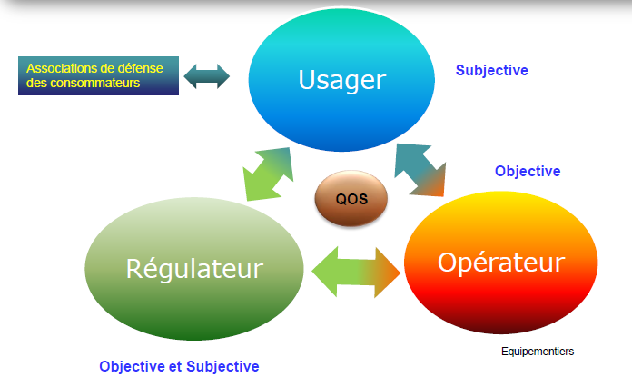





General Overview on QoS of the Internet Mobile
General Environment of the QoS
Services under Internet:
- Data *
- Videos *
- VoIP
...
* Concerned by this presentation
Internet QoS
QoS And OTTs :
Senegal, Dakar, March 24-25, 2015

Slide 5
General Overview On QoS Of the Internet Mobile
General Environment of the QoS
Reference : The Recommendation Rec. G. 1000.
Subscriber
Operator/Provider
(Theoretical/imaginary)
Difficult to deploy
(Operational/actual) a methodology for measuring and evaluation is necessary
QoS Expected By the Users
QoS Offered By The operator/Provider
QoS Such that perceived By The subscriber
QoS Issued By the operator/Provider
Senegal, Dakar, March 24-25, 2015

Slide 6
General Overview On QoS Of the Internet Mobile
Parameters of services "data"
Parameter | Example of Cause | Example of consequences | Example of influence QoS/QoE
Loss Of Packets | Errors Of transmission | Retransmission Of Packets | Delay In the navigation Flow low Download
Latency (End-to-end delay) | Files Of waiting, congestion | Delay In the real-time applications | Impossibility To play online Offset of a image of CCTV
Jitter | Use of different paths algorithms of different queuing in the nodes | The Stack do not arrive in the correct order | Delay In the navigation flow low download .
Senegal, Dakar, March 24-25, 2015

Slide 7
General Overview On QoS Of the mobile Internet
Parameters of services "video"
Parameter | Example Of cause | Example of consequences | Example of influence QoS/QoE
Time of onset of the first image slow | Bad Sizing the buffer | Great expectations before the start of the image | Great expectations before the start of the image
Availability of video | Server Congestion Link to slow transmissions | Flow of the non-continuous video | video stop offset of the video
The resolution and Frame-rate (Image by sec) | Bad Sizing of the resolution in relation to the user flow | Transmission Channel insufficient to route the video | Delays, stop of the Video
The Codec used | Bad compression therefore more data | Transmission Channel insufficient to route the video | Delays, stop of the video
Poor delivery of the video | The application of reading is poorly designed/configured | Bad synchronization of flows | Cut, stop of the video
Senegal, Dakar, March 24-25, 2015

Slide 8
Plan of the presentation
General Overview On QoS Of the mobile Internet
Operational Aspects
Regulatory Aspects (ITU-T standards and recommendations)
  Regulatory Aspects at the national level
  Conclusions And recommendations
Senegal, Dakar, March 24-25, 2015

Slide 9
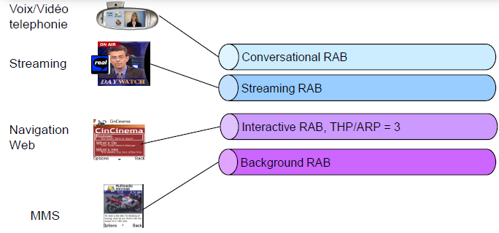
Operational Aspects
Services and classes of a UMTS network
The resources of the networks are allocated and managed according to the profile of QoS for each service.
Senegal, Dakar, March 24-25, 2015

Slide 10
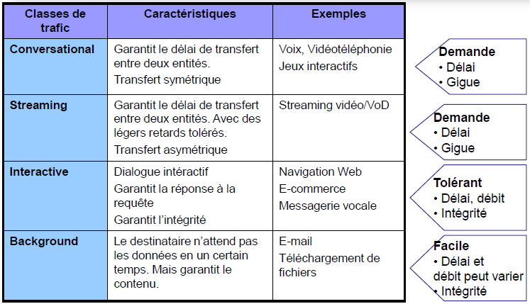
Operational Aspects
Classes of a UMTS network
Senegal, Dakar, March 24-25, 2015

Slide 11
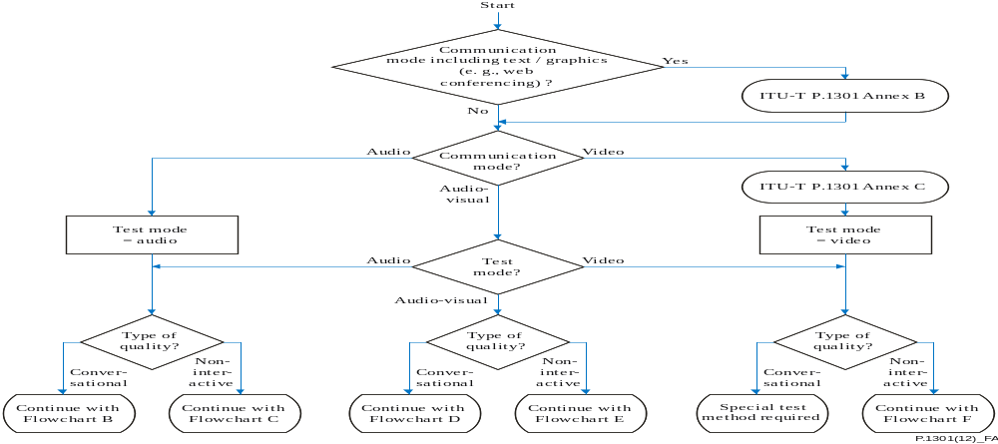
Operational Aspects
QoS Flow Chart of the Video Calling service
Reference : The Recommendation Rec. ITU-T P. 1301.
Telemeeting With texts and graphics
Telemeeting With the video only
Senegal, Dakar, March 24-25, 2015

Slide 12
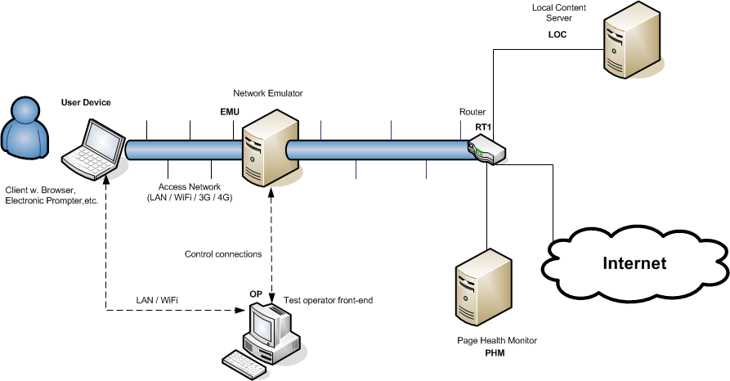
Operational Aspects
QoS Tests Architecture of Web service
Reference : The Recommendation Rec. P. 1501.
Senegal, Dakar, March 24-25, 2015

Slide 13
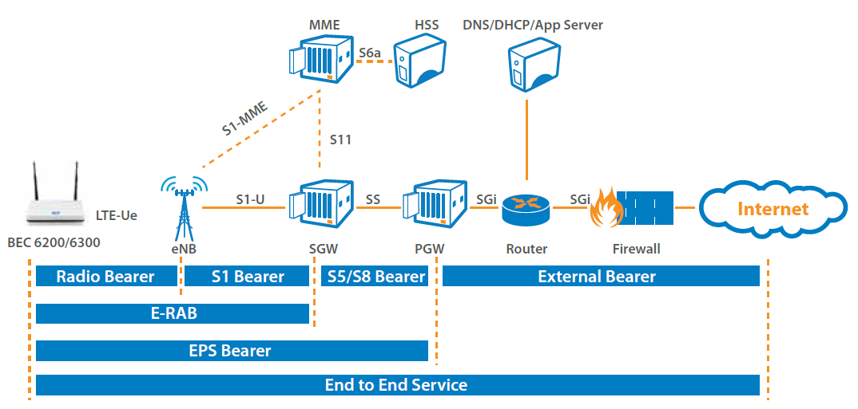
Operational Aspects
QoS Architecture in a LTE network
A BEarer is a transmission medium of user traffic of signalling with the characteristics, transport attributions ,treatment of data and the resources allocated across the network: priority, flow, level of quality, ...
Two types of treatment have been defined.
Default BEarer :
-is established at the initial connection of the equipment to the network.
-remains established as long as the service has not changed. A subscriber may have multiple DefaultB each with an IP address.
Dedicated Bearer :
-is established when there is a need to ensure a level of QoS for a service: VoIP, Visio, Video,...
-This is the equivalent of a dedicated tunnel for one or several traffics. It is based on the IP of the Default Bearer.
Senegal, Dakar, March 24-25, 2015

Slide 14
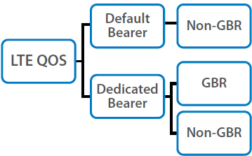
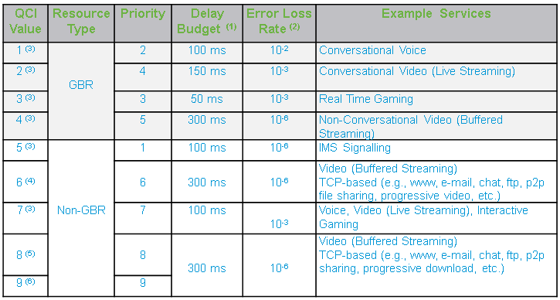
Operational Aspects
Examples of QoS Indicators of Values in a LTE network
The Dedicated Bearers include two categories:
GBR: warranted debit
Non-GBR: unwarranted debit
Senegal, Dakar, March 24-25, 2015

Slide 15


Operational Aspects
Architecture of end to end QoS Evaluation in a broadband network
End-TB-End Service Quality
Access Network
Internet Service Provider Network
Public Internet
NTP
Local Switch
Physical Access
Transit
Download And Upload Speeds
Internet Content Providers
End User
Line Termination
Gateway
Senegal, Dakar, March 24-25, 2015

Slide 16
Plan of the Presentation
General Overview On QoS Of the mobile Internet
Operational Aspects
Regulatory Aspects ITU-T (standards and recommendations)
  Regulatory Aspects at the national level
  Conclusions And recommendations
Senegal, Dakar, March 24-25, 2015

Slide 17
Regulatory Aspects ITU-T
General Framework
The ITU-T recommendations under the SG12 dealing with the QoS/QoE
E. 420-E. 479, E. 800-E. 859
G. 100-series, Except G. 160-, G. 180- and G. 190-series
G. 1000-series
I. 350-series (Including Y. 1501/G. 820/I. 351), I. 371, I. 378, I. 381
P-Series, Except P. 900-series
Y. 1220-, Y. 1530-, Y. 1540-, Y. 1560-series

Slide 18
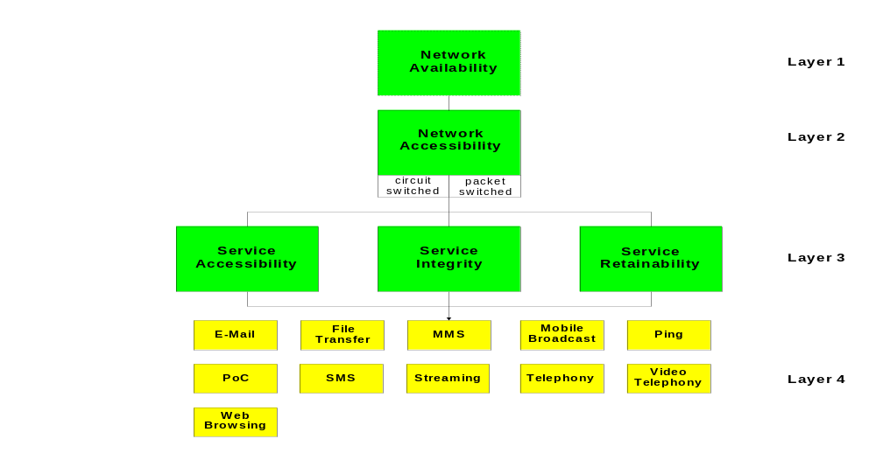
Regulatory Aspects ITU-T
General Framework
The levels of the QoS
Senegal, Dakar, March 24-25, 2015

Slide 19
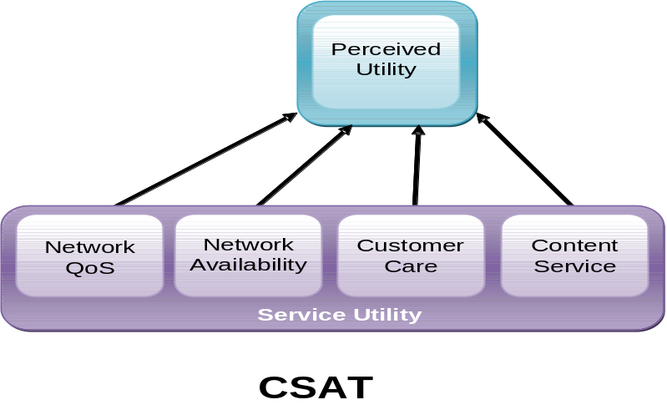

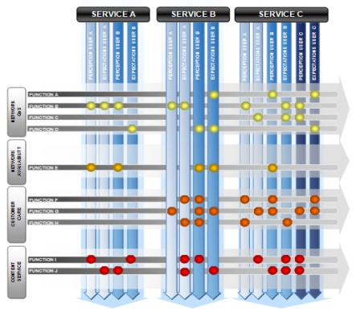
Regulatory Aspects ITU-T
General Framework
Reference : The Recommendation Rec. G. 1000.
Model of Satisfaction
Framework
Subscriber
Operator/Provider
Waiting
Waiting of the subscriber
QoS Expected By the Users
QoR
QoS offered by The operator/provider
QoO
Waiting Review
Satisfaction Of
the subscriber
Non Satisfaction
QoS Such that perceived by the subscriber
QOP
QoS issued by the operator/Provider
QoS
Perception of the Subscriber
ITU-T G. 1000
Methodology
SCAL (KQI)
Four Models of the Market
Performance Model
Universal Model
ACF Model
CSAT Model
QoS Model
E. 802 E. 803
Senegal, Dakar, March 24-25, 2015

Slide 20
Regulatory Aspects ITU-T
Categories of the QoS of Multimedia services/Internet
Reference : The Recommendations Rec. ITU-T G. 1010 and G. 1050.
In implementation of the relevant recommendations of the ITU-T including the G. 1010 and G. 1050, we can establish guidelines concerning the requirements in terms of performance, the end user's point of view, about the different applications and aggregate them in a set of categories: numbering to (8). The categorization is based on the following parameters:
The Delay and the losses of Packets ;
The variation of the delay (jitter).
Senegal, Dakar, March 24-25, 2015

Slide 21
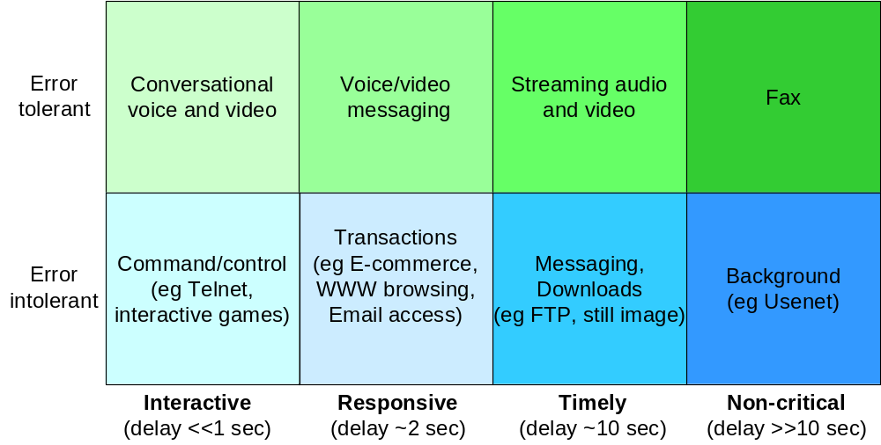
Regulatory Aspects ITU-T
Categories of the QoS of Multimedia services/Internet
Reference : The Recommendations Rec. ITU-T G. 1010 and G. 1050.
Senegal, Dakar, March 24-25, 2015

Slide 22
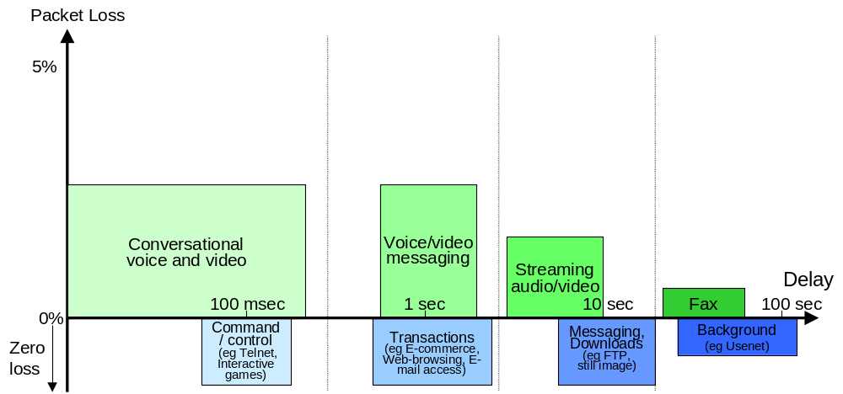
Regulatory Aspects ITU-T
Categories of the QoS of Multimedia services/Internet
Reference : The Recommendations Rec. ITU-T G. 1010 and G. 1050.
Senegal, Dakar, March 24-25, 2015

Slide 23
Regulatory Aspects ITU-T
Modeling of the QoS of Multimedia services/Internet
There are five types of objective evaluation models of the Multimedia/Internet quality:
Perceptual Models: The input to the model is the media itself (audio and video signals).
Parametric Models: The input to the model is the information from the flow of packets and the state of customer information. A parametric model also requires additional Information such as the type of codec and the binary debit.
Models of stream of bits: The input to the model is a piece of information derived from the flow and other information pertaining to the packets.
The hybrid models: The input to the model is the flow of the packets. Perhaps also information pertaining to the status of the client.
Planning Models: The input to the model includes the parameters for planning of the quality of Networks. It usually requires a prior knowledge of the testing.
Senegal, Dakar, March 24-25, 2015

Slide 24
Regulatory Aspects ITU-T
Modeling of the QoS of Multimedia services/Internet
Summary of the models of the ITU-T:
Application | Media | Through (CONV) /Non-Through (NONCONV) | Subjective Test methodology | Objective test methodology
 |  |  |  | Model | FR/RR/NR | Primary use
Telephony | Speech | NONCONV | (ITU-T P. 800] (ITU-T P. 830] (ITU-T P. 835] (ITU-T P. 1301] | (ITU-T P. 862) + (ITU-T P. 862.1 ] (NB) (ITU-T P. 862.2 ] (WB) (ITU-T P. 863] (NB/WB/SWB) | FR | LAB, MY
 |  |  |  | (ITU-T P. 563] (NB) (ITU-T P. 564] (NB/WB) | NR | MY
 |  | CONV | (ITU-T P. 800] (ITU-T P. 805] (ITU-T P. 1301] | (ITU-T G. 107] (NB) | NR | PLN
 |  |  |  | (ITU-T P. 561) + (ITU-T P. 562] (NB/WB) | NR | MY
Video telephony | Multimedia (Note) | CONV | (ITU-T P. 920] (ITU-T P. 1301] | (ITU-T G. 1070] (NB/WB) | NR | PLN
Senegal, Dakar, March 24-25, 2015

Slide 25
Regulatory Aspects ITU-T
Modeling of the QoS of Multimedia services/Internet
Summary of the models of the ITU-T:
Application | Media | Through (CONV) /Non-Through (NONCONV) | Subjective test methodology | Objective test methodology
 |  |  |  | Model | FR/RR/NR | Primary use
Video streaming (Mobile TV/IPTV) | Video | NONCONV | (ITU-T P. 910] (ITU-T J. 140] [ITU-R BT.500-1 STANDARD3] | (ITU-T J. 144] (SD) (ITU-T J. 247] (QCIF, CIF, VGA) (ITU-T J. 341] (HD) | FR | LAB, MY
 |  |  |  | (ITU-T J. 249] (SD) (ITU-T J. 246) (QCIF, CIF, VGA) (ITU-T J. 342] (HD) | RR | MY
 | Audio | NONCONV | (ITU-T P. 830] [ITU-R BS.1116-1] [ITU-R BS.1285] [ITU-R BS.1534-1] | [ITU-R BS.1387] | FR/RR | MY/PLN
 | Multimedia | NONCONV | (ITU-T P. 911] | (ITU-T P. 1201.1 ] (QCIF, QVGA, HVGA) (ITU-T P. 1201.2 ] (SD, HD) (ITU-T P. 1202.1 ] (QCIF, QVGA, HVGA) (ITU-T P. 1202.2 ] (SD, HD) | NR | MY
Web browsing | Data |  |  | (ITU-T G. 1030] | NR | PLN
Senegal, Dakar, March 24-25, 2015

Slide 26
Plan of the presentation
General Overview On QoS Of the mobile Internet
Operational Aspects
Regulatory Aspects (ITU-T standards and recommendations)
  Regulatory Aspects at the national level
  Conclusions And recommendations
Senegal, Dakar, March 24-25, 2015

Slide 27
Regulatory Aspects at the national level
Provisions to provide by the regulator in the specifications/licensing of operators of broadband networks
Examples of parameters for administrative QoS :
Parameter (Unit) | Example of value (1^{Era} Year) | Example of value (2Th Year)
Conformity of the network and the equipment to international standards (ITU) | -------------------- | --------------------
Permanence of Services (time and day) | 24/24 AND 7/7 | 24/24 AND 7/7
Cumulative Duration of unavailability of a base station must not exceed per year a duration (hour) | 24 | 12
Obligation of investment for more capacities to connect to the international (Gbps) | 200 | 400
Deadline for operating (in time) | 5 OR 7 | 4
Time of servicing failures (hour) | 24 | 12
Rate of litigation on invoices ( %) | 0.5 | 0.4
Senegal, Dakar, March 24-25, 2015

Slide 28
Regulatory Aspects at the national level
Provisions to provide by the regulator in the specifications/licensing of operators of broadband networks
Examples of parameters for technical QoS QoSQoS Techniques:
Parameter (Unit) | Example of value (1^{Era} Year) | Example of value (2Th Year)
Success Rate of the first attempt ( %) | 95 | 98
Rate of successful connections in a fixed deadline (5 To 15s in relation to the network) ( %) | 96 OR 98 | 98 OR 99
The downflow average minimum required for 90% of the population covered (Mbps) | 2 Or 4 | 4 OR 7
Rate cut downloading or uploading ( %) | 5 | 3
Average time to start the video (s) | 10 | 15
Maximum number of stops of the video (figure) | 3 | 1
Senegal, Dakar, March 24-25, 2015

Slide 29
Conclusions and Recommendations
  The requirement to establish a regulatory framework for the QoS for broadband networks at the national level.
  QoS for Internet in a context of mutation: NGN network all IP, IoT, IPv6, MTOM,...
  QoS for Internet at two speeds. Divergent Positions USA, Europe, ICANN,...
  OTTs And QoS : Problems of distributing the responsibilities?
Senegal, Dakar, March 24-25, 2015

Slide 30
Thank you for your attention
Questions/Answers
Talib@anrt.ma // Htalib@ties.itu.int
Senegal, Dakar, March 24-25, 2015

