Slide 1

ITU Regional Standardization Forum For Africa
Dakar, Senegal, 24-25 March 2015
Overview of
ITU-T's activities on EMF
Dr. Fryderyk Lewicki
ITU-T SG5 Vice-chairman of WP2
Rapporteur for Q7/5
Orange Polska, Poland
fryderyk.lewicki@orange.com

Slide 2
The issue…
The electromagnetic fields
are unknown and
undetectable for people…
7,1 billions of mobile
subscriptions
were in 2014
Lack of regulation
and/or
non-compliance...
In 2014 global mobile
penetration
reached 97%
Lack of
communication and
information to citizens…
It can generate a lack of trust, which may become fear…

Slide 3
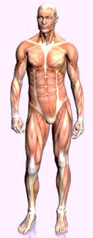
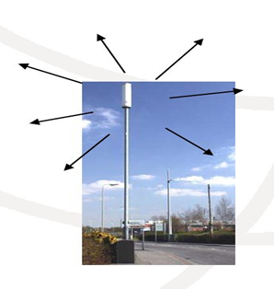
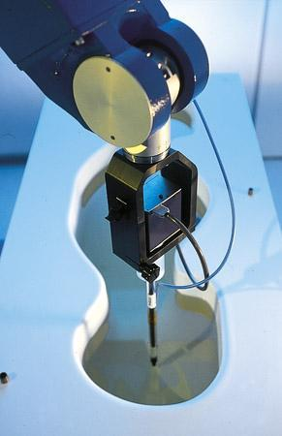
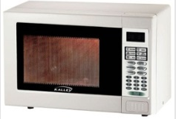
Regulations for non-ionizing radiations
Exposure standards:
Specifications that limit the exposure of people to electromagnetic fields (EMF)
Emission standards:
Specifications that limit the emission of electromagnetic fields (EMF) from the devices

Slide 4
ITU-T Study Group 5
Leading study group for: electromagnetic compatibility and electromagnetic effects
Question 12
Terminology
7 Questions
WP1/5
Damage prevention and safety
WP3/5
ICT and climate change
4 Questions
WP2/5
Electromagnetic fields: emission, immunity and human exposure
Q7/5 Human exposure to electromagnetic fields (EMFs) due to radio systems and mobile equipment
Question 20
Smart sustainable cities and communities
6 Questions
Notes:
4

Slide 5
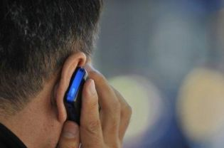
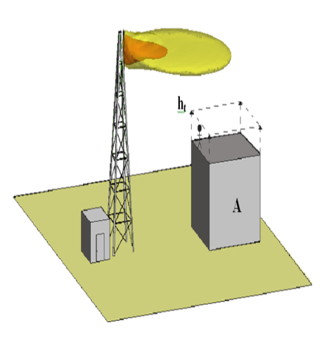
Question 7/5
Human exposure to electromagnetic fields (EMFs) due to radio systems and mobile equipment
Main study area:
Real site measurements and modeling of the multiple sources operating on different frequencies and transmitting antennas
Determine the validity of electromagnetic field predictions
Procedures and guidance on numerical modeling of EMFs in the areas around telecommunication transmitting antennas and various systems
Guidance based on existing SAR measuring and calculating procedures, techniques and protocols for evaluating EMF due to ICT equipment
Handbook to answer frequently asked questions about human exposure to EMF

Slide 6
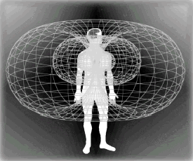
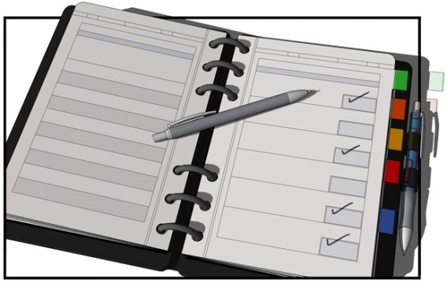
Question 7/5
Human exposure to electromagnetic fields (EMFs) due to radio systems and mobile equipment
Main tasks:
Develop Recommendations for the telecommunication sector
Implement the mandate of the ITU Resolutions on EMF; especially a support to developing countries according to ITU-T Resolution 72 (WTSA-12, Dubai, 20-29 November 2012)
Best practice and mitigation techniques in the protection against non-ionizing radiation
Collaboration with other standardization bodies (IEC, CENELEC, WHO) in order to avoid duplication of work
Maintenance and enhancement of the existing Recommendations

Slide 7

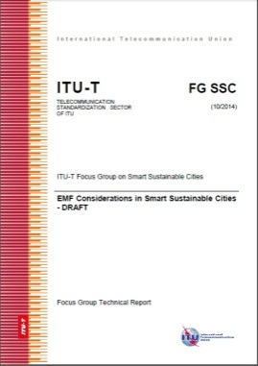
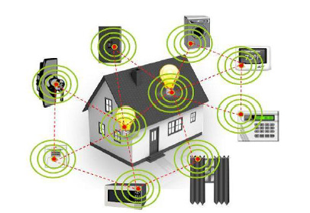
ITU-T SG5
Focus Group on Smart Sustainable Cities (FG-SSC)
The range of devices that are connected to the internet is rapidly growing
In most cases the connection is wireless – it means that the devices have to radiate electromagnetic fields (EMF)
FG-SSC includes a Technical Report on “EMF considerations in smart sustainable cities”
The design and deployment of wireless networks must ensure electromagnetic field (EMF) compliance and minimize human exposure to radio frequency (RF) radiation
EMF considerations in smart sustainable cities have to ensure the networks and connected devices operate safely and most efficiently
itu.int/en/ITU-T/focusgroups/ssc/Pages/default.aspx
Notes:
7

Slide 8
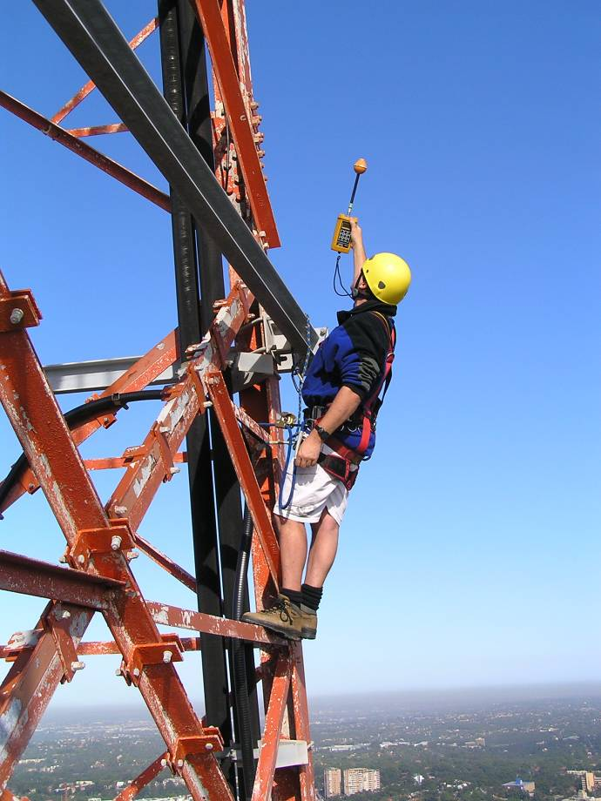
Typical EMF assessment
Safety
EMF compliance at sites
Occupational Health & Safety (OH&S) for workers and public
Environmental
Radio signals in the community
Educational & informative

Slide 9
EMF assessment methods
Calculations or measurements?
There are many methods to show the compliance
National regulations are most important
EMF assessment method depends on site & environment
Calculations - suitable in many cases, & have significant benefits - accurate, fast & cost effective, possible for the sources not in operation yet
Measurements - required in very complex environments, difficulty to take into account the time variation, the presence of staff and equipment may influence the results
The simplest method is recommended to be applied first, even if other methods are more accurate
More sophisticated (and accurate) methods should be used if no compliance is observed by less sophisticated (and accurate) method
☞ ITU-T Recommendations - guidance on both calculation and measurements

Slide 10
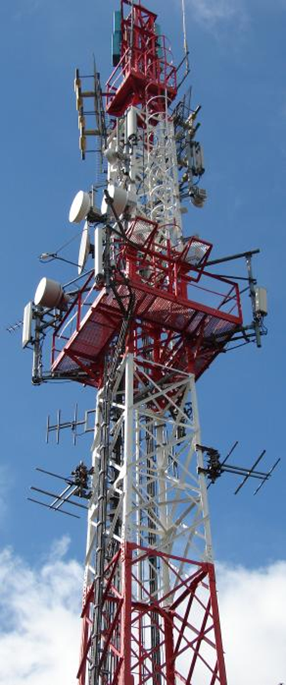
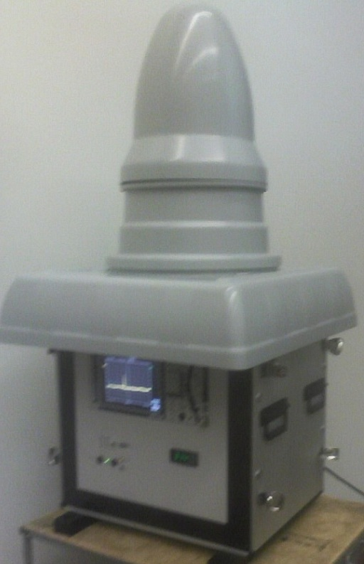
EMF assessment methods
Field monitoring
EMF fields are unknown to general public
The confidence can be achieved thanks to the control of the EMF by taking continuous measurements and having a proper communication (for example websites)
The balance between costs and accuracy is very important (broadband and frequency selective measurement)
☞ ITU-T Recommendations – cover field monitoring too

Slide 11
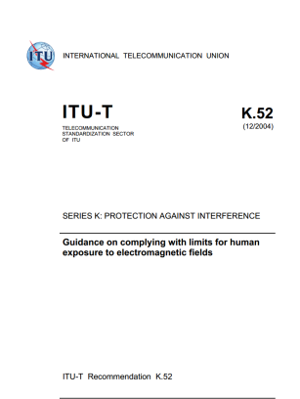
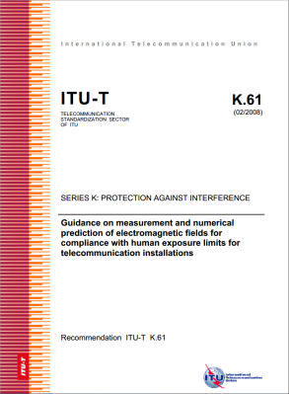
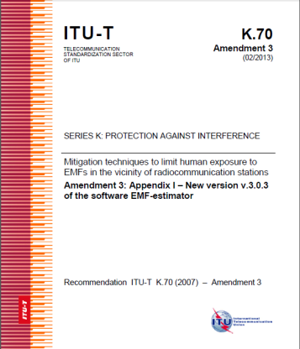
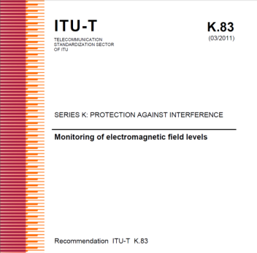
ITU-T Recommendations for EMF assessment
Recommendation ITU-T K.52 (2000/2014) - Guidance on complying with limits for human exposure to electromagnetic fields – includes „K.52calculator software”
Recommendation ITU-T K.61 (2003/2008) - Guidance on measurement and numerical prediction of electromagnetic fields for compliance with human exposure limits for telecommunication installations
Recommendation ITU-T K.70 (2007/2014) - Mitigation techniques to limit human exposure to EMFs in the vicinity of radiocommunication stations – includes „EMF Estimator software”
Recommendation ITU-T K.83 (2011/2014) - Monitoring of electromagnetic field levels

Slide 12
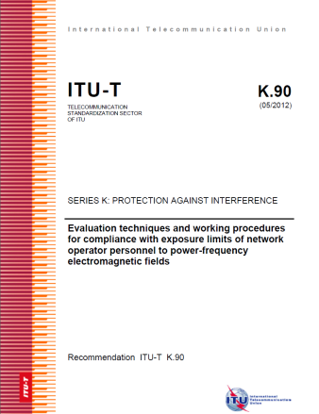
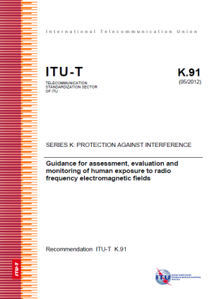
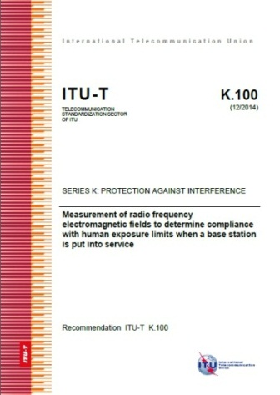
ITU-T Recommendations for EMF assessment
Recommendation ITU-T K.90 (2012) - Evaluation techniques and working procedures for compliance with limits to power-frequency (DC, 50 Hz, and 60 Hz), electromagnetic field exposure of network operator personnel – includes EMFACDC software
Recommendation ITU-T K.91 (2012/2014) - Guidance for assessment, evaluation and monitoring of human exposure to radio frequency electromagnetic fields – includes „Uncertainty calculator” and „Watt_Guard” software and Supplement „EMF-guide”
Recommendation ITU-T K.100 (2014) - Measurement of radio frequency electromagnetic fields to determine compliance with human exposure limits when a base station is put into service

Slide 13
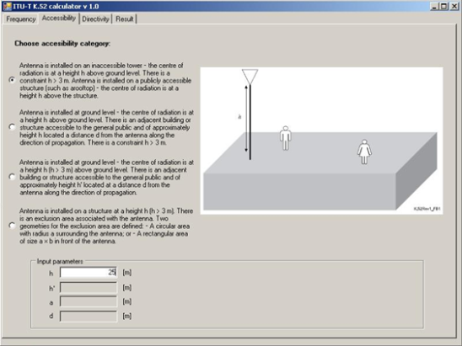
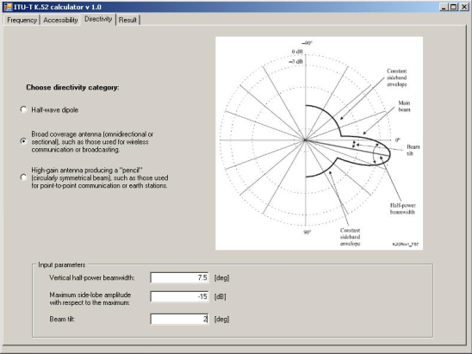
Highlights on deliverables
Recommendation ITU-T K. 52 aims to help with compliance with safety limits for human exposure to EMFs
Provides guidance on calculation method, and installation assessment procedure
Is based on safety limits provided by ICNIRP
Determines the likelihood of installation compliance based on accessibility criteria, antenna properties and emitter power
K52calculator is a software for simplification of calculations
☞ Recommends IEC Standard for the compliance measurement of mobile handsets.

Slide 14
Highlights on deliverables - continued
Recommendation ITU-T K. 61 helps telecommunication operators to verify compliance with exposure standards promulgated by local or national authorities
Provides guidance on measurement methods that can be used to achieve a compliance assessment
Provides guidance on the selection of numerical methods suitable for exposure prediction in various situations

Slide 15
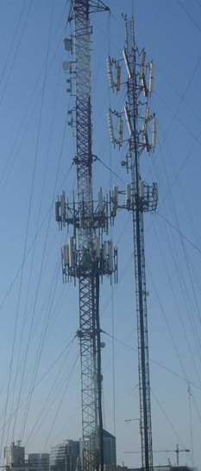
Highlights on deliverables - continued
Recommendation ITU-T K. 70 defines techniques which can be used by telecommunication operators to evaluate the cumulative (total) exposure ratio in the vicinity of transmitting antennas and to identify the main source of radiation
Provides guidance on mitigation methods which allow reduction of radiation level
Provides guidance on procedures necessary in the environment (on site) in which, in most cases, there is a simultaneous exposure to multiple frequencies from many different sources
☞ Includes a software that implements the
methodology:
EMF estimator

Slide 16
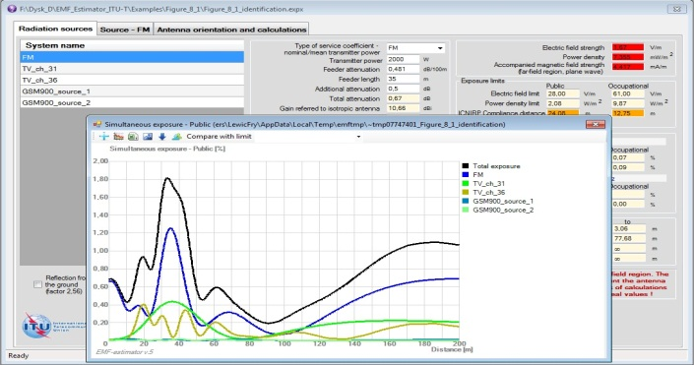
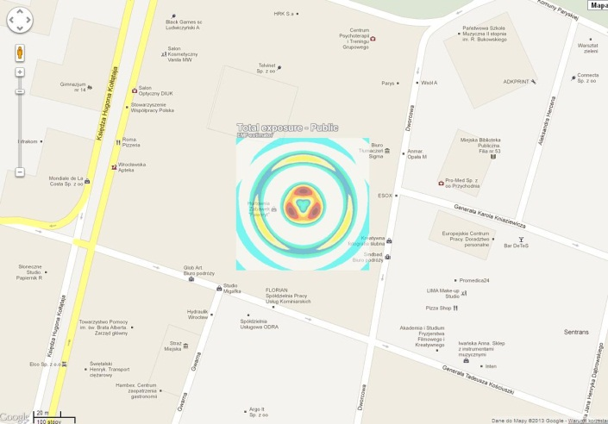
Highlights on deliverables - continued
EMF-estimator is the Annex I to the ITU-T Recommendation K.70
The last version of the software (12.2014) can be loaded from the:
  http://www.itu.int/ITU-T/recommendations/rec.aspx?rec=9140
EMF-estimator is offered by ITU-T since 06.2007
It is periodically updated / expanded according to the needs (in 2009, 2011, 2013 and 2014)
The main new options are:
  The line of calculation can be oriented in any direction
  There is a possibility to put results on the Google Maps
  Many projects can be opened in parallel

Slide 17
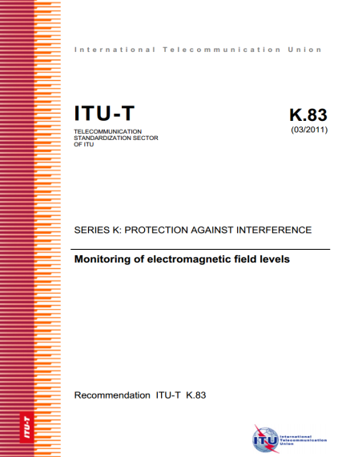
Highlights on deliverables - continued
Recommendation ITU-T K.83 provides guidance on how to make long-term measurements and monitoring of EMF in the selected areas that are under public concern, in order to show that EMFs are under control and under the limits
The balance between costs and accuracy is very important (broadband and frequency selective measurement)
​  Implementation of Recommendation ITU-T K.83 "Monitoring of electromagnetic field levels" in countries (e.g. Argentina, Brazil, Colombia, Ecuador, El Salvador and Uruguay)

Slide 18
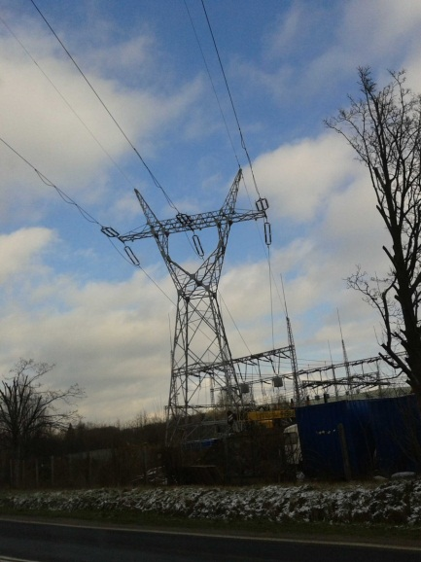
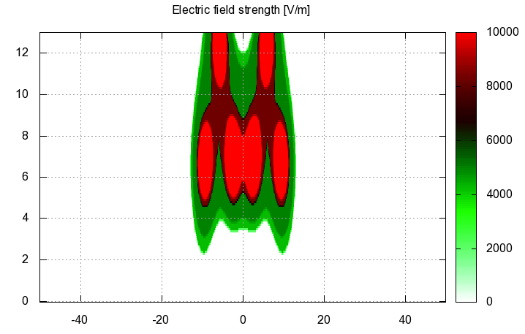
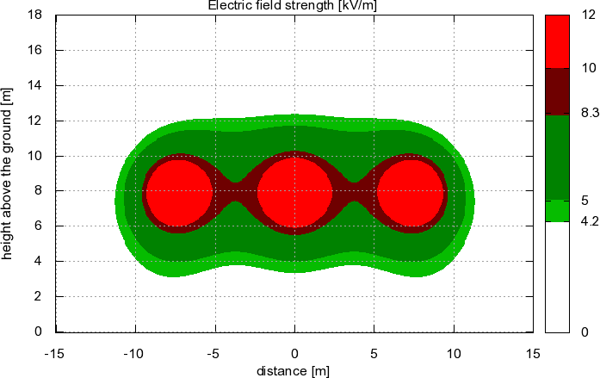
Highlights on deliverables - continued
Recommendation ITU-T K.90 provides guidance on the compliance with safety limits for the personnel in the vicinity of power supply lines of medium-voltage (MV) and high-voltage (HV) power lines at power frequencies (DC, 50 Hz, and 60 Hz), concerning EMF exposure
It includes software: EMFACDC
​

Slide 19

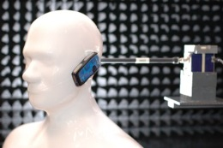
Highlights on deliverables - continued
Recommendation ITU-T K.91 provides guidance on how to assess and monitor human exposure to radio frequency (RF) electromagnetic fields (EMF) in areas with surrounding radio communication installations based on existing exposure and compliance standards in the frequency range of 8,3 kHz to 300 GHz
includes software „Uncertainty calculator”
Includes software „Watt_Guard” – for EMF level assessment in the vicinity of Radio Amateur installations

Slide 20

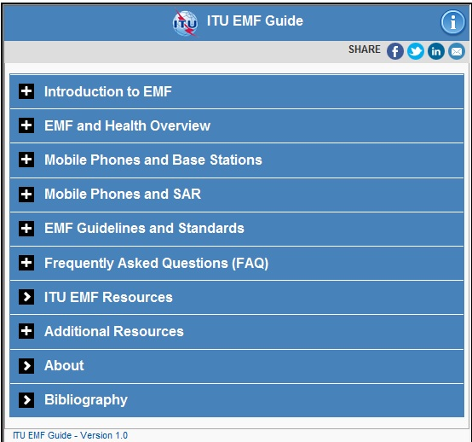
Highlights on deliverables - continued
Guide on electromagnetic fields and health (​Supplement 1 to Recommendation ITU-T K.91)
Answers to typical questions asked by the public on EMF, and to address typical misunderstandings on EMF matters in the society
Provides education and information: promoting EMF information and education resources suitable for all communities, stakeholders and governments
Supports clarification of the science: referencing the WHO and other stakeholders
Provides information most useful in helping clarify uncertainties concerning EMF

Slide 21

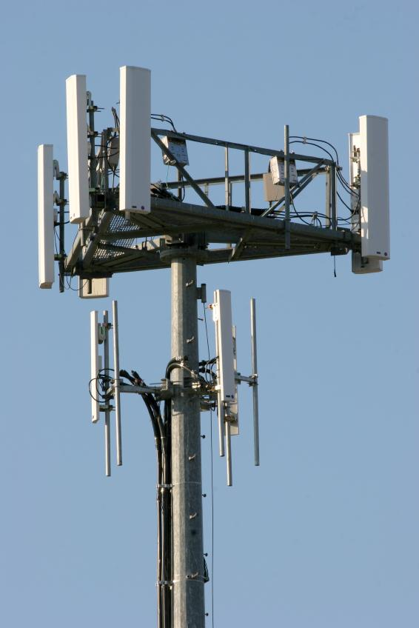
Highlights on deliverables - continued
Recommendation ITU-T K.100 provides guidance on how to measure radio frequency electromagnetic fields in order to determine compliance with human exposure limits when a base station is put into service
Simplified assessment procedures to identify those installations which are known to be compliant with EMF exposure limits without measurements

Slide 22

Deliverables under study
Recommendation ITU-T K.env - Guidance on the Environmental Management for Electromagnetic Radiation from Radiocommunication Base Stations
Recommendation ITU-T K.maps - Maps of the RF EMF

Slide 23
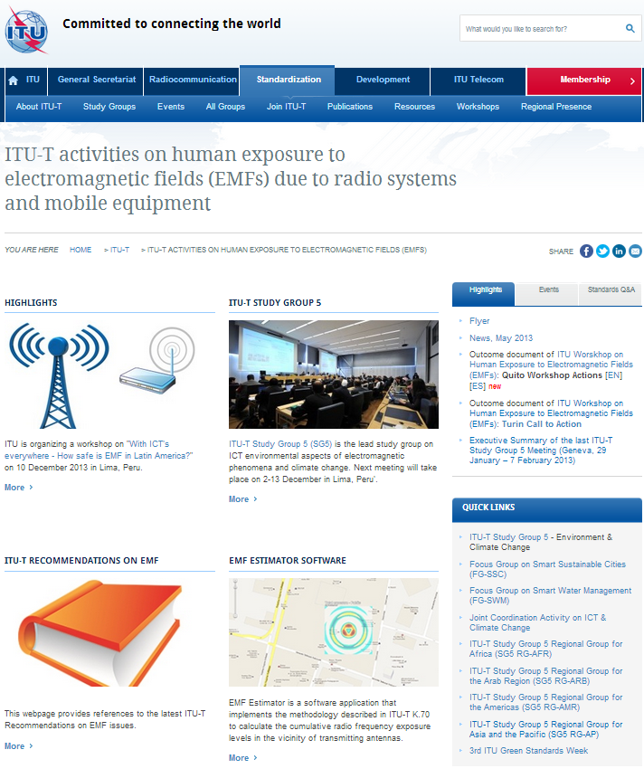
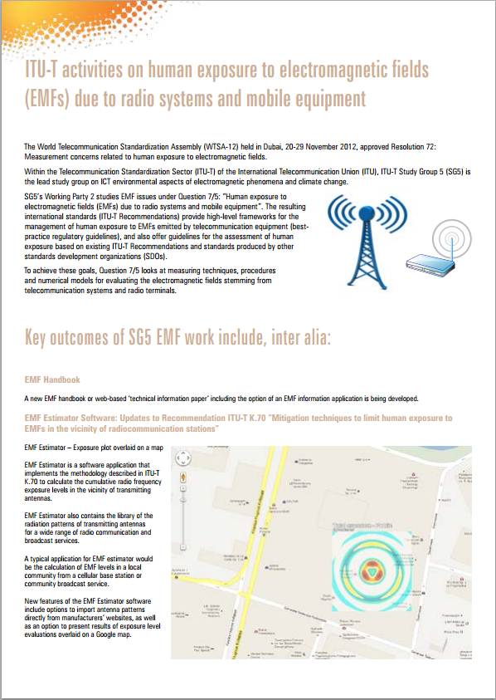
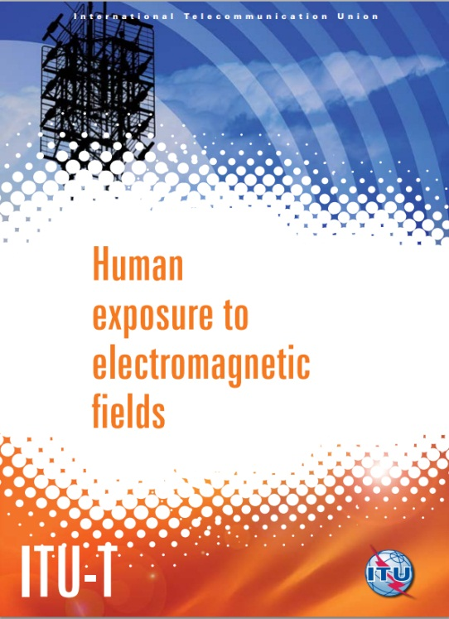
EMF flyer and website

Slide 24
Conclusions
Compliance with EMF exposure limits is a substantial factor in smart sustainable cities development
Good communication with public is a very important task
Efficient deployment of wireless infrastructure reduces the RF EMF from networks and devices
ITU’s guidance can be helpful in smooth and safe implementation of wireless systems
Notes:
24

Slide 25
ITU-T/SG5 “Environment & Climate Change”
itu.int/go/tsg5
ITU-T/SG5 Series K Recommendations (free of charge)
itu.int/ITU-T/recommendations/index_sg.aspx?sg=5
ITU-T and EMF
itu.int/go/emfs
Thank you

