Slide 1
Ewaste in Senegal
ITU Regional Standardization Forum For Africa Dakar, Senegal, 24-25 March 2015
Boussoura TALLA GUEYE
Cofounder - SetTIC

Slide 2
1 | Overview
2 | Conventions, Laws & Regulations
3 | SetTIC – An e-waste recycling Center
4 | Call to action
5 | Impact of e-waste management

Slide 3
E-Waste in Senegal Overview
Ewaste flow study - 2008
 | 2008 | 2009 | 2010 | 2011 | 2012 | 2013 | 2014 | 2015
E-waste Mobile phones & Computers (tonnes) | 872 | 1 165 | 1 541 | 2 021 | 1 259 | 1 505 | 1 081 | 2 157
E-Waste flow (for mobile phones and computers) almost doubled between 2009 and 2015
Study did not include other e-waste:
UPS
Printers
TV / household appliances
……
Mobile subscribers:
March 2008: 4 135 719
June 2014: 14 065 291

Slide 4
E-Waste in Senegal Conventions, Laws & Regulations
Senegal signed Basel & Bamako conventions
Local law:
Environmental code for global waste management
No specific regulation for e-waste management
Many stakeholders for informal sector are collecting, dismantling e-waste without any security equipment

Slide 5
E-Waste in Senegal SetTIC – An e-waste recycling Center
The first e-waste recycling center authorized by the Ministry of Environment
SetTIC provides e-waste collection and dismantling services as well as sensitization for public/private sectors to e-waste potential impact on health and environment
SetTIC is also a social project through Initiave SetTIC
Bridge digital divide program
sensitization at population level

Slide 6
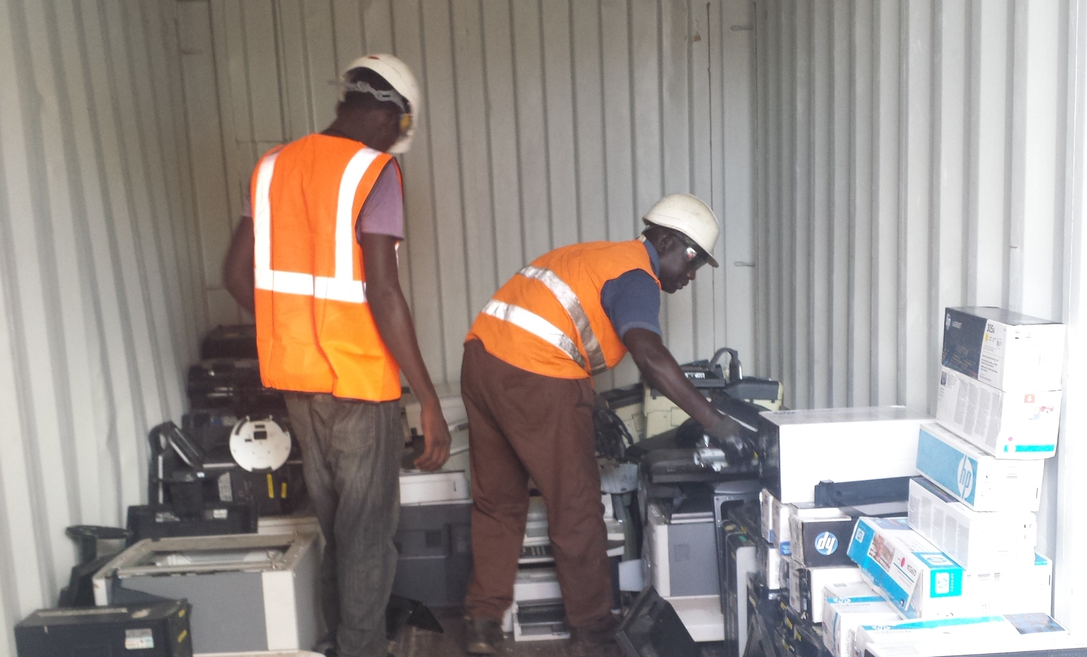
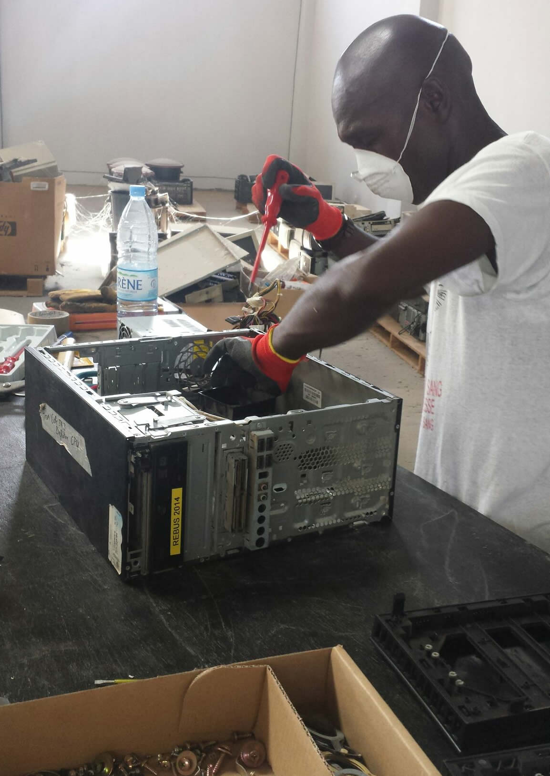
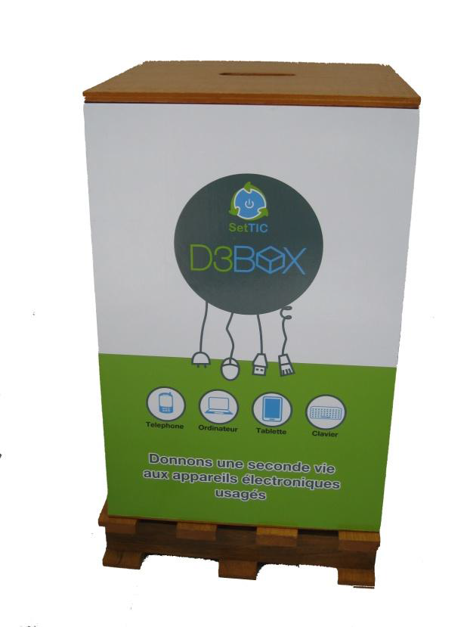
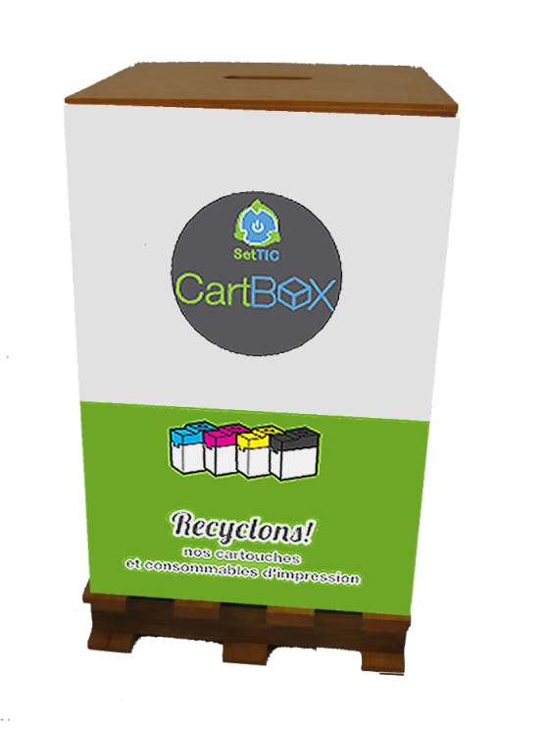
E-Waste in Senegal SetTIC aproach for e-waste recycling
Non hazardous waste
Local treatment
Collection: directly from
warehouse or through
collection boxes
Hazardous waste
Export to Europe for treatment
Local dismantling

Slide 7
E-Waste in Senegal Call to action
Senegal needs a law for e-waste management: storage, collection, recycling
E-waste collection & recycling also need to be funded: for example, through taxes
Collectors & Recylers
Government
Consumer
Companies
Manifecturers
Regulation
Support recyclers to develop collection points
Finance & Recycle imported EEE
Obligation to return e-waste to a collection point
Finance & Recycle e-waste through authorized recycling centers

Slide 8
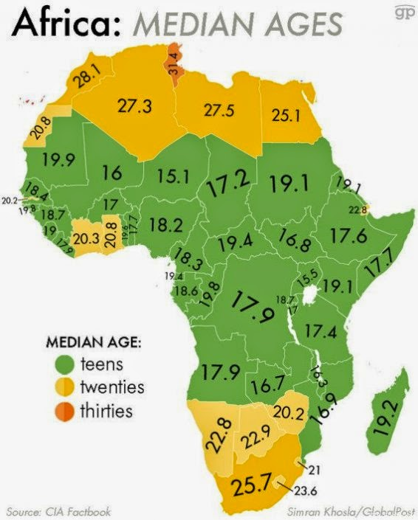
E-Waste in Senegal Impact of e-waste management
Reduce impact on environment & health
Green business opportunity:
Improve revenue for collectors from informal sector
Green jobs creation youth & disable people

Slide 9
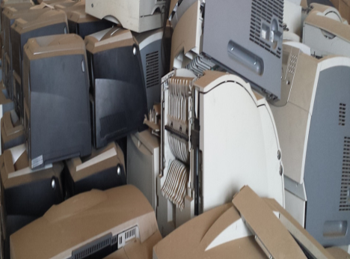
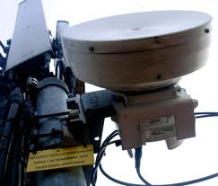
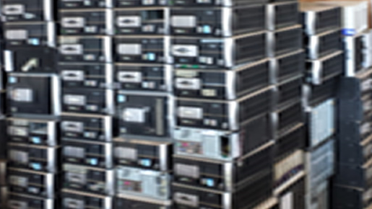
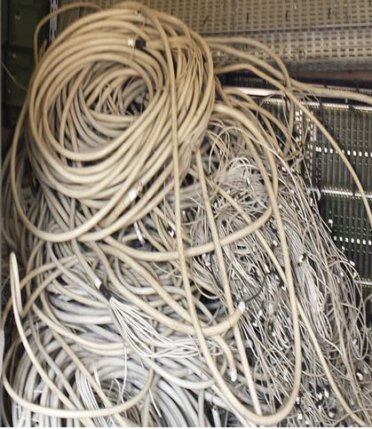
THANK YOU

