Slide 1
ITU Regional Standardization Forum For Africa Dakar, Senegal, 24-25 March 2015
E-waste management as business case (Rwanda)
Anita BATAMULIZA HODARI
In charge of E-Waste management.
Rwanda Utilities Regulatory Authority.
anita.batamuliza@rura.rw
anitahodari@yahoo.com

Slide 2
PRESENTATION OUTLINE
1
Main E-waste Types Rwanda
2
Potential Stakeholders
3
Importation and Usage of EEE in Rwanda
4
E-waste material flows and future trends of E-waste in Rwanda
5
Approach to E-waste management and Potential revenues from selling E-waste components
6
Conclusion

Slide 3
MAIN E-WASTE TYPE IN RWANDA

Slide 4
MAIN TYPE OF E-WASTE IN RWANDA ( CONT.)

Slide 5
POTENTIAL E-WASTE STAKEHOLDERS IN RWANDA
Regulatory Authority
EEE bulk users
RURA
REMA
Districts
Individuals
National governments
Banks
Schools (including schools with the One-laptop-per-child program and TVET schools)
NGOs
Development partners
Big companies ( MTN, TIGO, AIRTEL, etc)
Universities
EEE handlers
Producers& Distributors
EEE retail shops
Auto shops/garages
EEE recycle shops/facilities
Waste collectors
EEE repairs ( informal)
DELL
SAMSUNG
NOKIA
HP
SONY
TECHNO
KONKA
ACER
COMPUTER POINT
Potential entities for E-waste recycling
Metal buyer
Plastic buyer

Slide 6
IMPORTATION OF EEE IN RWANDA
 | 2010 (kg) | 2011 (kg) | 2012 (kg) | 2013 (kg) | 2014 (kg)
PCs (both laptops and desktops) | 358,186.00 | 227,351.00 | 410,629.42 | 295,975.62 | 261,063.74
Mobile phones | 0.00 | 168,015.00 | 318,231.60 | 0.00 | 963,922.86
Televisions | 457,710.00 | 695,216.00 | 480,978.25 | 339,269.66 | 205,297.75
… | … | … | … | … | …
Total | 5,879,947.00 | 5,997,561.00 | 9,725,161.20 | 6,758,415.08 | 7,408,713.10

Slide 7
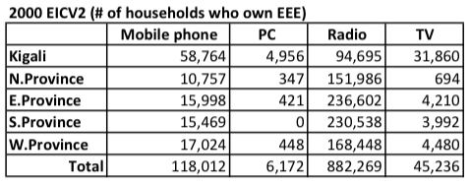
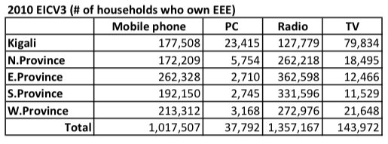
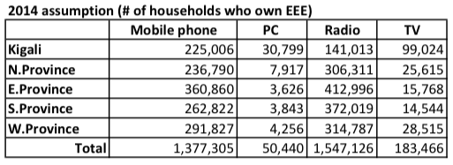
EEE USAGE IN RWANDA ( CENSUS DATA)
Annual growth rate of 5.95%

Slide 8
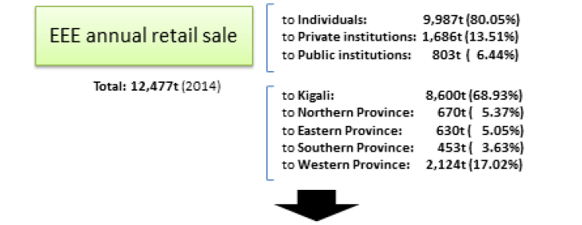
EEE/E-WASTE MATERIAL FLOW IN RWANDA

Slide 9
EEE/E-WASTE MATERIAL FLOW IN RWANDA

Slide 10
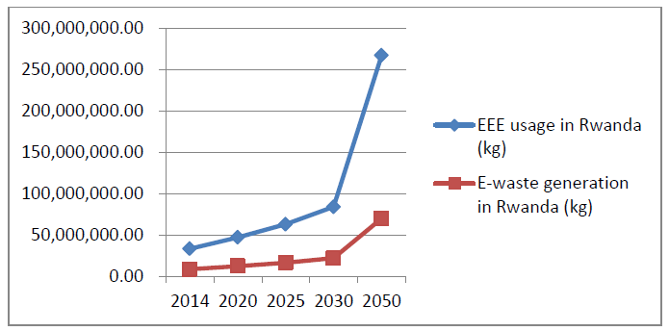
FUTURE TRENDS OF E-WASTE IN RWANDA

Slide 11
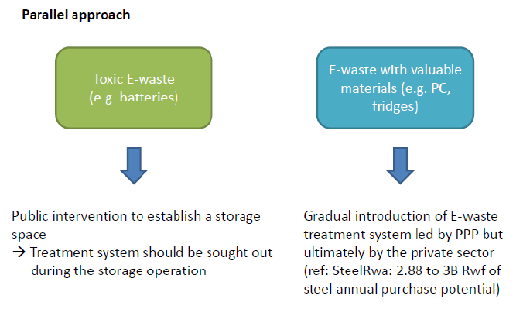
APPROACH TO E-WASTE MANAGEMENT IN RWANDA

Slide 12
E- WASTE POLICY, LAW AND REGULATIONS
Obligation to return
return it to a retailer, manufacturer / importer or to a collection point
Consumer
Obligation to organise and Finance collection and treatment systems
Registration in the regulatory Authority
Be grouped into PRO association under ICT chamber
Finance and organise collection and treatment of E-waste
Retailer/ Manufacturer/ Importer
Obligation to dispose of
Recycler/ collectors/refurbishers
Registration
Licensed by the Regulatory authority ( RURA)
control by PRO and cantonal authorities
Guarantee best disposal
Exporter
proof legal disposal
export permit granted by the Environmental Authority ( REMA)

Slide 13
E-WASTE FIVE YEAR STRATEGY
E-waste Strategic Area of Focus Rwanda.docx

Slide 14
PROPOSED E-WASTE TREATMENT FLOW
Collection of
e-waste
Segregation and storage
Metal scrap
Sale to SteelRwa or mastersteel
Plastic scrap
Sale to Rwanda Plastic
Eventual add of components
Eventual refurbishment
Examination of refurbishment or reuse possibilities
Batteries
Sale to battery recycler in Kigali
Manufacture of new products
Sale to second hand market
Dismantling
CRT glass
Large e-waste recycler
PCB Boards of low and high quality
Sale to PCB smelters ( UMICORE)
Recovery of reusable components
Recovery of scrap
Non recyclable hazardous waste
Storage until final disposal

Slide 15
POTENTIAL REVENUES FROM SELLING E-WASTE FRACTIONS IN RWANDA
Average price of Components on International Market
 | E-WASTE COMPONENT | PRICE/ TONNE
 | Mobile phones | 30,000 | USD/tonne
 | Computers - central unit | 10,000 | USD/tonne
 | Computers - monitors | 2000 | USD/tonne
 | Other ICT equipment | 2500 | USD/tonne
 | Other e-waste | 200 | USD/tonne
An estimated amount of 100 million Rwandan Francs ( 140,000 USD) can be generated yearly by selling E-waste components .
Potential recycled material buyers in Rwanda

Slide 16
GREEN JOBS CREATION
Rwanda Aims to create 200,000 new jobs each year.
More than 1,000 jobs will be created through proper E-waste collection , refurbishment and recycling
Women, Youth and Disabled people associations will be used in the collection of e-waste with incentives.

Slide 17
CONCLUSION : E-WASTE TO BENEFITS
Business
Reduce disposal cost ( Hiring of warehouses.eg. Stockpiles of E-waste )
Minimize use of non-renewable resources
Create new economic & “greening” business opportunities
etc
Communities
Improved revenues through providing E-waste collection incentives
Create jobs
Enhance economic competitiveness
Reduce impact to human health & the environment
etc
There is significant potential for job creation and revenue generation when E-waste is properly managed .

Slide 18
Thank You

