Slide 1

ITU Regional Standardization Forum For Africa
Dakar, Senegal, 24-25 March 2015
Overview of the
Overvoltage Protection Guide for Telecommunications Equipment Installed in Customer Premises
Dr. Ahmed Zeddam
ITU-T SG5 Chairman
Orange, France
ahmed.zeddam@orange.com

Slide 2
Introduction
This presentation contains a brief overview of the Overvoltage Protection Guide for telecommunications equipment installed in a customer premise which has been published as international standard [Recommendation ITU-T K.98]

Slide 3
Information provided in the guide
This Guide contains the information needed to protect telecommunications equipment installed in customer premises from damage due to lightning strikes to the power and telecommunications lines/cables. It considers the impact of the different types of power distribution systems, the length of the telecommunication SPD bonding conductor length and the resistance to earth at the customers’ premise.

Slide 4
About protection of Equipment
☞ Protecting telecommunications equipment, within a
structure, requires a combination of 2 main components:
  Equipment resistibility. All equipment installed in customer premises has to be compliant with the appropriate resistibility level of Recommendation ITU-T K.21 “ Resistibility of telecommunication equipment installed in customer premises to overvoltages and overcurrents”
  Additional protective measures :
    Cable routing practices complying with Recommendation ITU‑T K.66 “Protection of customer premises from overvoltages”,
    Earthing and bonding practices complying with Recommendation ITU‑T K.66,
    Installation of Surge Protective Devices (SPD) for overvoltages protection according to Recommendation ITU-T K.66. This includes the use of both Multi-Service Surge Protective Devices (MSPDs) and primary protectors and finally,
    Installation of an external lightning protection system (LPS) in order to achieve direct strike protection of the building.

Slide 5
Contents
The contents of this guide include:
Surge coupling and mechanisms of damage
Elements of protection
Installation of Protection
Mains power distribution system types
Information is given in this Recommendation with a reference to other documents when necessary

Slide 6
Surge coupling and mechanisms of damage
This information follows the method of IEC 62305-2 where 4 coupling mechanisms S1 to S4 are defined:
S1 = Lightning strike to the building
S2 = Lightning strike near the building
S3 = Lightning strike to power line or telecom line
S4 = Lightning strike near a telecom line
This guide concentrates on source S3

Slide 7
Elements of protection
Equipment resistibility. The test requirements are given in Recommendation ITU-T K.21. This guide has information on selecting the relevant resistibility level e.g. basic, enhanced or special. Enhanced requirements are recommended for mains power equipment. Special requirements are generally used when high isolation levels are required.

Slide 8
Elements of protection
Correct classification and use of ports.
Detail on this is given in Recommendation ITU-T K.75 “Classification of interface for application of standards on resistibility and safety of telecommunication equipment”.
For safety and reliability reasons it is important to connect internal cables (do not leave the building) to internal ports and external cables (cables which terminate in the network or run between buildings) to external ports

Slide 9
Elements of protection
Cable routing Information details are contained in Recommendation ITU-T K.66. The user is referred to Recommendation ITU-T K.85 “Requirements for the mitigation of lightning effects on home networks installed in customer premises” and IEC 60364-4-44 for detailed information. The critical loop is the loop formed by the cabling between the equipments and the earth wires back to the MET.

Slide 10
Elements of protection
Earthing and bonding Information details are contained in Recommendation ITU-T K.66. Logically the shorter the SPD bond wire the better. This is confirmed in ITU-T K.98 and it is also expected that the lower the resistance to earth at the customers’ premises the better. This is not always so according to Recommendation ITU-T K.98

Slide 11
Elements of protection
Surge Protective Devices (SPDs). Gives the location of primary protection. Clusters are protected by an Multiservice Surge Protective Device (MSPD) . Primary protection is installed to protect MSPDs when required against direct strikes. It is essential with clamping SPDs that the primary SPD protects downstream SPDs.
MSPDs are good insurance against damage.
Primary protection is only installed when necessary.

Slide 12
Elements of protection
Direct strike protection of a structure. Direct strike protection of the structure is outside the scope of Recommendation ITU-T K.98 and the reader is directed to IEC 62305-3.
Direct strike protection is only installed when necessary

Slide 13
Elements of protection
Installation of protection. The installation of SPDs is well covered in Recommendation ITU-T K.66 and the reader is directed to this recommendation.
A particular problem can occur when the Neutral is not connected to the PE under surge conditions and solutions are given. The reader is referred to Recommendation ITU-T K.85 for examples and the techniques of risk assessments.

Slide 14
Mains distribution systems
The mains distribution systems can be described as follows:
TN-S. The Neutral and PE is earthed only at the distribution transformer
TN-C. The PE and Neutral conductors are linked and earthed at the customer premises
TT and IT. The PE and Neutral conductors are not linked. The PE conductor is earthed at, but does not leave, the customer premises

Slide 15
Simulations
The major part of this guide is the simulation of lightning strikes to power and telecommunication lines/cables. They were performed for:
The three types of power distribution systems
Earthed equipment and floating equipment
Protected and un protected equipment installations

Slide 16
Simulations
For different earthing and bonding conditions at the customer premises:
  100 Ω, 2 Ω and no path to earth
  10 metre and 1.5 m SPD bonding conductor length
To provide information on the current waveform and the energy dissipation in downstream SPDs (in the equipment or in the MSPD) to enable the rating of these SPDs to be more accurately determined

Slide 17
Example of simulated configuration
L
3.0 kV isolation
Associated earthed equipment
SELV
PEN
N
1.5 kV isolation
Switching Centre
TNV3
PE
MET
Earth
electrode resistance
Earth
electrode resistance

Slide 18
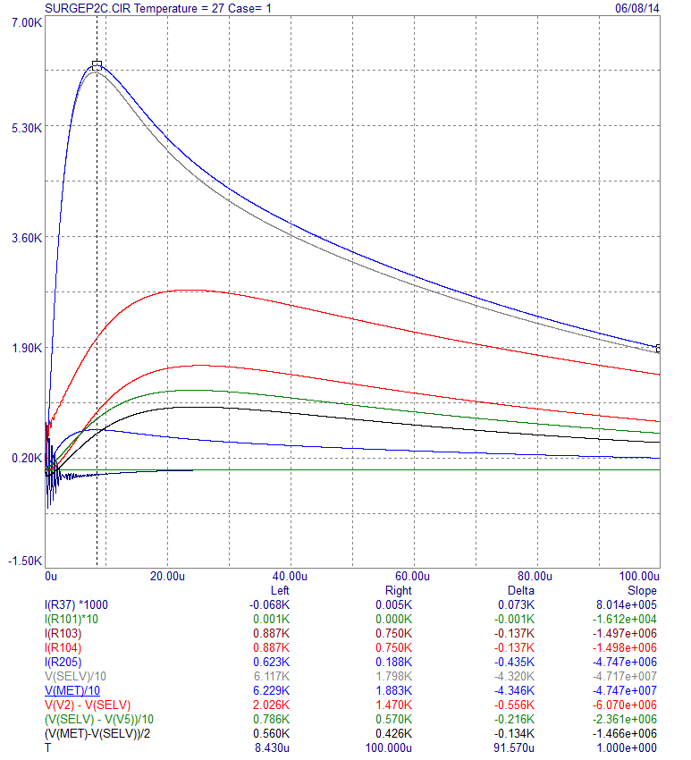
Example of result of simulation

Slide 19
Main results of simulation
It is possible to protect telecommunications equipment against a direct strike to the services providing the strike point is more than a couple of hundred metres from the customers’ premise in an urban area or denser area.

Slide 20
Main results of simulation
Floating equipment is far easier to protect than earthed equipment.
Earthed equipment can only be protected when the primary protector bond wire is 1.5 m or less.

Slide 21

Conclusions
It recommends the use of Multiservice Surge Protective Devices (MSPDs) as the first level of protection
Primary protection is only installed to protect the MSPD when necessary
☞ The majority of installations could be protected for some tens of Euros per equipment cluster and consequently the reliability of service significantly increased

Slide 22
ITU-T/SG5 “Environment & Climate Change”
itu.int/go/tsg5
ITU-T/SG5 Series K Recommendations (free of charge)
itu.int/ITU-T/recommendations/index_sg.aspx?sg=5
Thank you

