Slide 1
Typology and Benchmark of Tools for Assessing the Mobile Networks QoS and QoE
ITU Regional Standardization Forum, SG 5 and SG 12 Regional Group for Africa
Dakar, Sénégal, 24 -25 March 2015
Session 4: Tools and Methodologies for Testing the Quality of Service for Mlutimedia Services over Internet/Broadband Networks (Mobile and Fixed)
Speaker: Prof. Sami TABBANE

Slide 2
Agenda
1
Quality KPIs: Measured and Perceived
2
Processes and Tools
3
4G Innovations
4
Annex: SFM Presentation and Tools

Slide 3
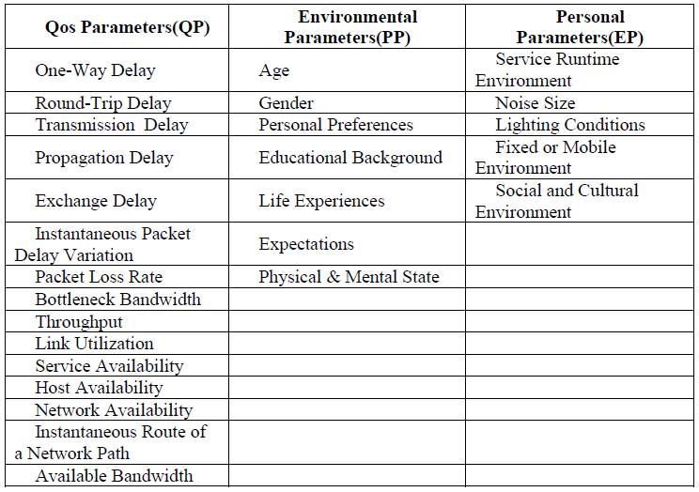
Impact Indexes of QoE

Slide 4
QoS KPIs
Call Blocking Rate
Call Success Rate
Call Drop Rate
Voice quality
MSC/BSC/Network Availability
International Availability
Network Efficiency Ratio
SMS Access Success Rate
Received SMS Rate
MMS Access Success Rate
Received MMS Rate
Internet Connection Success Rate
Data Transmission Throughput
Internet Session Maintain
Data Connection Establishment Duration
Web Service Unsuccessful Rate
Apparent Web Service Throughput
FTP Data Service Connection Failure Rate
Apparent Throughput of the FTP Service
Coverage

Slide 5
Which quality indicators are important for the user?
Results of a survey conducted in Tunisia (2014)

Slide 6

Telephony service reliability
91,6%
Moyenne / 100
90,2
8,3%
Base : 286 répondants

Slide 7
SMS service reliability
60,5%
Moyenne / 100
68,2
37,1%
Base : 286 répondants

Slide 8
MMS service reliability
23,8%
Moyenne / 100
44,6
70,6%
Base : 286 répondants

Slide 9
Internet service reliability
64,3%
32,2%
Moyenne / 100
72,7
Base : 286 répondants

Slide 10
Call success rate importance
95,8%
3,8%
Moyenne / 100
94,8
Base : 286 répondants

Slide 11
Communications quality importance
97,2%
2,8%
Moyenne / 100
96,1
Base : 286 répondants

Slide 12
City indoor coverage importance
97,2%
2,4%
Moyenne / 100
96,7
Base : 286 répondants

Slide 13
Outdoor coverage outside cities
91,6%
7,7%
Moyenne / 100
92,7
Base : 286 répondants

Slide 14
Indoor coverage importance
94,8%
4,9%
Moyenne / 100
95,4
Base : 286 répondants

Slide 15
Incar coverage importance
80,1%
18,9%
Moyenne / 100
83,5
Base : 286 répondants

Slide 16
Call continuity (no call drops for 100 calls)
58,4%
40,6%
Moyenne / 100
69,9
Base : 286 répondants

Slide 17
Call continuity (no call drops for 50 calls)
56,6%
42,3%
Moyenne / 100
71,0
Base : 286 répondants

Slide 18
Call continuity (no call drops for 20 calls)
75,5%
23,4%
Moyenne / 100
80,8
Base : 286 répondants

Slide 19
The 5 most important criteria (by order of importance)
1st criteria
Base : 286 répondants

Slide 20
The 5 most important criteria (by order of importance)
2nd criteria
Base : 286 répondants

Slide 21
The 5 most important criteria (by order of importance)
3rd criteria
Base : 279 répondants

Slide 22
The 5 most important criteria (by order of importance)
4th criteria
Base : 274 répondants

Slide 23
The 5 most important criteria (by order of importance)
5th criteria
Base : 263 répondants

Slide 24
Agenda
1
Quality KPIs: Measured and Perceived
2
Processes and Tools
3
4G Innovations
4
Annex: SFM Presentation and Tools

Slide 25
QoS and QoE measurements tools
Tools: no tool or technique is able to catch all the QoS of a network.
 Operators are using several tools (specific or not) on different interfaces (complementary or not)
Measurement techniques
Measurements
Field
System
Surveys
Measurement tools
Surveyors
OMC raw data
Passive probes
Calls and sessions generators
Generic/
Specific
Manual/ Automatic
Passive
Active

Slide 26
Main tools for measuring QoS and QoE parameters
Solution | Advantages | Drawbacks
Drive tests | Track the events at a geographical level and step by step | Not exhaustive (geographical and temporal) Heavy costs and logistics
OMC raw data analysis | Geographically (all the cells) and timely exhaustive (all the network) Reduced cost | Lacks the tracking of the events linked to a particular call or a session Lacks of measurements in coverage holes
Subscribers service perception surveys | Reflects the QoE as actually perceived by the users | Costly (surveys) Subjective
Field surveys | Voice quality measurements more objective | Costly (logistic and surveyors) Limited in time and space
Subscriber’s mobile based applications | Low cost Geographical and temporal representative, from the services usage | Lack of some parameters non available May have an impact on the mobile phone of the user

Slide 27

QoS parameters measurements
Measurement types
BTS
BSC
MSC
Raw data | Value
A | 3.15
B | 1.05
C | 0.95
NE counters
Call | SpQ
X Y Z | Bad Excellent Good
OMC counters
Measurement field
Subs. A | Subs. B | Dropped Call
+33 6 XXXX XXXX | +33 1 XXXX XXXX | No
+33 6 XXXX XXXX | +33 4 XXXX XXXX | Yes
Drive tests
Capture tool
CDR: Call Data Record

Slide 28




QoS parameters measurements
Measurements of network performance
Back to
user
Control of network performance
→ Optimization
Performance
statistics
Statistics from different counters and interfaces
E2E
service
quality,
QoE
Node B
Server
application
3G
SGSN
3G GGSN
RNC
UTRAN
Core nw
External nw

Slide 29

QoS parameters measurements
Different services ➔ different QoS needs
  KPIs should be defined separately for each service
Example: voice services - CS
KPI categories | Indicators | Measurements
Service accessability | Coverage availability Call blockage rate Call establishment delay | Ec/No, RSCP Admission control RAB assignment
Service integrity | Voice quality | Noisy frames (FER), MOS
Service retainability | Dropped calls | Handover failure No coverage Interference

Slide 30
QoS parameters measurements
Service KPI
Service FTP: FTP start-up failure rate, FTP abort rate, FTP throughput, …
Service HTTP: HTTP access failure rate, HTTP abort rate, HTTP access time, HTTP access time to text, HTTP throughput/delay, ...
Pusk-to-Talk over Cellular (PoC): PoC service availability, PoC service accessibility, PoC voice quality, PoC timely delivery of voice.
MMS: MMS send/retrieve failure rate, MMS send/receive throughput, MMS send/receive delay, MMS end-to-end delay, MMS notification delay.
WAP: WAP failure rate, WAP access time.
Ping: RTT

Slide 31

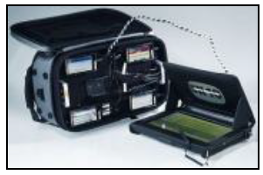
Field measurements
Example of Net check tool (Infocom)
➔ Manufactured for pedestrian measures.
It consists of:
  A portable equipment, installed in the backpack (based on HTC smartphones),
  An application XGMA controlled via a digital tablet allow auditing wireless networks in urban area, in shopping centers and public buildings.
➔This tool can also during the measurement campaign audit the service quality of mobile networks in car, when the vehicular is mobile.

Slide 32

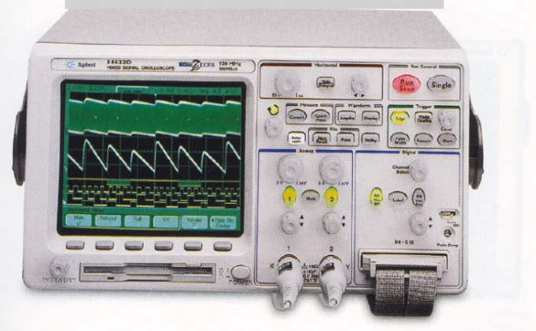
Field measurements
Network Optimization Tools Used are as the following:
  TEMS Investigation
  Agilent E6474A
  Neptune
  CDMA Air Interface Tester (CAIT)
  TEMS DeskCat
  Actix Analyzer
  NEMO
  Gladiator
  NetAct
  Mentum

Slide 33


Field measurements
Measurements
and
softwares
GPS
External antennas
Controler
Energy
Processing
Mobile QoS test equipment
Man to machine interface

Slide 34
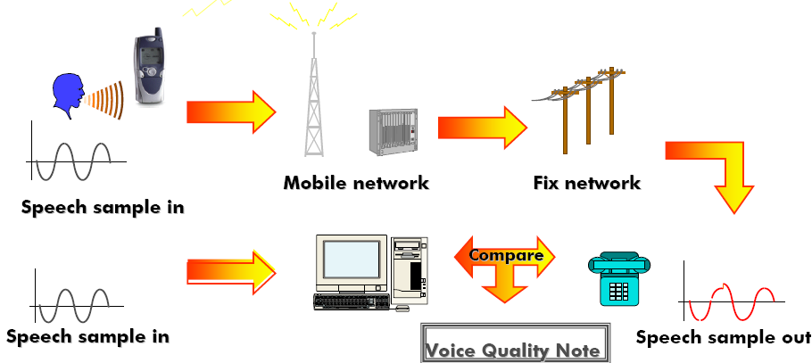
voice quality Analysis
Voice quality measurement principle

Slide 35
OMC measurements
Principle | Harvest from OMC (radio and network) events (counters) report from equipment Treatment of this counters ( with formula elaborated by the operating team or by treatment software)
Advantages | Global statistics: related to an BSC/ MSC/ SGSN/… area Less expensive than field measurements: distant measurements , no necessary to engage a team for measurements , …
Drawback | No localization of problems identified in radio level des (area with no coverage or interference area ) No follow up of one or multiple calls in particularly
Measurements | Radio measurements (KPI « classics »: QoS, traffic, performances, …)Network measurements (KPI « classics »: localization, attachment, calls, …)

Slide 36
OMC measurements
Tools
Proprietaries
Alcatel: RNO
Siemens: SPOTS (Fair interest for statistic reports)
Ericsson: TEMS Analyzer
…
Generic (multi-manufacturer)
APIC of Metrica: Evolution problem
MyCom of MyCom: equivalent to Metrica but less adapted to sophisticated reporting
AirCom: generally preferment for classic statistics
NetAct SQM: Nokia
OVPI: HP (for IP equipment)

Slide 37
Passive probes
Principle | Collect in a network equipment (nodes) and/or in an interface the exchanged messages between the network and multiple mobiles (files typically .log)
Advantages | More global than field measurements: related (in function of the used interface) to a cell, to an area BSC/MSC/SGSN, … Less expensive than field measurements: distant measurements , no necessary to engage a team for measurements , …
Drawback | No localization of problems identified in radio level des (area with no coverage or interference area )
Measurements | Radio measurements (Signal power level in broadcast or point to point, interferences level , power of neighbor cells, cell parameters, …) Exchanged messages and occurred problems during a connection (LU/RU, call/session, HO, …) for all levels les (layers 1, 2, 3 and highest in function of interfaces).

Slide 38
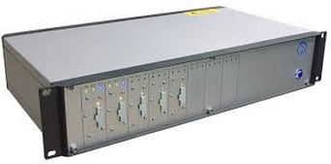
Passive probes
    Tektronics: K12/15XX (Failed statistics, …, simple and recently improved in term of ergonomic)
    Network General: Sniffer Pro + NPO (IP interfaces and analyzes via NPO)
    MyCom: NIMS-PrOptima (possibility of combination with drive tests in an SIG)
    Tekelec: Steleus 2.5 G (GPRS interfaces) and Steleus 3G (Iu interfaces ), multiple applicatives for de post-treatment. Preservation of data for few days. Supervision of the GPRS QoS on real time and production of QoS reports with alerts .

Slide 39
Passive probes
    HP: Ovis (Test of data services, production of KPI of availability and of response delay).
    RadCom: Network Consultant (interfaces A, Gb, Gi, Gn, Iub, Iur, Iu, Gi et Gn): decoding frame , Very good in post-treatment ( mare richer in information than other products, as statistics on PDP liberation causes)
    Trafica (NetAct de Nokia)
    Ipanema: Ipanema (Fix probes for data traffic capture of 2,5 G et 3G).
    Cigale (Astellia): Probes for capturing traffic 2G and 3G
    ➔Problems of update and maintenance comparing to other software manufacturer version

Slide 40
Protocol analyzers
Network interfaces analysis
Company | Product
Nethawk | 3G Analyzer
Agilent | Signaling analyzer
Tektronix | K15
Radcom | Performer analyzer
Acterna | Telecom Protocol Analyzer

Slide 41
Calls generators
Principle | Generation of serial calls and sessions, … according to predefined scenarios and harvest the ensemble of exchanged messages with detection of possible problems
Advantages | More exhaustive than probes Targeting procedures/mobiles/area/… with problems
Drawback | More expensive than probes Less « independents » than probes (because targeting in particular scenarios)
Measurements | Radio measurements (Power signal level in broadcast and in point to point, interference level, power of neighbor cells, cell parameters, …) Exchanged messages during a connection (LU/RU, call/session, HO, …) to all levels (layer 1, 2 et 3).

Slide 42
Tools Benchmark
Vendors | DT measurement tools | DT post processing tools | OMC tools | Performance monitoring tools | Probes tools | Geolocation tools | Customer QoS surveys | Subjective voice quality evaluation | Customer QoE tool
Opticom |  |  |  |  |  |  |  | ✓
Actix |  | ✓ | ✓ | ✓
JDSU |  | ✓ | ✓ | ✓
Xceed Tech |  | ✓ | ✓ | ✓
Aircom |  |  | ✓ | ✓
Ascom | ✓ | ✓ |  |  |  |  |  |  | ✓
Anite | ✓ | ✓ |  |  |  |  |  |  | ✓
Accuver | ✓ | ✓ |  |  |  |  |  |  | ✓
Accanto | ✓ | ✓ | ✓ |  |  |  |  |  | ✓
Net check | ✓
Epitiro | ✓
Ookla | ✓
Dingli | ✓ | ✓ |  |  |  |  |  |  | ✓
Ericsson |  |  | ✓ |  |  | ✓
Huawei |  |  | ✓ |  |  | ✓
NSN |  |  | ✓
Alcatel-Lucent |  |  | ✓
QoS Tracker |  |  | ✓
BI4T |  |  | ✓
InfoVista |  |  | ✓
Astellia |  |  | ✓ |  | ✓
Pixipnet |  |  |  |  | ✓
V3D |  |  |  |  |  |  |  |  | ✓
RTR-NetTest |  |  |  |  |  |  |  |  | ✓
Marketing institutes |  |  |  |  |  |  | ✓
QoEntum |  |  |  |  |  |  |  |  | ✓

Slide 43
Agenda
1
Quality KPIs: Measured and Perceived
2
Processes and Tools
3
4G Innovations
4
Annex: SFM Presentation and Tools

Slide 44

4G main features and the challenges for quality assessment
LTE performance requirements
Mobility: low mobility (0-15km/h) and high speeds
Latency: user plane < 5ms ; Control plane < 50 ms
Improved spectrum efficiency
Improved broadcasting
All IP
Scalable bandwidth
Carrier aggregation
Network sharing
Radio performance enhancement features

Slide 45
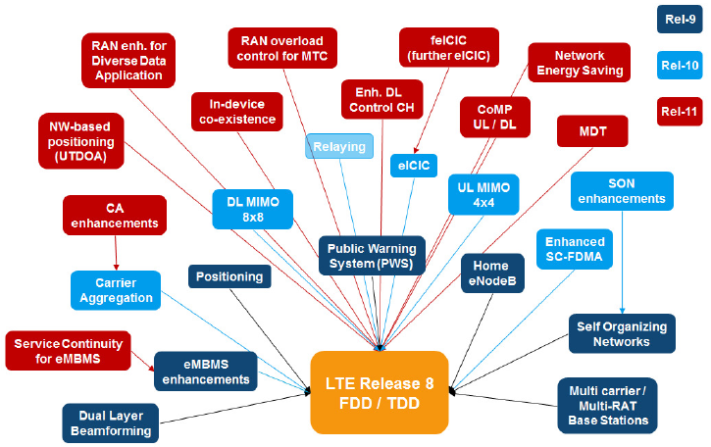
LTE releases evolutions and features

Slide 46
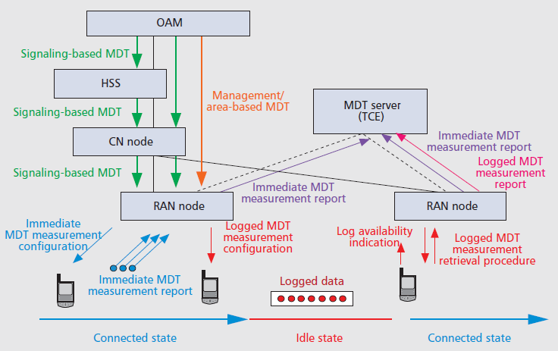
Minimization of Drive Tests Principle
Defined in Rel-10 with the following objectives:
Ability of the UE to include location information as part of the UE radio measurement reporting
Ability of the UE to log radio measurements during the UE’s idle state
Reuse of radio measurements to those that have to be performed as part of normal RRM procedures, minimizing additional complexity and battery consumption by the UE.

Slide 47
Conclusions
Trends in quality measurements
Drive testing was the very first type of tools for assessing the QoS,
System measurement tools (probes, OMC raw data, CDR based, …) used to get a wider picture of the network performance,
User experience focused measurements to be closer to user’s perception
Main issue so far in the transition to 4G and 5G

Slide 48



Thank You!
Address: 81, Avenue Hédi Chaker – 1002 – Tunis – TUNISIA
Tel.: +216 71 845 248/ +216 98 377 887
Fax: +216 71 845 249
Contact: info@sfmtechnologies.com
Site Web: www.sfmtechnologies.com

Slide 49
Agenda
1
Quality KPIs: Measured and Perceived
2
Processes and Tools
3
4G Innovations
4
Annex: SFM Presentation and Tools

Slide 50

Synoptic
Services for Fixed and Mobile Telecommunications Network and Systems
Created: 1995 by an expert group of Engineers, consultants, specialists,
20+ Countries around the globe
40+ Cellular Networks
Activities: Strategic Consulting, Engineering, Technical Assistance and Training in Telecommunications
Customers: Telecom Ministry, Operators, Regulators, Consulting Company.

Slide 51
SFM Group
19+ Years of experience
20+ Countries around the globe
40+ Cellular Networks
50+ Consultants and Experts
Turn Over 2014: MUSD 1.8
SFM Telecom for local activities
SFM Technologies for consulting and expertise
SFM International for training

Slide 52
SFM Group
1800+ Man-Days of Technical
Assistance
650+ Man-Days
Strategic Consulting
SFM
in 2014
550+ Man-Days Training
With 40% in site
50+Operators, Regulators
And Consulting Company

Slide 53

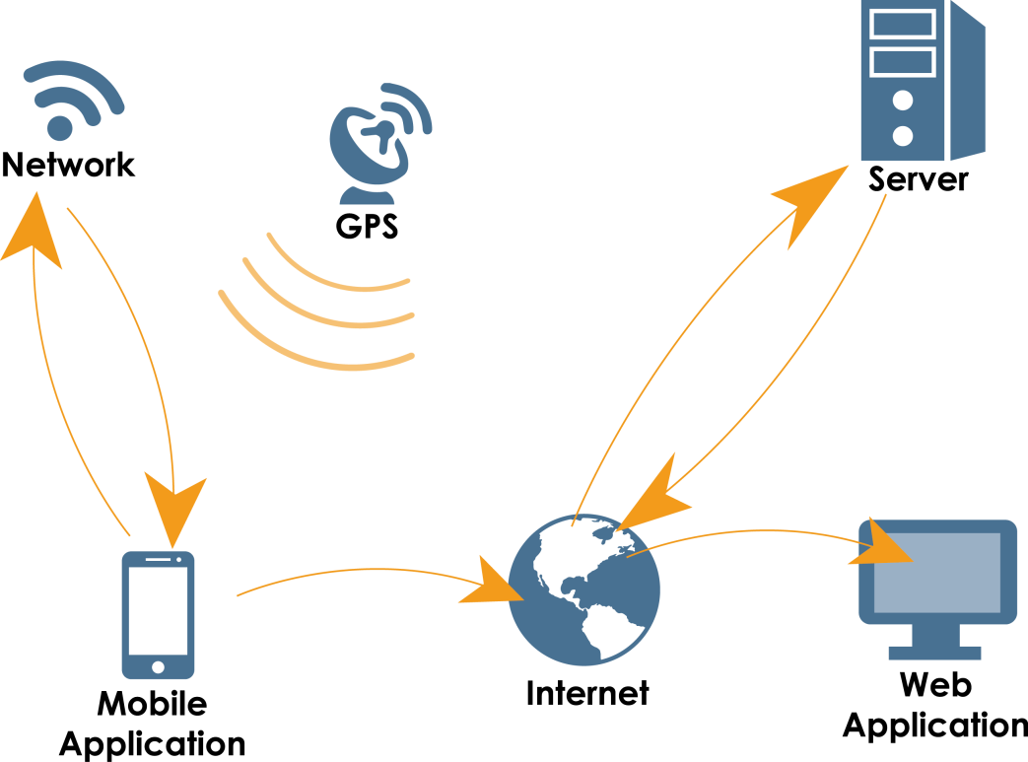
QoEntum: Automatic QoE for Network Performance Improvement And Business Monitoring
QoEntum Solution collects standard KPIs, including Voice and Data services from subscribers 'mobile Androïd smartphones. It reflects end-user experience and network performance perception. Information and measurements sent back to SFM server, where data are processed, stored, analyzed and immediately accessible via a secured web site.

Slide 54
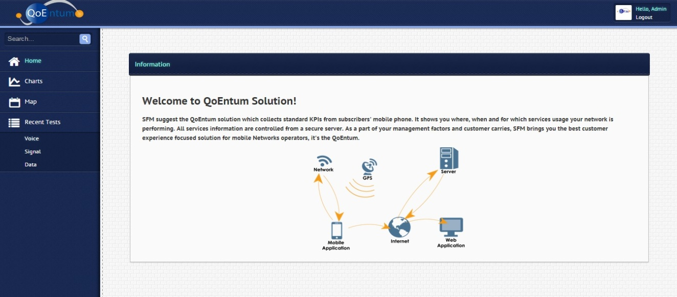
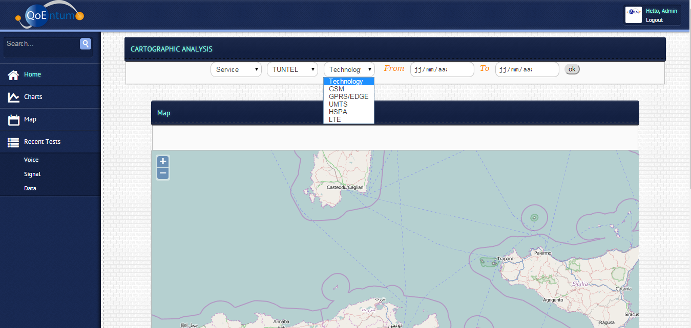
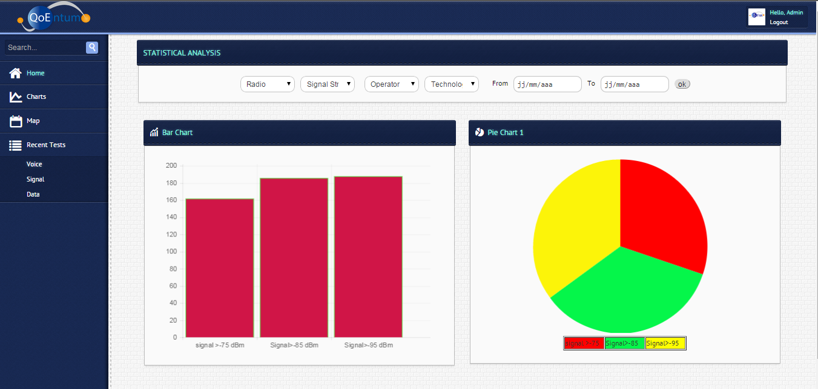
QoEntum: Sample screens

Slide 55

QoEntum: Indicators
QoS and Legal Department
CDR, CBR, Call Setup Time etc. per region
Data services KPIs: speeds UL and DL per location,
White areas: coverage problems (holes, low signal level, indoor/incar/outdoor coverage),
Network performance tracking,
Compliance with license conditions
Engineering and Optimization
Commercial and Marketing
CBR, CDR per area,
Mean call setup duration per area,
Signal level per user and per location,
Connected network (2G/3G/4G),
Real-time processing and display of the problems on maps
History of the measurements and comparison of networks performance (2G/3G/4G, region, …).
Data measurements: speed (UL, DL), setup success and delay,
HO rate,
Data activity rate,
Connection and sessions durations,
User information: UE type, location, activated services, used credit/SIM card and service, activity (sessions durations, calls, …), transmitted and received data volumes, …
Hotspots (density of test mobiles per area),
MOS and PESQ,
Mostly used application per subscribers,
Loss of revenues evaluation
User’s profile (behavior, …)
Perceived user quality
  Hotspots (density of test mobiles per area),
  MOS and PESQ,
  Mostly used application per subscribers,
  Loss of revenues evaluation
  User’s profile (behavior, …)
  Perceived user quality
USER

Slide 56

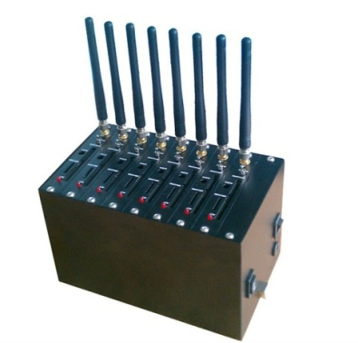

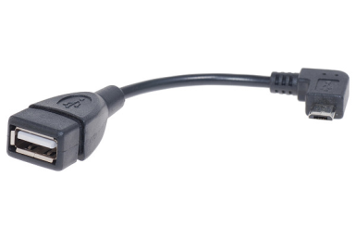
Tariffs Tracker: Automatic Control Tool of Telecommunications Services Tariffs
Backup
Collected Information Storage,
Databases,
Transaction History,
Generated reports.
SIM card platform for the generation of the calls, SMS and data sessions, and the collection of advice of charge.
Central platform
Scenarios configuration,
Pricing formulas Setting,
Call generation,
Charging Information collecting,
Tariffs plans comparing,
Audit reports generation.
Tariffs Tracker evaluates service tariffs as seen by the subscriber.

Slide 57


Contact
Adresse: 8, Rue Ibn Sina – El Menzah VI – 2091 Ariana – TUNISIA
Tel.: +216 71 284 314/ +216 98 377 887
Fax: +216 71 284 314/ +216 71 754 842
Email: info@sfmtechnologies.com
Site Web : www.sfmtechnologies.com

