Slide 1
ITU Regional Standardization Forum For Africa Dakar, Senegal, 24-25 March 2015
Broadband Internet QoS Parameters For Regulators (Measurement Tools and Methodologies)
Tahitii Obioha Network Planning and Optimisation Engineer Planet Network International, France.

Slide 2
Definitions of Terms
Based on ITU-T Recs. E.800, E.802 G.1020 and Y.1540 ETSI EG 202 057-4 , ES 202 765-4
Definition of QoS
defined as the collective effect of performance which determines the degree of satisfaction of a user of the service.
a measure of performance of the network itself.
Definition of Internet.
computer network consisting of a worldwide network of computer networks that use the TCP/IP network protocols to facilitate data transmission and exchange.
Definition of Internet Access.
making available of facilities and/or services for the purpose of providing an access to the public.

Slide 3
Definitions of Terms (cont’d)
Definition of Broadband.
Defined as a high-capacity transmission technique using a wide range of frequencies, which enables a large number of messages to be communicated simultaneously.
Because of its multiple channel capacity, broadband has replaced baseband, the single-channel technology originally used in most computer networks.
Definition of Last Mile broadband Access
refers to communications technology that bridges the transmission distance between the broadband service provider infrastructure and customer premises equipment (CPE).
Definition of Internet Access Providers
refers organization that provides users(subscribers) with an Internet access .
Similar to Internet Service Providers (ISPs).

Slide 4
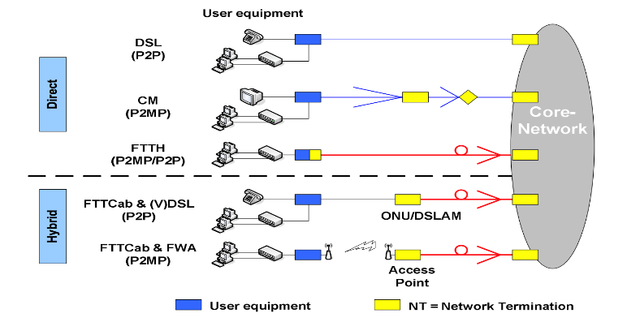
Broadband Access Solutions
Broadband Internet service refers to service which is delivered using fixed wired access networks(wired) and fixed wireless access networks (Last mile)).

Slide 5
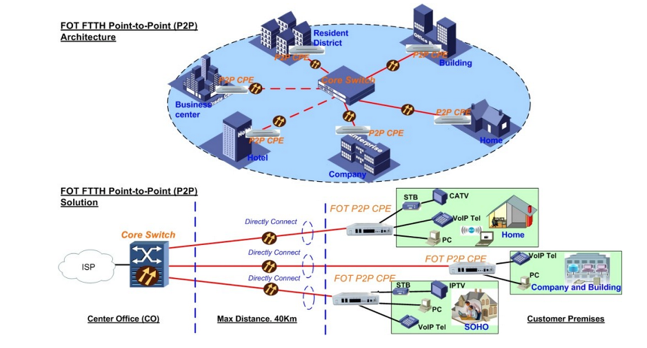
P2P- POINT TO POINT
P2P- Point to Point connection

Slide 6
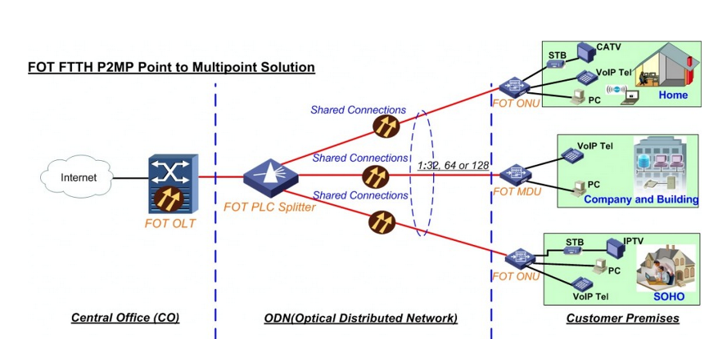
P2MP- POINT TO MULTI POINT
P2MP- point to multipoint connection (shared connections)
Contention Ratio 1:32 means a connection shared between 32 users.

Slide 7
Relationship between NP,QoS and QoE
Access Network + Core Network Highway
Terminal Equipment Vehicule/Truck
QoE depends majorly on QoS which in turn depends on Network Performance(NP)
thus NP parameters ultimately determine the QoS.

Slide 8
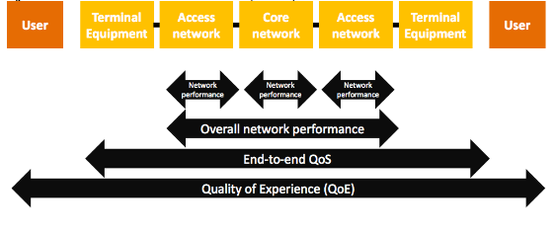
QoS Perspective for Regulators
Congestion Highway Traffic
Given the rapid growth of Broadband, Regulators should monitor QoS from a network point in terms of capacity and resource availability.

Slide 9
Objectives of QoS Evaluation(for Regulators)
Internet access provision, once under the administration of the research and education networks, has been undertaken by commercial providers.
Ensure Transparency by making known the minimum QoS level of service, which the service provider is required to provide, and the user has a right to expect, enabling consumers make informed choices among several service providers.
Verify Operators’ Service Level Compliancy by benchmarking their performance against standards and criteria imposed by country’s Regulatory Authority.
Protect the interests of consumers and enhance consumer satisfaction:
--Increasing and Diversified Complaints Broadband Internet Services --Unfair charges and unfair subscription --Provisioning of chargeable Value added services without explicit consent --Broadband Speed not provided as per plan or advertised.

Slide 10
Challenges faced by Regulators in Broadband QoS
Difficulty of distinguishing service levels and perceived values different groups of users have different needs requiring different service levels, . There is nothing to distinguish a business user from a home user, a big user from a small user, or local from overseas Internet traffic.
Definition of the responsibilities of suppliers of Internet access services not only in the area of their own resources, but also in the context of interconnection agreements.
Bandwidth Sharing (Contention Ratios)
the high susceptibility of the quality parameters of single users' services to the concurrent network load resulting from the sharing of network resources;
Reliance on technical measures The reliance on network statistics aside, it is difficult to measure QoS standards because of the Internet's technical setup--in particular, the concepts of packet switching and dynamic routing.

Slide 11
Challenges faced by Regulators cont’d
What measuring tools should be available to users so that they can correctly formulate a justifiable reason for complaint.
What parameters of quality and accessibility of services should be specified in ISP agreements for the services they provide for Internet access.
How service providers should inform their customers about the quality of service so that customers can make a choice going off the basis of their advertisements (actual quality).
Issue of independent and transparent auditing Most QoS monitoring system relies on self-reporting by access providers.
…

Slide 12
Broadband QoS Monitoring Approaches
Regulator centric
involves operators-Internet Access Providers (IAPs),
monitoring from an IAP’s End
checks parameters like Data Transmission Speed
Network availability,
Contention ratio
Bandwidth utilization
Latency
Packet Loss
User centric
does not involve operator (or regulator),
monitors from user end, more straightforward,
checks parameters like Throughput, Delay, and Jitter.

Slide 13
Methodologies as advised by ETSI (EG/ES)
Regulator centric Basic QoS parameters (ETSI EG 202 057-4)
Parameter | Measure | Measurement Method | Application
Login time | Number of successful logins | Test calls | All IAP services that are accessed via a login process
Data transmission speed achieved | a) The maximum possible data Transmission rate in kbps b) The minimum data transmission rate in kbps c) The mean value and standard transmission rate in kbps | Test calls | All IAP
Unsuccessful data transmissions ratio | % of unsuccessful data transmission | Test calls | All IAP
Successful login ratio | % of successful logins | Test calls | All IAP services that are accessed via a login Process
Delay (one-way transmission time) | a) The meanvalues of the delay inmilliseconds b) The standard deviation of the delay | Test calls | All IAP

Slide 14
Diagram of a Typical ISP setup in Africa
A
B
ISP Core Network
Home user network
ISP Access Network
D
C
International PoP (Spain)
Other Peering Networks Local
E
Other Peering Networks International

Slide 15
QoS Parameters Measurements
QoS of broadband Internet should be measured on the basis of :-
a) Data Transmission Speed (Download and Upload)
Data Transmission Speed defined as the time taken for an amount of data to be transferred successfully from Point A to Point B which points are both connected to the Internet.
b) Availability of Internet Access (Network Availability) (ETSI ES 202 765-4)
Availability of Internet Access is defined as the probability that the end user, through his/her Internet connection, is able to reach other network elements which are also connected to the Internet.
c) Latency (Round trip time (RTT))
Latency defined as the time interval between the instances that a packet of data is launched from an IP based machine located at Point A to the moment it is received by machine located at Point B.
d) Packet Loss
Packet Loss defined as the percentage ratio of those packets sent from Point A in the
network which did not reach their intended destination, Point B, to the total number of
packets transmitted over a specific time interval.

Slide 16
Methodology
a) Data Transmission Speed The upload and download speeds shall be derived from the measurement of SNMP counters that are maintained by the router(s) located at the point of presence (PoP).
b) Availability of Internet Access (Network Availability)
Access Network availability Point A)
Core network availability (Point B)
Local and International Connections Availability (Point C and Point D)
Availability of Internet Access equates to (1 – (Total Period of Downtime)/(Total
Available Period + Total Period of Downtime + Unavailability due to Planned Maintenance))
expressed as a percentage
Network Availability = 1- ( Downtime x100% )
Up time + Downtime + Preventive Maintenance
Service Availability = (Total operational hours – Total hours of service downtime) X 100%
Total operational hours
N A > S A (24 hours period TOH 20h, TDT 3h, PM 1hr) NA =87% SA= 85%

Slide 17
Methodology cont’d
c) Latency (Ping Tests)
Latency shall equate to half the average time taken for a minimum of five(5) consecutive Internet Control Message Protocol ICMP Echo request/reply pairs between the end users CPE and the PoP.
d) Packet Loss (Ping Tests)
Packet Loss shall equate to the ratio of the number of ICMP echo/reply packets which are lost when transmitted from Point of Presence to the end uses CPE, as opposed to the total number of ICMP requests.
An ICMP ping request which does not generate a counter reply is deemed to be lost.

Slide 18
Network Performance Parameters Measurements
Why measure NP Parameters ?
a) Reactive Monitoring Consumer complaints are received at the Authority citing significant deterioration of broadband QoS
and/or
b) Active Monitoring A deterioration of broadband QoS is observed by the Authority through studies which it conducts from time to time or otherwise.

Slide 19
Network Performance Parameters Measurements
NP Parameters are divided into two
a) Connection Oriented Parameters applicable to
Access Network, Local and International Gateways
b) Core Oriented Parameters applicable to Core Network
Connection Oriented Parameters comprise of :
Available Data Rate defined as the speed by which a connection can handle traffic measured in bits per second (bps).
Connection Utilization defined as the ratio between the actual bandwidth which is committed and in use as a percentage of the Available Data Rate of a given connection.
Packet Drop Ratio defined as the number of packets which a specific connection drops out of the network as a ratio of all the packets which are handled by the connection

Slide 20
Network Performance Parameters Measurements
Core Oriented Parameters comprise of
Bandwidth Utilization is defined as the amount of bandwidth which is utilized at the Core Network as a ratio of the total bandwidth available in the core network. This indicator is to be measured during the Time Consistent Busy Hour (TCBH)
Time Consistent Busy Hour (TCBH):The one hour period starting at the same time
each day for which the average traffic of the resource group concerned
is greatest over the days under consideration. ITU
recommends analysis of 90 days to establish TCBH.
Bandwidth Utilization = Peak utilization(@TCBH) x 100%
Available bandwidth
Packet Drop Ratio is defined as the number of packets which are dropped out of the core Network as opposed to the total number of packets which are handled by the core network.

Slide 21
Broadband QoS Parameters and Threshold of a Regulator
PARAMETER | REGULATOR
Network Availability | >95%
Latency (Local) | <150ms
Latency (Int’l) | <350ms(terrestial) <800ms (satellite)
Bandwidth Utilisation | <80% during peak time (@TCBH)
Connection Speed download | >80% of specified from user to ISP
Service Activation Customer Support | 100% in 15 working days 60% calls in 60 seconds 80% calls in 90 seconds

Slide 22
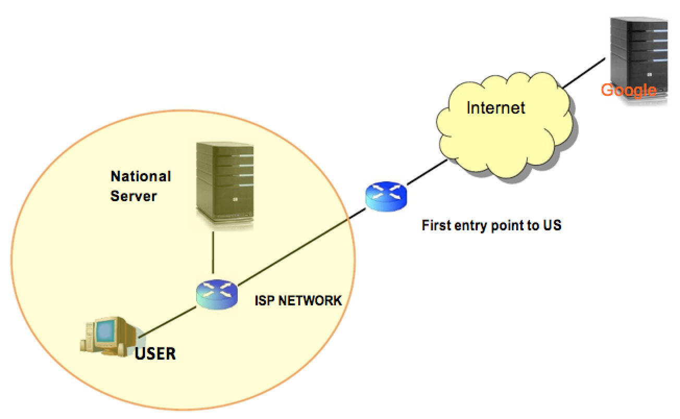
Latency RTT-Local and International
Local: circle, Int’l: square

Slide 23
Measurement Tool
There are several private companies on the telecommunications market, that provide systems to measure these parameters. e.g. Opticom, Empirix , IXIA , NetIQ et al
There are also public-domain tools available over the Internet, for instance at http://speedtest.net, that can be used to test the properties of access points.
The most powerful of the public-domain is the M-LAB TOOL (FCC approved)
http://measurementlab.net, The M-Lab tool lets users perform the following tests:
1) Network Diagnostic Tool (NDT): test your connection speed and receive diagnosis of problems limiting speed.
2) Glasnost Test: test whether certain applications or traffic are being blocked or throttled on your broadband connection. 3) Pathload2: see how much bandwidth your connection provides.
4) Neubot: perform periodic tests to measure NP and application-specific traffic throttling. (OECD uses it)
c

Slide 24
Advertised Broadband Speeds (OECD)
Using Neubot from MLAB

Slide 25
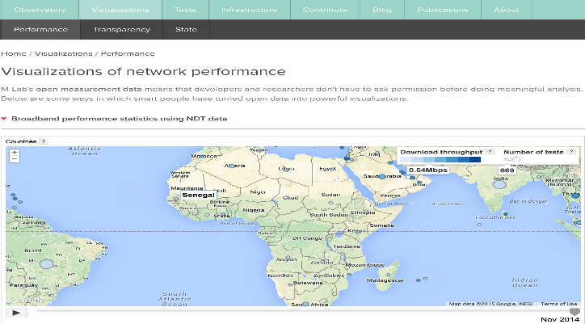
M-Lab Features
The M-Lab tool offers a wide variety of what it calls visualizations of the acquired data relative to the countries of the world. Under Performance we have:

Slide 26
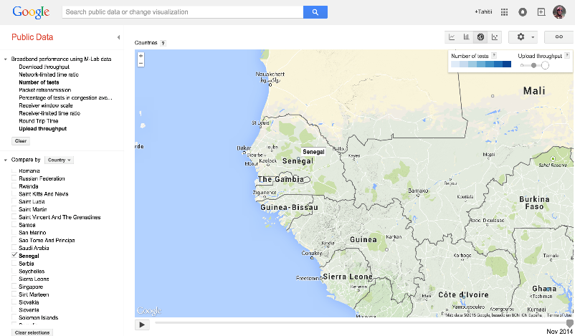
MLAB DATA ON PERFORMANCE

Slide 27
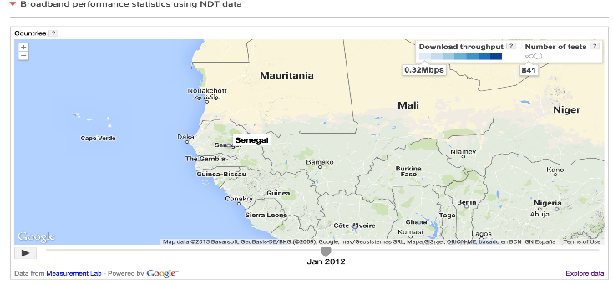
M-Lab Features

Slide 28
Contributing To Open Internet and Net Neutrality
Participate in your little way to ongoing projects.
NEPAD – New Partnership for Africa's Development (NEPAD)
developing policies, strategies and projects at continental level for the development of information and communication technologies (ICT) throughout Africa. OECD- Organisation for Economic co-operation and development http://www.oecd.org/sti/broadband/oecdbroadbandportal.htm
Active Participation in AFRINIC (Regional Internet Registry for Africa) African sites hosted on african ISPs.
WHY PARTICIPATE?
There are many uncharted areas unfortunately. There are far too few servers throughout the world, which weakens the M-Lab tool as geographical location of system servers can severely affect results.

Slide 29
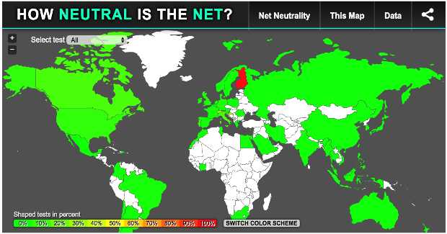
MLAB TOOL ON NET NEUTRALITY
The M-Lab tool offers a wide variety of what it calls
visualizations of the acquired data relative to the countries of the world. Under transparency we have:
No Data in most African Countries except for Ivory Coast and South Africa early 2010

Slide 30
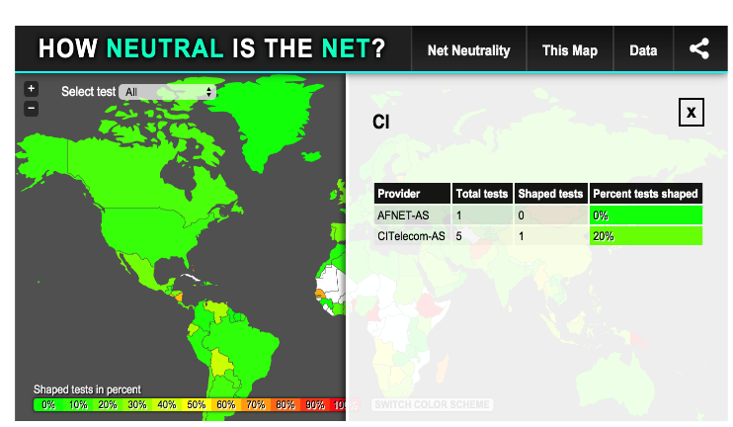
MLAB TOOL ON NET NEUTRALITY
ZOOM IN ON COTE D’IVOIRE

Slide 31
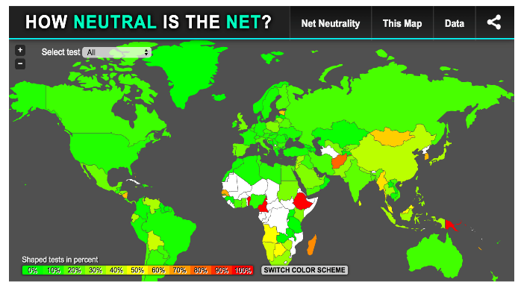
MLAB TOOL ON NET NEUTRALITY (2014)
Data in most African Countries more especially with Countries that has IX, This isn’t the case for Countries in the hinter land of Africa. Mali for example owing to its location (distant from submarine cables.

Slide 32
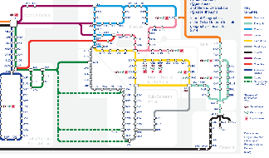
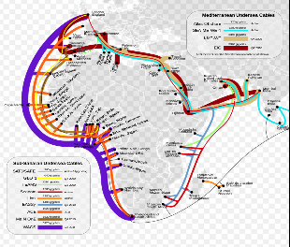
REGULATORS SHOULD CONTRIBUTE TO MLAB
MORE ESPECIALLY COUNTRIES WITH IX

Slide 33
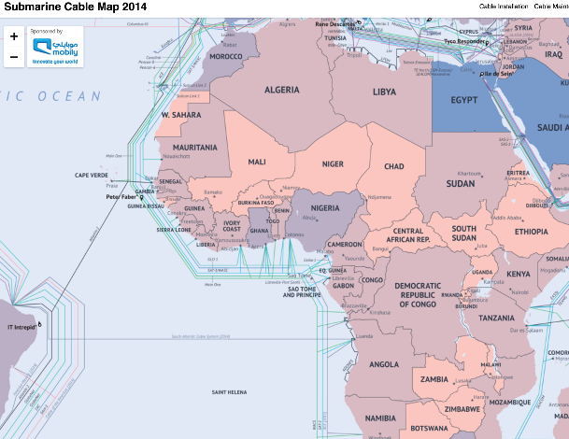
REGULATORS WITH INTERNET EXCHANGE (IX)
MORE ABOUT SUBMARINE CABLES MAP VISIT http://submarine-cable-map-2014.telegeography.com/

Slide 34
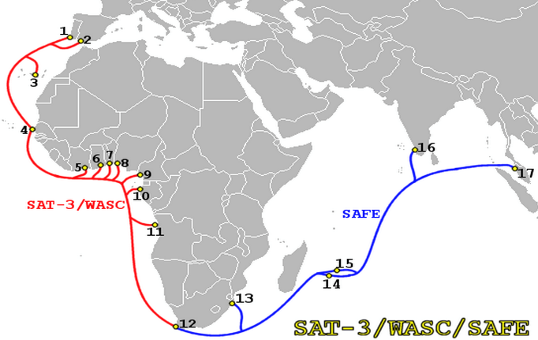
REGULATORS WITH INTERNET EXCHANGE (IX)
ZOOM IN ON SAT-3/WASC/SAFE

Slide 35
AFRICAN UNDER SEA CABLES 2016
ACE to be comissioned later this year 2015 (MALI is a participant)
Visit for more details:
https://manypossibilities.net/african-undersea-cables/

Slide 36
VOLUNTEER FOR SAMKNOWS
https://www.samknows.com/regulators
The SamKnows Whitebox performs the following tests:
• speed of data collection based on the HTTP protocol;
• data upload speed based on the HTTP protocol;
• availability of links;
• delay variation (jitter);
• delay (latency) in both ICMP and UDP;
• loss of both ICMP and UDP packets;
• DNS server response time;
• failure rate of queries to the DNS server;
• response time of Web pages;
• failure rate of loading a Web page.

Slide 37
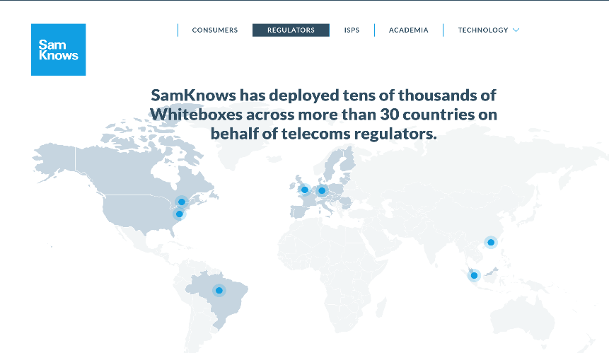
VOLUNTEER FOR SAMKNOWS

Slide 38
Conclusion
The idea behind the Internet was to find a way to move packets without the need for reliability, the Internet cannot guarantee that traffic will go from one point to another; Thus To set QoS standards for the Internet is to demand quality from a network that is designed to allow imperfection.
Most efforts to regulate QoS standards have been from the point of view of access. Little has been done to carry those standards through delivery, e.g. having backup servers and contingency plans in a world which increasingly relies on the robustness of its communications links.
.

Slide 39
Recommendation
African Regulators should contribute by using MLab tool.
and/or volunteer to receive Samknows Whiteboxes, especially those with Internet Exchange (IX)
African Regulators countries should work closely together with NEPAD e-programme in order to enrich its databse for the benefit of its member states as is the case with OECD.

Slide 40
THANK YOU FOR YOUR ATTENTION for more information or guidance on Broadband QoS Monitoring email:info@planetworkint.com

