Slide 1
ITU Regional Standardization Forum For Africa Dakar, Senegal, 24-25 March 2015
QoE & QoS of Multimedia Services
Joachim Pomy
OPTICOM GmbH Germany
consultant@joachimpomy.de

Slide 2
Recommendation G.1080
Quality of experience requirements for IPTV services
user requirements for QoE for IPTV services
defined from an end user perspective
agnostic to network deployment architectures and transport protocols
specified as end-to-end and information is provided on how they influence network transport and application layer behavior
QoE requirements for video, audio, text, graphics, control functions and meta-data are provided

Slide 3
Important Definitions
3.2.1 channel zapping: The act of quickly changing from one channel to another.
3.2.2 clean audio: Audio track of an IPTV service with background sounds removed.
3.2.3 group of pictures: The group of pictures (GOP) is a group of successive pictures within a MPEG-coded film and/or video stream. Each MPEG-coded film and/or video stream consists of successive GOPs. From the MPEG pictures contained in it, the visible frames are generated.
3.2.4 triple play services: Services that include IPTV, VoIP, and Internet access.
3.2.5 VoD trick modes: Download and streaming video on demand (VoD) systems provide the user with a large subset of VCR functionality including pause, fast forward, fast rewind, slow forward, slow rewind, jump to previous/future frame, etc. These functions are usually referred to as "trick modes".

Slide 4
QoE dimensions

Slide 5
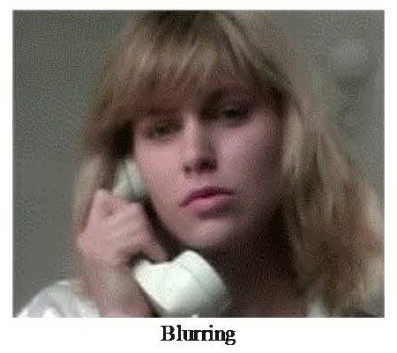
Compression artefacts - 1

Slide 6
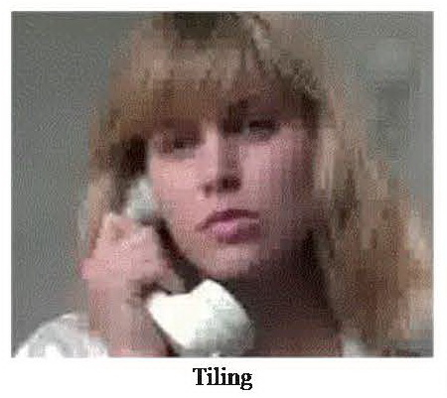
Compression artefacts - 2

Slide 7
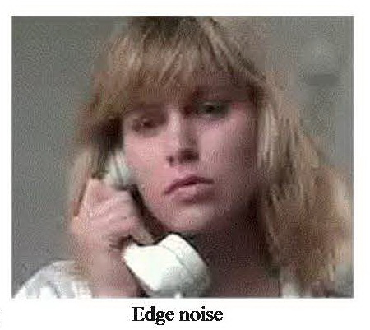
Compression artefacts - 3

Slide 8
Components that contribute to channel zapping time

Slide 9
Codecs
II.1 Video codecs
This clause provides a non-inclusive list of video codecs for television applications.
The following video codecs are used for television applications:
• H.262 (a.k.a. MPEG-2 Video);
• H.264 (a.k.a. MPEG-4 AVC or MPEG-4 Part 10);
• SMPTE 421M (a.k.a. VC-1, previously known as VC-9, the standardized version of Windows Media™ 9);
• AVS.
II.2 Audio codecs
This clause provides a non-inclusive list of audio codecs for television applications.
Most video service offerings (e.g., those using MPEG transport streams or similar) are capable of supporting more than one audio codec along with a single or sometimes multiple video encoding schemes depending on the head-end equipment and set-top box.
Example audio formats used for television applications are:
• MPEG audio layer II (also known as Musicam, used in DVB systems, and MPEG-1 audio layer 2);
• Dolby digital used in ATSC systems (formerly known as AC-3);
• NICAM 728 (European digital format for PAL);
• Advanced audio coding – AAC (either MPEG-2 AAC or MPEG-4 AAC ([b‑ISO/IEC 14496-3], Subpart 4));
• MP3 (MPEG-1 Audio layer 3) used particularly for music content.

Slide 10
Different Frame Types

Slide 11
IP packet loss in different frames

Slide 12
Packet Loss Requirements

Slide 13
Any questions ?
Contact: Consultant@joachimpomy.de

