Slide 1
ITU Regional Standardization Forum For Africa Dakar, Senegal, 24-25 March 2015
QoS/QoE Assessment Methodologies (Subjective and Objective Evaluation Methods)
Samuel K. Agyekum,
Quality of Service (QoS) Officer
samuel.agyekum@nca.org.gh

Slide 2
Presentation Outline
Subjective Assessment (Evaluation) Methodology
Principle and Overview
Model and Metrics
Expected Outcome
Application Scenarios & ITU-T recommendations
Objective Assessment (Evaluation) Methodology
Principle and Overview
Model and Metrics
Expected Outcome
Application Scenarios & ITU-T recommendations
ITU-T G.1000: Applicability to Subjective & Objective Evaluation Methods
Relationship b/n Objective & Subjective Evaluation Methods
Conclusion & Recommendation

Slide 3
Subjective Evaluation Method (Principle and Overview)
The concept of Subjective Evaluation method is to quantify the user’s QoE of a given service from a psycho-acoustic and visual perspective.
Two main testing methods are identified:
Listening Only
Conversational
Subjective quality rating methods for speech, audio, video and multimedia include:
Absolute and Relative rating
Category and Continuous rating

Slide 4
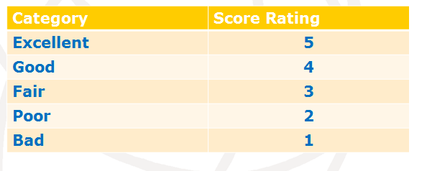
Subjective Evaluation Method (Model and Metrics)
Mean Opinion Score (MOS)- Is a numerical averaging of the perceived audio quality of speech signals as judged by a number of evaluators.
MOS is an Absolute Category Rating (ACR) metric
MOS is expressed in one number, from 1 – 5.

Slide 5
Subjective Evaluation Method (Expected Outcome)
Improved Codec design/optimization:
Quality Terminal design
Interference Monitoring

Slide 6
Application Scenarios & Associated ITU-T Recommendations

Slide 7
Objective Evaluation Method –(Principle and Overview)
The principle of objective quality assessment is to estimate subjective quality solely from objective quality measurement or indices.
Employs statistical models (media layer, parametric, bit-stream layer, hybrid etc) for quality predictions.
Depends on validating the objective estimation model against unknown subjective databases
Three major model approaches have been indentified- Full Reference, Non Reference, and Reduced Reference

Slide 8
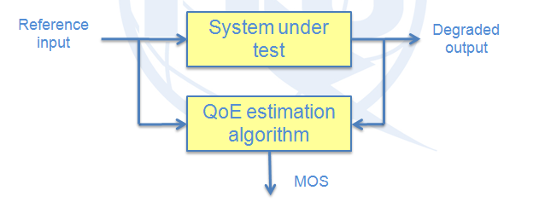
Objective Evaluation Method (Model & Metrics)
Full-Reference (FR)
The QoE estimation algorithm requires access to both the reference input and the degraded output

Slide 9
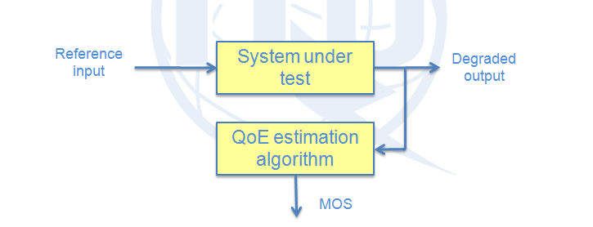
Objective Evaluation Method (Model & Metrics)
Non-Reference (NR)
The QoE estimation algorithm only requires access to the degraded output.

Slide 10
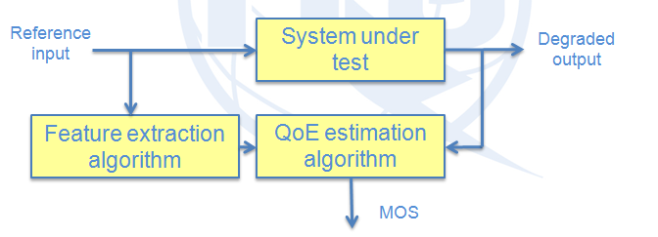
Objective Evaluation Method (Model & Metrics)
Reduced Reference (RR)
The QoE estimation algorithm requires access to the degraded output and some limited features extracted from the reference input

Slide 11
Objective Evaluation Method (Model & Metrics)

Slide 12
Objective Evaluation Method (Expected Outcome)
Objective quality assessment models in essence provides the following results/outcome:
– Planning: "Planning" refers to estimating the perceived quality of services of networks/systems before they are implemented. Since it is not used in a real-time environment, no real-time inputs are required to the objective model.
– Lab-testing: "Lab-testing" refers to estimating the perceived quality of services of networks/systems in the laboratory while the equipment is being developed.
– Monitoring: "Monitoring" refers to estimating the perceived quality of services of networks/systems that are operational. Necessary information is collected from the network and analyzed to reflect the degradation of the quality experienced by users.

Slide 13
Application Scenarios & Associated ITU Recommendations

Slide 14
ITU-T G.1000: Applicability to Subjective & Objective Methods

Slide 15
ITU-T G.1000: Applicability to Subjective & Objective Methods
Subjective Method (1st Quadrant)
Requires customer’s planned perception of the service.
Objective Method ( 2nd Quadrant)
Requires network performance measurements and network-centric metrics to estimate the service provider’s offerings of QoS.

Slide 16
ITU-T G.1000: Applicability to Subjective & Objective Methods
Objective Method( 3rd Quadrant)
Requires QoS measurements and user-centric metrics to assess achieved or delivered QoS
Subjective Method (4th Quadrant)
Requires opinion survey rating as per customer’s perception of the service.

Slide 17
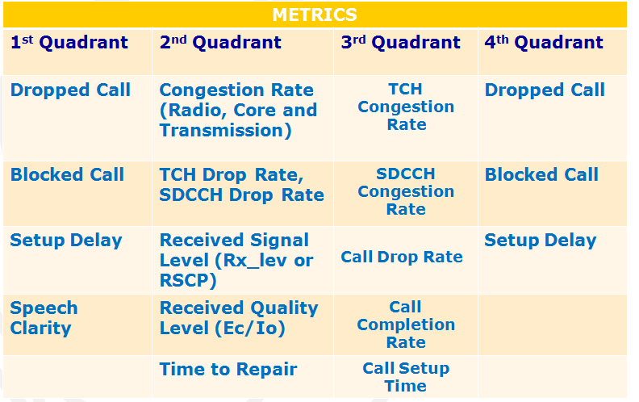
ITU-T G.1000: Applicability to Subjective & Objective Methods

Slide 18
Relationship b/n Objective & Subjective Evaluation Methods
Both evaluation methods are experiment-based
Objective methods are highly statistical in nature where as subjective methods are empirical and arithmetic
Objective methods are less costly as against Subjective methods which are expensive and time-consuming.
Results of subjective method can serve as input parameters for quality prediction models used in objective evaluation methods.

Slide 19
Conclusion & Recommendation
The presentation establishes that Qos/QoE assessment methods are very useful for in-service quality monitoring and management, as well as codec optimization, codec selection and quality design of networks or terminals.
It is recommended that further R&D activities be carried out by standardization bodies such as ITU, IEC etc to ensure efficient and reliable quality testing methods by regulators and operators.

Slide 20
Thank You for your Kind
Attention

