Slide 1
ITU Regional Standardization Forum For Africa
Dakar, Senegal, 24-25 March 2015
QoS issues in Digital Financial Services
Joachim Pomy
OPTICOM GmbH Germany
consultant@joachimpomy.de

Slide 2
Agenda
Context
QoS or QoE ?
Relevant in technical terms ?
Just another Recommendation ?
Way forward

Slide 3
Context - 1
Consumer Experience &​ Protection Working Group
  The Working Group on Consumer Experience & Protection will define minimum requirements for quality of service for reliable digital transactions and data protection safeguards, to build consumer confidence.
  Leaders
    Sumi​t Jamuar, KYCTrust Limited
    Bedoui Adel, Tunisie Télécom
    Nicola O’Reilly, Consumers​ International
  https://extranet.itu.int/ITU-T/focusgroups/fgdfs/consumer/SitePages/Home.aspx
  Next e-meeting : today ! (16:30 CET)

Slide 4
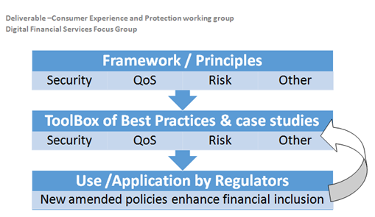
Context - 2

Slide 5
Agenda
Context
QoS or QoE ?
Relevant in technical terms ?
Just another Recommendation ?
Way forward

Slide 6
End-to-end QoS
Quality of Service (QoS)
  The totality of characteristics of a telecommunications service that bear on its ability to satisfy stated and implied needs of the user of the service
  Characteristics can be measured by objective means
    level meter
    delay counter
    etc.
  Often confused with Network Performance (NP)
    IETF uses QoS to describe the performance of functional services in network layer models
QoS often more precisely named as "end-to-end QoS"
6
Notes:
6

Slide 7
User Perception influenced by much more
7
Notes:
7

Slide 8
Quality of Experience
User Perception of quality not limited to the objective characteristics at the man-machine interface
For end users counts the quality that they personally experience during their use of a telecommunication service
Quality of Experience (QoE) takes into account additional subjective parameters
  stemming from user expectations
  from the context, in which the user is embedded during the use of the service, such as
    personal mood
    environment
  potential discrepancy between the service offered and individual users reading additional features into the service
8
Notes:
8

Slide 9
Agenda
Context
QoS or QoE ?
Relevant in technical terms ?
Just another Recommendation ?
Way forward

Slide 10
Relevant in technical terms
Network
  e.g. packet loss, BER, radio coverage, stability
Terminal
  Reliability, available functions, storage, battery issues
Regulation
  Proper response to customer needs

Slide 11
Agenda
Context
QoS or QoE ?
Relevant in technical terms ?
Just another Recommendation ?
Way forward

Slide 12
Just another Recommendation ?
Study Group 12 PERFORMANCE, QOS AND QOE
  Responsible for Recommendations on performance, quality of service (QoS) and quality of experience (QoE) for the full spectrum of terminals, networks and services ranging from speech over fixed circuit-based networks to multimedia applications over networks that are mobile and packet based. Included in this scope are the operational aspects of performance, QoS and QoE; the end-to-end quality aspects of interoperability; and the development of multimedia quality assessment methodologies, both subjective and objective.
Hence the first answer might be YES:
  Lets go ahead and write a new Recommendation on QoS for DFS

Slide 13
Integrate DFS QoS and QoE
E.803: Quality of service parameters for supporting service aspects
E.804: Quality of service aspects for popular services in mobile networks
G.1000-G.1999: Multimedia Quality of Service and performance – Generic and user-related aspects
P.1500-P.1599: Methods for objective and subjective assessment of quality of services other than voice services
Y.1500-Y.1599: Quality of service and network performance
anything else ?

Slide 14
Agenda
Context
QoS or QoE ?
Relevant in technical terms ?
Just another Recommendation ?
Way forward

Slide 15
Way forward
In order to accommodate the QoS related needs of the DFS community
  Participation in FG DFS and its WG CEP is solicitated
  Contributions to Study Group 12 are encouraged
    In general (of course)
    Regarding DFS QoS and QoE (in particular)

Slide 16
To Remember
ITU work is contribution driven
  Please show up and contribute and make it happen !
Next meetings:
  ITU-T SG12: Geneva, 5 – 14 May 2015
  FG DFS WGs: 20 April 2015, Washington D.C, USA
  FG DFS: 21-22 April 2015, Washington D.C, USA

Slide 17
Any questions ?
Contact:
Consultant@joachimpomy.de

