Slide 1
Big Data：Industry & Standards
Huawei Technologies, Co., Ltd
17th June 2014

Slide 2
Contents
Industry and technical trends
Big data for telecom industry
Big data standards issues
Proposals for ITU-T
Notes:
讲解词：
针对运营商对大数据的商业诉求，我们来看看大数据对应的具体应用场景。

Slide 3
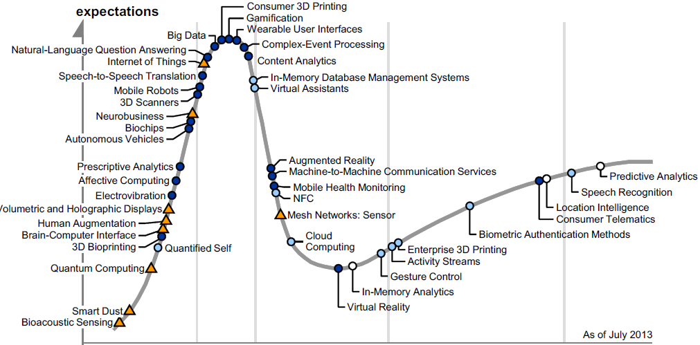
Big data to fetch real values
In a post-disillusion era, big data needs to be able to fetch real values for the industry. Especially in Telecom.
Garter 2013:Big data reaches a hype

Slide 4
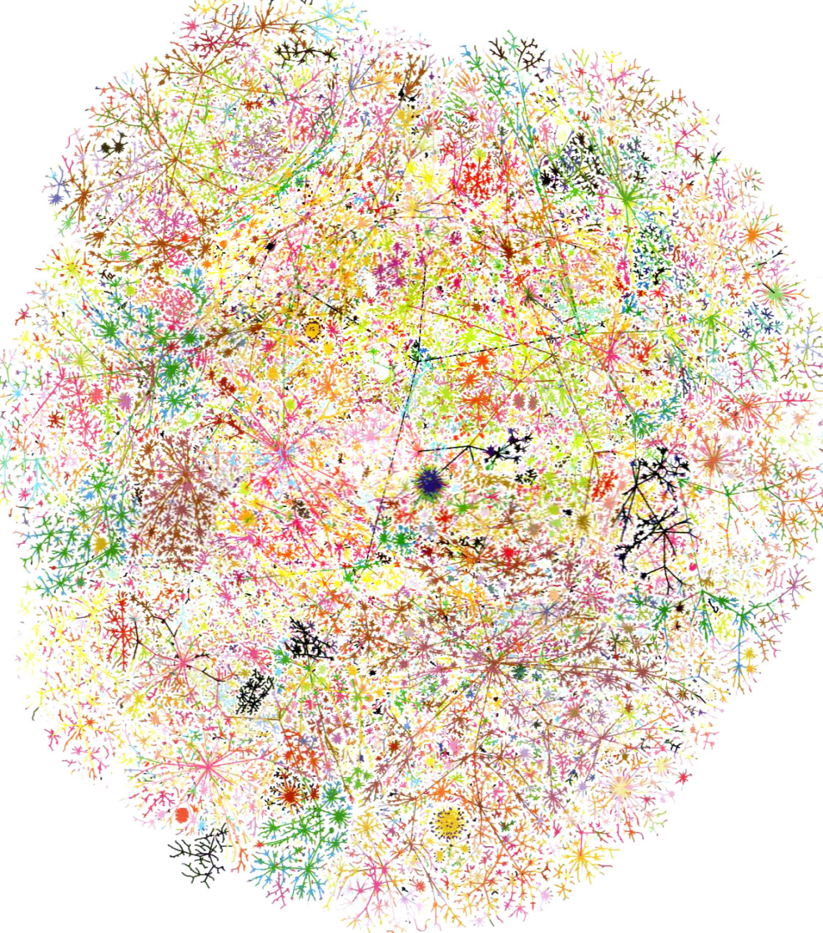
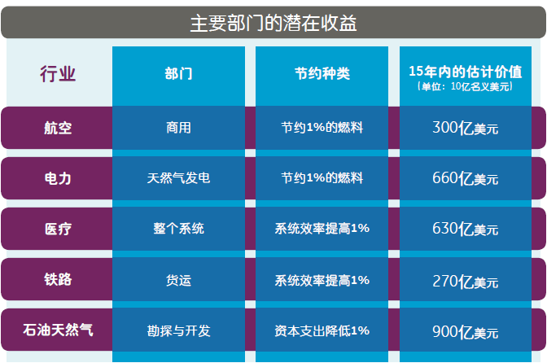
Convergence of physical world and digital world
Volume
QoS/QoE
Digital human
Variety
Productivity
Value
Digital business
Velocity

Slide 5
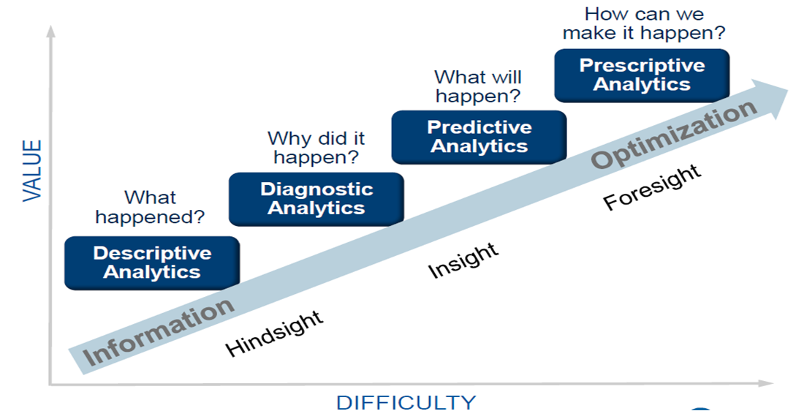
Why now？
Breakthrough in distributed & cloud computing
Massive parallel computing can be done on traditional computers.
Distributed algorithms need no optimization and optimal architecture.
Costs for data acquisition are significant lower now.

Slide 6
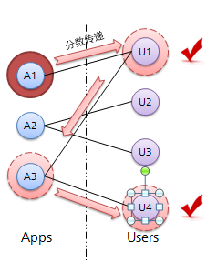
Algorithms breakthrough, fully automated analytics
X-Rank algorithm
Graph-base data mining
Fully automated, no human intervention needed
More accurate
Transitive to save future work
Using the most advanced new
algorithms, telecom operators
can make the value-added
service recommendation
196% more accurate and effective.

Slide 7
Continuous progress of technologies
Applications
Higher operational
efficiency
Real Time analysis and decision
Accurate marketing
Better QoE
Business innovation
Key Analytics technologies
Analysis engine
Search engine
Feature analysis
Info extraction
KPI association
Diagnosis
Analytics capability opening
Recommendation engine
Locus analysis
Automated Q&A
Anomaly detection
User portrait
User association
Machine translation
Traffic matrix
Association Warning
Analytics API
Feature engineering
Natural language processing
Graph analysis
Text query
Text mining
Incremental analysis
Image understanding
…
Fundamental algorithm
Classification
Clustering
Statistical learning
Associative learning
Deep learning
FSM learning
Matching learning
Sorting learning
semantics
Markovian decision
Bayesian network
…

Slide 8
Contents
Industry and technical trends
Big data for telecom industry
Big data standards issues
Proposals for ITU-T
Notes:
讲解词：
针对运营商对大数据的商业诉求，我们来看看大数据对应的具体应用场景。

Slide 9
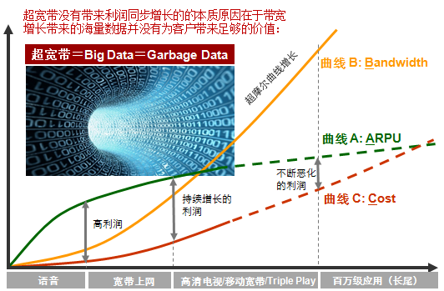
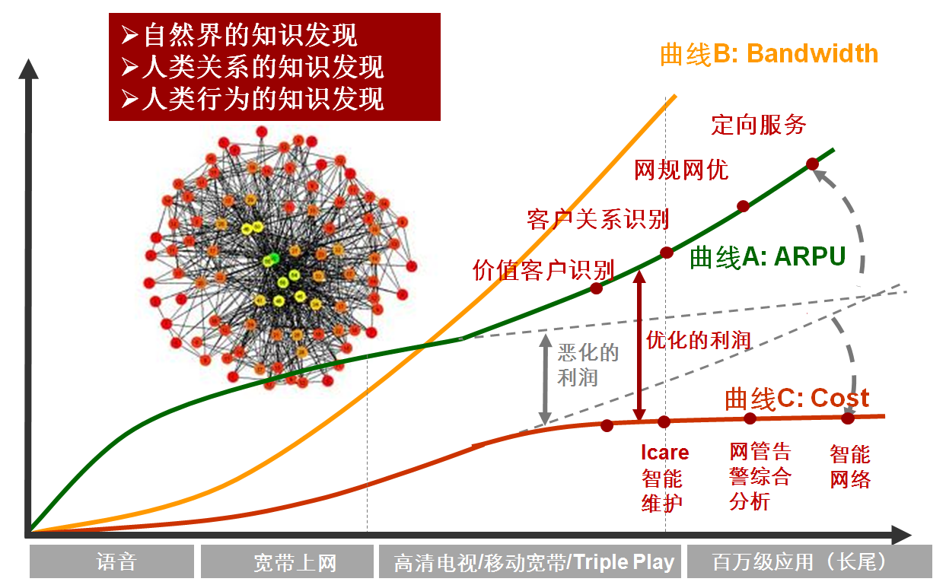
Big Data in Telecom
Step by step ：
Phase 1：System Architecture ➔Value：Infrastructure Phase 2： Data integration ➔Value： 1+1>2 Phase3：Data mining➔Value： New knowledge

Slide 10
Three stages
External data and service
Source
BigData-C
Data as commodities
Self-service
Applications
BigData-R
Data as assets
BigData-M
Data as a tool
Customer-oriented
In-house data and service

Slide 11
Three typical scenarios
Deep
Scale UP
Accurate marketing
1
Inward value enhancement
Customers
Value cashing
(vertical industry)
3
2
O Operational efficiency (OSS/BSS, network optimization, QoE)
Wide
Outward capability opening
Notes:
讲解词：
根据前面的商业目标，运营商大数据主要应用场景，需从两个角度进行总结，对内是通信价值深度挖掘，对外是通信能力开放，非通信价值提升。
从这两个角度，我们可以划分为三类场景：
1、精准营销和维挽
可以识别用户，并匹配触发的时机，资源和渠道，提高业务营销的成功率。可以提前甄别潜在离网用户，并进行干预，以降低存量用户的离网率
2、运营效能提升
基于大数据分析的网络投资，故障诊断，网络优化和业务体验提升
3、对外价值变现
向传统行业，线上行业，政府，公共事业单位等开放运营商的数据洞察信息，获取数据的开放变现收入
下面我们就针对这3类场景，分别阐述一些具体的应用，希望能对大数据的应用做一些启发。

Slide 12
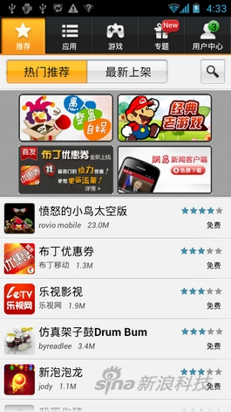
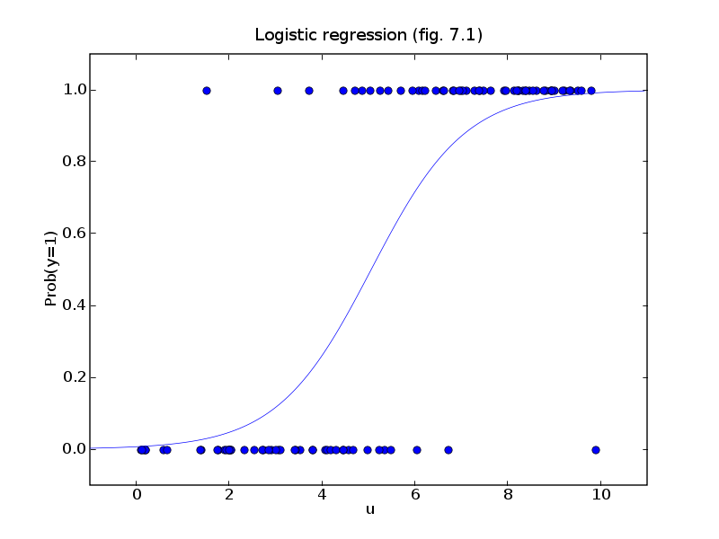
Example 1：APP recommendation
Available in Huawei APP Store
> 30 million users
> 1bn samples
> 14 million features
Indices | New algorithm | Conventional algorithm | Performance increase
Conversion rate | 0.059% | 0.034% | 72.97%
Browsing rate | 0.063% | 0.043% | 48.27%
Per capita download | 2.55 | 2.11 | 20.92%
Per capita browsing | 317.80 | 320.56 | -0.86%
Unit downloading rate | 0.1868 | 0.1089 | 71.48%
Logic regression
Today
Deep learning
coming soon…

Slide 13
Example 2：Network real monitoring
Stream data mining: high-speed , accurate , effective detection of traffic anomalies for monitoring , diagnosis and control.
Report form generation
Orcale database
（original data records）
Orcale data
（outcomes）
ETL
（Format conversion）
KPI computation every 15 min
Past
100000msg/s
Now
1 million msg/s
Real-time stream data mining
Reporting every min

Slide 14
Contents
Industry and technical trends
Big data for telecom industry
Big data standards issues
Proposals for ITU-T
Notes:
讲解词：
针对运营商对大数据的商业诉求，我们来看看大数据对应的具体应用场景。

Slide 15
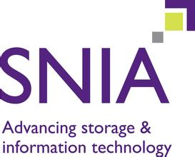
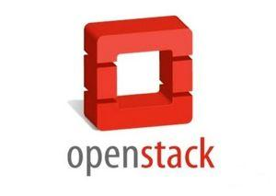
Where are standards needed?
How much are standards needed?
There is a long argument if big data needs standards?
In general, YES. But different areas have different answers.
Big data has strong IT flavor, it needs both standards and open source.
Generation
Storage
Analytics
Exchange
Application
Standards
Open Source

Slide 16
Definitions and Reference Architecture
What is it?
NIST has a lot of material on this from its Big Data Working Group.
Many participants of NIST are in the SGBD.
Why do we need it?
Forms the foundation for industry to talk about Big Data characteristics.
Needed to create any further standards.
Where will it happen?
Not sure. ISO/IEC JTC1 is now having a SG on big data doing something.
ITU-T may need consider this task, at least for big data in Telecom.

Slide 17
Definitions and Reference Architecture(ISO/IEC JTC1)

Slide 18
Network Driven Analytics
What is it?
Collecting lots of data from network elements and applications.
Real time analysis of the big picture of the network based on this data.
Key to network operation OSS/BSS, network optimization, user experience.
Why do we need it?
More value than current network monitoring in terms of network performance optimization
Can make the most use of NFV and SDN by taking real time actions in the network based on this analysis to dynamically reconfigure and adjust network. Brocade made a presentation on this.
Where will it happen?
Not clear yet.
ITU-T may be a good place for this job. Perhaps SG11 or other relevant SG.

Slide 19
Personalized Network Experience
What is it?
Use Big Data and machine intelligence technologies to personalize network experience.
Drive user’s QoE optimization with business goals, using business metrics.
Why do we need it?
Fine link between the technical side and the business side .
Cognitive networks driven by the business metrics rather than the technical metrics allowing then to optimize the customer experience with business goals.
Where will it happen?
Not clear yet.
ITU-T may be a good place for this job. Perhaps SG11 or other relevant SG.

Slide 20
Security and Data Protection
What is it?
A broad category of requirements and capabilities across the entire BD ecosystem is needed for security reasons.
Includes individual privacy and corporate security and regulatory.
Why do we need it?
Ensure verifiable compliance with both GRC (Governance, Risk & Compliance) and CIA (Confidentiality, Integrity & Availability) regulations
Needs to support multi-tenant, multi-level policy-driven, sandbox, access control, authentication on protected data in-line.
Security and data protection considerations differ for different types of data sources, collection phase, storage phase, and analytics phase.
Where will it happen?
Likely to be in ISO/IEC JTC1.
ITU-T SG17 should also have some consideration for in-house work or collaboration.

Slide 21
Contents
Industry and technical trends
Big data for telecom industry
Big data standards issues
Proposals for ITU-T
Notes:
讲解词：
针对运营商对大数据的商业诉求，我们来看看大数据对应的具体应用场景。

Slide 22
Proposals for ITU-T
Build a standards landscape for big data in telecom and related industries.
Carry out feasibility research on Big Data standardization by each SG.
Identification technical areas needing standardization and assignment of priorities to these areas.
Development of roadmap for big data standardization in ITU-T.
Cultivate collaboration with ISO/IEC JTC1 and other SDOs & industry organizations like IIC, etc. that have high relevance to big data.

Slide 23
Thank you very much!

