Slide 1


De-Briefing Meeting on WCIT-12
Durban, July 8th 2013

Slide 2


Slide 3

Draft Action Plan for the
Implementation of WCIT12 outcomes
By
Dr. Sherif Guinena
Advisor to NTRA Exec. President
Coordinator for African Common Proposals to WCIT 12

Slide 4

سـرى
Preamble.
§1 : Purpose and Scope of the Regulations.
§2 : Definitions.
§3 : International Network.
§4 : International Telecommunication Services.
§5 : Safety of Life and Priority of Telecommunications.
§5a : Security and Robustness of Networks.
§5b : Unsolicited Bulk Electronic Communications.
§6 : Charging and Accounting.
§7 : Suspension of Services.
§8 : Dissemination of Information.
§8A : Energy Efficiency/E-waste.
§8B : Accessibility.
§9 : Special Arrangements.
§10 : Final Provisions.
ITR 88
ITR 12

Slide 5
سـرى
Appendix 1 : General provisions concerning accounting.
Appendix 2 : Additional provisions relating to maritime telecommunications.
Resolution 1 : Special measures for landlocked developing countries and small island developing states for access to international optical fibre networks.
Resolution 2 : Globally harmonized national number for access to emergency services.
Resolution 3 : To foster an enabling environment for the greater growth of the Internet.
Resolution 4 : Periodic review of the International Telecommunication Regulations.
Resolution 5 : International telecommunication service traffic termination and exchange.
ITR 88
ITR 12

Slide 6
ITRs Main Topics
سـرى
ITR 88
ITR 12
Applicability of the ITRs (ROA/OA).
Obligatory ITU-T Recommendations.
Security and Confidence in Telecommunications/ICT.
Internet Issues, Human Rights, Non-discriminatory Access, Land Locked, IIC.
Accounting and Economical issues.
Transparency in Retail and Wholesale Prices; Roaming issues.
Numbering, Naming, Addressing and Identification; misuse issues.
Origin Identification.
Routing Information.
Quality of Service.
Environmental issues: Energy efficiency, e-Waste and Accessibility.
Periodic Revision of the ITRs.

Slide 7
The Skelton of the Draft Action Plan
A break down of the detailed action items to implement the WCIT outcomes is in the following Excel document:
A mechanism to elaborate this Action Plan is proposed in the next slides.
Draft Action Plan

Slide 8
Durban Plan of Action
The participants of the workshop on the outcomes of WCIT, in adopting this action plan, call upon Africa region to:
Be inclusive: Invite all African Member States, as well as other States, to be party to the revised ITRs, while taking all concerns into account, so that Africa and all other regions can maximize the benefits derived from the treaty
Be progressive: Emerge as a global leader on topics such as making ICTs accessible to people with disability, energy efficiency and managing e-waste
Be proactive: Identify institutional frameworks within our respective countries that would help translate the provisions of the treaty into policy and legislation.
Be dedicated: To contribute actively and proactively to studies and initiatives regarding these matter.
Be collaborative: Among ourselves, and to seek partnerships with interested entities, especially UN agencies such as the ITU.
Shape the global agenda: Project Africa as a symbol of regional cooperation and coordination in global Telecommunications.

Slide 9
How to implement WCIT/WTSA-12 ?
Forming a Standardization Working Group for Africa.
Evolves and works under ATU.
Comprises thematic Working Parties.
Collaborates with Africa sub-regional Standardization Bodies (existing and evolving).
Coordinates and supports Africa’s standardization activities and involvement in the ITU-T activities.

Slide 10


AfriTSO
African Telecommunication Standardization
Working Group
WP1
Organize
WP2
BSG
WP3
NNAI
Internet
CoCoCola
Human
WP4
Technical
Security
Legal
Economic
AfriTSO
www.AfriTSO.org

Slide 11
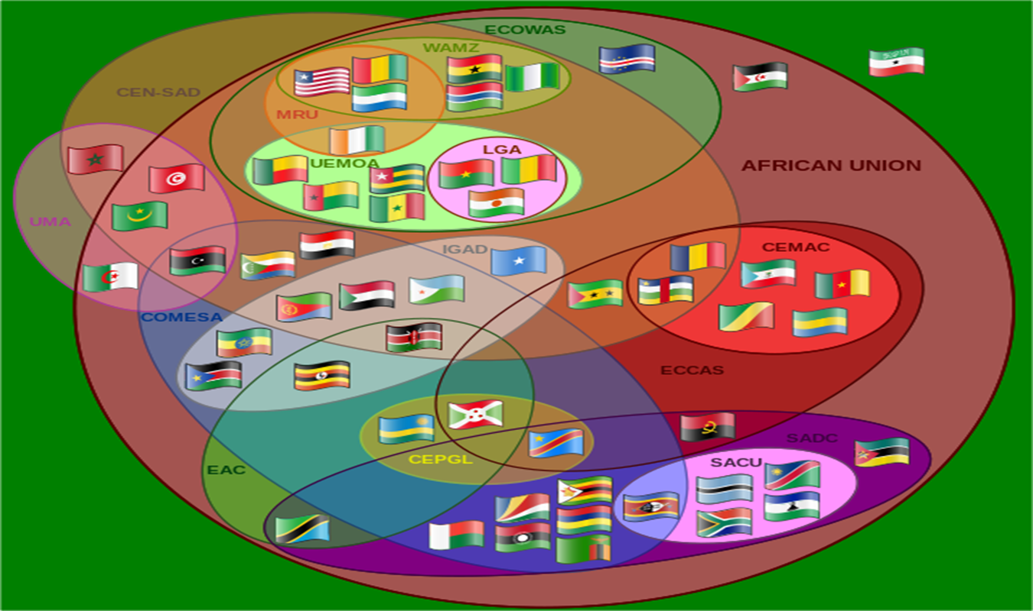
Africa’s Regional Economic Communities RECs

Slide 12
Africa’s Regional Standardization Bodies RSB
REC
AfriTSO
RSB?
RSB?
RSB?
RSB?
RSB?
REC
REC
REC
REC

Slide 13
AfriSTO modus operandi
MeM
MeM
MeM
MeM
WP1
Organizational
WP2
BSG
WP3
NNAI
Internet
CoCoCola
Human
WP4
Technical
Security
RSB
REC 1
AfriTSO
MeM
MeM
MeM
MeM
RSB
REC n
www.AfriTSO.org

Slide 14
Initial Mandates
Elaborate on the WCIT/WTSA detailed implementation Action Plan.
Encourage and Follow-up of African Participation and Submissions to ITU-T SGs work.
Facilitate communication and collaboration between Africa Regional Standardization Bodies and ITU-T SGs Regional Groups.
Coordination of African [Common] Proposals.
Coordinate capacity building, including acquaintance with ITU-T SGs Questions and main topics.
………..

Slide 15
Proposed Initial Actions
Formation of the Working Parties (Nominees?).
Recommended: basically ITU-T SGs’ Chairmen and Vice Chairmen from Africa, and others).
Elaboration and enhancement of the Action Lines.
Forming AfriTSO.
Start with the coordination, encouragement and Follow-Up activity.

Slide 16

Thank You

