Slide 1


De-Briefing Meeting on WCIT-12
Durban, July 10th, 2013

Slide 2


Slide 3

Debriefing Meeting, Durban, South Africa
July, 10th, 2013
Impact of the new ITRs
on Africa – Part 1 (NNAI)
Dr. Sherif Guinena
Advisor to NTRA Exec. President
Coordinator for African Common Proposals to WCIT 12

Slide 4

Preamble.
§1 : Purpose and Scope of the Regulations.
§2 : Definitions.
§3 : International Network.
§4 : International Telecommunication Services.
§5 : Safety of Life and Priority of Telecommunications.
§5a : Security and Robustness of Networks.
§5b : Unsolicited Bulk Electronic Communications.
§6 : Charging and Accounting.
§7 : Suspension of Services.
§8 : Dissemination of Information.
§8A : Energy Efficiency/E-waste.
§8B : Accessibility.
§9 : Special Arrangements.
§10 : Final Provisions.
ITR 88
ITR 12

Slide 5
Appendix 1 : General provisions concerning accounting.
Appendix 2 : Additional provisions relating to maritime telecommunications.
Resolution 1 : Special measures for landlocked developing countries and small island developing states for access to international optical fibre networks.
Resolution 2 : Globally harmonized national number for access to emergency services.
Resolution 3 : To foster an enabling environment for the greater growth of the Internet.
Resolution 4 : Periodic review of the International Telecommunication Regulations.
Resolution 5 : International telecommunication service traffic termination and exchange.
ITR 88
ITR 12

Slide 6
ITRs Main Topics
ITR 88
ITR 12
Applicability of the ITRs (ROA/OA).
Obligatory ITU-T Recommendations.
Security and Confidence in Telecommunications/ICT.
Internet Issues, Human Rights, Non-discriminatory Access, Land Locked, IIC.
Accounting and Economical issues.
Transparency in Retail and Wholesale Prices; Roaming issues.
Numbering, Naming, Addressing and Identification; misuse issues.
Origin Identification and CLI.
Routing Information.
Quality of Service.
Environmental issues: Energy efficiency, e-Waste and Accessibility.
Periodic Revision of the ITRs.

Slide 7
Applicability of the ITRs
Applicability didn’t change, since the CS addresses the ROAs and the AOAs.
abis) These Regulations also contain provisions applicable to those operating agencies, authorized or recognized by a Member State, to establish, operate and engage in international telecommunications services to the public, hereinafter referred as "authorized operating agencies".

Slide 8
Applicability of the ITRs
Obligatory to MSs (was Administrations).
Transfer of Obligations to ROA/AOA by the CS:
No. 38 CS: “The Member States are also bound to take the necessary steps to impose the observance of the provisions of this Constitution, the Convention and the Administrative Regulations upon operating agencies authorized by them to establish and operate telecommunications and which engage in international services OR which operate stations capable of causing harmful interference to the radio services of other countries”.

Slide 9
Compromises on the Applicability and Enforcement of the ITRs
But under compromises, several provisions became non-mandatory:
AOA should comply with, to the greatest extent practicable, the relevant ITU-T Recommendations.
Member States shall endeavor to ensure that AOA ……
Member States shall endeavor to ensure that CLI ……
Subject to national law, Member States shall endeavor to ensure that AOA provide and maintain ….
… taking due account of the relevant ITU-T Recommendations ..

Slide 10
Compromises on the Applicability and Enforcement of the ITRs
Member States should create an enabling environment for the implementation of IXP …
Member States should create an enabling environment for the implementation of IXP …
Member States shall foster measures to ensure that authorized operating agencies provide free-of-charge, transparent …
Member States shall endeavor to encourage investments in international telecommunication …

Slide 11
Compromises on the Applicability and Enforcement of the ITRs
Member States shall individually and collectively endeavor to ensure the security ..
Member States should endeavor to take necessary measures to prevent the propagation of unsolicited bulk electronic …

Slide 12
Compromises on the Applicability and Enforcement of the ITRs
Member States are encouraged to adopt energy-efficiency and e-waste best practices taking into account the relevant ITU-T Recommendations.
“Member States shall [promote]/[encourage ROA/OA to adopt] best practices for energy efficiency and e-waste reduction, management and recycling [[of telecommunications [/ICT] facilities and installations], taking into account relevant ITU-T [ITU] Recommendations.”

Slide 13
Impact of the Applicability of the ITRs on Africa
Some new or revised articles open the door for Africa for some steps forward.
Africa may face cases where enforcing the ITRs on international operating agencies is crippled.
There will be a very important role of the national Regulations and Legislations to implement and /or enforce the ITRs.
Bilateral treaties may fill the gaps, with caution!

Slide 14
§1.4 , §1.6 : ITU-T Recommendations
Implementation of the ITU-T Recommendations is not mandatory by the CS and by the ITRs.
Also by the CS, it is the sovereign right of MSs to regulate its telecommunications.
The CS and the ITRs calls for facilitating the Interconnection between MSs.
And MSs should not cause harm, and should keep peaceful relations and international cooperation with other MSs.
AOA are Willing to interconnect internationally, they will do their best to comply to the ITU-T Recommendations.

Slide 15
§1.4 , §1.6 : ITU-T Recommendations
Important role of national Regulations and Legislations to ensure the that the ITU-T Recommendations are implemented and/or enforced, whenever the ITRs refer to “…… in accordance to applicable ITU-T Recommendations”.
Development of effective and affordable Dispute Resolution Mechanisms to resolve cases where MSs or AOAs refrain from being bound to the provisions of ITRs, or when the provisions of the ITRs are not obligatory.

Slide 16
§3.5 : Numbering Resources
3.5 Member States shall endeavor to ensure that international telecommunication numbering resources specified in ITU-T Recommendations are used only by the assignees and only for the purposes for which they were assigned; and that unassigned resources are not used.
New Article, (it was intended to be mandatory).
Was compromised to be limited to Numbering Resources only to avoid inclusion of Internet Resources.
Will support Africa efforts to combat misuse of numbering resources including its economical impact.
National Regulations and effective dispute resolution mechanism will support the implementation of this provision.
Awareness needed through involvement in ITU-T SG2 studies.
§10 Dissemination of information : Shame list for Misuse?!

Slide 17
§3.6 : CLI (Calling Line Identification)
3.6 Member States shall endeavor to ensure that international calling line identification (CLI) information is provided taking into account the relevant ITU-T Recommendations.
New Article, it was intended to be nearly mandatory.
Was compromised to depart from inclusion of the Internet.
Will support Africa efforts to combat Fraud, Security and ensure users’ convenience.
National Regulations and effective dispute resolution mechanism will support the implementation of this provision.
Awareness needed through involvement in ITU-T SG2 and SG3 studies.
Model legislations are available in other regions.

Slide 18
§3.1, §3.4, §4.3, §4.5 : QoS
… a satisfactory quality of service should be maintained to the greatest extent practicable, corresponding to the relevant ITU-T Recommendations.”
It was noted that QoS is deteriorating with the advent of the “commercialization” principle, in particular for IP based services.
QoS were intended to be mandated in some articles, but couldn’t.
These revised Articles will support Africa’s efforts to ensure adequate QoS irrespective of the commercialization of the international telecom.
National Regulations, QoS Monitoring Systems and effective and affordable dispute resolution mechanism will support the implementation of these provisions.
Awareness and capacity building on Qos/QoE measures is needed, through involvement in ITU-T SG12 and other SGs’ studies.

Slide 19
§2.5, §3.3: International Routes
2.5 International route: Technical facilities and installations located in different countries and used for telecommunication traffic between two international telecommunication terminal exchanges or offices.
3.3 Authorized operating agencies shall determine by mutual agreement which international routes are to be used. Pending agreement and provided that there is no direct route existing between the terminal authorized operating agencies concerned, the origin authorized operating agency has the choice to determine the routing of its outgoing telecommunication traffic, taking into account the interests of the relevant transit and destination authorized operating agencies.
Very Controversial: the proposed modifications requested:
> MSs right to know the route, if needed &
> MSs right to select the route.

Slide 20
§2.5, §3.3: International Routes
Intended targets:
  Mitigate Fraud, resulting for inappropriate Hubbing.
  Identification of origin and trace of calls, to combat numbering misuse.
  Identification of origin, for security reasons (to be able to combat malicious calls and cybercrime).
  To trace Spam sources.
  Intentional selection of the traffic route to avoid redirecting country’s traffic to a hostile country(ies) (for National Security objectives).

Slide 21
§2.5, §3.3: International Routes
The opposing views were (as usually stated):
  Fear of anti-competitive practices by AOA of MSs.
  Fear of MSs intervention to put political/ economical pressure on other MSs.
  Fear of exposure of commercial agreements, in a free market environment.
  Fear of obstructing least-cost routs.
  Technical difficulties to trace the routes (e.g. IP/packetized traffic).
  Embedded cost implications on AOA.

Slide 22
§2.5, §3.3: International Routes
The Hidden arguments were though to be:
  Could expose or hinder illegal interception and commercial espionage by some MSs/SMs, especially in conflict regions.
  Could expose fraudulent activities of Hubs and traffic Aggregators.
  Could impact least cost routes, even though these routes may financially or technically harm DC MSs/AOAs.
  The current revised provision gives the right only to Oas to select the route and to unveil the routing info. DCs’ MSs and national AoA have little power, if any.

Slide 23
§2.5, §3.3: International Routes
Africa should support technical studies in the relevant ITU-T SGs that help in availing the routing information.
Africa should adopt National Regulations that can oblige their AOAs to unveil the routing information, if so needed, and these national AoAs to request inclusion of routing info in their agreements with other international OAs.
Bilateral Agreements could be conducted with some MSs authorities to provide routing information in case of international telecommunications fraud, or in case of security breaches investigations.

Slide 24
§5 , Res. 2 : Safety and Emergency Telecom
Safety-of-life telecommunications shall be entitled to transmission as of right, and
where technically practicable, have absolute priority.
Res 2: TSB : SG2 continue exploring the option of introducing a single globally harmonized national number for access to emergency services in the future,
Res 2: MSs: to introduce, in addition to their existing national emergency numbers, a globally harmonized national number for access to emergency services, taking into consideration the relevant ITU-T Recommendations.
The Regional approach is an interesting starting point!

Slide 25
§11 : Energy efficiency/e-waste
8A.1 Member States shall cooperate to encourage operating agencies and industry to adopt energy efficiency international standards and best practices, including disclosure and labelling schemes, so as to reduce energy consumption of communications facilities and installations.
8A.2 Member States shall cooperate to encourage operating agencies and the industry to take-back schemes and recycling management facilities to reduce e-waste resulting from communications facilities and installations, [and to avoid causing harm to other Member States from such e-waste.] | [and to ensure that such practices does not cause harm to other Member States.]

Slide 26
§11 : Energy efficiency/e-waste
Member States are encouraged to adopt energy-efficiency and e-waste best practices taking into account the relevant ITU-T Recommendations.
Some MSs didn’t want to be bound by “International Standards” , or to “be obliged with take-back or recycling management” Although the provision is just encouraging OAs!
Africa national legislations and international bilateral agreements or contracts should embed such requirements, e.g. manufacturer take-back or regional recycling facilitation;
Participation in developing the relevant Recommendations, in addition to awareness raising.

Slide 27
§12 : Accessibility
Member States should promote access for persons with disabilities to international telecommunication services, taking into account the relevant ITU-T Recommendations.
Was not an African proposal, (Hungary, CITEL, and India) however was supported by Africa in the conference.
Note the focus on telecom : “… Telecommucication/ICT services … “
Africa should participate in the development of relevant Recommendations.

Slide 28
Conclusion
سـرى
Several new positive provisions added.
However Hard Compromises were experienced.
Follow up is vital to make use of the provisions:
  National Regulations and legislations;
  Also to mitigate negatives aspects;
  Implementation of relevant WTSA Resolutions;
  Implementation/enforecment of ITU-T Recommendations;
  Participate in ITU-T Recommendations development;
  Elaborate on Dispute Resolution Mechanisms.
  Awareness.

Slide 29
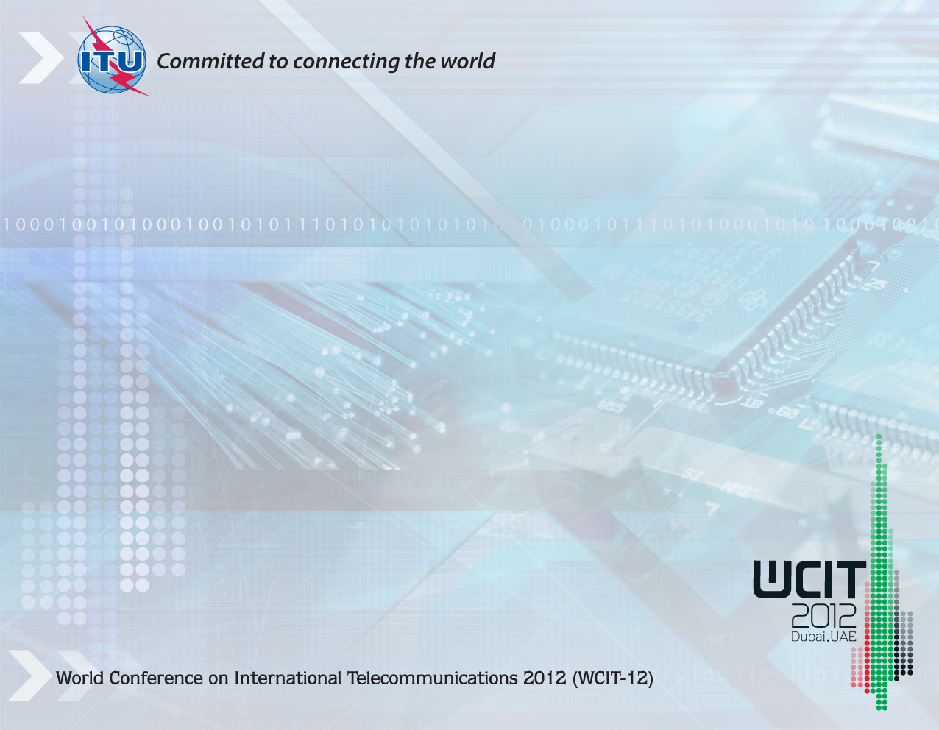
Thank You

