Slide 1


Debriefing Meeting on WCIT-12
Durban, South Africa, July 10th, 2013

Slide 2

Aftermath

Slide 3

Debriefing Meeting, Durban, South Africa
July, 10th, 2013
Aftermath of WCIT 2012
By
Dr. Sherif Guinena
Advisor to NTRA Exec. President, EGYPT
Coordinator for the African Common Proposals to WCIT 12

Slide 4

سـرى
Preamble.
§1 : Purpose and Scope of the Regulations.
§2 : Definitions.
§3 : International Network.
§4 : International Telecommunication Services.
§5 : Safety of Life and Priority of Telecommunications.
§5a ⇨ 6 : Security and Robustness of Networks.
§5b ⇨ 7 : Unsolicited Bulk Electronic Communications.
§6 ⇨ 8 : Charging and Accounting.
§7 ⇨ 9 : Suspension of Services.
§8 ⇨ 10 : Dissemination of Information.
§8a ⇨ 11 : Energy Efficiency/E-waste.
§8b ⇨ 12 : Accessibility.
§9 ⇨ 13 : Special Arrangements.
§10 ⇨ 14 : Final Provisions.
ITR 88
ITR 12

Slide 5
سـرى
Appendix 1 : General provisions concerning accounting.
Appendix 2 : Additional provisions relating to maritime telecommunications.
Resolution 1 : Special measures for landlocked developing countries and small island developing states for access to international optical fibre networks.
Resolution 2 : Globally harmonized national number for access to emergency services.
Resolution 3 : To foster an enabling environment for the greater growth of the Internet.
Resolution 4 : Periodic review of the International Telecommunication Regulations.
Resolution 5 : International telecommunication service traffic termination and exchange.
ITR 88
ITR 12

Slide 6
ITRs Main Topics
سـرى
ITR 88
ITR 12
Applicability of the ITRs (ROA/AOA/OA).
Obligatory ITU-T Recommendations.
Security and Confidence in Telecommunications/ICT.
Internet Issues, Human Rights, Non-discriminatory Access, Land Locked, IIC.
Accounting and Economical issues.
Commercialization vs Accounting Rate systems.
Transparency in Retail and Wholesale Prices; Roaming issues.
Numbering, Naming, Addressing and Identification; misuse issues.
Origin Identification.
Routing Information.
Quality of Service.
Environmental issues: Energy efficiency, e-Waste and Accessibility.
Periodic Revision of the ITRs.

Slide 7
African and Developing Countries put Great Expectations on the new ITRs (1/4)
Internet is part of the Telecommunications echo system.
Freedom (equitable) of access to the international telecommunication services (including the internet).
ITRs applicable on ALL Operating Agencies.
Commercialization (Special Arrangements) is not on the expense of Quality of Service.
Mandatory Recommendations, only as necessary.

Slide 8
African and Developing Countries put Great Expectations on the new ITRs (2/4)
Confidence and Security in the use of ICT.
Combating and encountering SPAM.
Respect (no misuse) of Numbering, Naming, Addressing and Identification (NNAI) resources.
Origin identification of calls.
Knowing the routes of calls for accounting purposes and fraud mitigation, and for security purposes.

Slide 9
African and Developing Countries put Great Expectations on the new ITRs (3/4)
Saving the DCs’ from the Hazards of e-waste.
Saving the DCs’ environment.
Consideration for the accessibility of the disabled and the elderly.
Dissemination of information to combat fraud and misuse.

Slide 10
African and Developing Countries put Great Expectations on the new ITRs (4/4)
Fair compensation for carried/terminated traffic.
Cost-oriented charges for mobile roaming and wholesale prices.
Transparency of retail/whole sale charges.
Reduction of roaming charges.
Reduction of IIC cost.
Investment in Broad Band Infrastructure.
Alternative Dispute Resolution on international connectivity matters including the Internet.

Slide 11
African and Developing Countries put Great Expectations on the new ITRs (5/4)
Frequent revision of the ITRs.
Considerations for Land-Locked countries.
Better consideration of Emergency services.

Slide 12
Some WCIT Specific Characteristics
Great resistance to ETNO Proposal (Network Operators charge content providers for differentiated QoS);
Claimed to impact significantly revenue flow, not in favor of some stakeholders, and will be an unsurpassed precedence.
Although the issue is not denied by some regions (EU) !!
Trying to impose network neutrality globally;
Exclusion of content providers and telecommunications application providers who may be covered by the treaty if they fall under the OA classification!

Slide 13
Some WCIT Specific Characteristics
Great resistance to even “mention” Security or Spam by name as well as data protection, privacy, cybersecurity in the treaty,
on the assumption that it is best not to be handled by intergovernmental organizations such as the ITU, but by specialized Private Sector, Consortia, Fora, ….etc entities.
to limit MSs’ (especially DCs) rights and capabilities to monitor traffic (e.g. deep packet inspection , c.f. ITU-T Rec. Y2770):
  to impede charging according to actual IP traffic (D.50)!
  to prevent content screening by specific Régimes!
  for specific security purposes!

Slide 14
New Articles and Resolutions
  Security;
  Spam;
  Energy efficiency;
  e-waste;
  Accessibility;
  Misuse;
  Calling Line Identification (CLI);
  Transparency in Mobile Roaming;
  Access to emergency services and unified emergency number;
  Promoting investments and competition;
  Access of Land Locked Countries;
  International traffic termination and exchange – mandates to SG3;
  Alternative Dispute resolution;
  Periodic review of the ITRs.

Slide 15
سـرى
Gain
Applicability reaffirmed, to cover ROA and AOA.
New Clause on Human Rights and Non-discriminatory access.
  Freedom of access to the international telecommunication services. (Inherently including the Internet).
  Respects and upholds human rights obligations.
New Resolution on Internet; opens the door for further studies on the Internet issues.
1 to elaborate on their respective positions on international Internet-related technical, development and public-policy issues within the mandate of ITU at various ITU forums including, inter alia, the World Telecommunication/ICT Policy Forum, the Broadband Commission for Digital Development and ITU study groups;

Slide 16
سـرى
Gain (cont. 2/5)
New Clause on misuse of Numbering Resources.
New Clause on provision of Calling Line Identification.
Preserving the original clause on Traffic Routing.
Affirmation of satisfactory QoS for Infrastructure and Service, with the understanding that QoS is to be above a minimum as per ITU-T Recommendations (included in WCIT Conference minutes).

Slide 17
سـرى
Gain (cont. 3/5)
New Clause on fostering IXPs.
New Resolution on International Traffic termination and exchange, considering mandating ITU-T SG3 to study:
  IIC,
  Fraud,
  Alternate Dispute Resolution Mechanisms,
  Establishment of Commercial Agreements,
  Charging and Invoicing of international traffic, …etc.
New Resolution on Land Locked Countries access to Fiber.
New Resolution on Accounting and Economic Principles, could refer indirectly to OTT.

Slide 18
سـرى
Gain (cont. 4/5)
New Clause on Roaming prices transparency, and Roaming whole sale prices reduction through competition.
New Clause on Roaming QoS, and avoidance of border zones problems, and Emergency Number for roamers (Res. on global emergency number).
Abandoning a USA proposal on a new Resolution for imposing free market policy on all Member States.

Slide 19
سـرى
Gain (cont. 5/5)
Security clause for the first time, reaffirms the role of the ITU in security studies (PP Res. 130).
Spam included, not by name, but by reference to avoid “content” (plus a specific clause to exclude content).
New Resolution on Periodic Revision of the ITRs (proposed 8 years);
- note that still a Decision has to be taken by PP 2014.

Slide 20
سـرى
Short Comings 1/2
Many Internet related Issues are not covered:
  No definition of Telecommunications /ICT.
  Scope does not include explicitly Telecom Applications Service Providers and OTTs.
  Misuse of Numbering Naming and Addressing are confined to Numbering only, to exclude Internet related resources.
  Keeping the old limited clause on traffic routing, not covering explicitly IP traffic (impacting: charging, security and user rights of origin identification).

Slide 21
سـرى
Short Comings 2/2
Non-Mandatory ITU-T Recommendations kept as is, (according to the Constitution).
Dilution of several clauses (subject to compromised text) e.g. : e-waste, accessibility, charging and accounting, Origin Identification …etc. Security and Spam clauses limited in scope, and not spread in several clauses.
IIC, International telecommunication service traffic termination and exchange and Alternative Dispute Resolution, cost orientation, moved to a Resolution, not as binding as an Article.

Slide 22
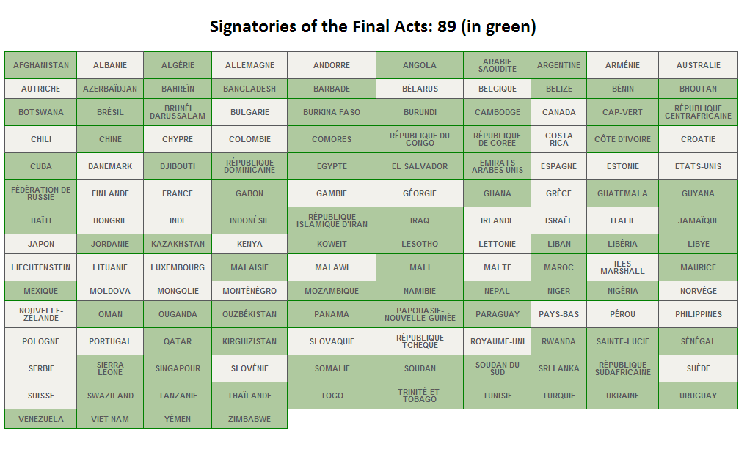

Slide 23

Thank You

