Slide 1
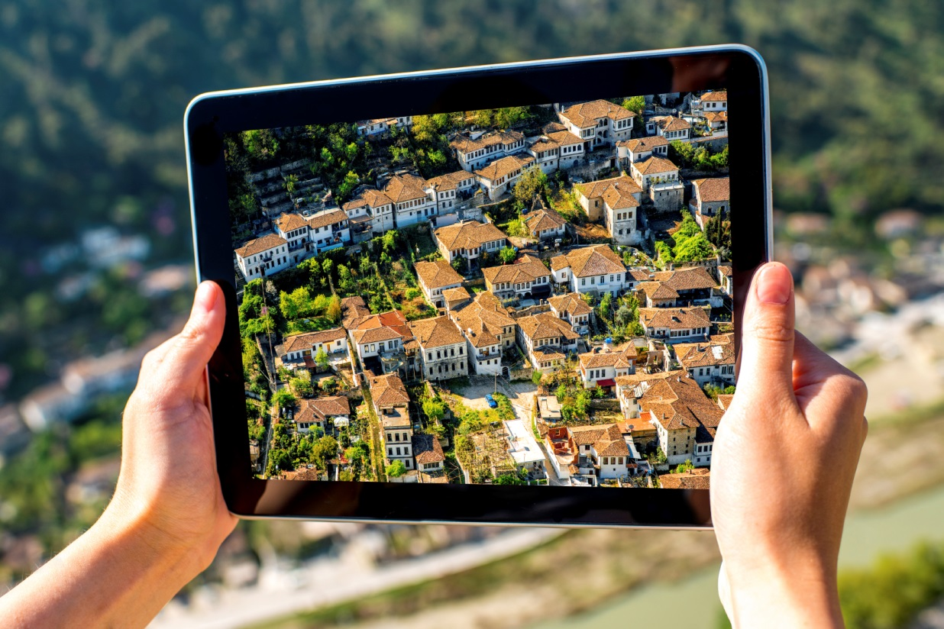
ITU/UNECE workshop
“Laying the Foundation for Sustainable Development Goals: Role of Smart Sustainable Cities”
2 May 2016, Geneva
Towards smart sustainable cities in the UNECE region
Domenica Carriero
Housing and Land Management Unit
Forests, Land and Housing Division, UNECE

Slide 2
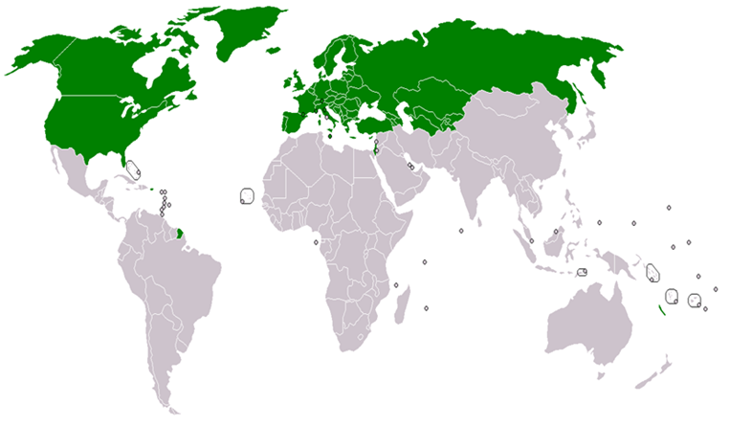
UNECE Committee on Housing and Land Management
Members:
56 countries in Europe, Central Asia and North America
1.
2.
3.
Mandate:
To improve housing, urban sustainability and land governance
1. Sustainable Housing and Real Estate Markets
2. Smart and Sustainable Urban Development
3. Land Administration and Management
4. Country Profiles on Housing and
Land Management

Slide 3
Urbanization in UNECE region
Statistics
1/5 of global population
73% urban residents (85% in 2050)
45% of the world’s GDP
45% of energy consumption
40% of GHG emissions
66% of global fresh water
Main challenges
High energy consumption
High quantities GHG emissions
Overpopulation and critical living conditions for citizens
Informal settlements
Conversion of land and green spaces into constructions and buildings
Mobility problems and lack of infrastructures and services
Housing issues
Notes:
Statistics: source “Climate neutral cities” p. 3
The region covered by the United Nations Economic Commission for Europe (UNECE) houses less than a fifth of the world’s population but is characterized by high levels of urbanization. Urban residents represent more than 73 per cent of its population and by 2150 the figure is estimated to rise to 85 per cent. The urban population in Middle East and North Africa according to the World Bank is about 58% and this number is increasing very rapidly.
This high level of urbanization presents serious challenges for sustainable development and climate change adaptation. The urban areas are responsible for considerable world’s energy consumption and greenhouse gas net emissions . This situation has the potential to become critical and irreversible if not acted upon soon.
Data source: The United Nations Department of Economic and Social Affairs.

Slide 4



Smart city: definition
Many existing definitions
UNECE/ITU definition combines the «smartness» and the sustainability of a city
Framed in the SDG 11
“A smart sustainable city is an innovative city that uses information and communication technologies (ICTs) and other means to improve quality of life, efficiency of urban operation and services, and competitiveness, while ensuring that it meets the needs of present and future generations with respect to economic, social and environmental aspects as well as cultural.” [UNECE/ITU]

Slide 5

Geneva UN Charter on Sustainable Housing
Main purpose: to ensure the access to decent, affordable and healthy housing for all
Scope: to improve the sustainability of housing in the ECE region through effective policies and actions at all levels, supported by international cooperation
UNECE endorsed the Geneva UN Charter in April 2015
Environmental protection
Cultural adequacy
Economic effectiveness
Social inclusion and participation
Notes:
(a) Environmental protection
The Charter supports the following actions aimed to limit the negative impact of housing on the environment:
Reduce the carbon footprint of the housing sector by reducing energy use throughout the entire life cycle of buildings
Decrease the adverse per capita environmental impact of cities, including by paying special attention to air and water quality and waste management;
Apply building codes and standards for energy efficiency and the environmental safety of new and existing residential buildings;
Retrofit and renovate existing housing stock in an environmentally friendly, energy-efficient, affordable and cost-efficient way;
Adopt green housing policies and integrate them into sustainable urban and territorial development policies

Slide 6












United Smart Cities
IDENTITY CARD
What: project
When: 2014-2020
Why: survey «Challenges and Priorities in the ECE region»
Who: UNECE with partners

Slide 7
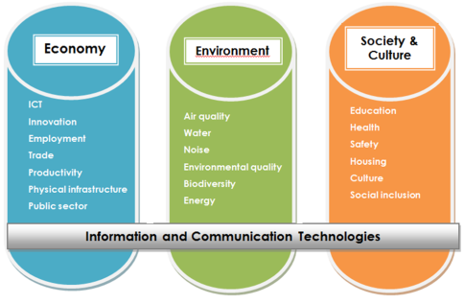
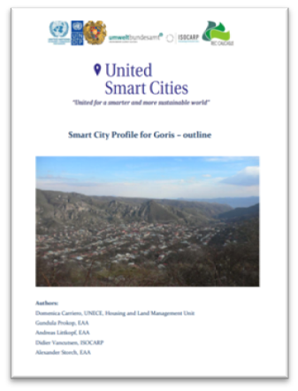
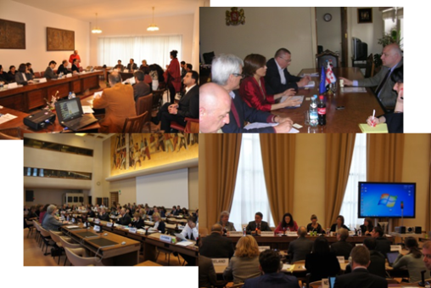
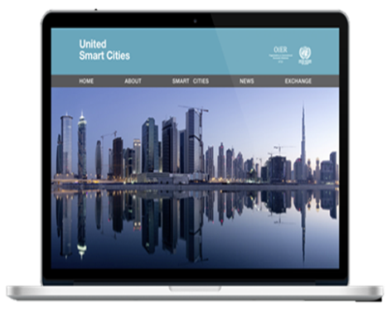
United Smart Cities - activities
Activity 1
Activity 2
Activity 3
Activity 4
Methodology
Pilot cities
City assessment
Implementation of the reccommendations
Monitoring
Benchmarking
Activity 5
Capacity building
Outputs
Standards
Smart sustainable city profiles
City action plan
Online platform
Stakeholders’ training, workshops, meetings and events

Slide 8
United Smart Cities: objectives
WHAT
Raise awareness/educate to the PROCESS of becoming smarter and more sustainable
Promote KNOWLEDGE and GOOD PRACTICES TRANSFER on sustainable urban development
Improve the inhabitants’ QUALITY OF LIFE
HOW
Help national and local authorities to develop POLICIES on sustainable urban development
Identify and develop smart FINANCING MECHANISMS
Establish COOPERATION and PARTNERSHIPS
Capacity building

Slide 9


Output 1: KPIs for smart sustainable cities to assess the achievement of SDGs (TD 1465 Rev.2)
Developed by a consortium of organizations– framework: ITU-T SG5
Base: the UNECE/ITU Smart Sustainable Cities Indicators endorsed by the Committee on Housing and Land Management on 15 December 2015 (ECE/HBP/2015/4)
Approach
3 main areas
19 topics
92 indicators (core & additional)

Slide 10
Urban indicators: benefits
Helpful tool to:
set priorities
measure changes
evaluate the current status of a city
serve as a starting point for action
Alignment with the SDGs and their indicators

Slide 11
Sources
More than 25 worldwide initiatives
Available statistical data (EUROSTAT, Urban Audit, World-Bank, WHO, FAO etc.)
Thematic maps (likelihood of drought, earthquakes, flooding, precipitations)
Other (perception surveys, check lists, expert judgement etc.)
ITU Focus Group on smart sustainable cities

Slide 12
UNECE-ITU Smart Sustainable City Indicators: Milestones for the adoption
2013: survey “Challenges and priorities for the UNECE region”
2013: 74th session of the Committee on Housing and Land Management (CHLM) - smart cities as one of the main priorities for member States
2014: Analysis of the sources and development of the draft list of indicators
2014: 75th session of the CHLM - smart cities enters the program of work of UNECE with the project “United Smart Cities” and indicators become a priority
2015: Draft indicators tested in the pilot city of Goris, Armenia for feasibility
2015, 11 May : Expert Consultation, Geneva, Switzerland – indicators discussed among experts
2015, 4 and 5 June: Workshop and Committee Bureau meeting, Rakvere, Estonia – starting point of the inter-governmental dialog
2015, 30 June: Cities workshop, Vienna, Austria – input from cities
2015, June: negotiations with ITU to merge ITU and UNECE indicators
2015, July: draft sent to the member States for comments
2015, 14-15 December: 76th session of the CHLM – indicators endorsed
2016, March: proposal to the ITU-T SG5 for a draft Recommendation (standard)
2016, 20-27 April: ITU-SG5 meeting, Kuala Lumpur, Malaysia – discussion of KPIs and approval with revisions
Long process – dialogue and negotiations (experts, countries, cities, organizations, etc.)
One-UN approach

Slide 13




Upcoming events in 2016
Upcoming Scheduled events
May 18-19: Rome, Conference «Shaping smarter and more sustainable cities: Striving for Sustainable Development Goals – UNECE-ITU
June, 2, Berlin, «Metropolitan solutions»
July, 6-8, Geneva, Conference «Reviewing the State of Safety in World Cities» - UNECE-UN-Habitat –Geneva Peacebuilding Platform
July, 25, Geneva, Forum on IoT and Smart Cities – UNECE-ITU-WEF
September 13-14, Geneva, 77th session of the Committee on Housing and Land Management

Slide 14

HABITAT III: UNECE contribution
United Nations Conference on Housing and Sustainable Urban Development Quito, Ecuador, 17 – 20 October 2016
1. Report for the ECE region “Towards a city-focused, people-centred and integrated approach to the new urban agenda”
Three expert consultations with more than 40 experts
  - 29 May 2015 in Milan, Italy;
  - 8 July 2015 in Geneva, Switzerland;
  - 21 September 2015 in Brussels, Belgium
2. Geneva UN Charter on Sustainable Housing
Negotiated by 56 ECE member States (2010 – 2015)
Approved by UNECE Committee on Housing and Land Management on 15 October 2014
Endorsed by ECE on 16 April 2015 and forwarded to HABITAT III

Slide 15



Thank you for your attention!
Domenica Carriero
Housing and Land Management Unit, UNECE
Email: domenica.carriero@unece.org
Tel.: +41 (0) 22 917 16 72
Website: www.unece.org/housing
Follow us:
@UNECE Housing and Land Management

