Slide 1

Shaping smarter and more sustainable cities from WSIS to Habitat III
Cristina Bueti
Advisor
ITU-T
2 May 2016

Slide 2
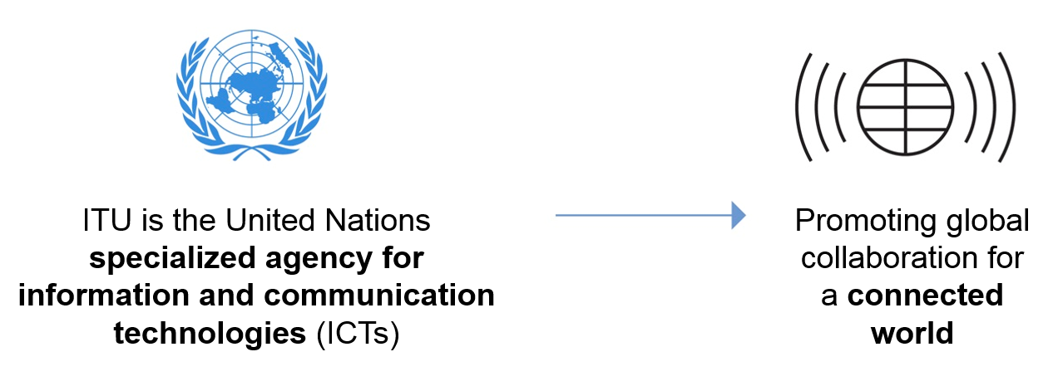

Who are we?

Slide 3

What do we do?
Allocation of global radio spectrum and satellite orbits
Bridging the digital divide
‘Committed to Connecting the World’
Establishing international standards

Slide 4

Some city facts
Cities account for about two-thirds of global energy demand.
Buildings produce a fifth of the world’s CO2 emissions.
Cities produce up to 70% of global greenhouse gas emissions (GHG).
Buildings account for roughly 40% of the world’s energy use.
An estimated 80% of global GDP is generated in cities.

Slide 5

ITU-T’s Smart Sustainable City programme
Develop international standards to address urban challenges.
Assist countries to develop policies and implement standards to build the cities we want
Help companies to support cities to become smart and more sustainable
Research and development on areas which include smart grids, water, mobility, logistic, waste, e-government.
Raise awareness on role of ICT in helping cities to become smarter and more sustainable.
Using ICTs to build the cities we want
Notes:
ICTs have a crucial role in SSC as it acts as the platform for the aggregation of information and data to help enable an improved understanding of how the city is functioning in terms of resource consumption and services.

Slide 6
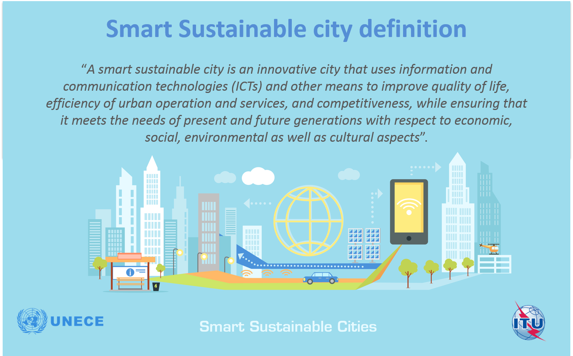

Slide 7



KPIs for SSC
International Definition
By 2050, 70% of the worlds population is expected to live in urban environments
ITU-T L.1600 (draft)
ITU-T L.1601 (draft)
ITU-T L.1602 (draft)
ITU-T L Suppl.17 to ITU-T L.1600
ITU-T L Suppl.18 to ITU-T L.1600
Notes:
“A smart sustainable city is an innovative city that uses information and communication technologies (ICTs) and other means to improve quality of life, efficiency of urban operation and services, and competitiveness, while ensuring that it meets the needs of present and future generations with respect to economic, social, environmental as well as cultural aspects”

Slide 8

ITU-T Study Group 20 (SG20) on
“Internet of Things and its applications, including smart cities and communities”
ITU-T SG20 is responsible for international standards to enable the coordinated development of IoT technologies, including machine-to-machine communications and ubiquitous sensor networks.
The group will develop standards to address urban-development challenges.
Upcoming meeting
SG20 meeting: 25 July to 5 August 2016, Geneva, Switzerland
Notes:
ITU-T SG20 will be responsible for international standards to enable the coordinated development of IoT technologies, including machine-to-machine communications and
ubiquitous sensor networks.
Established by the Telecommunication
Standardization Advisory Group (TSAG) in June 2015.

Slide 9

Towards IoT-enabled smart communities
WHAT TO DO?
FROM
TO
Nurture ‘Open Data’ platforms that utilize ‘Smart Data’ as an asset in its own right
to create citizen-centric innovations
driven & managed in collaboration by smart city stakeholders
Closed & un-connected vertical silos of functionally-oriented service providers
Innovative and Collaborative new models that connect these vertical silos
ENERGY
TELECOM
WATER
TRANSPORT
HEALTH
HOUSING
ECONOMY
POLICING
EDUCATION
WASTE
ENVIRO SVCS
SOCIAL SVCS
ENERGY
TELECOM
WATER
TRANSPORT
HEALTH
HOUSING
ECONOMY
POLICING
EDUCATION
WASTE
ENVIRO SVCS
SOCIAL SVCS
SERVICE MANAGEMENT
GUIDING PRINCIPLES
BUSINESS MANAGEMENT
TECH. & DIGITAL ASSET MGMT.
Visionary
Citizen-centric
Digital
Open
Collaborative

Slide 10






Forum on
Shaping Smarter and More Sustainable Cities:
Striving for
18-19 May 2016
Rome, Italy
Organizer:
Co-organizers:

Slide 11
Save the Date NOW
Dates | Title | Venue
11 – 12 May 2016 | Joint Huawei-ITU Forum on "Building a Better Connected World, Making Networks Greener" | Madrid, Spain
12 – 13 May 2016 | Joint ISO-IEC-ITU Workshop on Internet of Things | Berlin, Germany
18 – 19 May 2016 | ITU-UNECE Forum on “Shaping smarter and more sustainable cities: striving for sustainable development goals” | Rome, Italy
13 July 2016 | Joint ISO-IEC-ITU “World Smart City Forum” | Singapore
25 July 2016 | Joint UNECE-ITU-WEF Forum on IoT and Smart Cities | Geneva, Switzerland
31 August – 1 September 2016* | Forum on IoT | Buenos Aires, Argentina
5 – 9 September 2016 | 6th ITU Green Standards Week | Montevideo, Uruguay

Slide 12
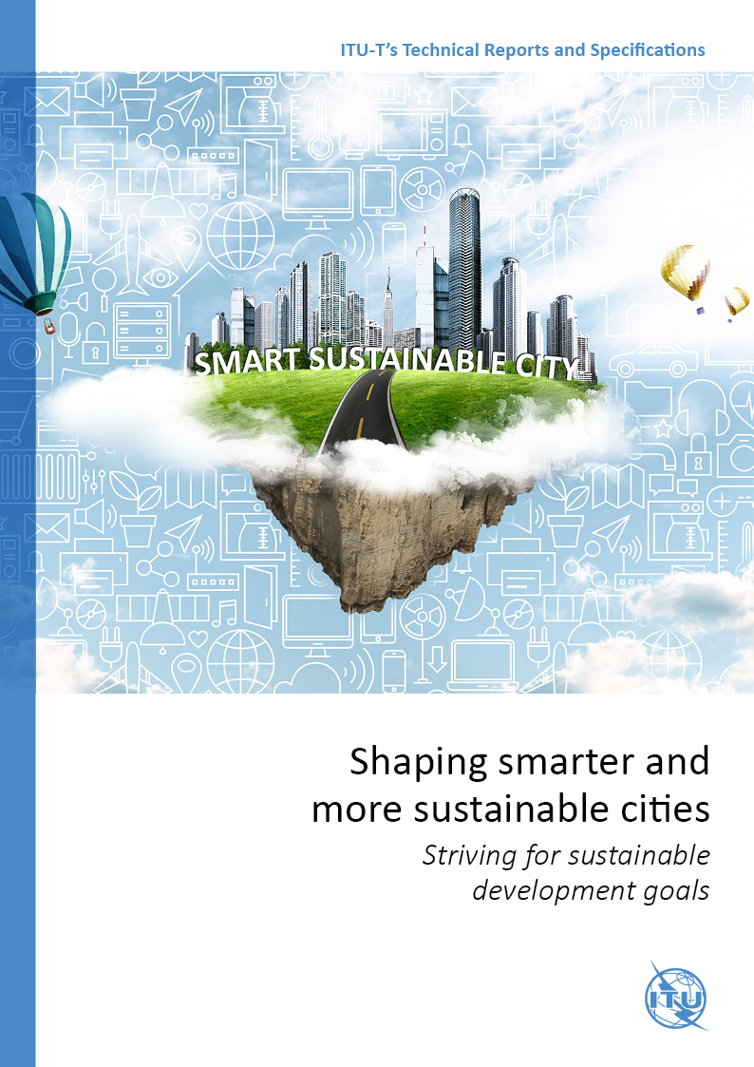
Flipbook: Shaping smarter and more sustainable cities: Striving for sustainable development goals
This compendium of Technical Reports and Specifications details policy and technical considerations relevant to the development of SSC, providing policymakers and engineers with valuable reference material to guide their pursuit of happier, safer life in our cities.
Content
Empowering SSC Transitions
Exploring the SSC Infrastructure
Metrics for Measuring SSC Transitions
Paving the way for SSC
Access here: http://wftp3.itu.int/pub/epub_shared/TSB/ITUT-Tech-Report-Specs/2016/en/flipviewerxpress.html

Slide 13



Towards HABITAT III
Participation and political commitment: promote the use of ICTs to set a new urban agenda and contribute to Habitat III.
Standardization: development and implementation of international standards to foster the integration of ICTs in city strategies.
Awareness and discussion: recognize ICTs as key enabler to help cities become smarter and more sustainable.

Slide 14

Thank you
ITU-T, IoT and applications, smart cities
http://itu.int/go/tsg20
cristina.bueti@itu.int

Slide 15



