Slide 1
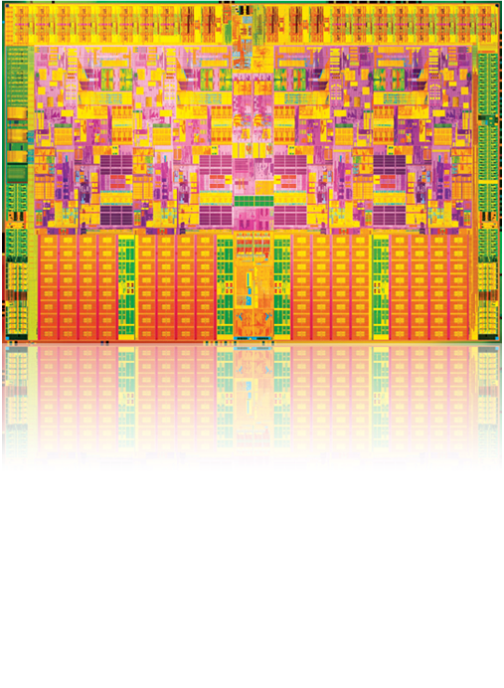
Embedded Solutions Smart Sustainable Cities ITU-UNESCO Montevideo, March 11. Marcelo E. Volpi LAR Technology Team

Slide 2
Today 85% of deployed systems are unconnected, do not share data with each other or the cloud.
And new devices are being added every day.
Internet of Things
50B
Devices 2020¹
Opportunity
> Compute Economics
+ Ubiquitous Connectivity
+ Big Data Analytics
Embedded Solutions
Internet of Things
Vision
= Business Transformation
1 Connect
2 Collect Data
3 Analyze
4 Transform
15B
Devices 2015
Internet of Things
Solutions
2B
Devices 2006
*Other names and brands may be claimed as the property of others.

Slide 3
Business Transformation
Efficiency and TCO → New Services
“Make everything smart”
Intel provides end to end IoT Solutions so that
you can quickly Connect, Manage, and
Protect your devices
Our Open, Scalable, and Reliable platforms
deliver state of the art technology from
trusted product lines such as Quark, Atom,
Intel Security, Wind River, and more
Create Value through our high performance
Analytics to realize the benefits of IoT by
focusing on what is important to your business:
Reducing costs
Improving productivity
Increasing growth
Internet of Things
Opportunity
Embedded Solutions
Internet of Things
Vision
Internet of Things
$
Solutions

Slide 4
Intel has industry leading products spanning from devices to the cloud, enabling rapid deployment of end to end IoT Solutions
Internet of Things
Opportunity
Things
> XMM Modem product line
> Kendrick Peak
> Quark processor
> I210 Ethernet controller
Gateway
> Wind River Intelligent Device Platform
> Moon Island Intelligent Gateway
Quark SoC and Atom E3800
Wind River Operating System
Intel Embedded Security
Network
> Wind River Intelligent Network Platform
> ONP Open Networking Platform
> SDI Software Defined Infrastructure
Embedded Solutions
Internet of Things
Vision
Internet of Things
Cloud
> Intel Data Center Manager
> IEEL Lustre for HPC
> Intel Distribution for Apache Hadoop
Services & Solutions
> API Management
> API Orchestration
> Intel Express Gateway & Tokenization
Solutions
> Intel Security Solutions
> Wind River Systems

Slide 5
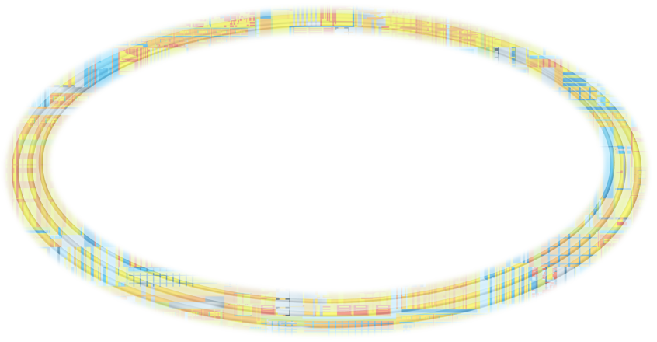
Intel’s Advantage
PROCESS TECHNOLOGY
INTEL ARCHITECTURE
PRODUCT DESIGN
Common Tools
Co-Optimized Process & Product
Co-Optimized Architecture & Software
Bet Performance, Power, Security
Rapid Product Ramp
Common Goals
SOFTWARE
MANUFACTURING
PACKAGING

Slide 6
Predictable Silicon Track Record Executing to
MOORE’s LAW Enabling new devices with higher functionality and complexity while controlling power, cost, and size

Slide 7
Tick Tock Model
Intel® Core™ Microarchitecture
Intel® Microarchitecture Codename Nehalem
Intel® Microarchitecture Codename Sandy Bridge
Intel® Microarchitecture Codename Haswell
Merom
Penryn
Nehalem
Westmere
Sandy
Bridge
Ivy
Bridge
Haswell
Future
65nm
45nm
45nm
32nm
32nm
22nm
22nm
14nm
New
Micro-architecture
New
Process Technology
New
Micro-architecture
New
Process Technology
New
Micro-architecture
New
Process Technology
New
Micro-architecture
New
Process Technology
TOCK
TICK
TOCK
TICK
TOCK
TICK
TOCK
TICK

