Slide 1



ITU Forum on "Human Exposure to Electromagnetic Fields (EMFs) in Latin America"
Electromagnetic Compatibility & EMF exposure: An Integral approach
Session 1: The other side of ICT convergence: EMF exposure and issues
Montevideo, ​Uruguay, 13 March 2014

Slide 2
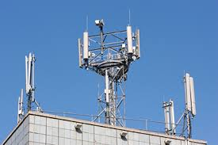

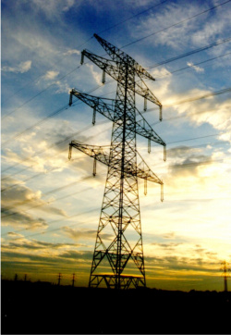

Outline
  Electromagnetic Compatibility
  EMF Exposure
  Conclusions

Slide 3
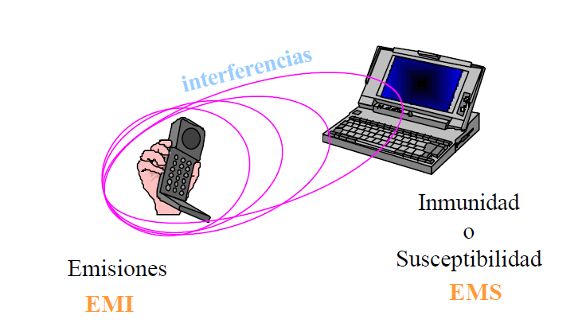
Electromagnetic Compatibility

Slide 4
Definitions
EMC - Electromagnetic Compatibility
  The ability of a device or system to function without error in its intended electromagnetic environment.
EMI - Electromagnetic Interference
  Electromagnetic emissions from a device or system that interfere with the normal operation of another device or system

Slide 5
Electromagnetic Compatibility
EMC – The ability of an electronic device to be electromagnetically compatible with its environment. (pollution analogy)
  Does NOT cause interferences with other systems
  Is NOT susceptible to emissions from other systems
  Does NOT cause interference with itself

Slide 6
Interference
Interference occurs if the received energy causes the receptor to behave in an undesired manner
Electronic devices produce electromagnetic (EM) emissions (radiation), but we classify them as
  Intentional Rad. – designed to produce EM radiation (TV trans., cell phones, radar etc)
  Unintentional Rad. – not designed to produce EM radiation (computer, auto ignition, etc.)

Slide 7
RF and health: exposure to non-ionising radiation
A biological effect is any measurable physiological response to EMF exposure ….not necessarily hazardous…this must be evaluated
An adverse health effect is a biological effect outside the body's normal range of physiological compensation that is detrimental to health or well-being
Fuente: Jafar Keshvari, scientific basis of the EMF exposure standards, ITU-Quito, Ago, 2013

Slide 8
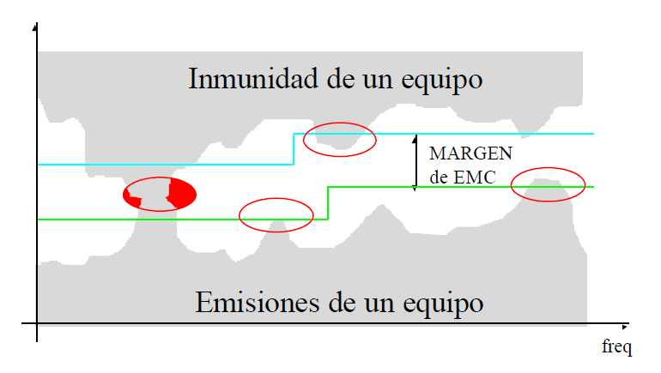
Limits and Thresholds
(*)
(**)
IEC
CENELEC
CISPR
IEEE
ITU
ICNIRP
IEEE
(*)Fuente: Ferran Silva, UPC, Red Pucará, CYTED, 2002.
(**)Fuente: Víctor Cruz Ornetta, ITU Workshop on Human Exposure, Quito Ecuador, 2013.

Slide 9
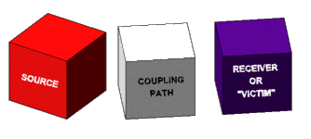
General case
Potential sources of electromagnetic compatibility problems include radio transmitters, power lines, electronic circuits, lightning, lamp dimmers, electric motors, arc welders, solar flares and just about anything that utilizes or creates electromagnetic energy.
Potential receptors include radio receivers, electronic circuits, appliances, people, and just about anything that utilizes or can detect electromagnetic energy.
Methods of coupling electromagnetic energy from a source to a receptor fall into one of four categories.
  1. Conducted (electric current)
  2. Inductively coupled (magnetic field)
  3. Capacitively coupled (electric field)
  4. Radiated (electromagnetic field)
Each of these three elements must be present although they may not be readily identified in every situation:
  A source of an electromagnetic phenomenon
  A receptor (or victim) that cannot function properly due to the electromagnetic phenomenon
  A path between them that allows the source to interfere with the receptor.
Electromagnetic compatibility problems are generally solved by identifying at least two of these elements and eliminating (or attenuating) one of them.

Slide 10
The basic decomposition of the EMC coupling problem
Source
(emitter)
Transfer
(coupling path)
Receptor
(Victim)
To reduce interference at the receiver/victim:
  Suppress source emissions
    Modify electronics, shielding, filtering, turn off source
  Make coupling path as inefficient as possible
    Move receiver away from the source
  Make receiver less susceptible to emissions
    Modify receiver electronics or shielding
Usually best to work from left to right
Un/Intentional Rad.
Notes:
Sources:
Electronic devices produce electromagnetic (EM) emissions (radiation), but we classify them as
Intentional Rad. – designed to produce EM radiation (TV trans., cell phones, radar etc)
Unintentional Rad. – not designed to produce EM radiation (computer, VCR, auto ignition etc)

Slide 11
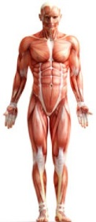
The basic decomposition of the EMC coupling problem
Source
(emitter)
Transfer
(coupling path)
Receptor
(Victim)
To reduce interference at the receiver/victim: …
Un/Intentional Rad.
Notes:
Sources:
Electronic devices produce electromagnetic (EM) emissions (radiation), but we classify them as
Intentional Rad. – designed to produce EM radiation (TV trans., cell phones, radar etc)
Unintentional Rad. – not designed to produce EM radiation (computer, VCR, auto ignition etc)

Slide 12
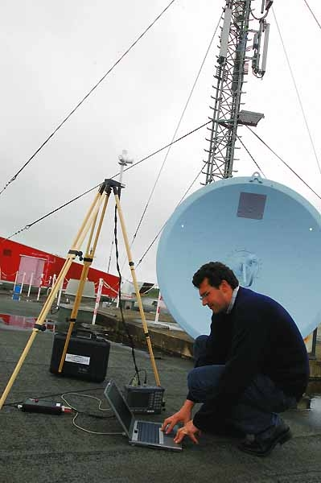
EMF: Stakeholders actions
(Ex. App to mobile)
Manufacturers of base stations and operators can:
Co-location of antennas where practicable
Use best practice engineering for antennas and base station compliance
Optimize the antenna network (more antennas less individual exposure)
Manufacturers of mobile phones
Optimize the phone radiation part design
Users:
If mobile phones users are worried they can reduce their exposure by
Using hands-free kits
Using loud-speaker option
Texting instead of calling
Reducing call times
Policymakers
Adopt international standards/Recommendations
On spot measurements and continuous monitoring
Management of public acceptance: Less public risk perception
Municipalities and barriers

Slide 13
Conclusions
Since the receptor (human) can not be modified, you must resolve the problem of electromagnetic compatibility EMF exposure, both in the source and/or the path.
Given the scientific uncertainty, and susceptibility that has been generated in the population, intervention is required from everyone involved acting in coordination.

Slide 14
Muchas Gracias!
Thank you!

