Slide 1
“ Forum on Environmentally Sound Management
of E-waste in Latin America”
Montevideo, Uruguay - March 12th , 2013
Building sustainable businesses and strategies through
e-waste management:
“Turning an e-challenge into an e-opportunity ”

Slide 2
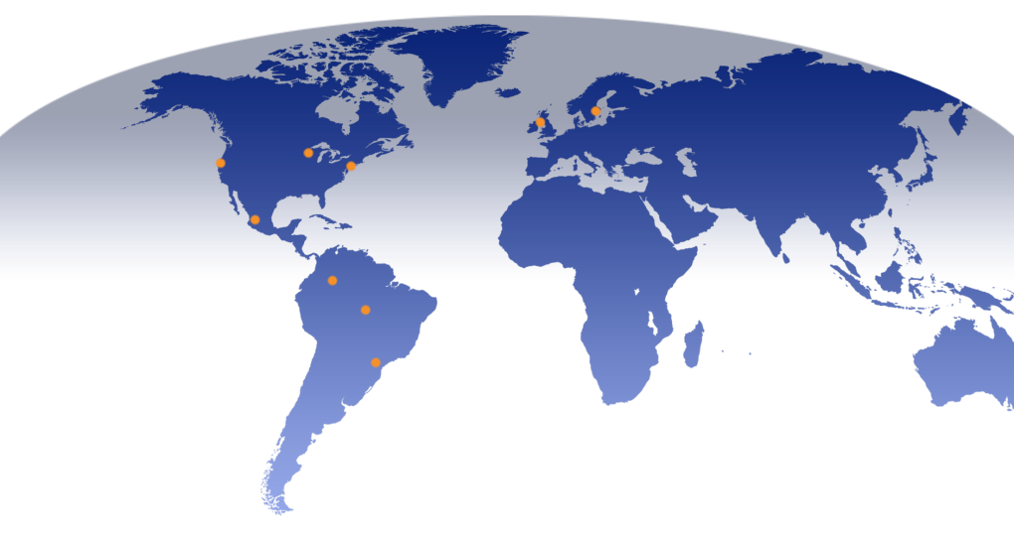

Global Footprint
Kristinehamn, Sweden
Moscow, Russia
Elk Grove Village, IL
Kilwinning, Scotland
Northbrook, IL
Chicago, IL
Zabreh ,
Czech Republic
Hayward, CA
Bridgewater, NJ
Guadalajara, Mexico
Manaus, Brazil
Bogota, DC
Colombia
São Paulo, Brazil

Slide 3
Mission
The electronics and technology industries are defined by their rapid speed of change. We are prepared to handle this increasing momentum through its unique vision for electronic recycling and reuse.
Our focused expertise on recycling and reuse allows our corporate partners to maximize their revenue on obsolete and end of life products.
Started operations in Latin America in 1998

Slide 4
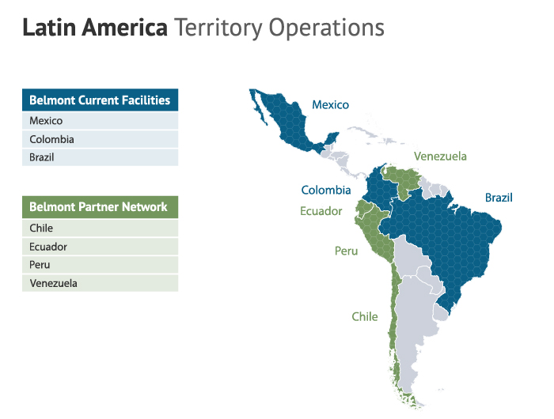

Slide 5

Our Contribution to Recycling
Take-back and Recycling programs require diligent design and planning, sustainability, transparency and environmental friendliness

Slide 6
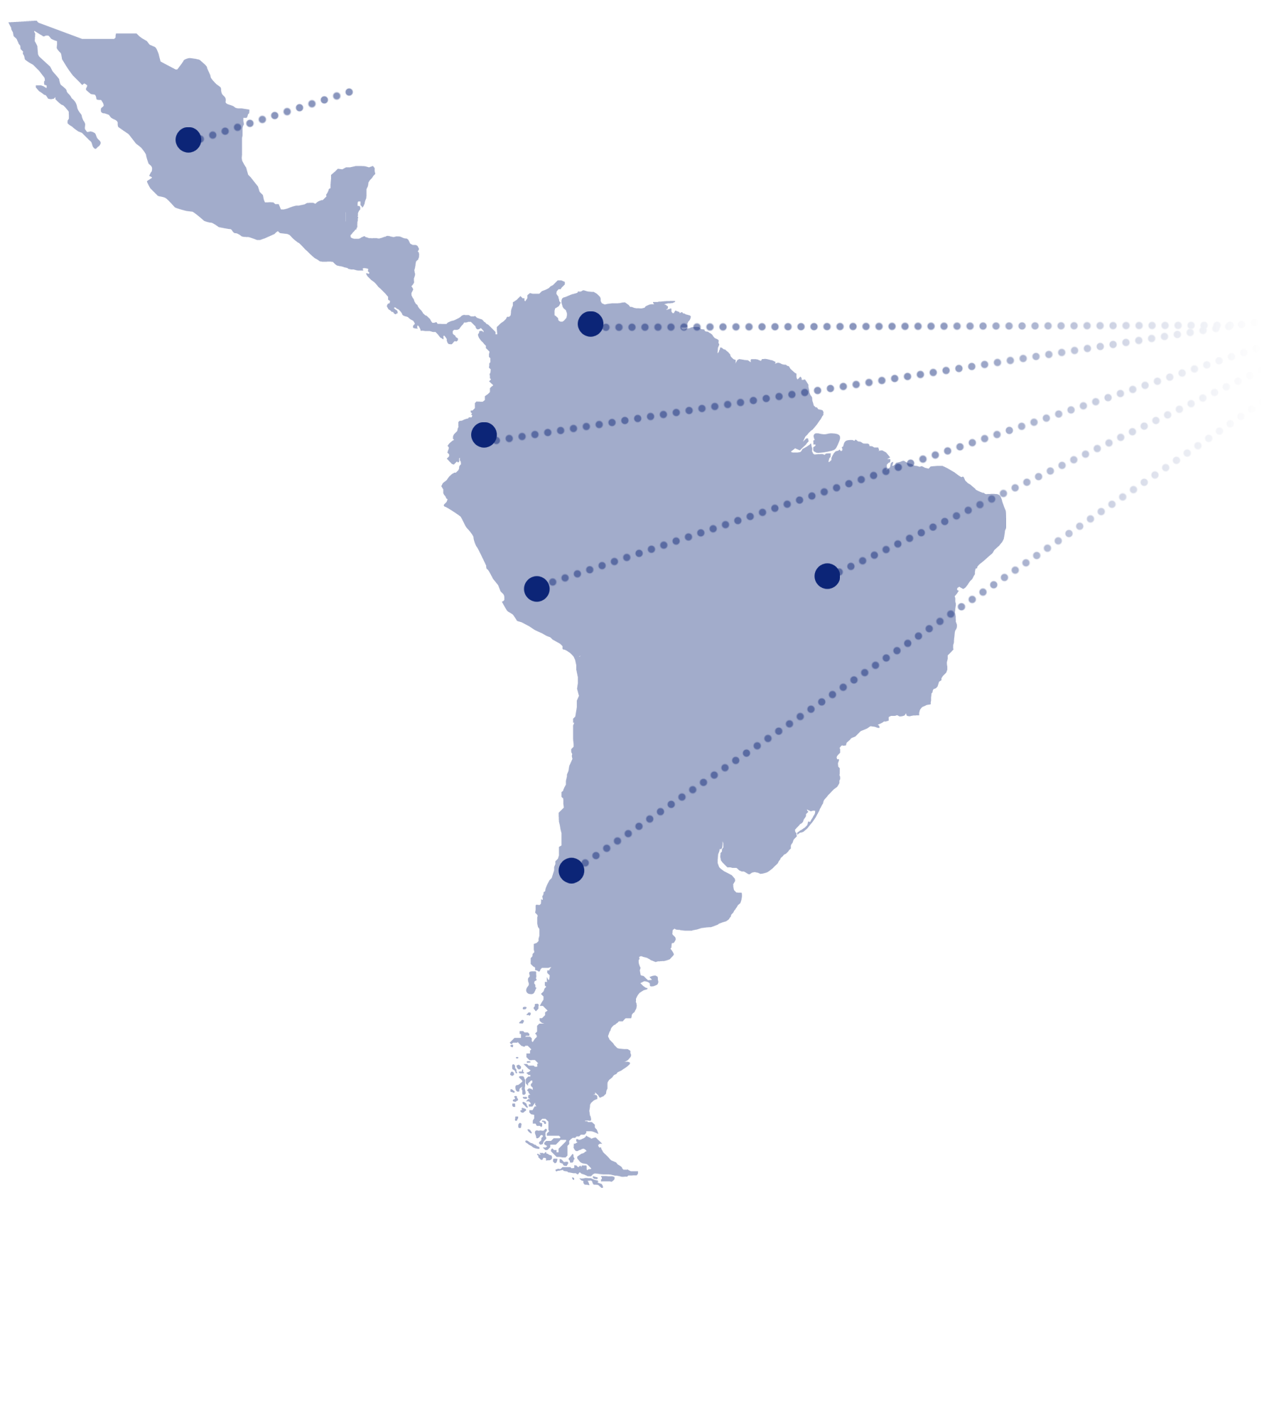

Take back programs in Latin America
Mexico
First started in 2006
Colombia
Ecuador
Peru
Brazil
Chile
Consumer free recycling programs with cellphone brands and cellphone operators
Notes:
TAKE BACK PROGRAMS
The first take back program was launched in Mexico in 2006, since then we have set up active take back programs in the following countries Chile, Colombia, Brazil, Peru and Ecuador collecting in the last 4 years the following quantities:
Cell phones over 1,000,000 pieces
Accessories over 10 tons
Batteries over 5 ton
CHALLENGES
A comprehensive and successful take-back program requires diligent design and planning; sustainability, transparency and environmental friendly process may gain more acceptance and participation extending the awareness.
The participation of the people is been increasing over the year by watching the example of what the others are doing, we provide different models and scenarios to work with a take back program that suits their requirements.

Slide 7
Recycling Challenges
Educating consumers that electronic recycling is good for the environment and therefore benefits everyone in society.
Definition of e-waste as legislation to allow the proper management and exportation of used electronics.
Lack of legitimate in-country recycling/refining facilities requires all materials to be exported increasing cost and complexities.
Logistics cost, national recycling campaigns
are expensive.

Slide 8
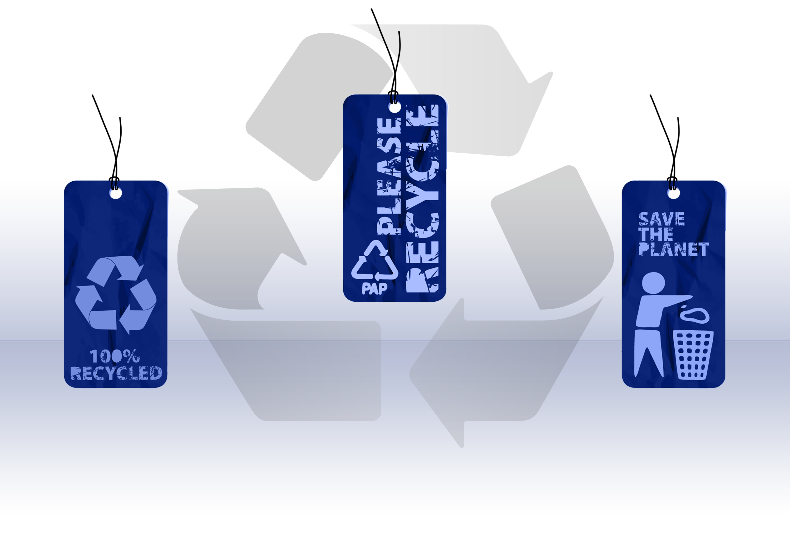
Recycling Benefits
Decrease volume
of electronic materials
sent to landfills
Recovered value being used to support environmental programs
Decrease the use of
natural resources
Helps to sustain the environment for future generations

Slide 9
Belmont Trading achievements in Latin America
* Regional recycling projects initiated in 2002 covering at least 17 countries around Latin America and the Caribbean .
* One of the first companies offering world class recycling services in Latin America.
* We provide consistent results in most of the countries in Latin America thru or own facilities or partner network
*Participated in a number of media and public events in order to raise awareness of recycling initiatives in Latin America

Slide 10

Reuse, Reduce, Recycle ….
Consuelo Velarde
consuelov@belmont-trading.com

