Slide 1
ITU C&I Programme
Key activities and main ITU outcomes which are related to the implementation of ITU C&I

Slide 2
The Business Plan for the ITU C&I Programme in 4 “Pillars”
The Standardization Sector side
Pillar 1: Conformity Assessment
Pillar 2: Interoperability Events
The Development Sector side
Pillar 3: Capacity building
Pillar 4: Establishment of test centres and C&I programmes in developing countries

Slide 3
Authority for Action:
ITU’s highest decision making bodies
Resolution 76: ITU World Telecommunication Standardization Assembly (WTSA-12)
Resolution 47: ITU World Telecommunication Development Conference (WTDC-14)
Resolution 177: ITU Plenipotentiary Conference
(PP-10)
Resolution 62: Radiocommunication Assembly 2012
Council Decisions: (2009, 2010, 2011, 2012, 2013, 2014)

Slide 4
WTSA-12
WTSA-12 designated the ITU-T Study Group 11 as a lead group on test specifications, conformance and interoperability testing which coordinates ITU-T activities related to the ITU C&I programme across all SGs and review the recommendations in the Conformance and Interoperability Business Plan for the long term implementation of the C&I programme

Slide 5
Council-12
C12/48
ITU-T to run a pilot of the conformity assessment programme for key technologies
ITU-T study groups to identify further technologies (ITU-T Recommendations) for C&I
ITU Secretariat invite labs/forums/consortia/SDOs to join the C&I Programme
ITU Secretariat to consult study groups towards identifying and suggesting topics for future events
ITU-T Study Groups to develop system roadmaps, identify and define the interfaces across which interoperability is needed
ITU-T Study Groups should identify or develop use cases, application profiles and test plans to use for interoperability testing for Recommendations

Slide 6
The key outcomes related to Pillar 1&2
as of June 2014 (1/2)
ITU-T SG11 developed a living list of key technologies suitable for C&I (http://itu.int/go/key-technologies)
ITU-T SG11 launched the list of pilot projects of conformity assessment (http://www.itu.int/go/pilot-projects)
ITU-T SG11 maintains the C&I reference table of ITU-T Recs. (http://itu.int/go/reference-table)
ITU-T SG11 established the new work item Q.TL-rec-pro “Testing Laboratories recognition procedure” (Nov. 13)
ITU-T SG11 established the CG on collaboration between ITU and TL (Nov. 13)
ITU secretariat cooperated with the relevant SDOs (ISO, IECEE, DCMAS, ILAC, IAF, etc.)

Slide 7
The key outcomes related to Pillar 1&2
as of June 2014 (2/2)
ITU conducted test events (e.g. from 2013 to 2014):
  Conformance & Interoperability event of IMS UNI, IPTV (Bangkok, Sept. 13)
  Continua Health Alliance Interoperability event on e-health (Geneva, Oct. 13)
  Performance assessment of mobile phones in conjunction with HFT in a car against Recs. ITU-T P.1100/P.1110 (May. 14)
  Interoperability of IMS-NNI, IoT (Aug. 14) (planned)
ITU-T SG11 established the new work item Q.Int_speed_test “Unified methodology of Internet speed quality measurement usable by end-users on the fixed and mobile networks”
There are available some new test specifications for IMS-NNI, benchmarking, NGN-UNI, etc.
JCA-CIT extended the list of conformity assessment approaches

Slide 8
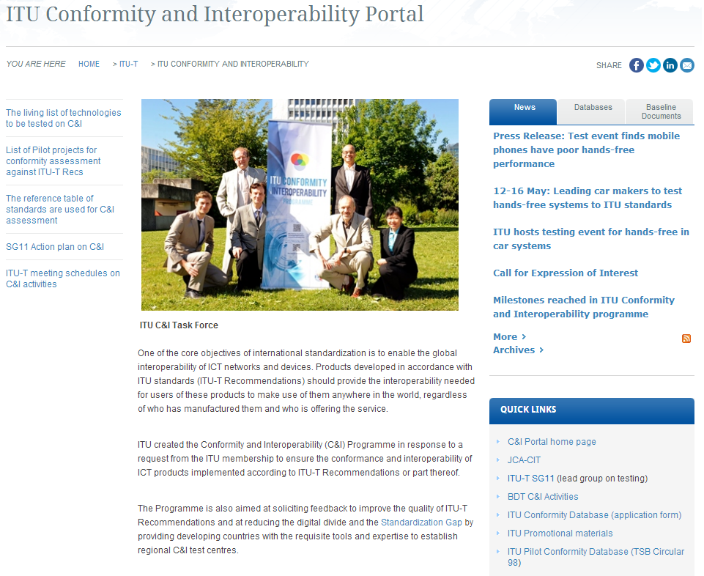
ITU-T C&I Portal
http://www.itu.int/en/ITU-T/C-I/Pages/default.aspx

Slide 9
SG11 Action plan
Principles of SG11 cooperation among other SGs
SGs
Key ITU-T Recs. suitable for C&I
SG11
WP4/11
Pilot projects which are
based on key ITU-T Recs. suitable for C&I
Reference table of all ITU-T Recs. and relevant test suites
SGs

Slide 10
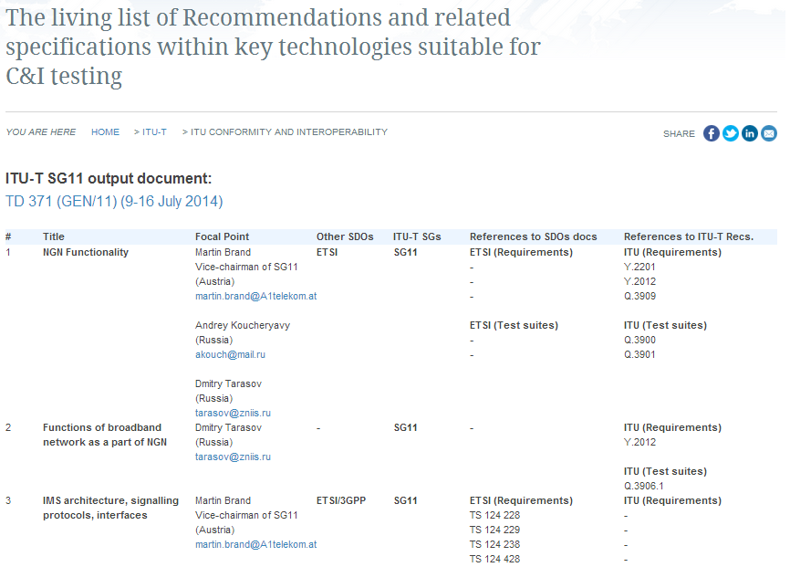
The list of key Technologies for C&I (1/2)
http://itu.int/go/key-technologies

Slide 11
The list of key Technologies for C&I (2/2)
http://itu.int/go/key-technologies
Network and equipment performance (benchmarking) – Req: Draft Q.39zz-1; TS:Q.3930, Q.3931.1-4, Q.3932.1-4,
QoS/QOE/NP – Req: Q.3925, Y.1541, Y.1542, Y.1543, draft Q.MSPQuality, Q.NP-req; TS:Q.QMS, Q.3930, Q.3931.1, Q.3931.2
NGN Functionality – Req: Y.2201, Y.2012; TS: Q.3909; TS: Q.3900; Q.3901
Functions of broadband network as a part of NGN – Req: Y.2012; TS: Q.3906.1
IMS architecture, signaling protocols, interfaces – Req: Y.2012; TS: Q.3904
IMS basic call – Protocol conformance testing – Req: Draft Q.39xx-1; TS: Q.3904
IMS supplementary services. Protocol specifications – Req: -; TS: Q.3943.1/2/4, Q.3942.1
IMS interconnection – Re: Q.3401; TS: -
Interoperability testing – Req: - ; TS: Q.3940, Q.3941.1-4
NGN monitoring system – Req: Q.3902, Q.3910, Q.3911, Q.3912; TS: -
Interworking of signaling protocols of NGN – Req: Q.1912.5, Q.3401, Q.3402; TS: Q.1912.5 B-F
RFID – Req: - ; TS: Q.3950
Internet speed access – Req: - ; TS: Q.InSpMs
Internet Access as perceived by user – Req: G.1000; TS: -

Slide 12
The pilot projects of conformance testing against ITU-T Recommendations (1/2)
http://itu.int/go/pilot-projects
Title of planned/on going Pilot Project under C&I Programme | ITU-T Recs. | SGs focal point | Interested companies | Motivations | Short-term strategy
The title of planned or on-going Pilot Project which SG is going to start and maintain |  | The contact of responsible person/expert (rapporteur, editor, etc) | The companies are going or have already involved to the project | The reason and expecting results under ITU C&I Programme | The short-term strategy (one year) for achieving the goals of the Pilot Project

Slide 13
The pilot projects of conformance testing against ITU-T Recommendations (2/2)
http://itu.int/go/pilot-projects
First ITU-T Pilot project
Testing scope: conformance testing of the Multi-technology network interface in accordance with series of Recs. ITU-T M.3170.x
Involved companies: China Telecom, FiberHome, ZTE, CTTL, BUPT, etc.
Goal: improvement of an interconnection between EMS, NMS, and OSS for the MTNM interface
Short-term strategy:
harmonize requirements based on the inputs provided by vendors, labs, operators
select an appropriate TL that has a competence to perform the relevant tests
perform testing at the appointed TL
populate ITU product conformity DB

Slide 14
The reference table of ITU-T Recommendations and relevant Test Specifications which are used for C&I testing (1/2)
http://itu.int/go/reference-table
Reference Table is a list of ITU-T Recs and applicable test suites (ITU/other SDOs) which indicate relevant parameters to be tested for conformity/interoperability

Slide 15
The reference table of ITU-T Recommendations and relevant Test Specifications which are used for C&I testing (2/2)
http://itu.int/go/reference-table
Reference table structure
ITU-T Recommendation (requirements)
Suitability for testing: Conformance and/or Interoperability
Relevant ITU-T Recommendation(s) which describes test specification(s) if it is available
Relevant SDO’s Test specifications (TS) if it is available
Parameters to be tested
Example (mobile universal charger)
ITU-T Recommendation (requirements): L.1000
Suitability for testing: Conformance and Interoperability
Relevant test specification: L.1005
Relevant SDO’s Test specifications (TS) if it is available: None
Parameters to be tested: Conformity of mobile universal charger solution

Slide 16
Testing Laboratories recognition procedure (1/2)
Background: Most SDOs/Forums/Consortia established its own TL’s recognition procedure. This approach helps them to ensure the credibility of their C&I Programmes.
TSB developed an overview on a best practice (GSMA, Continua, IECEE).
Goal: the aim of the ITU recognition procedure is to allow TL to be recognized as a laboratory with a competence to perform tests against ITU-T Recommendations.
First draft of the Recognition procedure was proposed by Russia (C97)
Recognition procedure defines:
Requirements for TL
Requirements for ITU-T assessors
Relevant procedure to apply for the ITU recognition
Conformance Assessment Steering Committee (CASC) is an instrument to follow up the recognition procedure
ITU-T SG11 established the CG aiming to clarify this issue
Correspondence group on collaboration between ITU and TLs
Chairman: Mr Isaac Boateng (vice-chairman of SG11)
CG documents: http://ifa.itu.int/t/2013/sg11/exchange/wp4/q11/
Last meetings: 20 Feb, 10 April, 14 May, 11 June, 2 July and 10 July 2014
Key outcomes: revised recognition procedure and best practice

Slide 17
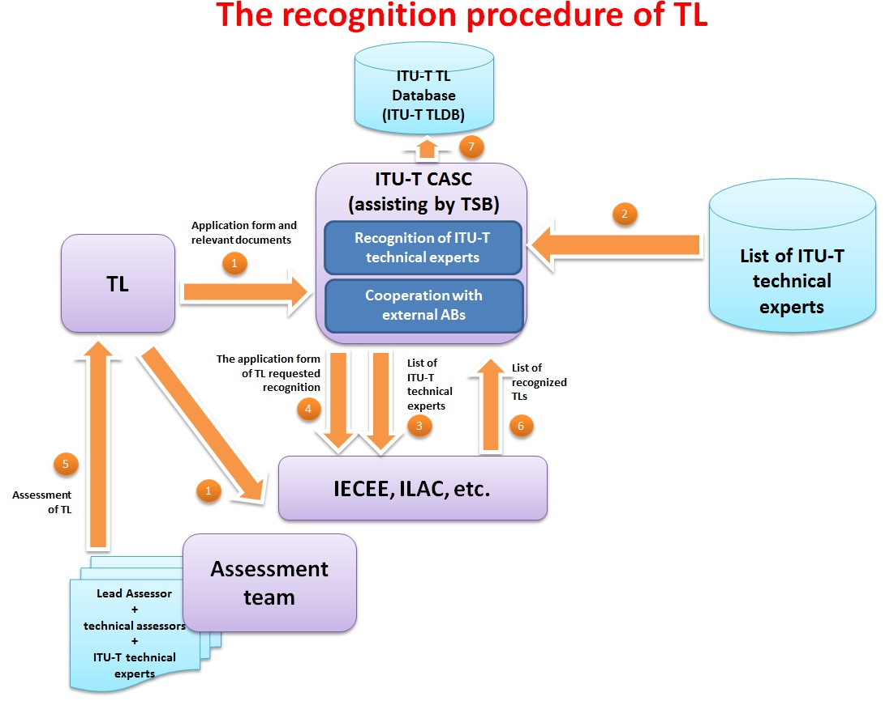
Testing Laboratories recognition procedure (2/2)
TD 474 (GEN/11) “Revised version of C-97 "Proposal to establish an ITU recognition procedure of testing laboratories with competence in ITU-T Recommendations”,
9-16 July 2014

Slide 18

  ITU Test Event (1/2)
  Performance assessment of mobile phones in conjunction with vehicle's HFT in accordance with Recs. ITU-T P.1100/P.1110 www.itu.int/go/test-event
Background
Many mobile phones do not work properly with HFT’s system and thereby significantly degrading the speech quality of the complete system
Findings
an incorrect behavior of the mobile phone in the wireless connection to a vehicle’s HFT
an unacceptable quality of a voice-call inside the car and outside the car for the conversational partner
Only 30 % of phones passed the tests
Key outcomes
New web portal describing the existing issues
A “white list” of mobile phones recommended by major car manufactures
Updated Recs. ITU-T P.1100/P.1110 with the new values of performance
  Venue: ITU Headquarters
  TL: HEAD Acoustics
  Date: 12-16 May 2014
  Participants: Mercedes-Benz,
  Volvo, Bosch, Toyota
  Number of tests: 40 (30 phones)
  ITU press-release

Slide 19
ITU Test Event (2/2)
JLR – loudness of the transmit audio (Junction Loudness Rating)
MOS-LQO RCV – Listening speech quality (receiving direction)
RFR – level of received sound in the assigned frequency range
SFR – level of sending sound in the assigned frequency range

Slide 20
Internet speed quality measurement (1/3)
The key reasons for establishing the global approach:
Internet services are playing the important role in our life (social networks, OTT, etc.)
Quality of Internet services becomes a such vexed issue (subscriber loyalty)
Fixed and Mobile operators are playing the significant role in Internet community
Customer is looking for the best offer of Internet access “speed/tariff”

Slide 21
Internet speed quality measurement (2/3)
The key issues of the existing Internet speed measurement systems:
The existing algorithms are not suitable for operators/regulators to manage customer's SLA
The method is not standardized by International SDO. There is no reliable mechanism for Internet speed checking
The existing measurement systems do not provide guarantee that testing results related to operator’s network (no guarantee that the measurement connection does not include the Internet segments)

Slide 22
Internet speed quality measurement (3/3)
ITU-T SG11 Q15/11 “Testing as a service TAAS” established the new work item
Q.Int_speed_test “Unified methodology of Internet speed quality measurement usable by end-users on the fixed and mobile networks”

Slide 23
Next ITU-T meetings
JCA-CIT meeting (11 July 2014)
SG11 regular meeting (9-16 July 2014)

Slide 24
Workshops and Training Courses
Contribute to increased awareness and improved knowledge
  Provide the necessary tools for participants to replicate knowledge in their country, taking into consideration national specificities
  Promote experience-sharing on testing, certification and accreditation among participants from different countries
  Present a practical learning on standards, regulations, real Lab experience and accreditation procedures
ITU Regional Offices play an active role to identify regional interested subjects, partners and to support its organization

Slide 25

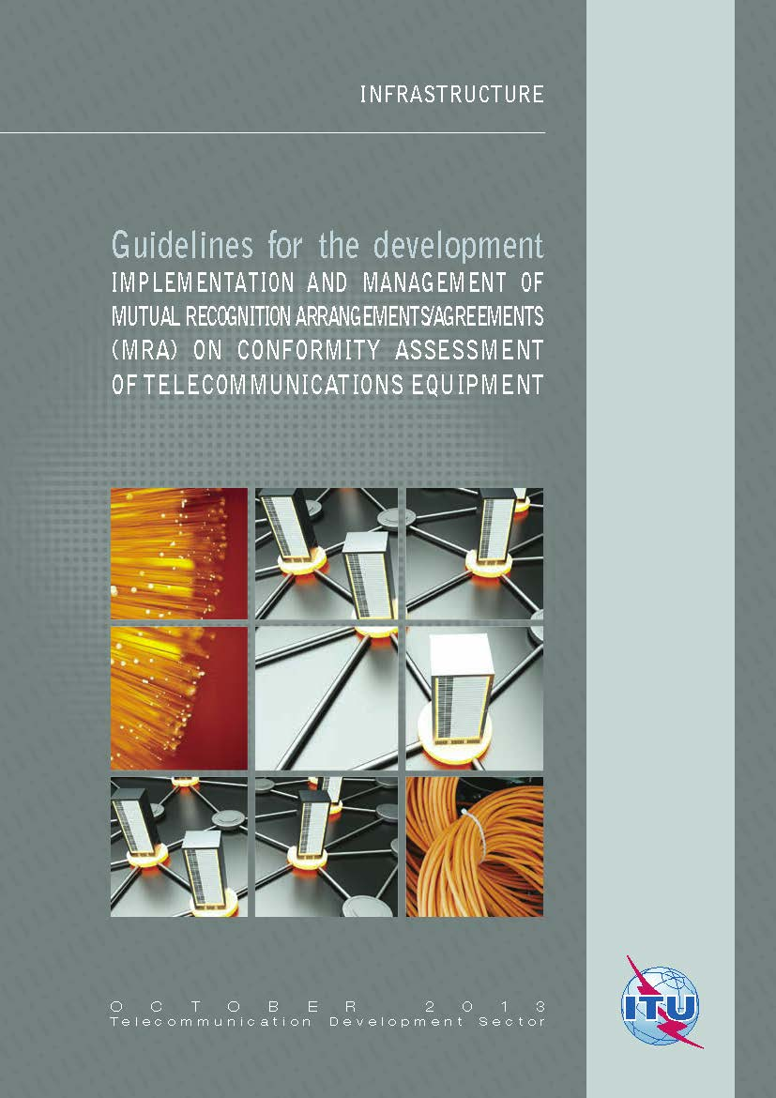
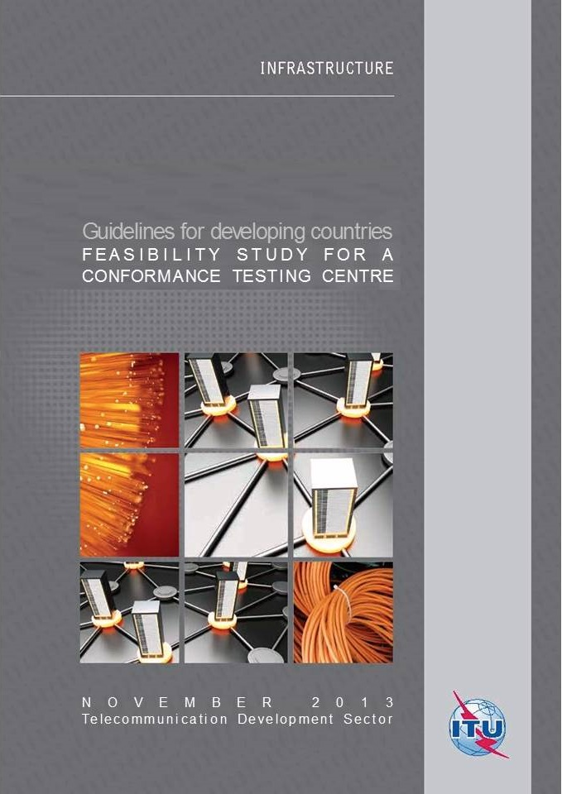

Slide 26
Assessement Studies
ITU is carrying out activities to:
assess C&I infrastructure in regions/sub-regions/countries
conduct analysis of the status in the regions
promote regional agreements about possible locations for testing capabilities
collaborate with regional experts in capacity building for accreditation and type approval testing
move forward to establishing regional test centres

Slide 27
Who is invited to join the
ITU C&I Programme (1/2)
ITU-T SG11 invites TLs/SDOs/Consortia to launch the pilot projects on the conformity testing against ITU-T Recs. TSB can help to conduct these events
TSB invites ICT Companies (e.g. vendors, operators, etc.) to launch the interoperability events based on the ITU-T Recs.
ITU-T SG11 invites companies to develop Test specifications against ITU-T Recs. Other contributions and proposals which are relevant to C&I issues are highly appreciated

Slide 28
Who is invited to join the
ITU C&I Programme (2/2)
ITU-T SG11 invites TLs and all interested parties to participate in CG for discussing the ITU TL’s recognition procedure
TSB invites Vendors and TL to populate the ITU Product Conformity Database

Slide 29


Denis Andreev
JCA-CIT Secretariat
ITU/TSB – C&I Programme coordinator
Fix. Tel: +41227305780
Mob.Tel: +41792494833
E-mail: denis.andreev@itu.int
TSB contacts
Conformance: conformity@itu.int
Interoperability: interop@itu.int
JCA-CIT: tsbjcacit@itu.int

Slide 30
Background slides

Slide 31
ITU web sources related to C&I Programme
ITU C&I resources
C&I Portal - http://www.itu.int/en/ITU-T/C-I/Pages/default.aspx
JCA-CIT - http://www.itu.int/en/ITU-T/jca/cit/Pages/default.aspx
SG11 (lead group on testing) - http://www.itu.int/en/ITU-T/studygroups/2013-2016/11/Pages/default.aspx

Slide 32
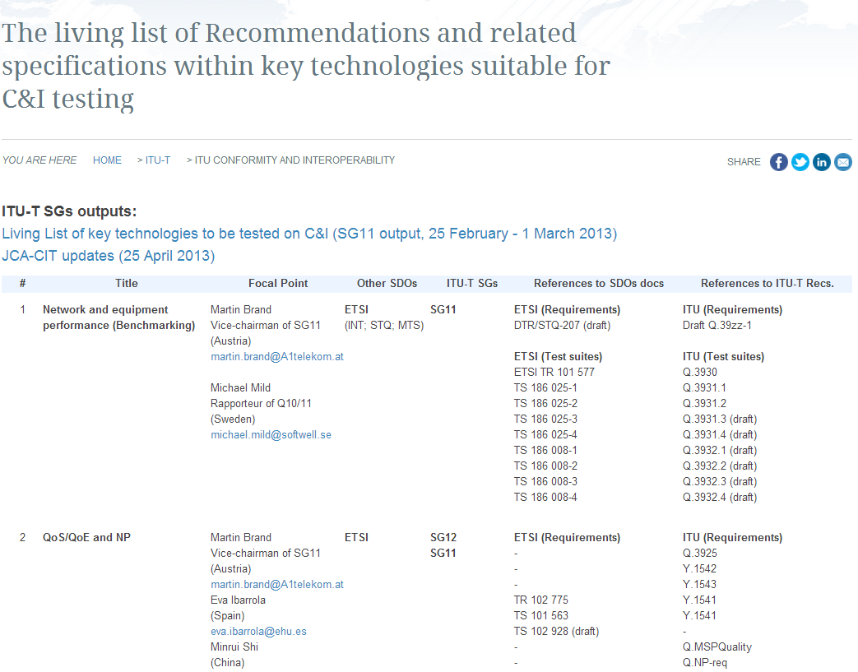
Living lists on the ITU-T C&I Portal (1/3)
http://itu.int/go/key-technologies

Slide 33
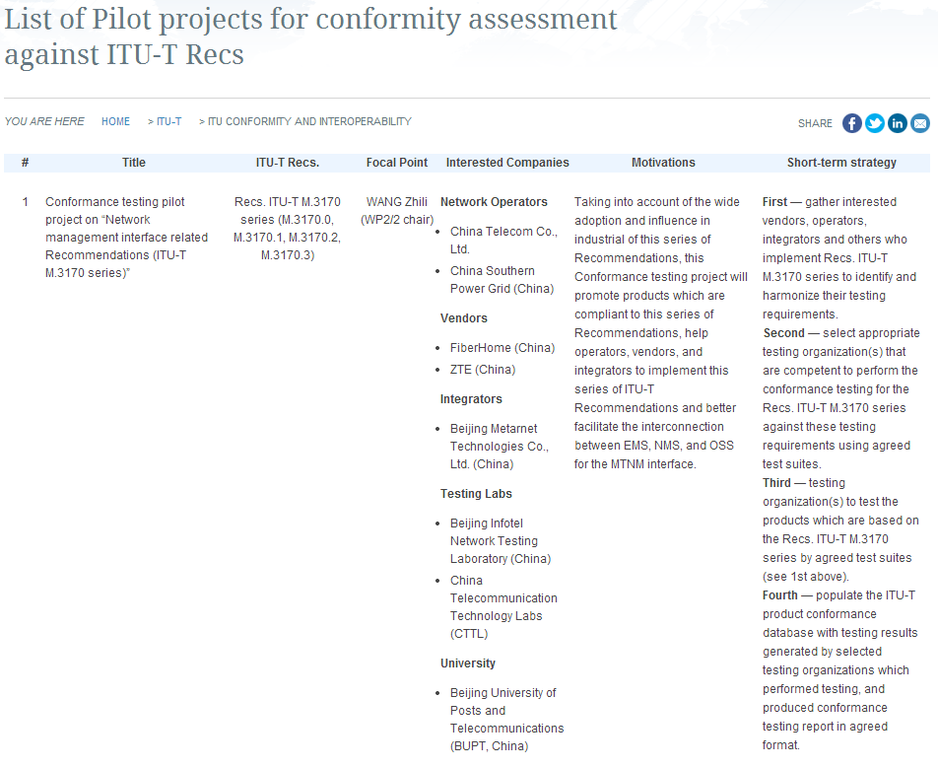
Living lists on the ITU-T C&I Portal (2/3)
http://www.itu.int/go/pilot-projects

Slide 34
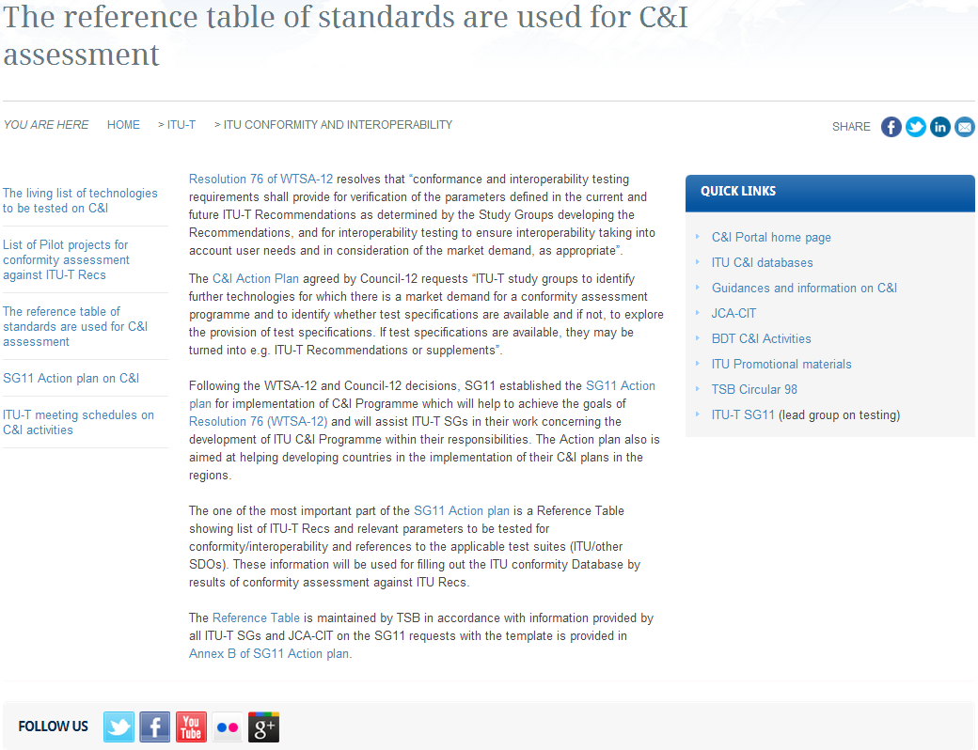
Living lists on the ITU-T C&I Portal (3/3)
http://itu.int/go/reference-table

