Slide 1
Overview of
Question 17/5
“Energy efficiency for the ICT sector and harmonization of environmental standards”
and
Question 13/5
“Environmental impact reduction including e-waste”
Paolo Gemma
Chairman of Working Party 3, ITU-T Study Group 5

Slide 2
Working Party 3 (WP3/5)
ICT and climate change
Work areas:
Q13/5 - Environmental impact reduction including e-waste
Q14/5 - Setting up a low cost sustainable telecommunication infrastructure for rural communications in developing countries
Q15/5 - ICTs and adaptation to the effects of climate change
Q16/5 - Leveraging and enhancing the ICT Environmental sustainability
Q17/5 - Energy efficiency for the ICT sector and harmonization of environmental standards
Q18/5 - Methodologies for the assessment of environmental impact of ICT
Q19/5 - Power feeding systems
Notes:
WP3/5 is responsible for studies relating to ICT, environment and climate change, development of methodologies for evaluating the ICT effects on climate change and publishing guidelines for using ICTs in an eco-friendly way.

Slide 3
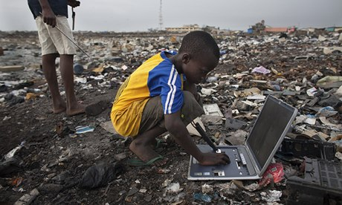
Facts about e-waste worldwide
There were 2.37 million tons of electronics discarded in 2013 - about 7kg for every person on the planet
Only 8% of old cell phones are recycled properly
Only 12.5% of e-waste is recycled
Recycling one million laptops saves enough energy to power 3,600 homes
Notes:
3

Slide 4
Question 13/5
Environmental impact reduction including e-waste
Main study area:
ensure the safety and environmental performance associated with ICT products, equipment and facilities, including the avoidance of hazardous materials and final disposal through standards
ensure that the ICT products, equipment and facilities cause minimum environmental and health impact
minimize the effect on the environment of existing and new products under development and especially the resulting e-waste
mitigate e-waste and reduce negative environmental and health impact like potential GHG emissions from uncontrolled handling through proper and environmentally responsible recycling

Slide 5
Question 13/5
Environmental impact reduction including e-waste
Main Tasks:
Develop Recommendations in the in the field of e-waste mitigation/minimization
Motivate ITU members to share their national experiences and spread the collected knowledge related to environmental and sustainability aspects of laws or directives
Determine processes to minimize the environmental (including health) impact of products (materials, hazardous materials avoidance), manufacturing processes, operational procedures and disposal;
Notes:
5

Slide 6
Deliverables under study
E-waste
Rare metal
A printing label format to provide rare metals information of ICT goods
Implementation guidelines for ICT supply chains due diligence on conflict minerals
Due Diligence Guidelines for Conflict Metals (Supply Title: Technical guidelines towards exercising due diligence when handling conflict minerals)
Technical report on life-cycle management of ICT equipment
Implementation guide on e-waste management
Supplement on Best practices on e-waste management in developing countries including information on country success stories
Test suites for assessment of the External universal power adapter solutions for stationary/portable information and communication technology device
Due diligence
Contributions are welcomed!
Take part of our discussion
Notes:
6

Slide 7
Highlights on deliverables
Power supply series
Recommendation ITU-T L.1000: Universal power adapter and charger solution for mobile terminals and other hand-held ICT devices:
Saves 82,000 tons of e-waste per year
Saves at least 13.6 MtCO₂ emissions annually
Recommendation ITU-T L.1001: External universal power adapter solutions for stationary information and communication technology devices:
Saves 300,000 tons of e-waste per year
Reduces the energy consumption and GHG emissions of external power supplies by between 25% and 50%
Recommendation ITU-T L.1002​: External universal power adapter solutions for portable information and communication technology devices:
Reduces e-waste, optimizing the use of scarce and raw materials and allowing for reuse
Recommends design for MTBF 50.000 hours of active use
Increases usability
Recommendation ITU-T ​L.1005​: Test suites for assessment of the universal charger solution:
Describes specific test suites applicable to the universal charger solution defined in ITU-T L.1000 (assesses energy efficiency, interworking, safety and EMC)
Notes:
MTBF: Mean Time Between Failure
ITU-T L.1000 provides high level requirements for a universal power adapter and charger solution that will reduce the number of power adapters and chargers produced and recycled by widening their application to more devices and increasing their lifetime. The solution also aims to reduce energy consumption. The longer life cycle and possibility of avoiding device duplication reduces the demand on raw materials and waste. The universal power adapter and charger solution is designed to serve the vast majority of mobile terminals and other ICT devices.
- “Universal power adapter and charger solution for mobile terminals and other ICT hand held devices” (Recommendation ITU-T L.1000)
- Saves 82,000 tons of e-waste per year
- Saves at least 13.6 million tonnes of CO2 emissions annually
ITU-T L.1001 provides requirements for a universal power adapter solution (UPA) for stationary ICT devices that will reduce the number of produced power adapters by widening their application to more devices, enabling their reuse and increasing their lifetime. The solution also aims to reduce energy consumption. The longer life cycle and possibility of avoiding device duplication reduces the demand on raw materials and production of huge e-waste amount. The universal power adapter solution for ICT equipment for stationary use is designed to serve the vast majority of ICT devices.
- Consented on 12 October 2012 - NEW - “External universal power adapter solutions for ICT equipment for stationary use” (Recommendation ITU-T L.1001)
- Saves 300,000 tonnes of e-waste annually
- Reduces the energy consumption and greenhouse gas (GHG) emissions of external power supplies by between 25% and 50%
7

Slide 8
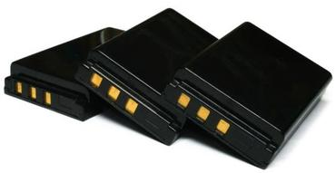
Highlights on deliverables
Batteries
Recommendation ITU-T L.1010​: Green batteries solution for mobile phones and other hand-held information and communication technology devices. ​
Extends the lifetime of handsets
Reduces global resources consumption
Eliminates toxic materials
Notes:
8

Slide 9
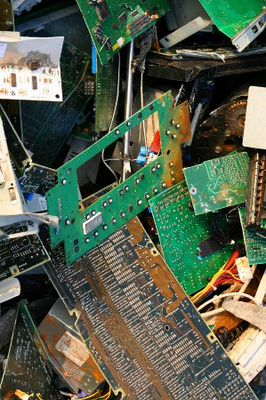
Highlights on deliverables
E-waste management
Necessity of rare-metal recycling:
A mobile phone contains no less than 20 rare metals
A ton of gold ore yields just 5 g of gold, whereas a ton of used mobile phones yields a staggering 400 g
Recommendation ITU-T L.1100: A method to provide recycling information of rare metals in ICT products
Necessity of a common and accurate measurement method:
For successful recycling, producers are required to provide detailed information on rare metals to recyclers.
A common measurement method can facilitate recycling information exchanges between producers and recyclers
Recommendation ITU-T L.1101: ​Measurement methods to characterize rare metals in information and communication technology goods:
XRF (X-ray fluorescence)
ICP-MS (inductively coupled plasma mass spectrometry
Notes:
ITU-T L.1100 outlines key considerations in all phases of the recycling process, and provides guidelines as to how organizations may fairly and transparently report on rare-metal recycling.
ITU-T L.1101 presents measurement methods to characterize rare metals in ICT goods. To achieve successful recycling systems, the rare metals information provided by manufacturers should be accurate.
For successful recycling, producers are required to provide detailed information on rare metals to recyclers. The provided information should be accurate for effective recycling. However, many measurement and characterization methods may be used to obtain this information on elements (rare metals). Moreover, each method has its intrinsic advantages and disadvantages for the analysis of these elements. Element separation abilities and quantitative resolutions are divergent in different measurement methods. A common measurement method can facilitate recycling information exchanges between producers and recyclers.
Based on the guidelines of IEC 62321, this Recommendation provides reference characterization procedures for efficient recycling of rare metals by using XRF (X-ray fluorescence) and ICP-MS (inductively coupled plasma mass spectrometry) measurement methods.
9

Slide 10
Energy is not inexhaustible, as natural resources are not infinite
We need to transform our daily behavior, envisioning ambitious goals for a sustainable future
Change is possible, but can’t wait… … we need to act right now!
Photo credit: leadchangegroup.com

Slide 11
Question 17/5
Energy efficiency for the ICT sector and harmonization of environmental standards
Main study area:
Definition of measurement methods, metrics/KPI and reference values for different technologies
Sharing of best practices for ICT’s energy efficiency enhancements
Analysis of the most energy efficient architectures and solutions in support of smart grids
Complement and harmonize ICT and environmental standards developed by other ITU Study Groups and Standardization Bodies
Notes:
11

Slide 12
Question 17/5
Energy efficiency for the ICT sector and harmonization of environmental standards
Main Tasks:
Develop Recommendations in the in the field of energy efficiency
Develop best practices and best reference cases
Provide and maintain an overview of key mitigation technologies
Coordinate with other ITU Study Groups and other bodies on a regular basis to ensure closest alignment

Slide 13
Deliverables under study
Work in progress
L.assDC - Assessment of energy efficiency on infrastructure in data center and telecom center
L.DC minimum set - Minimum data set and communication interface requirements for Data Center energy management
L.M&M_Networks - Energy efficiency measurement and metrics for telecommunication network
L.NET_Infra_assessment - Total network infrastructure Energy efficiency metrics
L.RBS_assesment - Energy efficiency metrics of mobile station cell site and best practice for energy saving
New work items
Assessment of energy consumption of telecommunication services
Reference operational model and interface for improving energy efficiency of ICT network devices
Analysis of the energy efficiency of telecommunication services used for the needs of smart grid applications
Standardization terms and trends in energy efficiency
Contributions are welcomed!
Take part of our discussion
Notes:
Work in Progress
L.assDC “Assessment of energy efficiency on infrastructure in data center and telecom center”. This Recommendation will define an assessment methodology of data center and telecommunication room infrastructure energy efficiency considering running conditions. The infrastructure will include an assessment methodology of whole Data center/ Telecom center infrastructure (or facility) efficiency, cooling system efficiency, power system efficiency, etc. It is expected to be consented in 2014
L.DC minimum set “Minimum data set and communication interface requirements for Data Center energy management”. This Recommendation will establish a minimum data set necessary to manage in environmentally conscious data centers and telecom centers. Moreover, it will define high-level interface requirements of ICT and facility equipment communication that contribute to energy saving and energy management. It is expected to be consented in 2014
L.M&M_Networks “Energy efficiency measurement and metrics for telecommunication network”. This Recommendation is jointly developed with ETSI EE and is aimed to define the topology and level of analysis to assess the mobile network energy efficiency (expressed as bit/Wh or m²/Wh), including radio base stations, backhauling systems, radio controllers and other infrastructure radio site equipment. The covered technology are GSM, UMTS, LTE (including LTE-A). Networks could be defined by geographic boundaries, such as city-wide, national or continental networks and could be defined by demographic boundaries, such as urban or rural networks. It is expected to be consented in 2014
L.NET_Infra_assessment “Total network infrastructure Energy efficiency metrics”. This Recommendation will specify principles and concepts of energy efficiency metrics and measurement methods to evaluate the energy efficiency of a total network consisting of telecommunication equipment and infrastructure equipment. The Recommendation will develop also methodology to consider the influence on total energy consumption of the maintenance activity establishing methodologies to consider the energy necessary for the transport activities embedded in the maintenance phase. It is expected to be consented in 2015
L.RBS_assesment “Energy efficiency metrics of mobile station cell site and best practice for energy saving”. This Recommendation report will energy efficiency metrics, test procedures, methodologies and measurement methods required to evaluate the energy efficiency of a mobile station cell site including the energy consumption for: equipment, infrastructure (including cooling and monitoring systems, lighting etc) and energy losses due to AC/DC rectifiers and cable losses. It will also contains the best practices for energy saving of the mobile station cell site. It is expected to be consented in 2015
Approved new Work Items
Assessment of Energy Consumption of Telecommunication Services. This new Recommendation will describe a methodology to assess the energy consumption of Telecommunication services. In particular the document is intending to define metrics and measurement methods for assessing (and measuring) the energy consumed by services. The output data obtained using this Recommendation can be used as input data for the methodologies developed in ITU-T Recommendation L.1410.
Reference operational model and interface for improving energy efficiency of ICT network devices. This new Recommendation will specify reference operational models for improving energy efficiency of networks including both wireline and wireless devices, both network and user side. Such reference model would help to reduce the network energy consumption, e.g. through entering energy saving sleep mode, implementing energy aware/proportional operation or traffic routing in order to reduce the number of active nodes
Analysis of the Energy Efficiency of Telecommunication Services used for the needs of Smart Grid applications. This new Supplement will be focused on the analysis of the energy consumption of different network technologies and architectures in support of the Smart grid (SG) and the identification of opportunities to improve the energy efficiency of SG, while matching the Service Levels required by the SG applications
Standardization terms and trends in energy efficiency. This new framework Recommendation will provide general requirements such as definitions of common understanding of terms, clarification of energy efficiency definition for different types of technologies (e.g. equipment/site/network/service level). It will refer to existing ITU-T Recommendations as well as other SDO’s deliverables

Slide 14
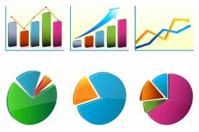
Highlights on deliverables
Recommendation ITU-T L.1300rev - Best practices for green data centers
Recommendation ITU-T L.1310rev - Energy efficiency metrics and measurement for TLC equipment
Recommendation ITU-T L.1320 - Energy efficiency metrics and measurement for power and cooling equipment for telecommunications and data centres
Recommendation ITU-T L.1340 - Informative values on the energy efficiency of telecommunication equipment
Notes:
Recommendation ITU-T L.1300rev “Best practices for green data centres”. This Recommendation provides a set of updated rules/best practices to be referred to when undertaking improvement of existing data centres, or when planning, designing or constructing new ones. More precisely, the following main areas are taken into account: ICT equipment and services; cooling and power equipment; data centre building and monitoring.
Recommendation ITU-T L.1310rev “Energy efficiency metrics and measurement for telecommunication equipment”. This Recommendation contains the definition of energy efficiency metrics test procedures, methodologies and measurement profiles required to assess the energy efficiency of different telecommunication equipment (DSLAM, MSAN, wireless, routers, Ethernet switches…), including now also Converged Packet Optical Equipment with packet signal, TDM signal and WDM signal functions.
Recommendation ITU-T L.1320 “Energy efficiency metrics and measurement for power and cooling equipment for telecommunications and data centres”. Recommendation ITU-T L.1320 contains the general definition of metrics, test procedures, methodologies and measurement profiles required to assess the energy efficiency of power and cooling equipment for telecommunications and data centres. Metrics and measurement methods are defined for power equipment, alternating current (AC) power feeding equipment (such as AC uninterruptible power supply (UPS), direct current (DC/AC) inverters), DC power feeding equipment (such as AC/DC rectifiers, DC/DC converters), solar equipment, wind turbine equipment and fuel cell equipment. In addition, metrics and measurement methods are defined for cooling equipment such as air conditioning equipment, outdoor air cooling equipment and heat exchanging cooling equipment.
Recommendation ITU-T L.1340 “Informative values on the energy efficiency of telecommunication equipment”. This Recommendation provides informative values on the energy efficiency of different types of telecommunication network equipment and small networking equipment in use in both the fixed and mobile networks. These values are related to energy efficiency metrics, test procedures, methodologies and measurement profiles that have been defined in Recommendation ITU-T L.1310. These informative values are intended to be a valued reference resource for those in the process of choosing the most energy-efficient technologies for network upgrade and deployment and, in so doing, reducing the carbon footprint of the Information and Communication Technology (ICT) sector.

Slide 15
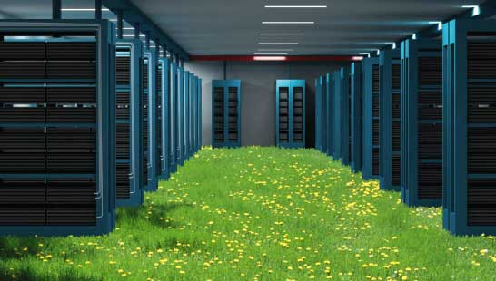
Highlights on deliverables
ITU-T L.1300rev Best practices for green data centres
For example, applying best practices to cooling could reduce the energy consumption of a typical data centre by more than 50%.
Best practices related to optimum design and construction
Efficient use and management of data centres, taking into account both power and cooling equipment
Notes:
Recommendation ITU-T L.1300 describes best practices aimed at reducing the negative impact of data centres on the climate. It is commonly recognized that data centres will have an ever-increasing impact on the environment in the future. The application of the best practices defined in this Recommendation can help owners and managers to build future data centres, or improve existing ones, to operate in an environmentally responsible manner. Such considerations will strongly contribute to a reduction in the impact of the information and communication technology (ICT) sector on climate change.
The application of the best practices defined in this Recommendation can therefore help owners and managers to build future data centres, or improve existing ones, to operate in an environmentally responsible manner.
For example, applying best practices to cooling could reduce the energy consumption of a typical data centre by more than 50 per cent.

Slide 16
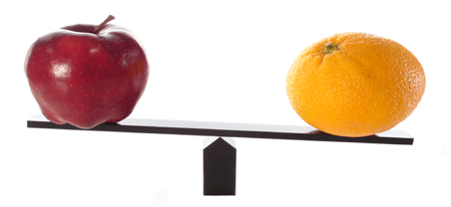
Highlights on deliverables
ITU-T L.1310rev
Energy efficiency metrics and measurement methods for telecommunication equipment
Metrics and measurement methods defined for broadband wireline/wireless equipment and small networking devices
These metrics allow for comparisons of equipment within the same class (e.g. equipment using the same technologies)
Notes:
Recommendation ITU-T L.1310 contains the definition of energy efficiency metrics test procedures, methodologies and measurement profiles required to assess the energy efficiency of telecommunication equipment.
Metrics and measurement methods are defined for telecommunication network equipment and small networking equipment.
These metrics allow for comparisons of equipment within the same class e.g. equipment using the same technologies.
Comparisons of equipment in different classes are out of the scope of this Recommendation.
Benefits:
Understand the evolution of network in term of efficiency
Compare different solution of the same technologies

Slide 17
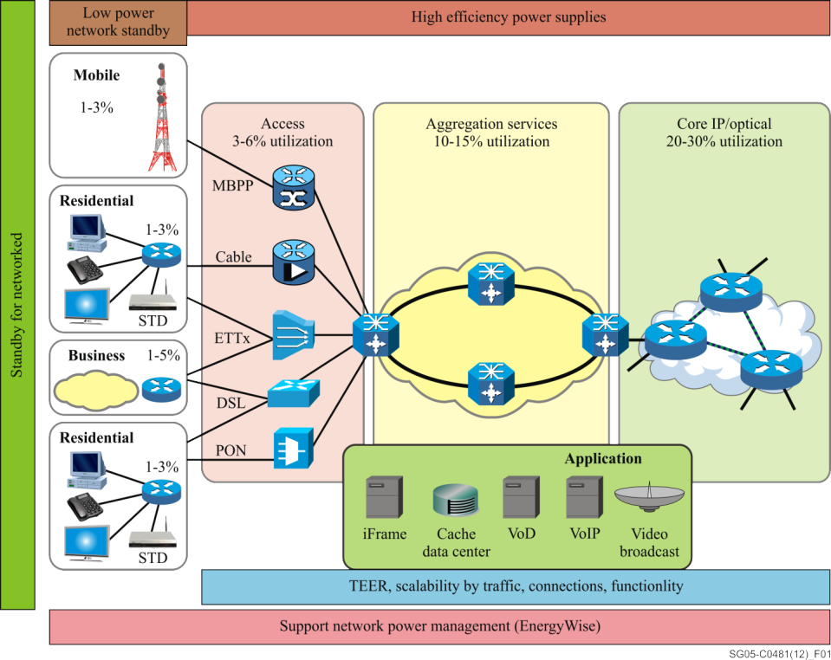
Highlights on deliverables
Supplement on energy efficiency for telecommunication equipment
This Supplement reviews the concepts for EE in application to networking devices
It presents a concept of place in a network as a base for classification, describes a process for creating a single metric for EE which reflects the qualities of equipment scalability with traffic levels and provides testing topologies and traffic pattern descriptions
Network functionality, measure energy usage, network architecture and components are analyzed
Power measurement conditions, positions in the network and energy efficiency are discussed
Notes:
Supplement on energy efficiency for telecommunication equipment reviews the concepts for energy efficiency in application to networking devices; it presents a concept of place in a network as a base for classification, describes a process for creating a single metric for energy efficiency which reflects the qualities of equipment scalability with traffic levels and provides testing topologies and traffic pattern descriptions.
Network functionality, measure energy usage, network architecture and components are analyzed
Power measurement conditions, positions in the network and energy efficiency are discussed in the supplement

Slide 18
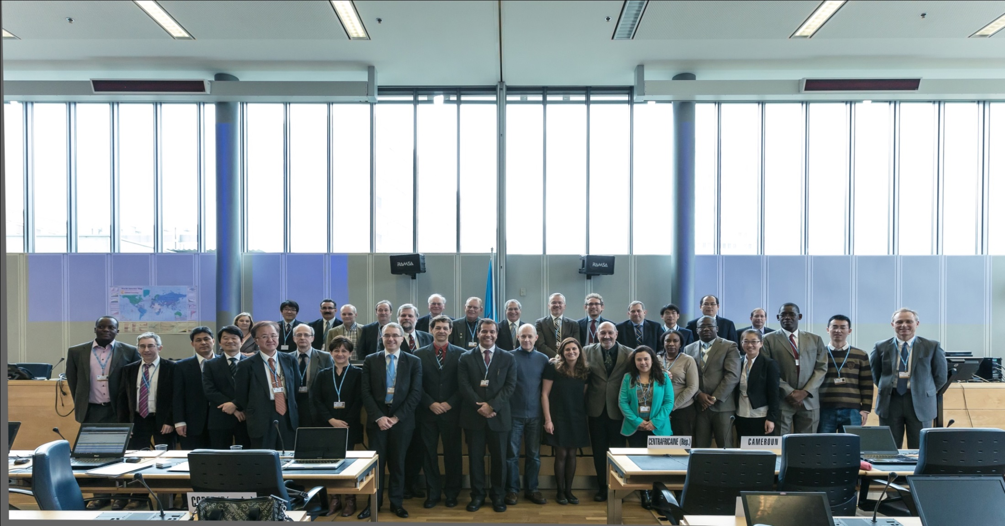
Additional information
ITU-T/SG5 “Environment & Climate Change” itu.int/go/tsg5
ITU-T and Climate Change itu.int/go/ITU-T/climate
THANK YOU! tsbsg5@itu.int

