Slide 1
Shaping
Smart Sustainable Cities
Cristina Bueti
Adviser, ITU

Slide 2
What is ITU doing to shape Smart Sustainable Cities?
ITU-T Study Group 5 “Environment and Climate Change”
Focus Group on Smart Sustainable Cities
Raising awareness and building partnerships
Research and development
Notes:
ITU has taken a leadership position to bring the multitude of technologies that target urban problems into the forefront. ITU is working on standards for a multitude of technologies that can target urban problems, including intelligent transport that can be applied to make city streets safer and cleaner; smart water and smart grid to create greater efficiency in these vital utilities; faster broadband technologies to ensure equitable access; cloud computing that offers to power many future applications.
To address the specific issue we have established a new Focus Group on Smart Sustainable Cities to assess the standardization requirements of cities aiming to boost their social, economic and environmental sustainability through the integration of ICTs in their infrastructures and operations.
FG SSC is trying to respond to key unsolved questions such as: what do we mean by smart sustainable city? what are the key performance indicators (KPIs) to gauge the success of smart city ICT deployments? Who are the key stakeholders in developing smart sustainable cities (SSC)? To what extend should we consider a city ‘sustainable’?
Essentially, how should we standardize the development of SSC? Where do we find a set of standards that acts as the foundation of SSC development which cities around the globe could develop upon?
This “Focus Group on Smart and Sustainable Cities” contributes to leverage the role of the ICT sector to foster the growth of smart and sustainable cities worldwide.
2

Slide 3
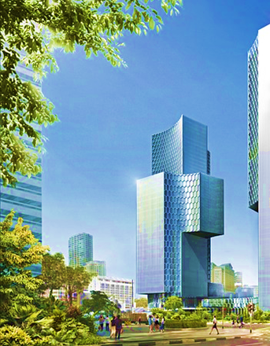
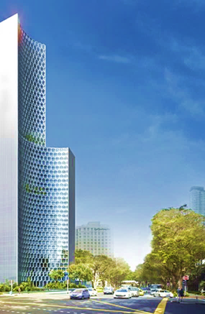
The city we want
Secure
Sustainable
Creative
Innovative
Smart
Comfortable
Inclusive
Digital
Clean

Slide 4
Focus Group on Smart Sustainable Cities (FG SSC)
Established at ITU-T Study Group 5 meeting in Geneva in February 2013.
Mandate: Extented to May 2015.
As an open platform for smart-city stakeholders to exchange knowledge in the interests of identifying the standardized frameworks needed to support the integration of ICT services in smart cities.
Participation is open to all.
Notes:
ITU has taken a leadership position to bring the multitude of technologies that target urban problems into the forefront. ITU is working on standards for a multitude of technologies that can target urban problems, including intelligent transport that can be applied to make city streets safer and cleaner; smart water and smart grid to create greater efficiency in these vital utilities; faster broadband technologies to ensure equitable access; cloud computing that offers to power many future applications.
To address the specific issue we have established a new Focus Group on Smart Sustainable Cities to assess the standardization requirements of cities aiming to boost their social, economic and environmental sustainability through the integration of ICTs in their infrastructures and operations.
FG SSC is trying to respond to key unsolved questions such as: what do we mean by smart sustainable city? what are the key performance indicators (KPIs) to gauge the success of smart city ICT deployments? Who are the key stakeholders in developing smart sustainable cities (SSC)? To what extend should we consider a city ‘sustainable’?
Essentially, how should we standardize the development of SSC? Where do we find a set of standards that acts as the foundation of SSC development which cities around the globe could develop upon?
This “Focus Group on Smart and Sustainable Cities” contributes to leverage the role of the ICT sector to foster the growth of smart and sustainable cities worldwide.
4

Slide 5
Management Team
Chairman:
Silvia Guzman
Vice-chairmen:
Flavio Cucchietti, Telecom Italia
Pablo Bilbao, Federation Argentina de Municipios, Argentina
Franz Zichy, USA ​
Nasser Saleh Al Marzouqi, UAE​
Ziqin Sang, Fiberhome Technologies Group
Sekhar Kondepudi, National University of Singapore
Secretariat:
Cristina Bueti, Adviser, ITU

Slide 6
Terms of Reference: Main Tasks and Deliverables
Main tasks and deliverables:
Defining the role of ICTs in environmentally sustainable smart cities, and identifying the ICT systems necessary to their development;
Identifying or developing a set of Key Performance Indicators (KPIs) to gauge the success of smart-city ICT deployments;
Establishing relationships and liaison mechanisms with other bodies engaged in smart-city studies and development;
Identifying future smart-city standardization projects to be undertaken by its parent group, ITU-T Study Group 5;
Developing a roadmap for the ICT sector’s contribution to Smart Sustainable Cities, providing cohesion to the development and application of technologies and standards.
Notes:
The FG–SSC will to assess the standardization requirements of cities aiming to boost their social, economic and environmental sustainability through the integration of information and communication technologies (ICTs) in their infrastructures and operations.
The FG–SSC will analyze ICT solutions and projects that promote environmental sustainability in smart cities and will identify best practices which could facilitate the implementation of such solutions in cities. It will develop a standardization roadmap taking into consideration the activities currently undertaken by the various standards developing organizations (SDOs) and forums. This “Focus Group on Smart and Sustainable Cities (FG – SSC)” will leverage the role of the ICT sector to foster the growth of smart and sustainable cities worldwide.
The FG–SSC has been tasked to analyze ICT solutions and projects that promote environmental sustainability in smart cities and will identify best practices which could facilitate the implementation of such solutions in cities. It has also been tasked to develop a standardization roadmap taking into consideration the activities currently undertaken by the various standards developing organizations (SDOs) and forums.
Smart cities stakeholders are, inter alia: municipalities, academic and research institutes, non-governmental organizations (NGOs), SDOs, and ICT organizations, industry forums and consortia.
6

Slide 7
Terms of Reference: Relationships
Collaboration with:
Within SG5: Q7, Q13, Q14, Q15, Q16, Q17, Q18, and Q19, etc.;
All ITU-T Study Groups, especially SG 11, SG13, SG15, SG 16, and SG17;
Other international, regional and national SDOs, such as ISO, IEC, IEEE, CEN/CENELEC, ETSI, etc.;
Relevant entities including: municipalities, federation of municipalities, non-governmental organizations (NGOs), policy makers, industry forums and consortia, companies, academic institutions, research institutions, etc.

Slide 8
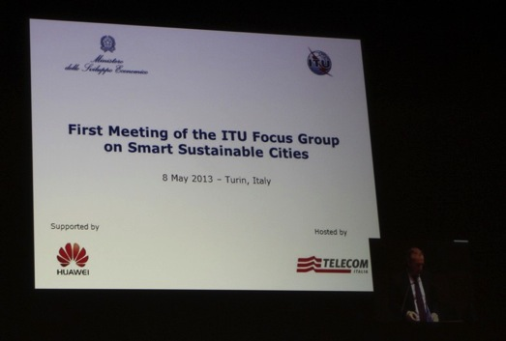
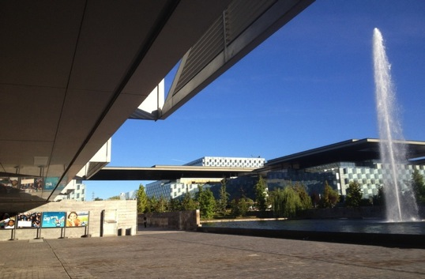
Past Meetings
1st meeting: Turin,
8 May 2013,
(Telecom Italia)
>50 participants
2nd meeting: Madrid, 17 Sept 2013,
(Telefonica)
>50 participants
Notes:
The FG-SSC held its first meeting on 8 May 2013 in Turin, Italy, where it started planning its work.
The structure and the deliverables of the FG-SSC were established.
Four working groups were created to deal with the following issues: the development of a roadmap for Smart Sustainable Cities, studies on ICT infrastructure to build Smart Sustainable Cities, studies on standardization gaps, KPIs and metrics.
The FG-SSC have already established a calendar of future meetings, which is available on the website of the FG-SSC.
During the second meeting of the FG-SSC, held in Madrid on 17 September 2013, there were fruitful discussions about there main documents that are under development. They are namely: a draft definition of Smart Sustainable Cities, a draft of Key Performance Indicators for Smart Sustainable Cities and a draft Stakeholders’ Map and City Engagement Plan.
8

Slide 9
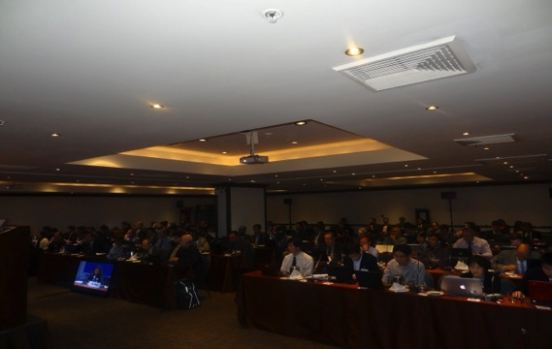
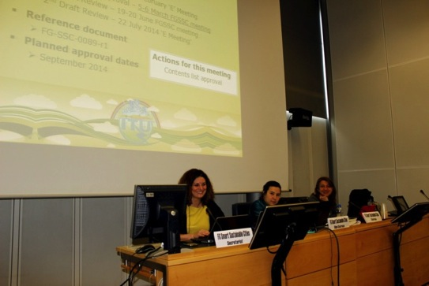
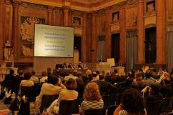
Past Meetings
3rd meeting: Lima, 6 Dec 2013,
(Gov. of Peru)
>60 participants
4th meeting: Geneva,
5-6 March 2014,
(ITU)
>30 participants
5th meeting: Genoa,
19-20 June 2014,
(City of Genoa)
>50 participants
Notes:
The FG SSC held its third meeting in Lima on 6 December 2013. The development of new deliverables was discussed and approved. Therefore, the FG SSC experts are currently drafting 6 technical reports that covers the following issues: smart buildings, smart infrastructure, smart water management, urban climate change adaptation, ICT infrastructure for security and resilience and EMF considerations in cities.
Furthermore, during all meetings, contributions received were reviewed and liaison statements to be sent to other bodies engaged in smart-city studies and development were prepared.
The FG SSC held its fourth meeting in Geneva on 5-6 March 2014.
9

Slide 10
Meeting Results
Turin, 8 May 2013 | Establishment of FG SSC structure and deliverables, 4 working groups created; Liaison statements sent to other bodies engaged in smart-city studies and development, such as ISO, IEC, IEEE, ETSI, EC DG Connect, UNECE, UNU, StEP, CEDARE, UNESCO, UN-Habitat, WMO, UNHCR, UNEP and UNFCCC.
Madrid, 17 September 2013 | Three main documents under development: Draft definition of Smart Sustainable Cities, Draft of Key Performance Indicators for Smart Sustainable Cities, Draft Stakeholders’ Map and City Engagement Plan; Liaison statements sent to other bodies engaged in smart-city studies and development.
Lima, 6 December 2013 | Creation of 6 technical groups within WG2 and appointment of the respective leaders; Progress on the three main documents under development; Extension of the FG SSC mandate; Liaison statements sent to other bodies engaged in smart-city studies and development.
Geneva, 5-6 March 2014 | Preliminary agreement on definition of SSC 14 Technical reports are being developed and a Roadmap for SSC (including technical specifications).
Genoa, 19-20 June 2014 | Preliminary agreement on definition of SSC 15 Technical reports are being developed A Roadmap for SSC (including technical specifications) that will be finalized in December 2014.
Notes:
The FG-SSC held its first meeting on 8 May 2013 in Turin, Italy, where it started planning its work.
The structure and the deliverables of the FG-SSC were established.
Four working groups were created to deal with the following issues: the development of a roadmap for Smart Sustainable Cities, studies on ICT infrastructure to build Smart Sustainable Cities, studies on standardization gaps, KPIs and metrics.
The FG-SSC have already established a calendar of future meetings, which is available on the website of the FG-SSC.
During the second meeting of the FG-SSC, held in Madrid on 17 September 2013, there were fruitful discussions about there main documents that are under development. They are namely: a draft definition of Smart Sustainable Cities, a draft of Key Performance Indicators for Smart Sustainable Cities and a draft Stakeholders’ Map and City Engagement Plan.
The FG SSC held its third meeting in Lima on 6 December 2013. The development of new deliverables was discussed and approved. Therefore, the FG SSC experts are currently drafting 6 technical reports that covers the following issues: smart buildings, smart infrastructure, smart water management, urban climate change adaptation, ICT infrastructure for security and resilience and EMF considerations in cities.
Furthermore, during all meetings, contributions received were reviewed and liaison statements to be sent to other bodies engaged in smart-city studies and development were prepared.
The FG SSC held its fourth meeting in Geneva on 5-6 March 2014.
10

Slide 11
Working Groups
1. ICT role & roadmap for Smart Sustainable Cities (SSC)
2. Smart Sustainable Cities Infrastructure
3. Standardization gaps, KPIs and metrics
4. Policy & positioning (communications, liaisons and members)

Slide 12
WG1 coordinator: Sekhar Kondepudi (National University of Singapore)
1. ICT role & roadmap for Smart Sustainable Cities (SSC)
Working Group 1
Plan and deliverables:
Technical Report on Overview of SSC and the role of ICT;
Technical Report on Definitions and Attributes of a Smart Sustainable City;
Roadmap for Smart Sustainable Cities.
Notes:
Three documents are currently under development:
Technical Report on Overview of SSC and the role of ICT - This document is a background paper on SSC and the role played by ICT
Technical Report on Definitions and Attributes of a Smart Sustainable City
Roadmap for Smart Sustainable Cities - This document will include the definition and the Technical Specifications for a Smart Sustainable City definition, attributes and a vision for SSC.
12

Slide 13
TR1/WG1 Technical Report on Overview of SSC and the Role of ICT
Highlights | Seek to provide information on the form and purpose of a smart sustainable city and the role of ICTs in its development.
Important dates | Approval to be sought at the FG SSC meeting: October 2014
Hyperlink | http://ifa.itu.int/t/fg/ssc/docs/draft_deliverables/
Working Group 1

Slide 14
TR2/WG1 Technical Report on Definitions and Attributes of a Smart Sustainable City
Highlights | Analysis of different definitions of Smart Sustainable Cities; sourced over 100 definitions and descriptors for Smart Sustainable Cities from academia, government, corporations, non-profits, SDOs etc; detailed analysis of different key words and attributes.
Important dates | Approval to be sought at the FG SSC meeting: October 2014
Hyperlink | http://ifa.itu.int/t/fg/ssc/docs/draft_deliverables/
Working Group 1

Slide 15
TR3/WG1 Roadmap for Smart Sustainable Cities
Highlights | Definition has been approved Technical Specifications for a Smart Sustainable City are being developed.
Important dates | The new document will be presented at the next FG SSC meeting: October 2014
Definition | A smart sustainable city is an innovative city that uses information and communication technologies (ICTs) and other means to improve quality of life, efficiency of urban operation and services, and competitiveness, while ensuring that it meets the needs of present and future generations with respect to economic, social and environmental aspects.
Working Group 1

Slide 16
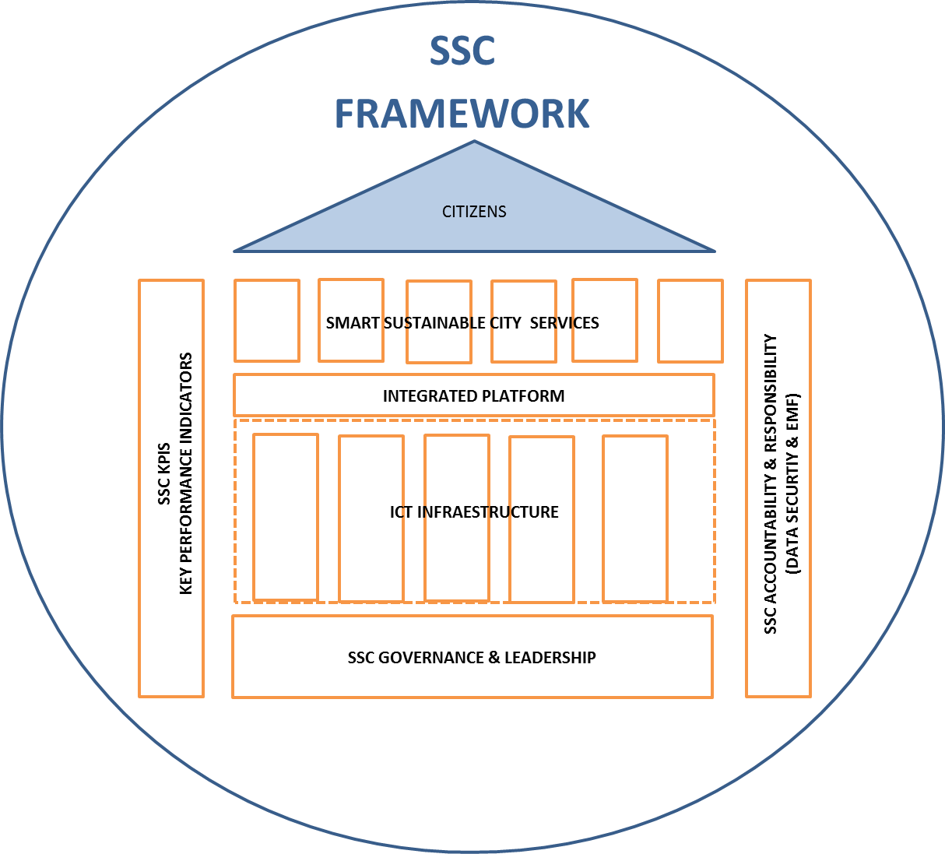
TR3/WG1 Roadmap for Smart Sustainable Cities (draft proposal)
How can cities become smarter & sustainable?
6 STEPS Decision-making based on governance & leadership ICT Infrastructure & Platforms SSC services identification SSC KPIs SSC accountability and responsibility Citizen engagement & transformation
Working Group 1

Slide 17
2. Smart Sustainable Cities Infrastructure
WG2 coordinator: Paolo Gemma (Huawei)
Working Group 2
Plan and deliverables:
Providing an overview of the use of ICT in cities;
Looking at future trends;
Identifying standardization’s need;
9 technical reports under development.
Notes:
Working Group 2:
Providing an overview of the use of ICT in cities
Looking at future trends
Identifying standardization’s need
7 technical reports under development
17

Slide 18
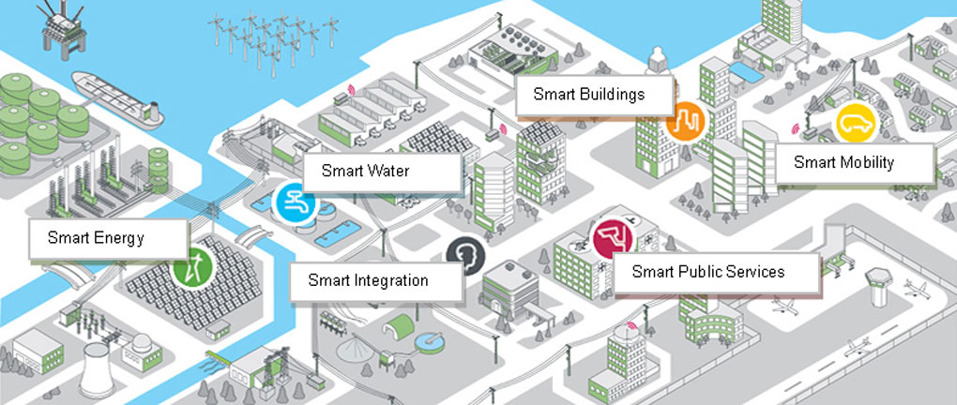
Areas of the Technical Reports
Integrated Management
Open Data
Smart Buildings
Smart Water management
Smart Infrastructure
Working Group 2
Climate Change Adaptation
Security and Resilience
EMF considerations
Energy Efficiency

Slide 19
TR1/WG2 Technical Report on Smart Water Management for Smart Sustainable Cities
Highlights | Smart Water Management (SWM) in cities seeks to alleviate challenges in the urban water management and water sector through the incorporation of Information and Communication Technologies (ICTs) products, solution and systems in areas of water management and sanitation.
Important dates | Approval to be sought at the next FG SSC meeting: October 2014
Hyperlink | http://ifa.itu.int/t/fg/ssc/docs/draft_deliverables/
Working Group 2

Slide 20
TR2/WG2 Technical Report on ICT Infrastructure for Climate Change Adaptation in cities
Highlights | Describes in general terms the impacts of climate change in cities and highlights the reasons for cities to improve their capacity to respond to the challenges posed by climate change. Further expands by identifying the role of ICTs in helping cities to adapt to climate change.
Important dates | Approval to be sought at the FG SSC meeting: October 2014
Hyperlink | http://ifa.itu.int/t/fg/ssc/docs/draft_deliverables/
Working Group 2

Slide 21
TR3/WG2 Technical Report on Cyber-Security, Data Protection & Cyber-Resilience in Smart Sustainable Cities
Highlights | Explores the requirements and challenges of creating a secure, reliable and resilient smart city. Considers how to provide innovative, resilient ‘smart’ solutions that leverage digital information while protecting against malicious violations, unintentional damage and natural disasters.
Important dates | Approval to be sought at the next FG SSC meeting: October 2014
Hyperlink | http://ifa.itu.int/t/fg/ssc/docs/draft_deliverables/
Working Group 2

Slide 22
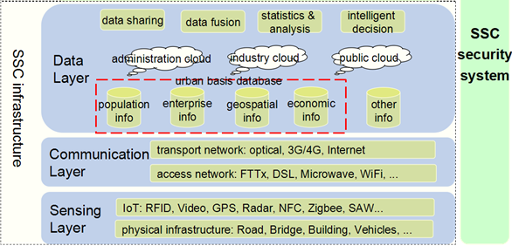
TR4/WG2 Technical Report on Smart Sustainable Cities Infrastructure
Working Group 2
Important dates | Approval to be sought at the FG SSC meeting: October 2014

Slide 23
TR5/WG2 Technical Report on Smart Sustainable Buildings for SSC
Highlights | Defines a smart / intelligent building in the context of Smart Sustainable Cities. Survey of current initiatives around building resiliency. Outline of potential resiliency protocol.
Important dates | Approval to be sought at the FG SSC meeting: October 2014
Working Group 2

Slide 24
TR6/WG2 Technical report on EMF considerations in SSC
Highlights | Introduction to SSC and importance of ICT’s and EMF considerations. Based on existing ITU and WHO technical and policy recommendations. Technical and policy requirements for EMF should be adopted nationally based on international recommendations. Cities need guidance on implementation that promotes efficient deployment. Provides a model framework as benchmark
Important dates | Approval to be sought at the FG SSC meeting: October 2014
Working Group 2

Slide 25
TR7/WG2 Technical report on Integrated management for SSC
Highlights | Access and integration of city information resources. Network Service of the model of city analysis and decision-making. Typical Applications of Comprehensive Management and Smart Decision-making.
Important dates | Approval to be sought at the FG SSC meeting: October 2014
Working Group 2

Slide 26
3. Standardization gaps, KPIs and metrics
WG3 coordinator: Ziqin Sang (Fiberhome Technologies Group)
Working Group 3
Plan and deliverables:
Technical Report on Standardization Activities and Gaps for SSC and suggestions to SG5
Technical Report on KPIs definition for smart sustainable cities
Technical Report on KPIs metrics evaluation
Notes:
Two documents are currently under development:
Technical Report on Standardization Activities and Gaps for SSC and suggestions to SG5 - This document is intended to be a standardization roadmap of SSC
Technical Report on KPIs for smart sustainable cities - This document analyzes KPIs and metrics of SSC
26

Slide 27
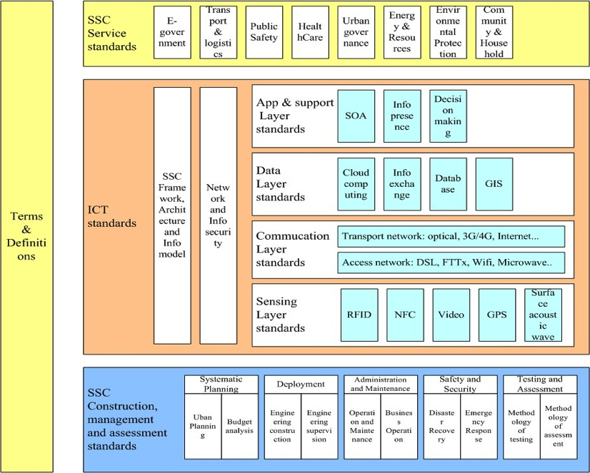
TR1/WG3 Technical Report on Standardization Activities and Gaps for SSC and suggestions to SG5
Approval to be sought at the FG SSC meeting: December 2014
Working Group 3

Slide 28
TR2/WG3 and TR3/WG3 on Key Performance Indicators for SSC
Proposed dimensions under study: | ICT Productivity Quality of Life Infrastructure development Environmental sustainability Equity and social inclusion
Taking into considerations other works on KPIs of SSC from, inter alia: | China Institute of Communications, Smart city white paper (2012) China, Ministry of Housing and Urban-Rural Development (MOHURD), Index system of pilot Smart City European smart cities, Ranking of European medium-sized cities (2007) ISO/TC268/SC1 ― Smart Community Infrastructures; Spain, IDC smart cities Index (2011) United States of America, Smart city wheel Japan, KPIs of SSC (2013).
Working Group 3
Notes:
Introduction of Draft Definition of Smart Sustainable Cities:
Description of key attributes of SSC
sourced over 80 definitions and descriptors for Smart Sustainbale Cities from academia, government, corporations, non-profits, SDOs etc.
detailed analysis of different key words and attributes
Overview of success stories of SSC
examples of smart sustainable cities worldwide (inter alia, in Europe and Asia)
Definition of a SSC
the FG SSC will develop a definition of what a SSC is
28

Slide 29
TR2/WG3 and TR3/WG3 on Key Performance Indicators for SSC
Highlights | Two documents called “Technical Report on KPIs definitions for SSC” and “Technical Report on KPIs metrics evaluation”. Assess how the use of ICTs has an impact on the sustainability of cities.
Important dates | Approval to be sought at the next FG SSC meeting: October 2014.
Working Group 3
Notes:
Introduction of Draft Definition of Smart Sustainable Cities:
Description of key attributes of SSC
sourced over 80 definitions and descriptors for Smart Sustainbale Cities from academia, government, corporations, non-profits, SDOs etc.
detailed analysis of different key words and attributes
Overview of success stories of SSC
examples of smart sustainable cities worldwide (inter alia, in Europe and Asia)
Definition of a SSC
the FG SSC will develop a definition of what a SSC is
29

Slide 30
4. Policy & positioning (communications, liaisons and members)
WG4 coordinator: Daniela Torres (Telefónica)
Working Group 4
Plan and deliverables:
Stakeholders Map including standardization bodies & non-standardization bodies
City Engagement Plan based on technical contributions of the Working Groups
Focus Group Communications
Notes:
Working Group 4:
Stakeholders Map including standardization bodies & non-standardization bodies
City Engagement Plan based on technical contributions of the Working Groups
Focus Group Communications
30

Slide 31
TR1/WG4 Technical Report on Smart Sustainable Cities Stakeholders
Highlights | Overview of Smart Sustainable Cities. Sustainability Challenges of Stakeholders in Cities. Stakeholder Identification & Roles. Recommendations to SSC Stakeholders to drive SSC.
Important dates | Approval to be sought at the next FG SSC meeting: 18 September 2014
Working Group 4
Notes:
Introduction of Draft Stakeholders’ Map and City Engagement Plan:
Proposed structure
Part 1:ICT Standards Organizations and their work on SSC
Part 2: Forums and other organizations' work on SSC
Part 3: ITU-T's work in the area of SSC
Part 4: Future needs and proposed new SSC standards roadmap
31

Slide 32
Moving forward on Smart Sustainable Cities…
Focus Group on Smart Sustainable Cities (Reading, United Kingdom, 14-16 October 2014)
Forum on Smart sustainable Cities (Reading, United Kingdom, 14-16 October 2014)
4th ITU Green Standards Week (Beijing, China, 22-26 September 2014)
Including a Forum on “Setting the vision for smart sustainable cities”(24 September 2014)
Join us!

Slide 33
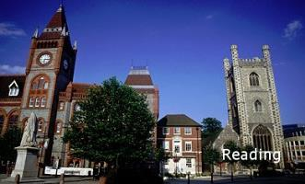
Conclusions
Need to engage new cities & other key stakeholders (such as academic and research institutes, civil society, NGOs, SDOs, and ICT organizations, industry forums and consortia) to participate and contribute.
Next Steps …
Next meeting: Reading, United Kingdom, 14-16 October 2014
Collaboration and contributions are welcomed!
Notes:
Let me conclude by saying that as our planet becomes more urban, we need to ensure that our cities become smarter and more environmentally sustainable.
We need to work together to build smart sustainable cities promoting long-term sustainability ambitions for the cities of the future and improving quality of life of our citizens.
Standards are vital to shape smart sustainable cities. We need to foster the development of international standards and policies in order to help cities become a place for opportunities for economic growth, social well-being and high quality of life.
With coordinated thinking and a collegial approach to maximizing the benefits of new technologies for the benefit of all, we can ensure that our increased migration to cities can be matched by an increase in the quality of urban environments and ultimately an increased in quality of life for all of our cities’ citizens.
ICTs can help shape the cities we dream of and make them real.
33

Slide 34
Links & Additional Information
ITU-T and Climate Change itu.int/ITU-T/climatechange
ITU Focus Group on Smart Sustainable Cities itu.int/en/ITU-T/focusgroups/ssc/
ITU Symposia & Events on ICTs and Climate Change itu.int/ITU-T/worksem/climatechange
Thank YOU
cristina.bueti@itu.int

