Slide 1
Energy Saving for Future Networks
"Future Networks: Cloud Computing, Energy Saving, Security and Virtualization"

Slide 2
Objectives and design goals for Future Networks
Environmental awareness one out of four objectives for Future
Networks recommended by Y.3001
Energy consumption/ optimization stated as design goal for
Future Networks

Slide 3
Environmental aspects of Future Networks
Green by FN
Environmental load
reduction achieved
by FN
Green FN
Environmental load
caused by FN
Positive issues:
New way of working
(communicating instead of
commuting)
Reduction of movement and
transportation
Reduction of greenhouse gas
Negative issues:
Energy consumption
Consumption of natural
resources
Generation of waste
Focus on green FN: energy saving within the networks
themselves

Slide 4


Methods for energy saving
technical
non-technical
static, dynamic methods
Regulation by law
SG13 is working on technical methods for energy
saving

Slide 5
SG13 work on green Future Networks
Y.3021 Framework of energy saving for future networks
(published)
Y.3022 Measuring energy in networks (published)
Y.energy ECN Energy efficiency class of networks
(consent planned 2015, active participation in Q16/13
welcome)

Slide 6
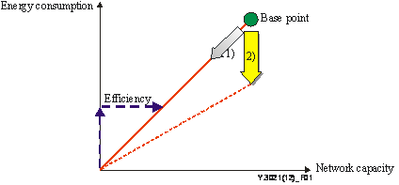
Approaches to energy saving
Reduction of required
network capacity
Improvement of energy
efficiency
Throughput of the network
bps
network energy efficiency: =
consumed power
W

Slide 7
Lifecycle stages
For reduction the analysis of energy consumption at each
stage of the lifecycle is important.
ITU-T L.1400
RAW MATERIAL Components
NW construction
NW operation
Disposal/ Recycling
Focus on NW operation stage:
energy consumption for “always-on” equipment
control of energy consumption by network architecture,
capabilities and operation

Slide 8
Considered levels for energy saving technologies
in Y.3021
Device-level
Technologies which are applied to electronic devices, such as large
scale integration (LSI) and memory.
Equipment-level
Technologies which are applied to one piece of equipment
(a set of devices) such as a router or switch.
Network-level
Technologies which are applied to equipment within the whole
network (e.g. a routing protocol applied to multiple routers).

Slide 9

Device level technologies
Higher integration, smaller chip size:
Reduction of power consumption ~ (driving voltage reduction)²
Multi-core CPU
Energy consumption ~ (clock frequency)³
Usage of lower clocked multiple CPU cores in a single processor
instead of a single high clocked CPU
Clock-gating
Reduction of power consumption by suspension of clock supply to
circuits in case of they are not busy
Digital pre-distortion
Reduction of power consumption by improve the linearity of power amplifiers PA
(cancellation of distortion by input of an inversely distortion)

Slide 10
Equipment level technologies
Optical network node
All-optical packet switching can reduce power consumption by traffic
aggregation and by the avoidance of optical to electric and
electric to optical translation
Sleep mode control
Power saving by the deactivation of components and/or functions of
e.g. a router/ switch when they are not used. The effect of energy
saving depends on traffic dynamics
Adaptive link rate (ALR) and dynamic voltage scaling (DVS)
ALR: power saving by bit rate control of the interface according to the processed traffic amount
DVS: power saving by driving voltage control of the CPU, hard disc, NIC, etc. according to the to the processed traffic amount
Thermal design
Power saving by avoidance of cooling system due to thermal design of nodes

Slide 11

Network level technologies
Burst switching
Aggregation of packets into data bursts at routers can save energy consumption ( reduction of header computation )
Energy consumption based routing
Traffic distribution into multiple routes so that each node treats the minimum traffic and makes limits link rate or driving voltage to the adequate level so that unnecessary energy can be saved, precond.: ALR/DVS (similar sleeping mode)
Transmission scheduling
Saving energy by operation with fewer buffers at the nodes: control of the amount and the timing of packet transmission
Content delivery network (CDN)
CDN save bw/ energy by access a server nearer than the original
one

Slide 12
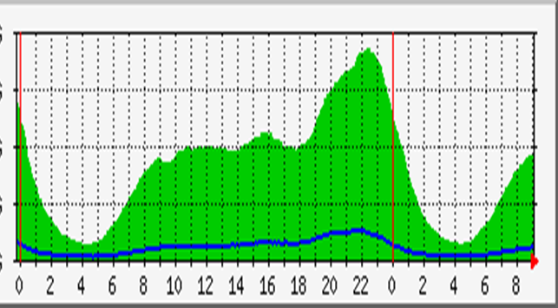
Network level technologies (cont.)
Traffic peak shifting
Reduction of power consumption by reduction of the maximum traffic to be accommodated by shifting the transmission of the traffic peak as much as possible onto the time axis (e.g. cache servers)
Source: Mobitel Data
Energy consumption-aware network planning
Inclusion of energy efficiency and the reduction of the environmental impact (e.g. energy consumption reports) in addition to performance and reliability aspects into the network planning process
Layout for less traffic

Slide 13
Problems & limitations of technologies
Examples
LSI: increased leakage current
Clock gating: too frequently transition between ON and OFF states of the clock requires additional energy
Optical network node: difficulties regarding realization on a large and practical scale
Sleep mode control: control traffic handling
ALR/ DVS: Treatment of burst traffic (quick response time, efficient frequent change)
CDN/ cache server: inefficient in case of small hit rate

Slide 14
Classification of technologies
Technology level | Reduction of capacity |  | Improvement of energy efficiency
 | Reduce traffic | Peak-shift | Dynamic control | Less power
Device |  |  | Multi-core CPU Clock gating | LSI fabrication Advanced power amplifier
Equipment | Cache server |  | Sleep mode control ALR/DVS | Optical node Thermal design
Network | CDN | Traffic peak shifting | Routing/traffic engineering Energy-aware network planning (dynamic) | Circuit/burst switching Light protocol Transmission scheduling Energy-aware network planning (static)

Slide 15
Calculation of network energy consumption
(on/off/sleep)
Network energy profile: Energy consumption of network elements
versus offered traffic load (for each interface, node and server)

Slide 16

Calculation of network energy consumption (cont.)
For further details see alsoc Y.3022
node,i : in case of a switch
node,i : in case of a router

Slide 17
Impacts of energy saving technologies
Impacts on network performance
Introduction of energy-saving technologies may alter the network performance
- increased delays,
- congestion,
- connection hang-ups (e.g. in case of too long status transition time)
Impacts on service provisioning
Mitigation of increased energy consumption because of new service provision
Energy-saving technologies have to be realized as the
trade-off between energy saving and performance degradation

Slide 18

Ongoing work and future studies
Y.energyECN draft recommendation on “Energy efficiency class of networks”: continues work of Y.3022 by the determination of energy efficiency classes that allow to compare networks by their energy consumption
Mandatory & options technologies for network energy saving
Overcome (at least to some extend) problems and difficulties implied in current technologies for network energy saving
Active participation in work very welcome
For further information do no hesitate to ask
Mr. Gyu Myoung Lee, Rapporteur Q.11,16/13, gmlee@kaist.ac.kr
Mr. Leo Lehmann, WP3/13 Co-chairman, Leo.Lehmann@bakom.admin.ch

