Slide 1

Standardization activities in ITU-T SG15 related to energy efficiency
Hiroshi OTA
ITU/TSB

Slide 2


ITU consists of three sectors and General Secretariat
ITU-T
develops ICT standards
ITU-R
manages radio spectrum and satellite orbits
ITU-D promotes ICT development
General Secretariat coordinates work of ITU

Slide 3
ITU-T Study Groups (SGs)
SG2: Operational aspects of service provision and telecommunications management
SG3: Tariff and accounting principles including related telecommunication economic and policy issues
SG5: Environment and climate change
SG9: Television and sound transmission and integrated broadband cable networks
SG11: Signalling requirements, protocols and test specifications
SG12: Performance, QoS and QoE
SG13: Future networks including cloud computing, mobile and next-generation networks
SG15: Networks, technologies and infrastructures for transport, access and home
SG16: Multimedia coding, systems and applications
SG17: Security
TSAG: Telecommunication Standardization Advisory Group

Slide 4
SG15: Networks, Technologies and Infrastructures for Transport, Access and Home
Optical transport networks and access network infrastructures
Optical and other infrastructures, systems, equipment, fibres, control plane technologies
Customer premises, access, metropolitan and long haul
Lead SG for:
  access network transport
  optical technology
  optical transport networks
  smart grid
Details are at http://www.itu.int/en/ITU-T/studygroups/2013-2016/15

Slide 5
SG15 Working Parties
WP1/15: Transport aspects of access networks and home networking
WP2/15: Optical access/transport network technologies and physical infrastructures
WP3/15: Transport network structures

Slide 6
Questions under SG15
Q1:Coordination of access and Home Network Transport standards
Q2: Optical systems for fibre access networks
Q3: General characteristics of transport networks
Q4: Broadband access over metallic conductors
Q5: Characteristics and test methods of optical fibres and cables
Q6: Characteristics of optical systems for terrestrial transport networks
Q7: Characteristics of optical components and subsystems
Q8: Characteristics of optical fibre submarine cable systems
Q9: Transport network protection/restoration
Q10: Interfaces, Interworking, OAM and Equipment specifications for Packet based Transport Networks
Q11: Signal structures, interfaces, equipment functions, and interworking for transport networks
Q12: Transport network architectures
Q13: Network synchronization and time distribution performance
Q14: Management and control of transport systems and equipment
Q15: Communications for Smart Grid
Q16: Outside plant and related indoor installation
Q17: Maintenance and operation of optical fibre cable networks
Q18: Broadband in-premises networking

Slide 7
Energy efficiency by SG15
For other sectors
  Smart grid
  Broadband transport for application for energy efficiency (e.g., teleconference)
For telecommunication networks
  Power saving for broadband access
  Power saving for home networking
  Improved efficiency by broadband transport

Slide 8
Smart grid

Slide 9
Smart Grid: definition
The "Smart Grid" is a two way electric power delivery network connected to an information and control network through sensors and control devices. This supports the intelligent and efficient optimization of the power network.
(Terminology deliverable from the ITU-T Focus Group on Smart Grid)

Slide 10
Smart Grid Overview - A conceptual model
Source: National Institute of Standards and Technology (NIST)

Slide 11
Smart Grid benefit: cut peak load
Through AMI (Advanced Metering Infrastructure) – two way communication
Demand/response: cut energy use during times of peak demand
Dynamic pricing: encourages to reduce power consumption voluntarily during peak period

Slide 12
Smart Grid benefit: Integrating renewable energy
Renewable energy sources (wind, solar ...) are not stable
  makes integration with conventional power grid difficult
Smart Grid:
  Wide-Area Situational Awareness
Electric vehicles-to-grid (load and electric storage)

Slide 13
Role of ICT in Smart Grid
The fundamental challenge in power grids is to ensure the balance of generation and demand/consumption
The fundamental challenge in the Smart Grid is to ensure balance of generation and demand/consumption when integrating all those new technologies that are aimed at addressing in a sustainable manner energy independence and modernization of the aging power grid:
  Utility scale Renewable Energy Sources (RES) feeding into the transmission system
  Distributed Energy Resources (DER) feeding into the distribution system
  Plug-in (Hybrid) Electric Vehicles (PHEV)
  Demand Side Management (DSM)
  Consumer participation
  Storage to compensate for the time varying nature of some renewables
Source: S. Galli, A. Scaglione, Z. Wang, “For the Grid and Through the Grid: The Role of Power Line Communications in the Smart Grid,” Proceedings of the IEEE, June 2011.

Slide 14
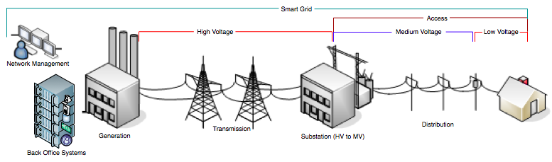
Smart Grid Communication
  ITU-T G.9901 (04/2014): Narrow-band OFDM power line communication transceivers - Power spectral density (PSD) specification.
  ITU-T G.9902 (G.hnem) (10/2012): Narrow-band OFDM power line communication transceivers – G.hnem Cenelec A, B, CD, and FCC.
  ITU-T G.9903 (G3-PLC) (02/2014): Narrow-band OFDM power line communication transceivers – G3-PLC Cenelec A, B, FCC and ARIB bandplan.
  ITU-T G.9904 (PRIME) (10/2012): Narrow-band OFDM power line communication transceivers – PRIME Cenelec A.
  ITU-T G.9905 (08/2013): Centralized metric-based source routing

Slide 15
Mitigation of climate change and improving energy efficiency
Report: “Boosting Energy Efficiency Through Smart Grids”
Details are at http://www.itu.int/ITU-T/climatechange/report-smartgrids.html
This report discusses the role of ICT in the smart grid with a view of energy efficiency, with the ultimate goal of hindering climate changes.

Slide 16
Power saving for broadband access

Slide 17
Power saving for broadband access
DSL, optical transport (FTTH) and G.fast are used for broadband access
Power consumption increases as bit rate increases
Full capacity is not always needed
Large amount of energy saving is expected since the number of installed equipment is huge
Power saving for ADSL and G.fast
Power saving methods for FTTH were also discussed

Slide 18
G.fast - What is FTTdp ?
A broadband access solution taking fibre to a distribution point (FTTdp) very close to the customers premises, with total wire length to the customers’ transceiver up to 250m.
  It is expected that the bulk of the loop lengths may be in the order 30 to 50m. On 30 m loops, aggregate data rates up to at least 500 Mb/s should be supported on a single pair.

Slide 19
FTTdp/G.fast “raison d’être”
To provide the best aspects of ‘Fibre to the home’ and ‘ADSL’:
  Fibre to the home bit-rates
  customer self-installation like ADSL

Slide 20
Applications
Next-generation IPTV service at well over 100 Mb/s
Access to small and medium business sites at well over 100 Mb/s
Backhaul for very small wireless cell sites, including HetNet (Heterogeneous network)
Backhaul for WiFi hot spots

Slide 21
Service rate performance targets
500-1000 Mb/s for FTTB deployments @<100m, straight loops
500 Mb/s at 100m
200 Mb/s at 200m
150 Mb/s at 250m
Aggregate service rates ≥500 Mb/s with start frequency of 23 MHz and VHF and DAB bands notches

Slide 22
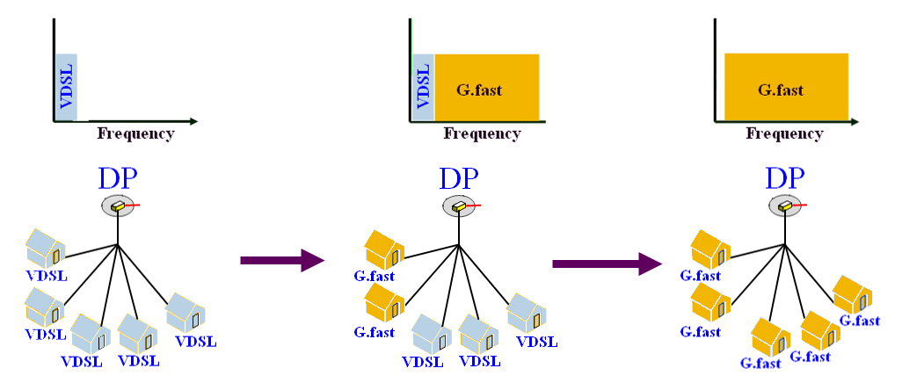
Migration example
Coexistence with xDSL: VDSL2 to G.fast migration

Slide 23
Power saving for G.fast
Optimize the power consumption and performance using the states below:
  L0 - Full power state
  L2 - Reduced power state
  L2.1 - Low power state with mains powering
  L2.1 - Low power state with battery powering
  L2.2 - Standby state
  L3 - Idle state: no signal is transmitted

Slide 24
Power saving for DSL
ADSL2 (ITU-T G.992.3) and ADSL2+ (ITU-T G.992.5)
Power management mode
  Three link states
    L0: full power (The ADSL link is fully functional)
    L2: low power (Operates at a reduced bit rate consuming less power)
    L3: idle (There is no signal transmitted on the line with further reduced power consumption)

Slide 25
Home networking

Slide 26
Home networking (HN)
Home network connects devices in a home so that these devices can communicate.
ITU-T developed standards for home networking technologies which uses wireline.
It supports power lines, telephone wiring and coaxial cables.
Its target is Gbit/s data rates

Slide 27
Power saving modes - HN
Four modes of operation are defined with the intention of reducing the total power consumption in home networks.
  Full-power mode (L0): up to the maximum data rate is possible.
  Efficient-power mode (L1): power consumption is reduced by limiting medium access. The maximum data rate is supported.
  Low-power mode (L2): Only a limited data rate is supported.
  Idle mode (L3): no data except for control messages is transmitted or received

Slide 28
Broadband transport

Slide 29
Broadband transport
SG15 develops various standards for broadband transport
  Development for “beyond 100 Gbit/s” transport is ongoing
Facilitates energy efficiency because:
  Aggregated transport decreases number of equipment, optical fibres, etc.
  Enables other sectors’ energy efficiency (e.g., teleconference)

Slide 30
THANK YOU
For further information
http://www.itu.int/ITU-T/studygroups/com15
tsbsg15@itu.int

