Slide 1
An introduction to ITU-T, the Standardization Sector of ITU
Sabrina Fares Camp
ITU

Slide 2
ITU’s Standardization Sector
Produces standards covering all fields of telecommunications on a worldwide basis
Defines tariff and accounting principles for international telecommunication services
Notes:
ITU-T
- Develop interoperable, international standards (ITU-T Recommendations)
- Bridge standardization gap
- Cooperation among standardization bodies
ITU-T study groups look at issues such as: multimedia, security, environment and climate change, network and transport, broadband access, quality of service and experience, next generation networks, cloud compuring, intelligent transport systems, numbering and addressing, tarrif, security.
Some examples:
Internet Access through ITU standards
95% of all international traffic runs over fibre = ITU standards
Access:
ADSL: ITU-T G.992
Powerline Transmission:
ITU-T G.9960 (G.hn)
FTTX (Fibre to the <x>):
GPON (Gigabit Passive Optical Networks) ITU-T G.984
Bendable fibers: ITU-T G.657
Multimedia
Advanced video coding: ITU-T H.264
Used to compress billions of clips on YouTube, high-definition content on Blu-ray Discs
New work H.265:
Joint Collaborative Team (ITU-T, ISO/IEC) to reduce data rate by 50%

Slide 3
ITU-T Membership
193 Member States and Regulatory Bodies
450 Companies, Business Associations, NGOs
45 Universities & Research Establishments

Slide 4
Why is standardization important?
International Standards essential in a complex world
Standards make things easier
Essential for international communications … and global trade
Drive competitiveness… efficiency, responsiveness and innovation
Standards provide interoperability and economies of scale
Lower prices and increase availability by reducing technical barriers and promoting compatibility between systems and networks
Manufacturers, network operators and consumers benefit
All ITU-T Recommendations are freely available

Slide 5
ITU-T Study Groups
SG2 - Operational aspects
SG3 - Economic and policy issues
SG5 - Environment and climate change
SG9 - Broadband cable and TV
SG11 - Protocols and test specifications​
SG12 - Performance, QoS and QoE
SG13 - Future networks
SG15​ - Transport, Access and Home
SG16 - Multimedia
SG17 - Security

Slide 6
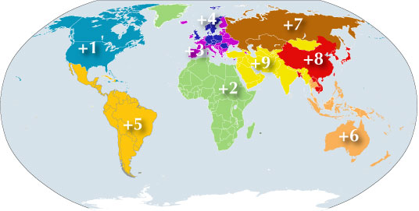
Numbering Resources Study Group 2
Service definition, numbering and routing
Telecommunication for disaster relief/early warning
Telecommunication management
Notes:
Misuse
Significant issue for some MS
Attempt to find practical solutions
National efforts vs international efforts
Resource constraints
WTSA Res 61
Consider mechanism to allow regulators to request carriers to release routing information
Collaborate and share information
Enhance ITU role and give effect to ITU-T Recommendations
Guidelines
Further studies in SG2
SG3 to study economic effects of call blocking
Cell Broadcasting
Technology that allows alerts to be sent to all mobile handsets connected to a given base station
SG2 studying, in liaison with other involved groups, possible harmonization of certain codes
A draft document is being progressed

Slide 7
Economic and policy issues Study Group 3
Tariff and accounting matters for international telecommunication services
Telecommunication economic, accounting and policy issues
Notes:
International Internet Connectivity:
This topic has been under study for many years
In April 2011, SG3 agreed a Supplement to D.50, on options for measuring international Internet traffic flows
the supplement focuses on how IP traffic flows can be measured at different points, including at Border Gateway Protocol (BGP) interconnect points
International Mobile Roaming
Responses to an SG3 Questionnaire confirm other studies: the large IMR price variations are not consistent with competitive markets
SG3 intends to develop a Recommendation, Supplement, or guidelines regarding IMR prices
There are proposals relating to the taxation provision of ITRs and IMR
Tariff and Accounting
Key ITU points:
-harmonization of global interconnection rates, also addressing VoIP, IP-based next-generation networks
-survey of international mobile termination rates
A key task of ITU is the complicated job of recommending some principles for the harmonization of global interconnection rates. Interconnection rates are the costs between telecommunication service providers when linking networks for the exchange of traffic. This work has become increasingly complex with the more widespread use of VoIP, and the move to IP-based or next-generation networks.
More recently ITU has surveyed international mobile termination rates, with a view to determining whether there are differences by region and, if possible, what might be causing those differences.

Slide 8
Environment and Climate Change
Study Group 5
ICT and Climate Change
Electromagnetic compatibility and electromagnetic effects

Slide 9
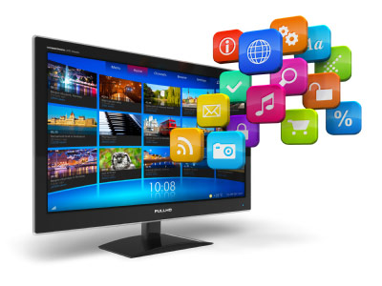
Broadband and cable TV Study Group 9
Integrated broadband cable and television networks

Slide 10
Protocols and test specifications Study Group 11
Signaling and protocols
Machine-to-machine (M2M)
Test specifications, conformance and interoperability testing

Slide 11
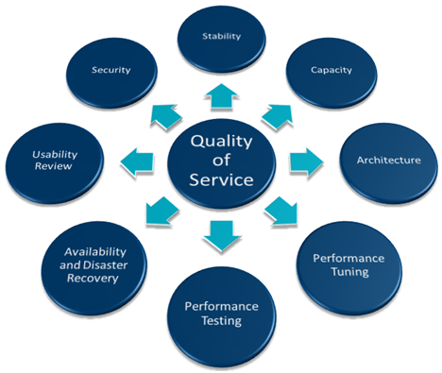
Quality of Service, Quality of Experience Study Group 12
Quality of service and quality of experience
Driver distraction and voice aspects of car communications
14

Slide 12
Future networks
Study Group 13
Future Networks
Mobility Management and NGN
Cloud Computing
Software-Defined Networking (SDN)

Slide 13
Transport, access and home Study Group 15
​Access network transport
Optical technology and optical transport networks
Smart Grid
Home network transport
Notes:
Fiber cable can be very flexible, but traditional fiber's loss increases greatly if the fiber is bent with a radius smaller than around 30 mm. This creates a problem when the cable is bent around corners or wound around a spool, making FTTX installations more complicated. "Bendable fibers", targeted towards easier installation in home environments, have been standardized as ITU-T G.657.

Slide 14
Multimedia Study Group 16
Multimedia coding, systems and applications
Ubiquitous and Internet of Things applications
Telecommunication/ICT accessibility for persons with disabilities
e-Health
intelligent transport system (ITS) communications
IPTV
Notes:
multimedia coding, systems and applications
ubiquitous and Internet of Things applications
telecommunication/ICT accessibility for persons with disabilities
IPTV

Slide 15
Security Study Group 17
Telecommunication security
Identity management (IdM)
Languages and description techniques

Slide 16
Joint Coordination Activities (JCA)
Software-Defined Networking
Technical aspects of telecommunication networks to support the Internet
Child Online Protection
Cloud Computing
Internet of Things
Accessibility and Human factors
Identity Management
IPTV
Conformance and Interoperability Testing
ICT and climate change

Slide 17
Focus Groups (FG)
Focus Group on Smart Sustainable Cities (FG-SSC)
Fous Group on Bridging the Gap: from Innovation to Standards (FG Innovation)
Focus Group on Smart Water Management (FG-SWM)
Focus Group on Digital Financial Services
Focus Group on Aviation Applications of Cloud Computing for Flight Data Monitoring

Slide 18
Intellectual Property Rights (IPRs)
TSB Director's Ad Hoc Group on IPR
- Patent Policy and its guidelines for implementation
- Software Copyright guidelines
- Marks guidelines
RAND Patent Policy and Guidelines adopted by ITU, ISO and IEC in 2008

Slide 19
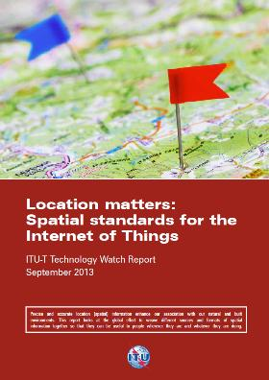
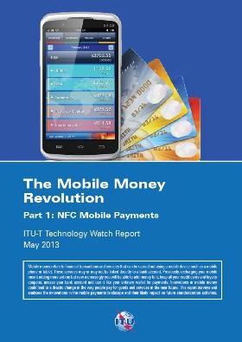
Technology Watch
ITU TechWatch Reports
Survey the ICT landscape to capture new topics for standardization

Slide 20
ITU Kaleidoscope
Academic Conference
Brainstorming on future trends in ICTs standardization
Total prize of USD 10,000 for top 3 papers
K-14: Living in a converged world - impossible without standards?
Saint Petersburg, 3-5 June 2014
Notes:
Kaleidoscope is a series of peer-reviewed academic conferences organized by ITU - SINCE 2008 - which brings together a wide range of views from universities, industry and research institutions of different fields.
The aim of Kaleidoscope conferences is to identify emerging developments in Information and Communication Technologies (ICTs) at an early stage to generate successful products and services through the development of international and open standards.
Papers reviewed by a committee of 150 ICTs experts - Each paper reviewed independently by 3 reviewers
Accepted papers :
Presented at the conference
Published in the conference proceedings
Published in IEEE Xplore
Considered for publication in a special edition of IEEE Communication Magazine
At Kaleidoscope 13: 30 accepted papers out of 99
You can still submit your paper for K-14: deadline extended to 9 December 2013

Slide 21
THANK YOU

