Slide 1
Radiocommunications and climate change
Geneva, Switzerland,
11 July 2014
Vadim Nozdrin, Counselor, ITU-R Study Group 7
<vadim.nozdrin@itu.int>
Study Group Department
Radiocommunication Bureau

Slide 2

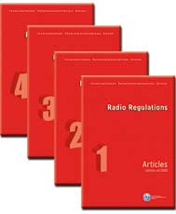


ITU-R activity
Establish and update international regulations governing use of the spectrum, through world and regional radiocommunication conferences adopting international treaties
Apply the international regulations governing use of the spectrum – Purpose: To ensure the most efficient use of the orbit/spectrum resource for operation of radiocommunication services free from harmful interference
Produce global standards, Recommendations, reports and handbooks for wireless radiocommunication systems and applications
Inform and assist administrations on radiocommunication matters: organization of and participation in information and capacity-building seminars, participation in colloquiums and workshops

Slide 3
Scope of studies for CC
Activities | Major tasks | Radiocommunication involved
Monitoring the environment | Satellite observations of the Earth’s atmosphere and surface The acquisition, processing, analysis and distribution of data from remote sensing satellites | Earth exploration-satellites Meteorological satellite
 |  | Space operation
 | Solar radio monitoring | Radioastronomy Space research
 | Ground observation of atmosphere characteristic | Meteorological aids
 |  | Radionavigation
 |  | Mobile systems
Other applications | Construction optimisation Traffic optimisation Energy, water and fuel savings Planting decision, irrigation planning Disseminating alert messages, coordination of relief activities and advice to public | Earth exploration-satellites
 |  | Mobile systems
 |  | Radionavigation
 |  | Broadcasting
 |  | Satellite
 |  | Amauters

Slide 4
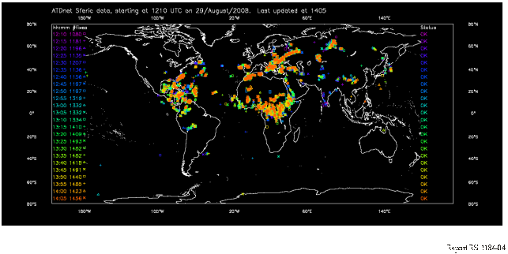
WRC-12
24-hour thunderstorm (lightning) detection system.
Notes:
seashore

Slide 5
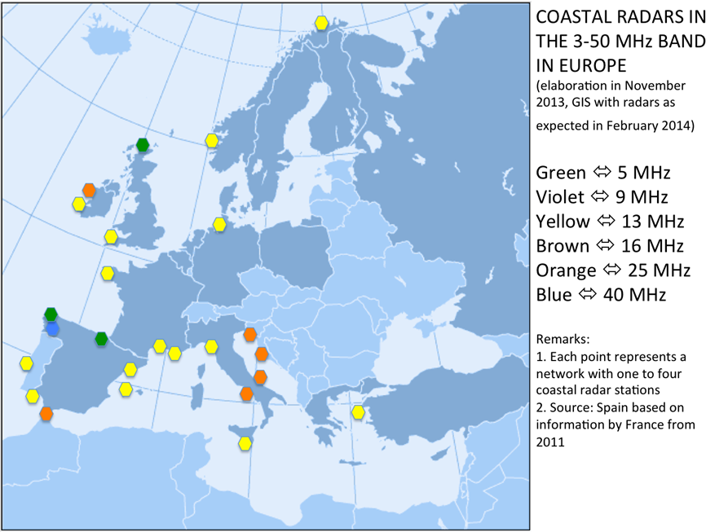
WRC-12
Oceanographic radars
Range-up to 300 km
Measurement
  Wave height
  Ocean currents
Practical implications
  Fish migration
  Prediction of pollution flow
  Search and rescue
  Tsunami prediction

Slide 6
WRC-12
Urging Members State :
to recognize the importance of Earth observation
promote the introduction of new applications to address issues such as emerging technologies, climate change, disaster management and other socio-economic matters

Slide 7
WRC -15
ACTIVE SENSING – resolution of 50 cm- additional 600 MHz spectrum
climate monitoring, the studying of natural systems, monitoring of potential hazards, disaster management, mapping, population monitoring.

Slide 8
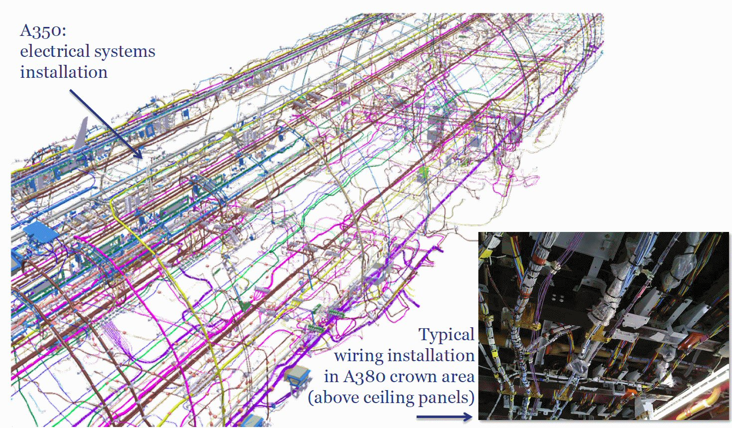
WRC-15
Replacing Aircraft Wiring with Radio (WAIC)
A380
  100 000 wires
  470 km
  5 700 kg
  Harness adds 30% to weight
  206 kg CO₂/hour or 2266 kg CO₂ Geneva- Pekin
  312,000 Active General Aviation Aircraft
  17,770 Passenger Aircraft
Aim to Replace 30% of Wires
Maintain or Increase Safety
Requirement for Spectrum with Appropriate Protection
Reduced fuel burn

Slide 9
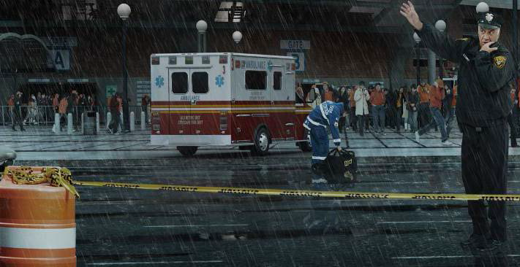
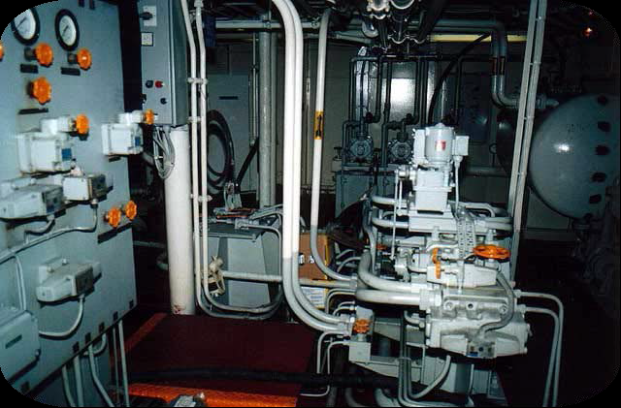
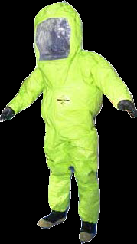
WRC-15
Broadband public protection and disaster relief (PPDR)
Need for video
  Improved situational awareness
  Safety of human life
Improved International Harmonization
  Improved aid support
  Cost reduction

Slide 10
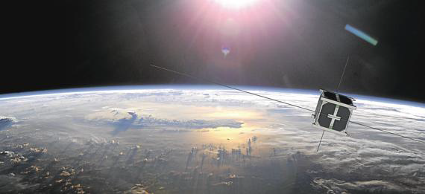
WRC-15
Nanosatellite : with a mass of 1 to 10 kg,
Picosatellite : with a mass between 0.1 and less than 1 kg
being used for a wide variety of missions and applications such as remote sensing, technology demonstration and education, as well as commercial applications;
many projects can be developed quickly and deployed with lower cost than with traditional satellites.

Slide 11
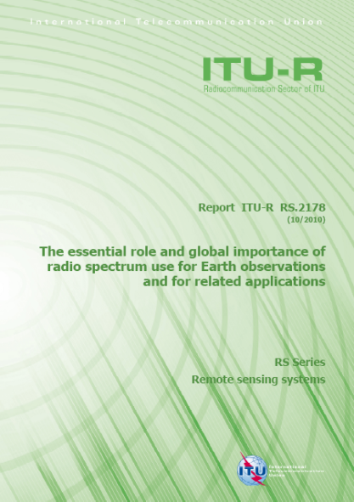
ITU-R highlights
  Earth observation satellite-based worldwide - 6.7 billion US $ in 2008
  Meteosat Third Generation in Europe- about 2.8 billion Euros
  90’s: an efficient warning system could have decreased the economic impact of natural disasters by 240 billion US $
  economic benefits to US agriculture (by altering planting decisions)-
  US $ 265-300 million/year
savings in the electricity and natural gas 512 million US $ in 2015 and 2.56 billion US$ -in 2017
http://www.itu.int/pub/R-REP-RS.2178-2010

Slide 12
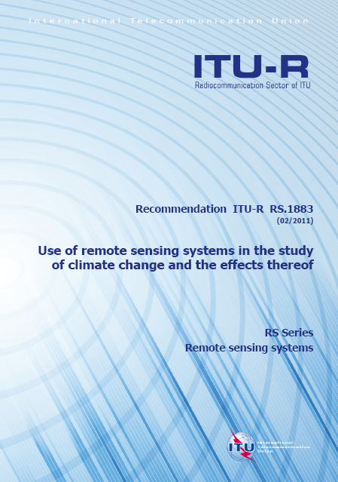
ITU-R highlights
Guidelines on the provision of satellite-provided remote sensing data for the purpose of studying climate change
Summary of status
of major climate variables and forcing factors
Disaster Management Database
https://www.sfcgonline.org/Remote%20Sensing/default.aspx
http://www.itu.int/rec/R-REC-RS.1883-0-201102-I/en

Slide 13
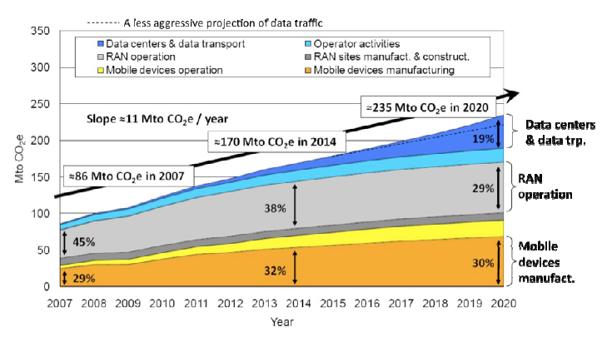
ITU-R highlights
Power efficient networks and devices
Smart network resource
management;
Alternative power source:
State regulation

Slide 14
Conclusions
ITU is committed to working with other organizations in combating climate change
Radiocommunications are totally relying on radio‑frequencies to be harmonised and protected worldwide
Radiocommunication system’s value can not be measured in only financial terms, as it prevents large losses of lives or promotes sustainable development

Slide 15

Questions?

